Slide 1
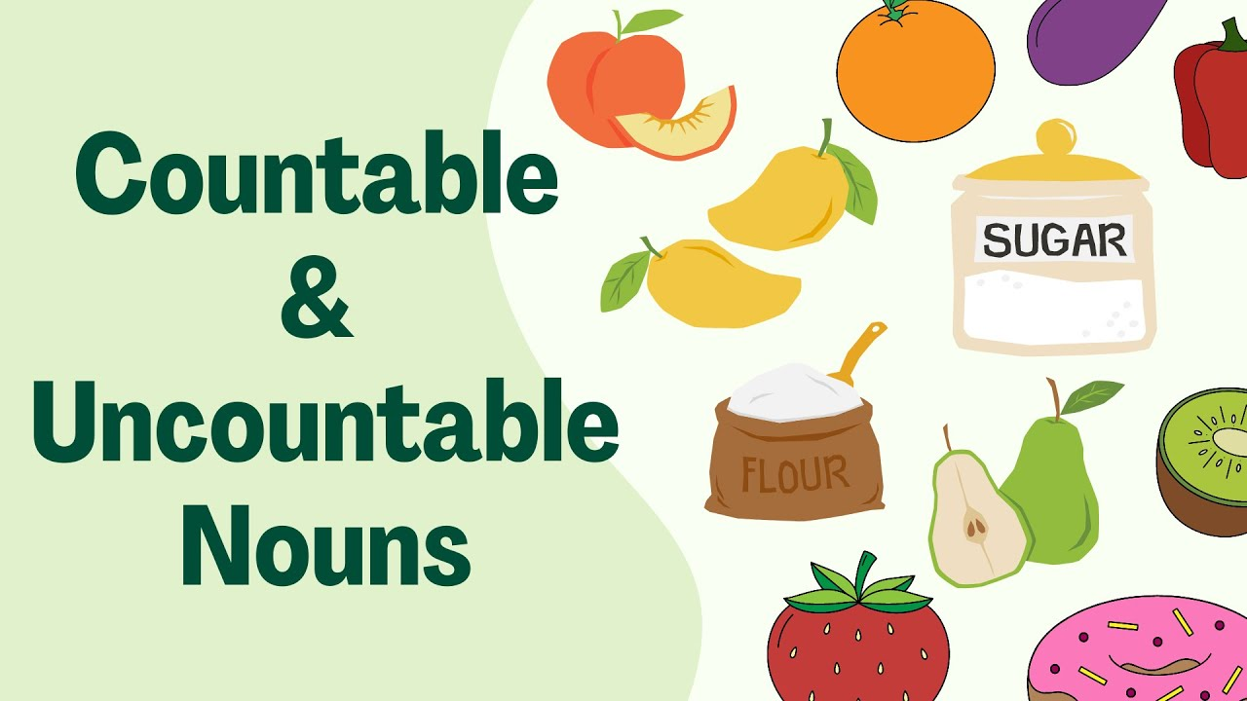

Slide 2
COUNTABLE NOUNS | UNCOUNTABLE NOUNS
Can be used with “a/an” | Can’t be used with “a/an”
Have plural forms | Don’t have plural forms
Can be counted | Can’t be counted
 | Include liquids
 | Include abstract nouns

Slide 3
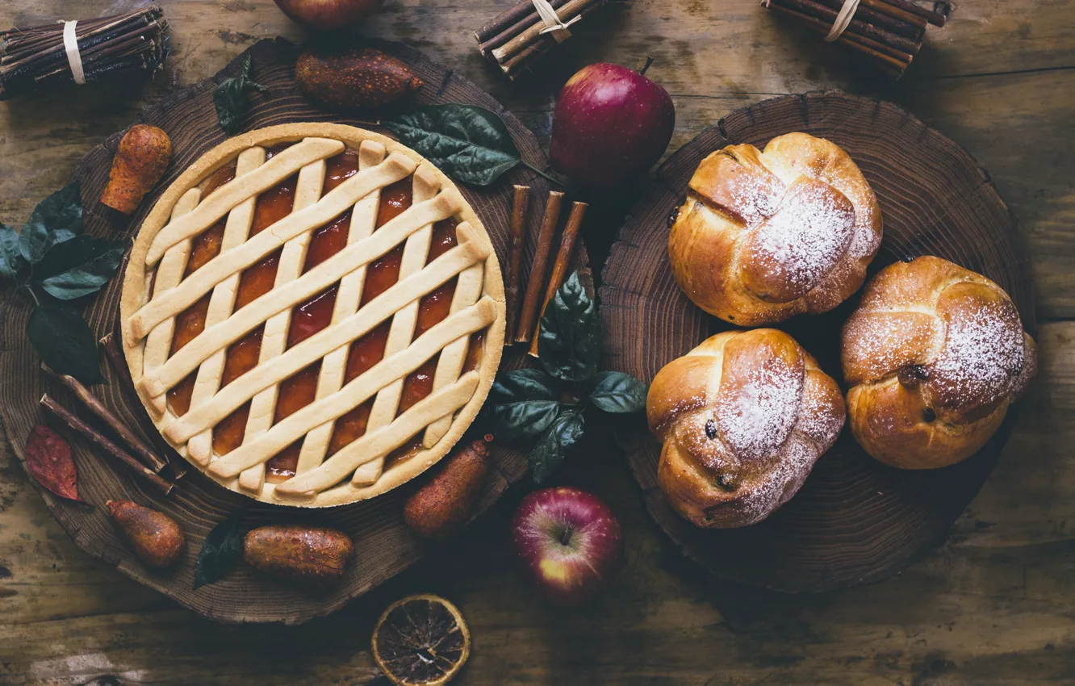
Сhoose the correct options:
1) There is/are some /any orange juice.
2) Is/ are there some/any cheese?
3) There isn’t / aren’t some/any apples.
4) There is/ are some/any slices of orange.
5)Is/ are there some/any eggs?
6)There isn’t /aren’t some/ any
chocolate.

Slide 4
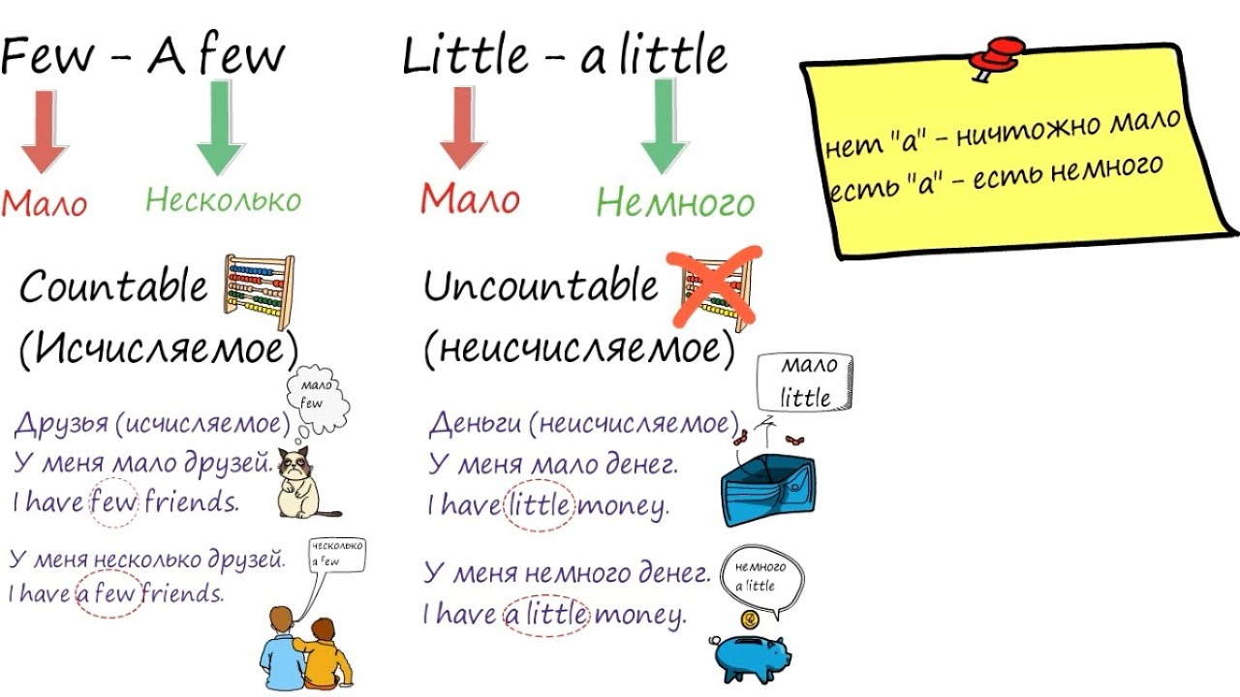

Slide 5
We don't have many oranges. We have a few
oranges.
There isn't much milk. There is a little milk.
A: Have we got much orange juice?
B: No, we've got a little.
I can't see many bottles of water. I can see a few
bottles of water.
There isn't much money. There is a little money.

Slide 6
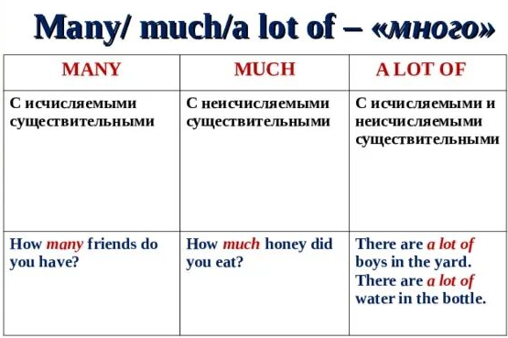

Slide 7
  A: How many carrots are there?
B: I don't know, but I think there aren't many.
I want to have a lot of money.
Do you have much information on this topic?
We don't have much time. Let's hurry up!
A: How much homework does your teacher give you?
B: Oh, he gives a lot of homework every day!
Are there many people in your class?

Slide 8
Thank you for your attention!!!

