Slide 1
Муниципальное бюджетное общеобразовательное учреждение
«Средняя школа № 6» города Смоленска проект по английскому языку по теме «Различия американского и британского варианта английского языка»
Работу выполнила:
Ученица 10 Б класса
Бальцер Злата Сергеевна
Руководитель проекта
Шестакова Лариса Леонидовна
Смоленск, 2023

Slide 2
Plan of work on the research project
To identify the topic of the project
To set tasks
To identify the hypothesis
To perform tasks
To collect and summarize information
To formalize the research project
To show a presentation of the research project
To present a vocabulary with differences between American and British English

Slide 3
The aim of this research is the identification of the differences between American and British English
Hypothesis: if the differences between American and British English are significant, they will be obstacles to people's communication
The problem: an insufficient awareness of English learners about differences between British and American English nowadays
The object of the research: English

Slide 4
Tasks
Methods
To study some literature on the topic
To collect some material on the issue
To expand and deepen knowledge of English
To analyze and describe features between two languages
To identify causes American and British English
To look through a dictionary of spelling, phonetic, lexical and grammatical differences between the two versions of the English
To make an independent vocabulary with differences between American and British English
Comparative analysis
Comparison of material
Synthesis of materials

Slide 5
Spelling differences
We often see differences between British and American English spelling. In the British version of the English language words, as a rule, retain the features of those languages (French, Italian), from which they moved to English, while in the American version of the English spelling of these words are adapted to the sound.

Slide 6
-or or –our
-er or -re
American | British | Translation
Color | Colour | Цвет
Honor | Honour | Честь
Humor | Humour | Юмор
Odor | Odour | Запах
American | British | Translation
Center | Centre | Центр
Liter | Litre | Литр
Somber | Somber | Мрачный
Theater | Theatre | Театр

Slide 7
Differences in grammar
Comparison of British and American English will not be complete if you do not pay attention to grammatical differences
Present Perfect and Past Simple
I have bought. (BrE)
I bought a new car. = I have bought a new car. (AmE)
She has gone to bed at 5pm. (BrE)
She went to bed at 5 pm. = She has gone to bed at 5pm. (AmE)
I have just seen him. (BrE) I just saw him. (AmE)
Has she left yet? (BrE)
Did she leave yet? (AmE)

Slide 8
Differences in pronunciation
Returning to history, it should be mentioned that peasants and commons moved here. They already had a distorted pronunciation, and eventually, it became different from the British one. First, the different emphasis of the words. Secondly, the pronunciation of some words is quite different. Third, even sounds are pronounced differently

Slide 9
The letter «o» in the closed syllable
Sounds [æ] and [a:]
Hot [hɒt] (BrE) [hɑːt] (AmE)
Clock [klɒk] (BrE) [klɑːk] (AmE)
Job [dʒɒb] (BrE) [dʒɑːb] (AmE)
Robot [ˈrəʊ.bɒt] (BrE) [ˈroʊ.bɑːt] (AmE)
Ask [a:sk] (BrE) [æsk] (AmE)
After [ˈɑːftə(r)] (BrE) [ˈæftər] (AmE)
Answer [ˈɑːnsə] (BrE) [ˈænsər] (AmE)
Dance [dɑːns] (BrE) [dæns] (AmE)

Slide 10
Conclusion
To conclude this chapter, I would like to say that British English has stricter rules, more formal, and more difficult to learn and understand than the American version of English in pronunciation, spelling, and grammatical aspects. As for the vocabulary of both versions, the words have almost the same popularity in perception for language learners. Some words are known to us from the very first lessons of learning English in the British version, and some in the American version, but we may not even suspect it.
Anyway, in American English, there are a little bit more international words and they are perceived more easily, due to the increasing influence of American culture on various spheres of society. Thus, words that you have never heard before can be understood thanks to the associative row which appears in your head, and by the similarity with your native words in spelling or sounding manner, you can understand the meaning of words without translating it, just by selecting a synonym

Slide 11
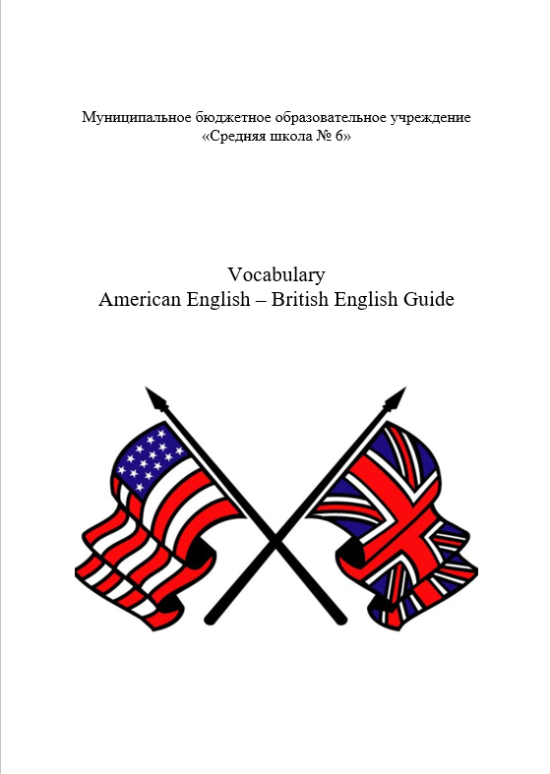
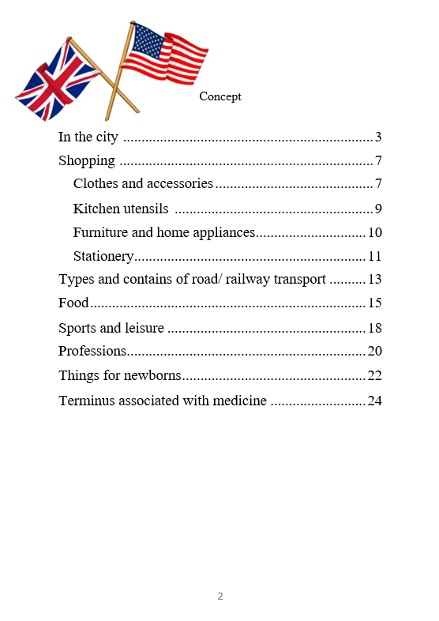
Product of my project

Slide 12
Thanks for your attention!

