Slide 1
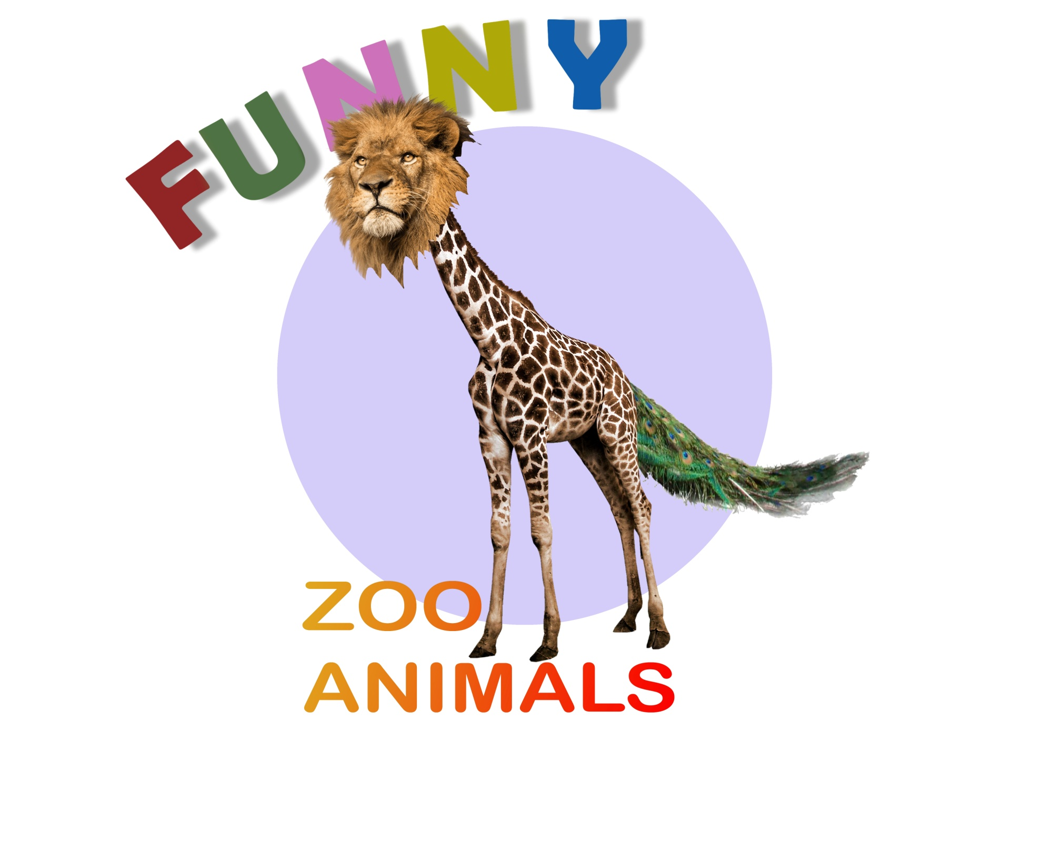
Spotlight 5
English teacher: Yakushin S.S.

Slide 2
Now we will describe the zoo animals!
But be careful, there will be false statements and you will have to correct them.
Let’s start!

Slide 3
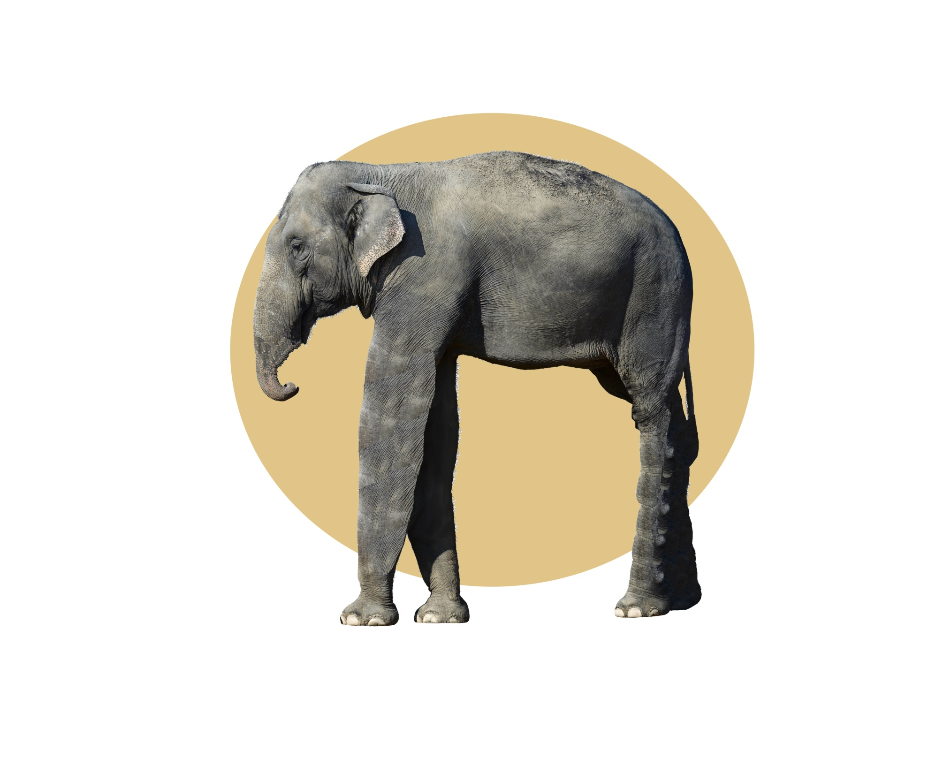
An elephant has got big ears, long legs and a short trunk.

Slide 4
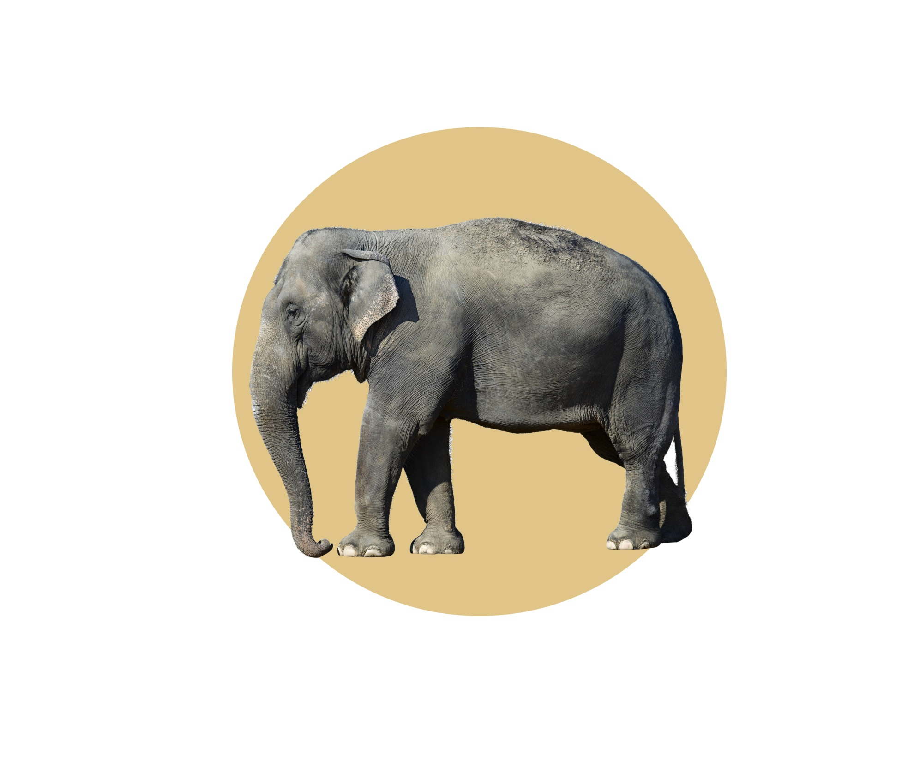
An elephant hasn’t got long legs and a short trunk.
It’s got short legs and a long trunk.

Slide 5
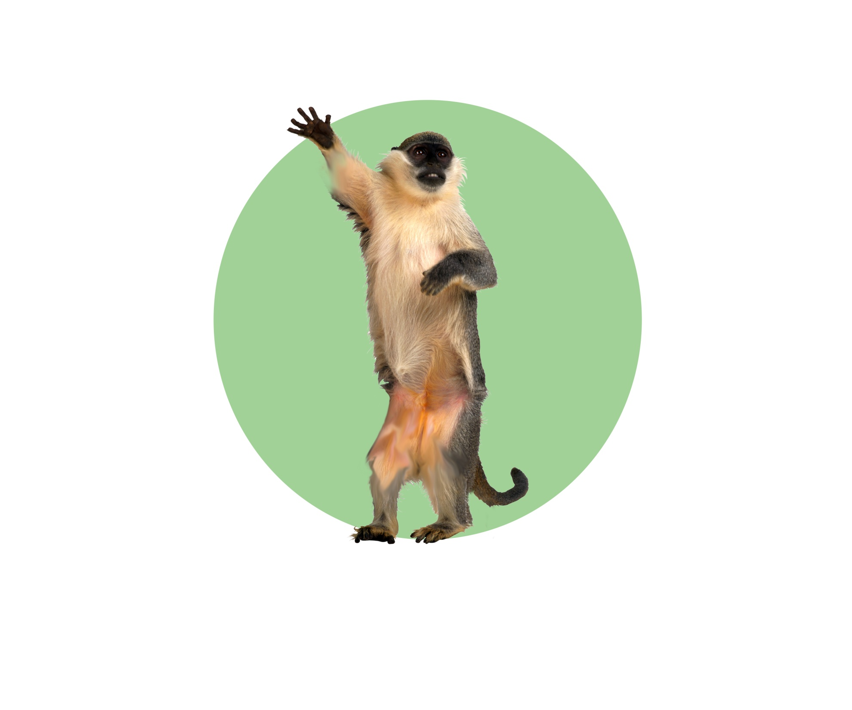
A monkey has got a short tail and short arms and legs.

Slide 6
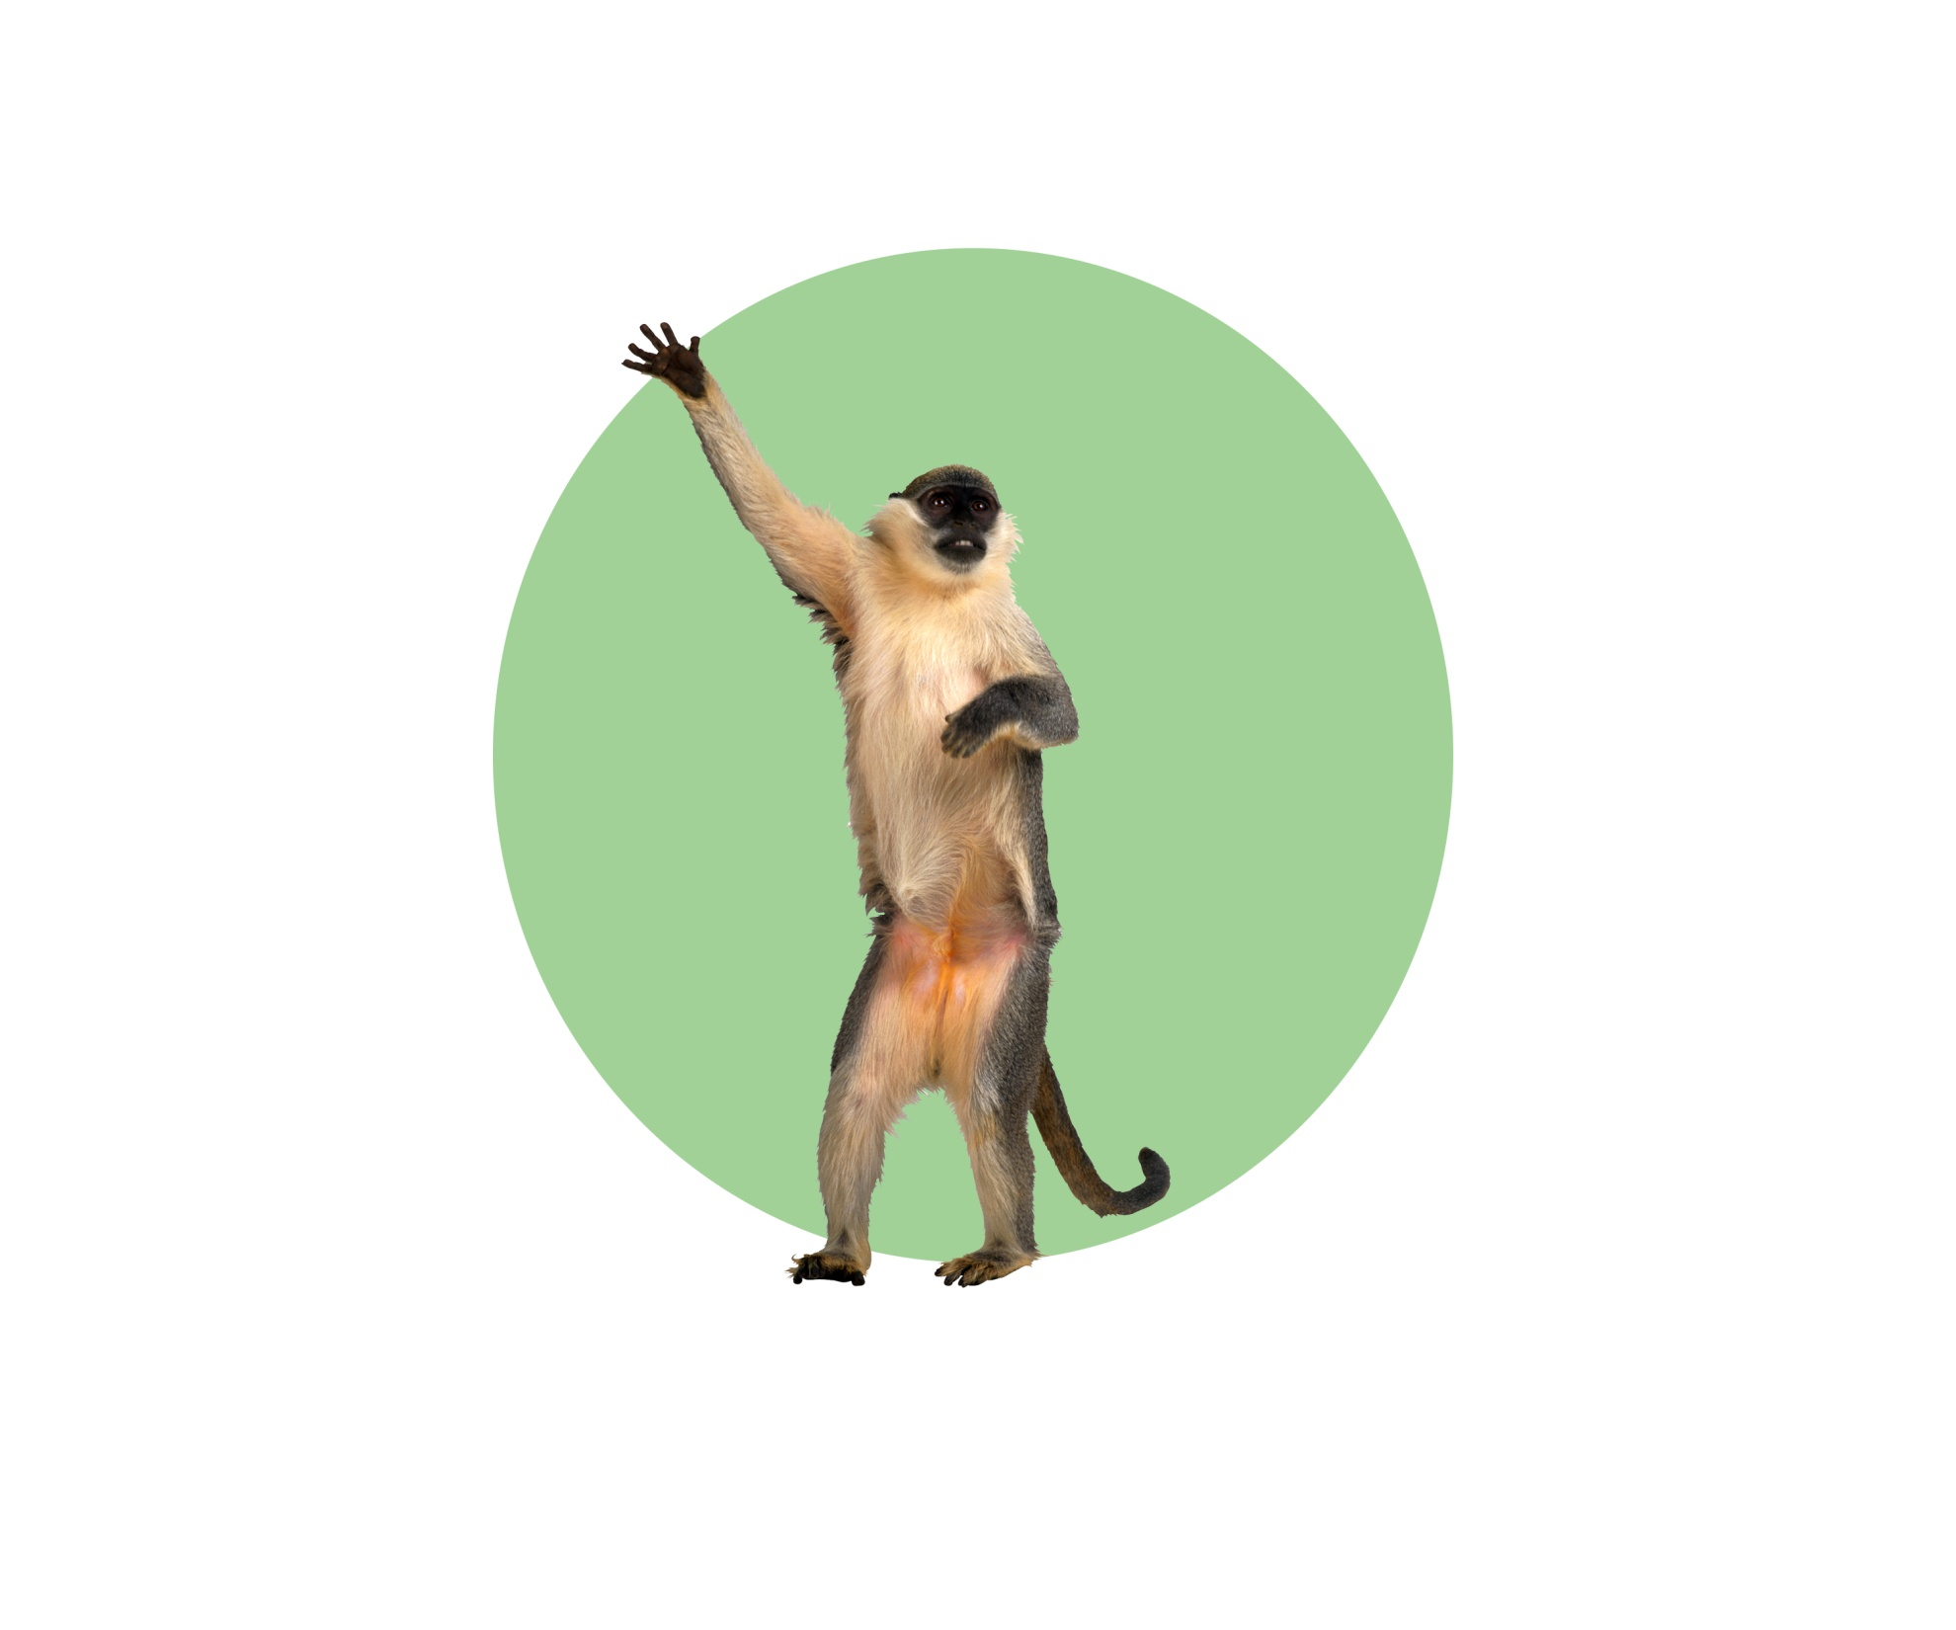
A monkey hasn’t got short arms, legs and a short tail.
It’s got long arms, legs and a long tail.

Slide 7
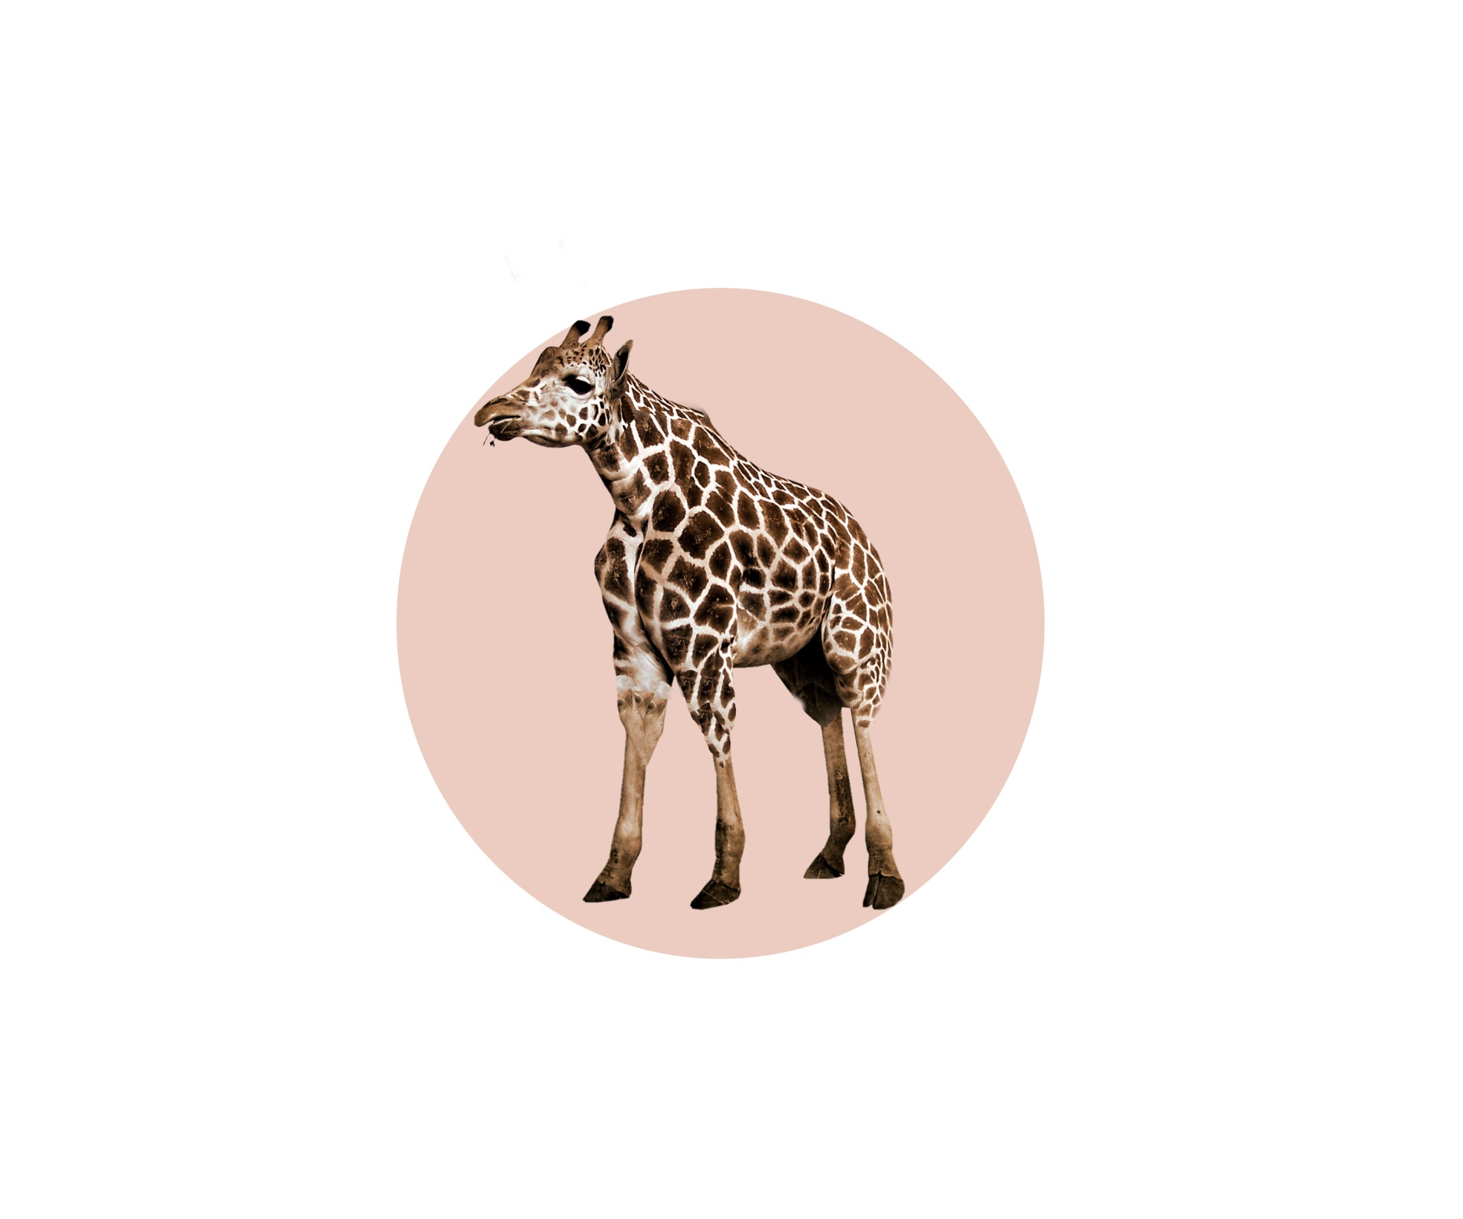
A giraffe has got a short neck, and short legs.

Slide 8
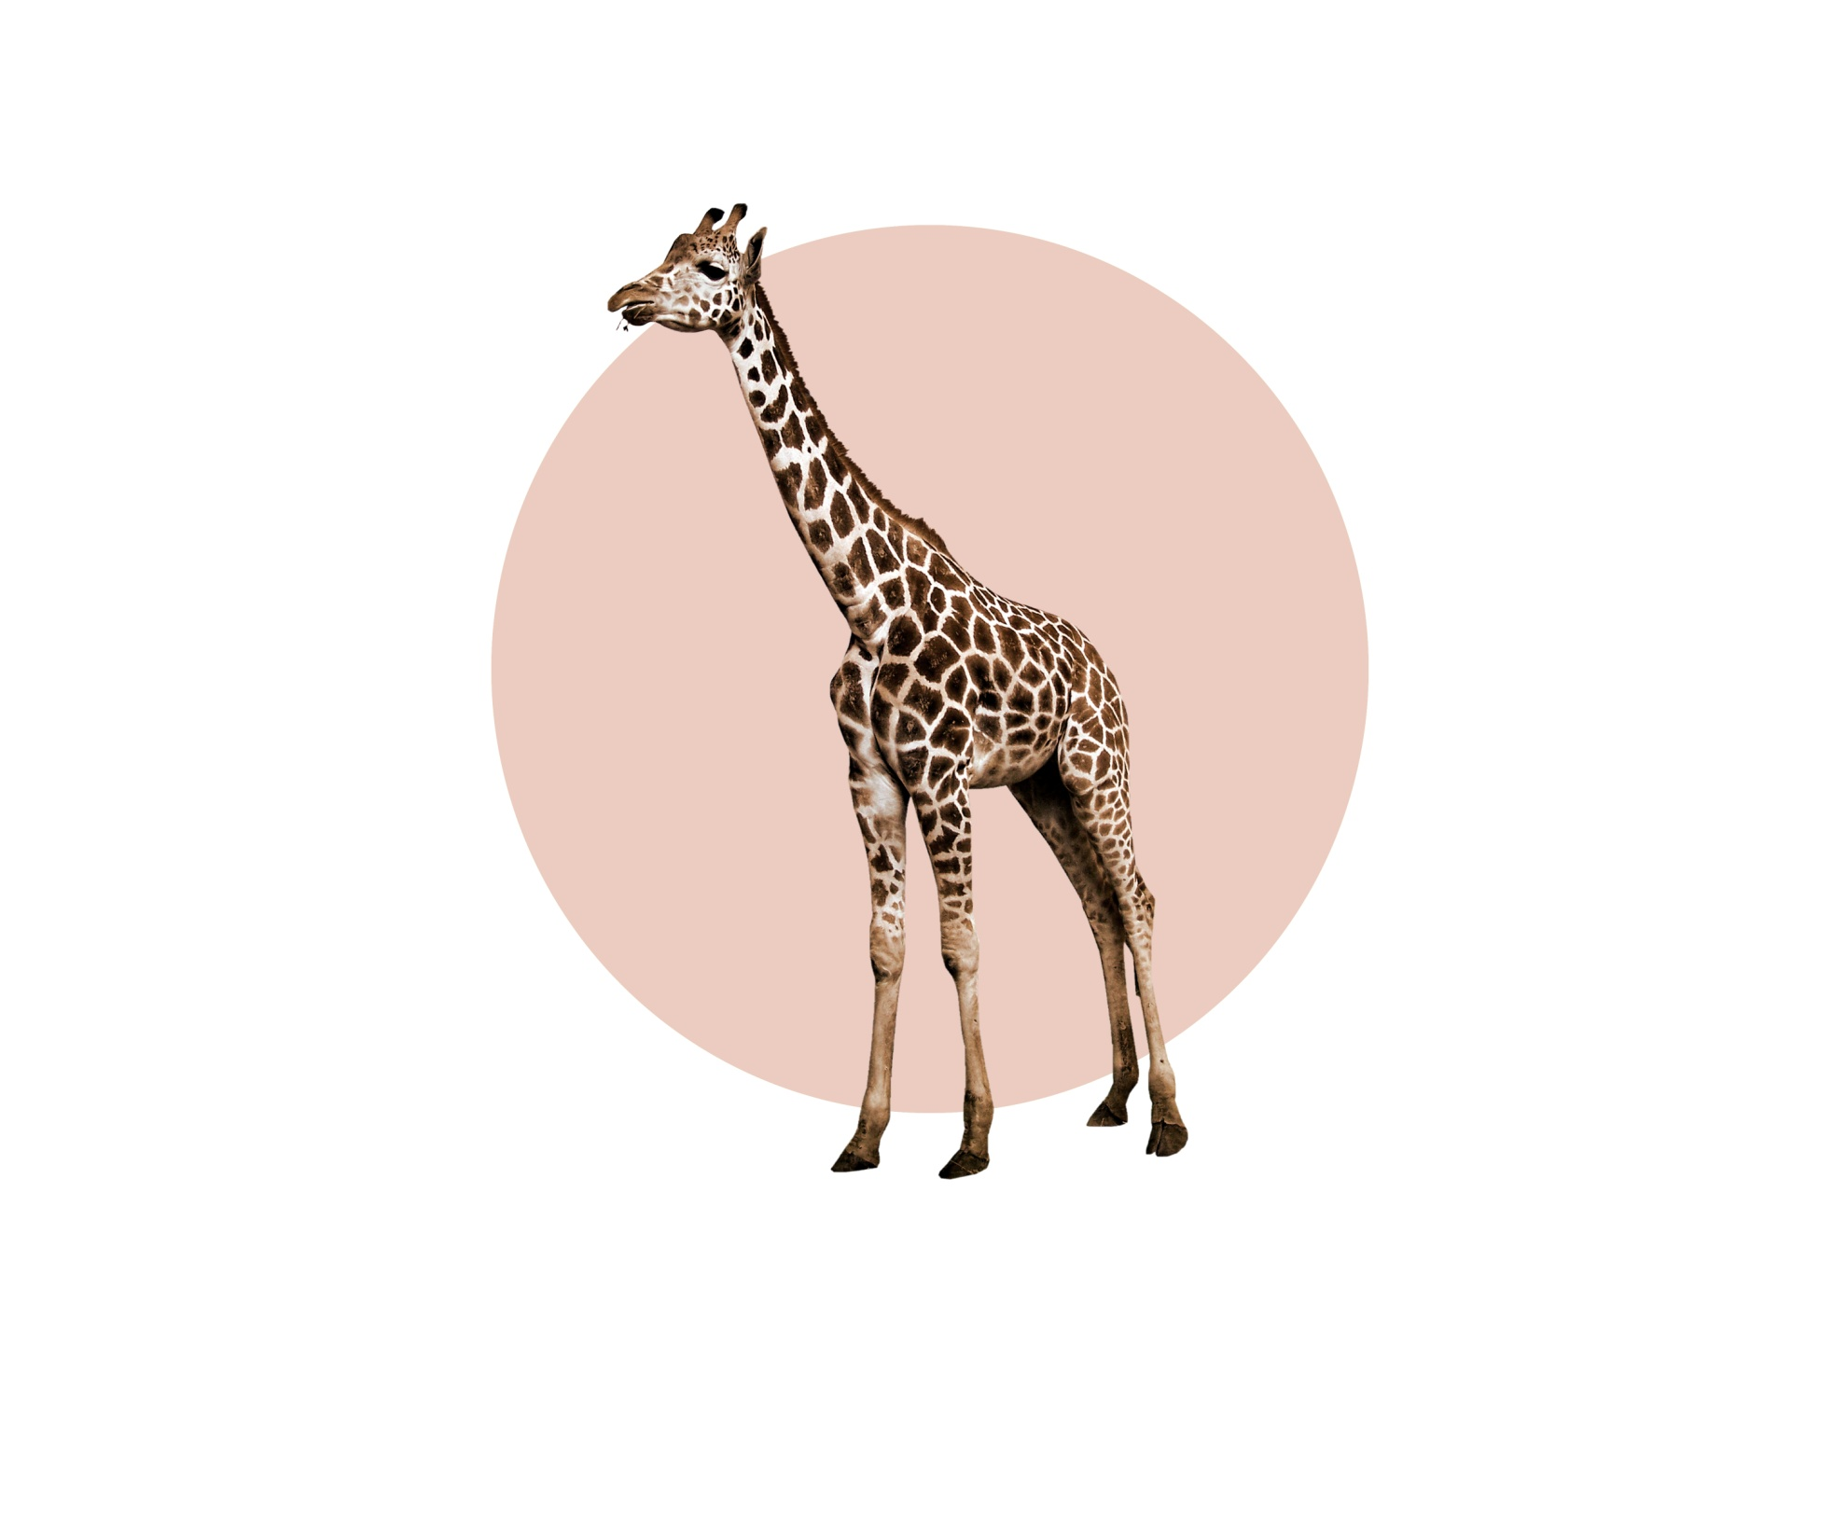
A giraffe hasn’t got a short neck and short legs.
It’s got a long neck and long legs.

Slide 9
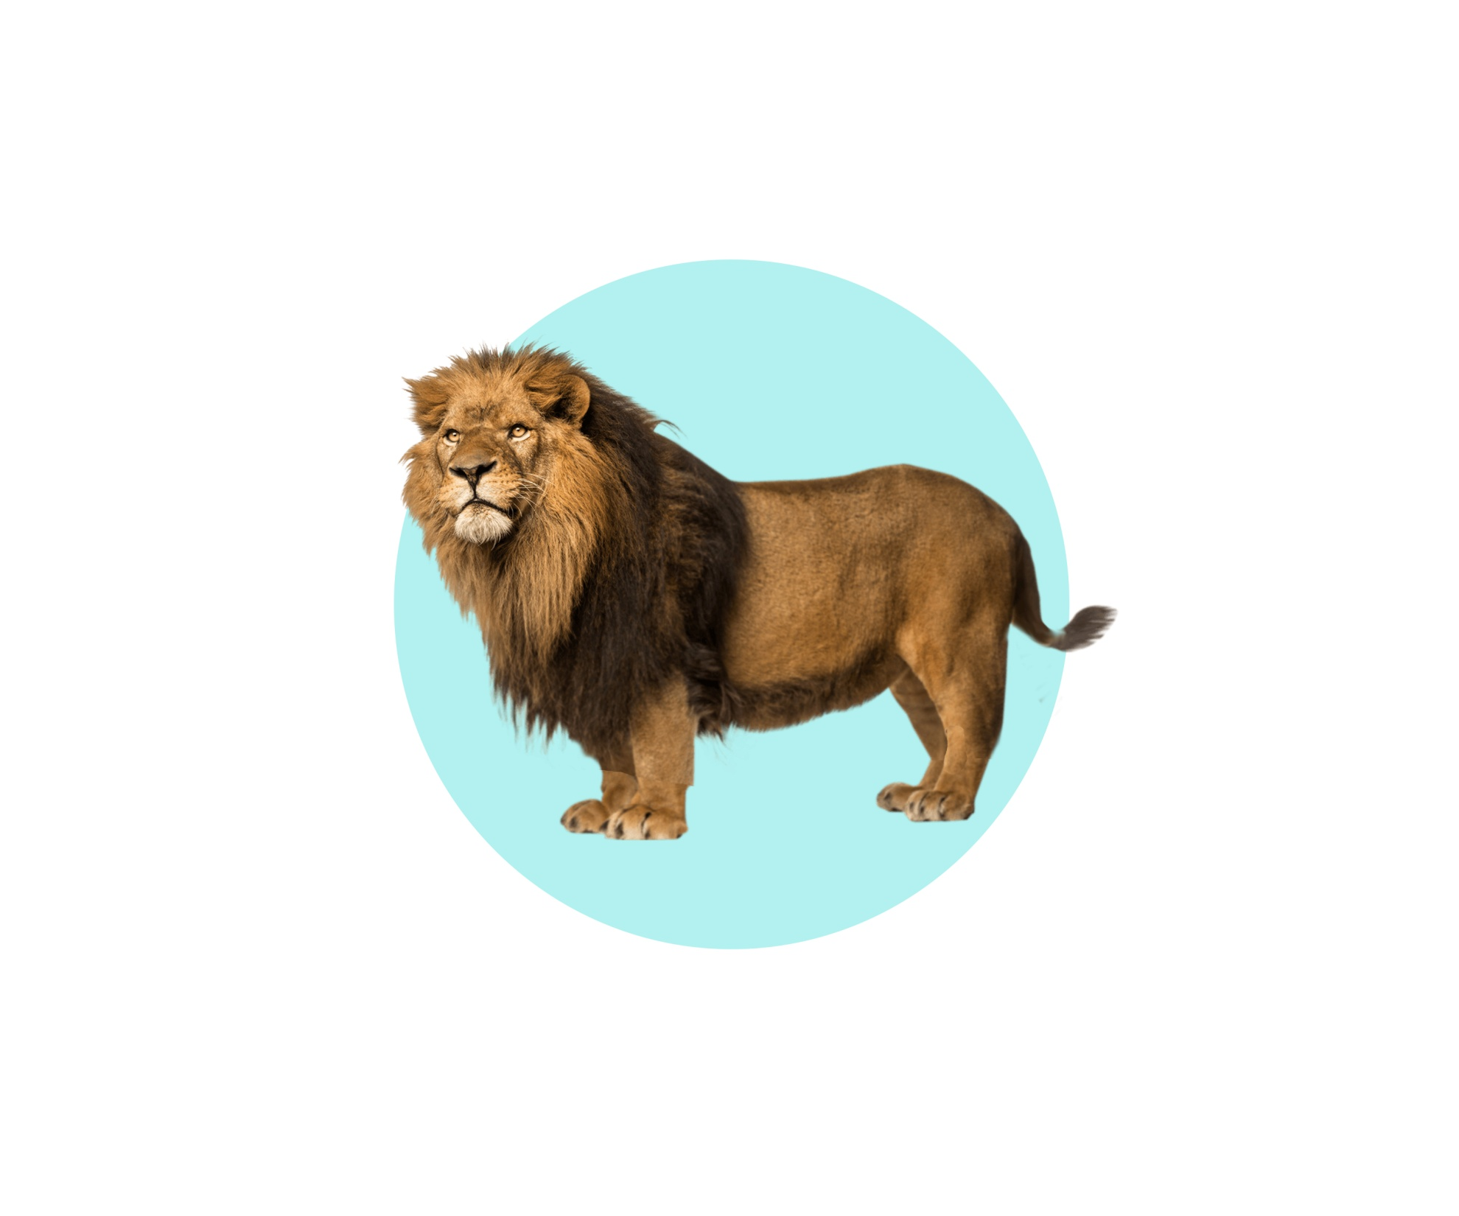
A lion has got short legs and a short tail.

Slide 10
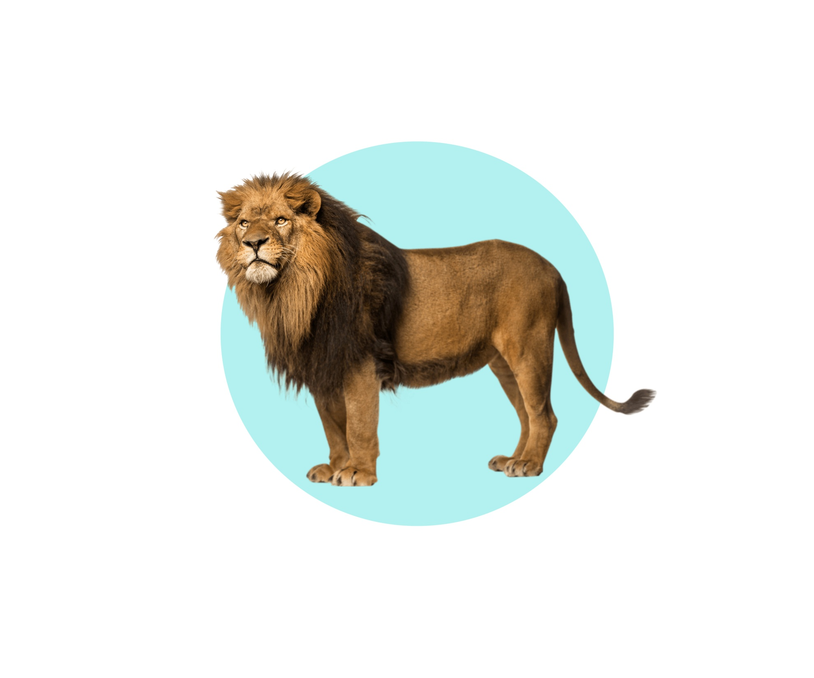
A lion hasn’t got short legs and a short tail.
It’s got long legs and a long tail.

Slide 11
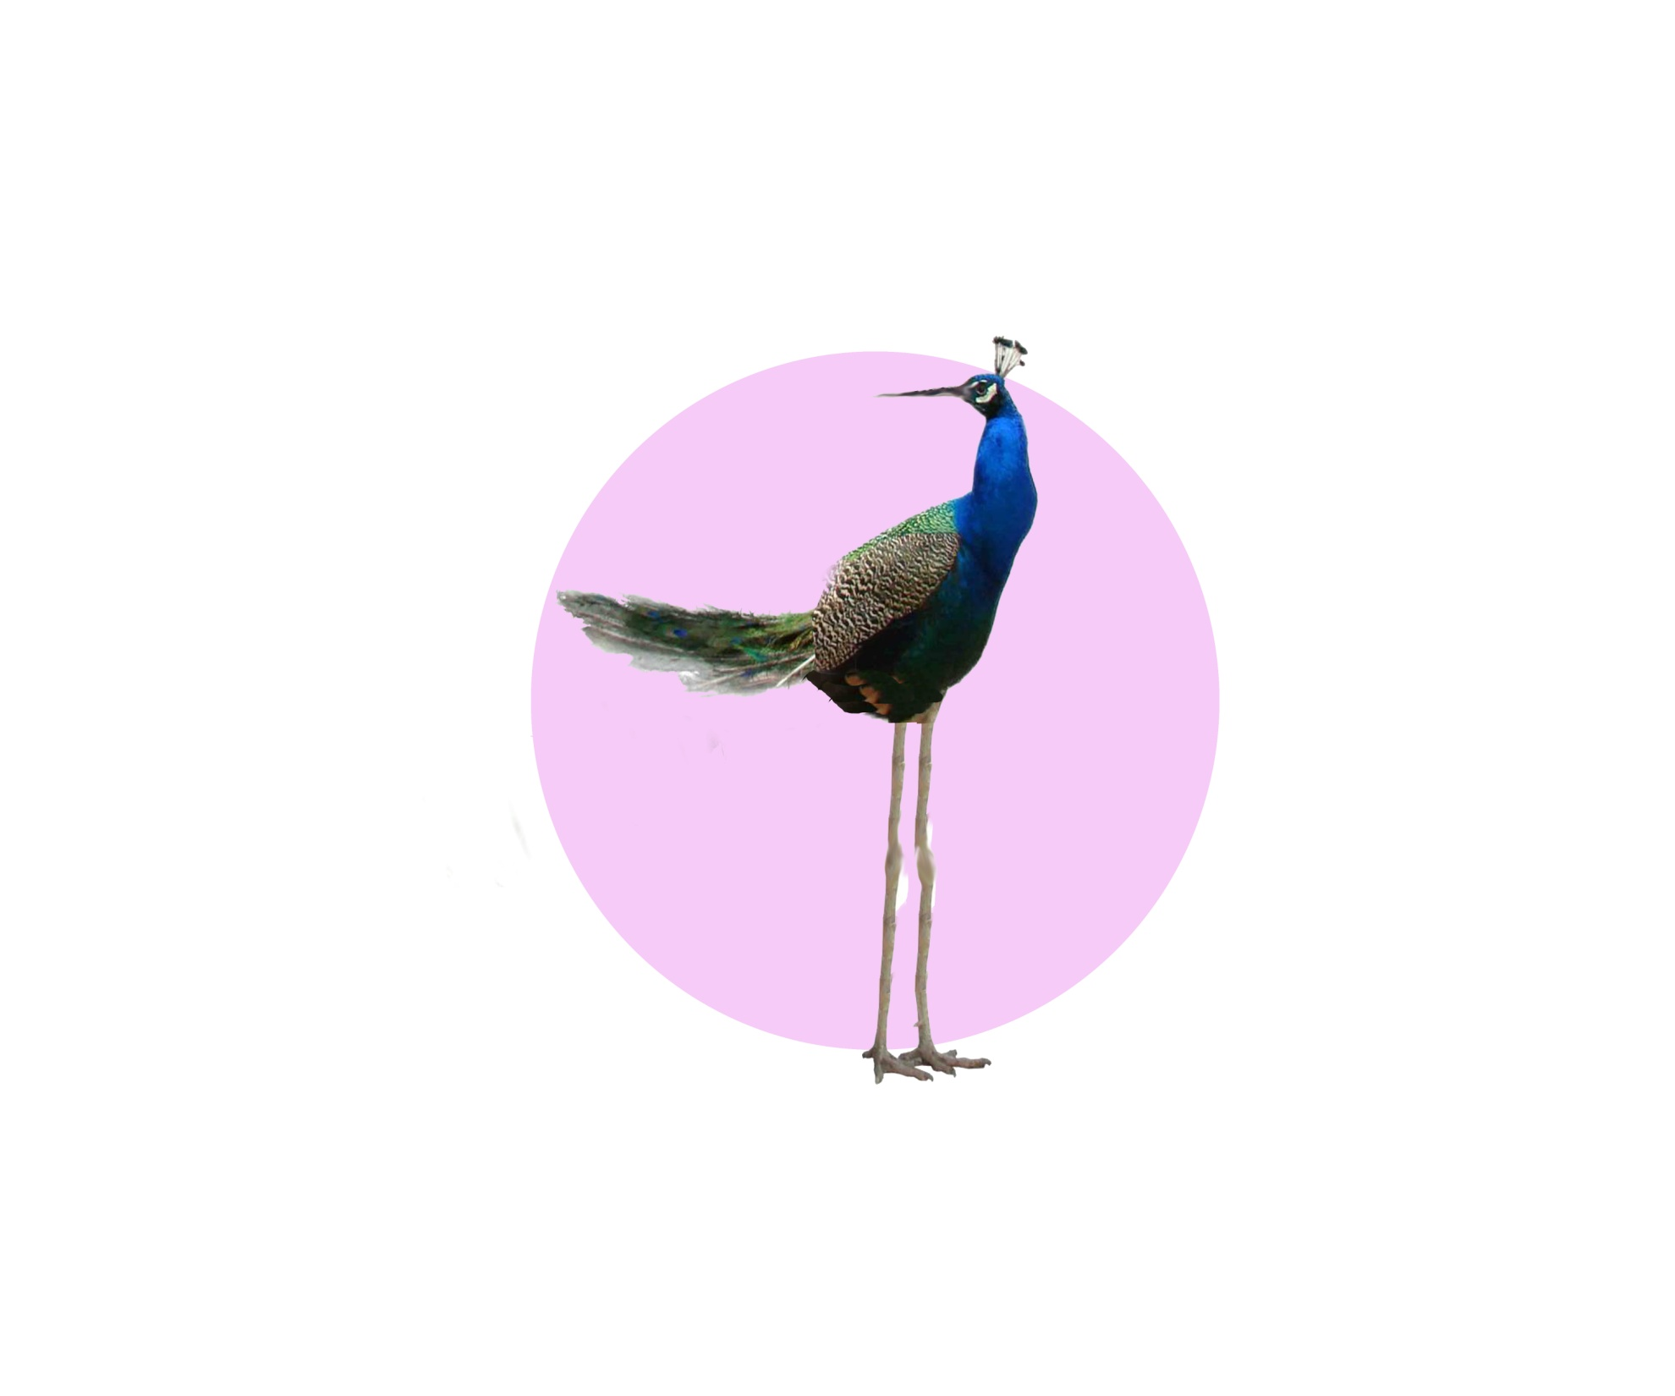
A peacock has got a long beak, long legs and short feathers.

Slide 12
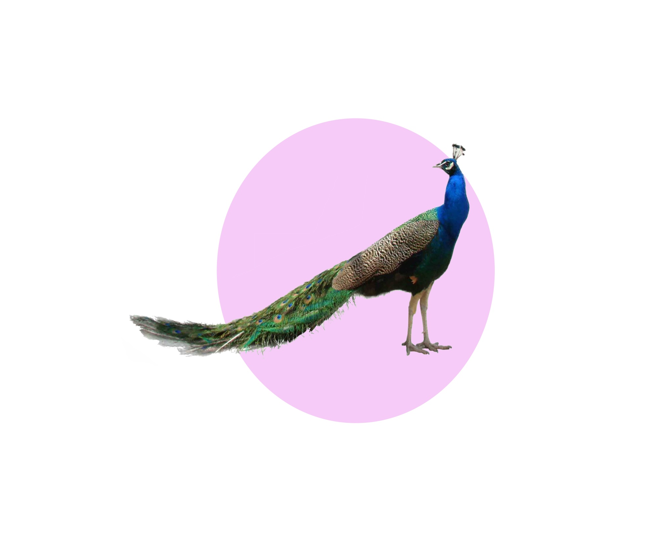
A peacock hasn’t got a long beak, long legs and short feathers.
It’s got a short beak, short legs and long feathers.

Slide 13
Well done, my friends!
You have corrected all the mistakes!
The animals thank you!
☺

