Slide 1
Family
2 form
Done by Grack S.A., English teacher
Gymnasium #2
Yuzhno-Sakhalinsk
2025

Slide 2
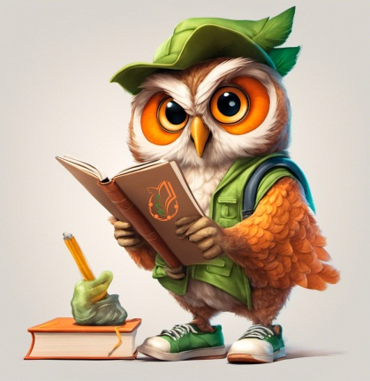
Professor Owl
Alright, buckle up, little learners! Get ready for some family fun with your friendly teacher, Professor Owl! Hoo-hoo!
(Professor Owl waves his wing excitedly!)
"Greetings, bright young English learners! Professor Owl here, and I've got two super fun family challenges for you! Are you ready to become family word wizards?"

Slide 3



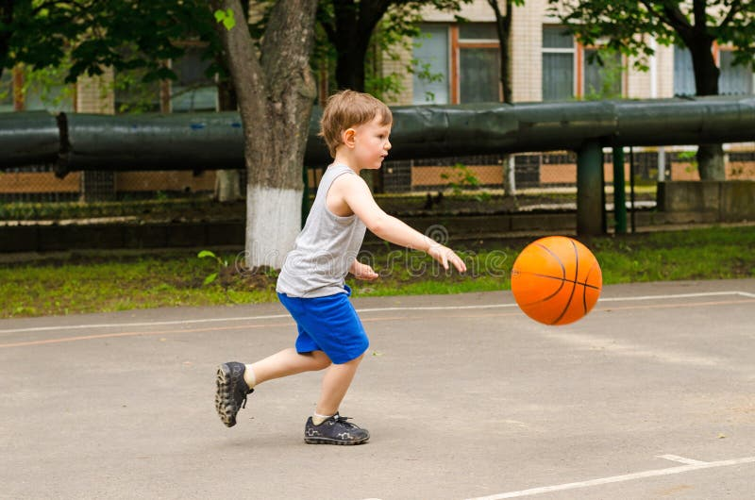
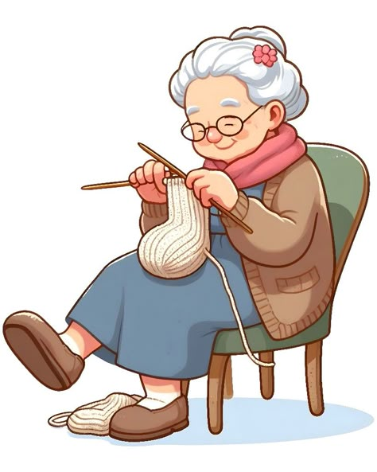
Task 1: Family Photo Match-Up!
"Hoo-hoo! Look at these family photos! But oh dear, some of the words are missing. Can you match the correct picture with the correct sentence describing the family member?“
Instructions: 1. Draw a line to connect the picture to the correct sentence. 2. Fill in the words.
Mother, father, brother, grandmother, grandfather
My___________________________ is laughing.
My ___________ _______________is in the garden.
My ____________________________ is reading.
My ____________________________is knitting.

Slide 4
Task 2: The "th" Family Secret!
"Hoo-hoo! Some special families have a secret sound! It's the "th" sound! Can you help me finish writing the family words by adding the correct letters?"
Instructions: Fill in the missing letters "th" in these family words.
1. Mo ____ er
2. Fa____er
3. Bro ____er
4. Grandmo____er
5. Grandfa____er

Slide 5
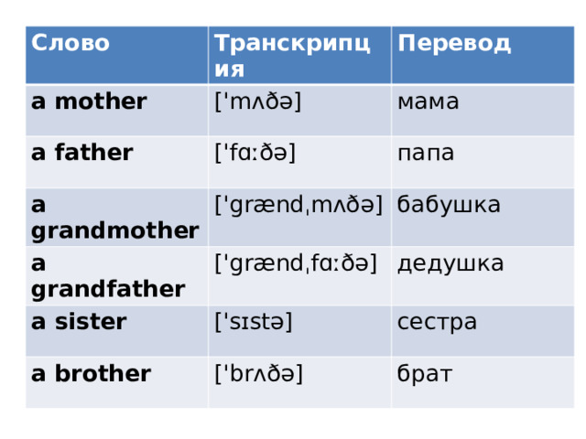
Transcription and translation.

Slide 6
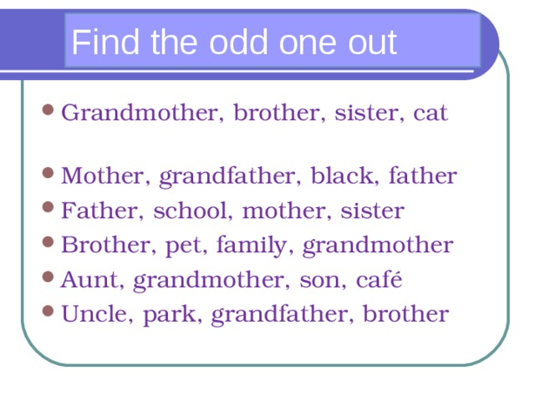

Slide 7
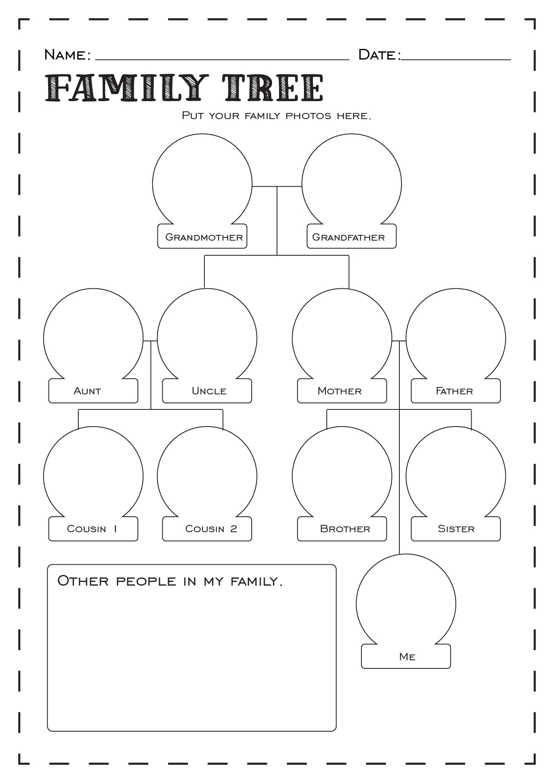
Draw the members of your family and name them

Slide 8
Lesson is over. Mr. Owl says Goodbye!

