Slide 1
Present Simple

Slide 2
Present Simple
I | swim.
I | don’t swim.
He/she/it | swims.
He/she/it | doesn’t swim.

Slide 3



What do Mike and Jake do?

Slide 4
What do Mike and Jake do?
Jake doesn’t swim.
Mike Swims.

Slide 5

What do Mike and Jake do?

Slide 6
What do Mike and Jake do?
Jake doesn’t run.
Mike runs.

Slide 7

What do Mike and Jake do?

Slide 8
What do Mike and Jake do?
Mike doesn’t play basketball.
Jake plays basketball

Slide 9
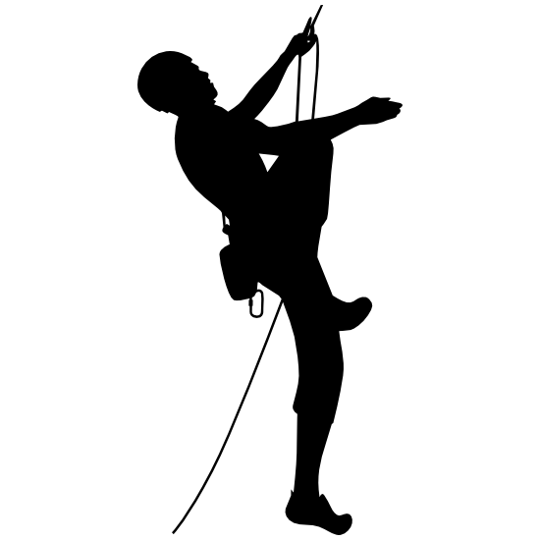
What do Mike and Jake do?

Slide 10
What do Mike and Jake do?
Jake doesn’t climb.
Mike climbs.

Slide 11

What do Mike and Jake do?

Slide 12
What do Mike and Jake do?
Jake doesn’t sing.
Mike sings.

Slide 13

What do Mike and Jake do?

Slide 14
What do Mike and Jake do?
Jake dances.
Mike doesn’t dance.

Slide 15


What do Mike and Jake do?

Slide 16
What do Mike and Jake do?
Jake doesn’t paint.
Mike paints.

Slide 17
Thank you!

