Slide 1
JOURNEY
to LITERLAND

Slide 2
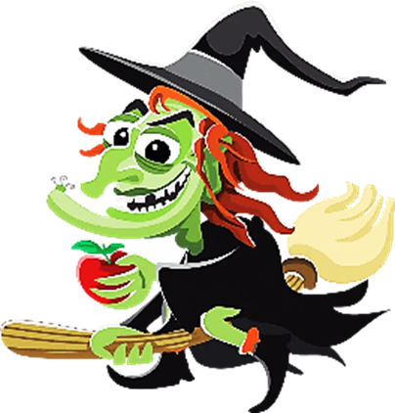

Slide 4
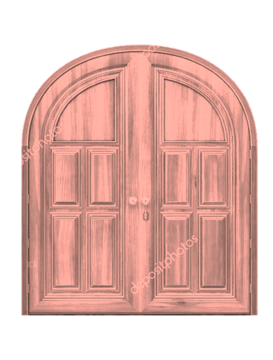


Slide 5

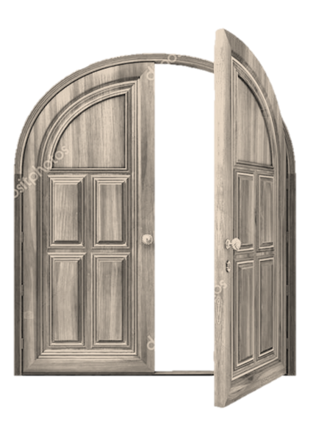

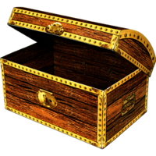
Do the task and then you’ll get
the money!
A
B
C
D
E
F

Slide 6



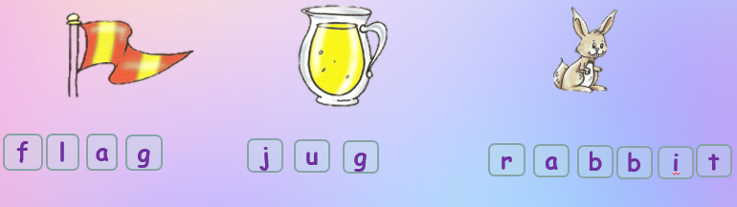
Make up words and read them
b
g
t
u
b
a
j
r
f
a
i
g
l
CHECK
NEXT ROOM

Slide 7
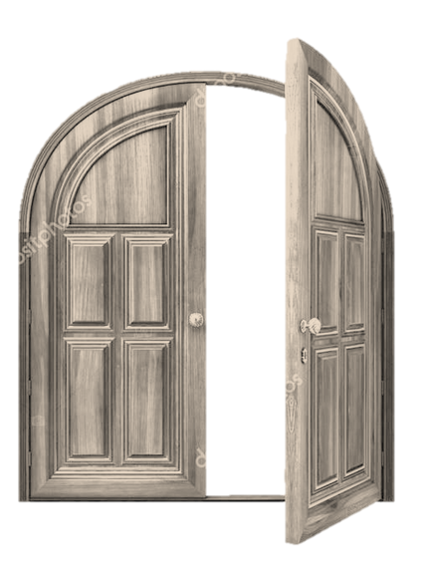

Oh, no………
A
B
C
D
E
F
NEXT ROOM

Slide 8

Do the task and then you’ll get
the money!
G
H
I
J
K
L

Slide 9
Yes!
Yes!
Yes!
Yes!
Yes!
Yes!
Yes!
Yes!
Yes!
Find 9 missing letters

Slide 10

Oh, no………
G
H
I
J
K
L

Slide 11
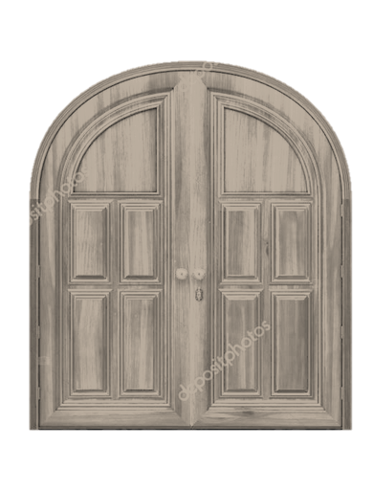
Do the task and then you’ll get
the money!
N
O
M
O
P
Q
R
P

Slide 12

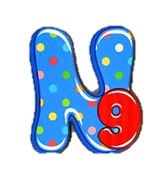
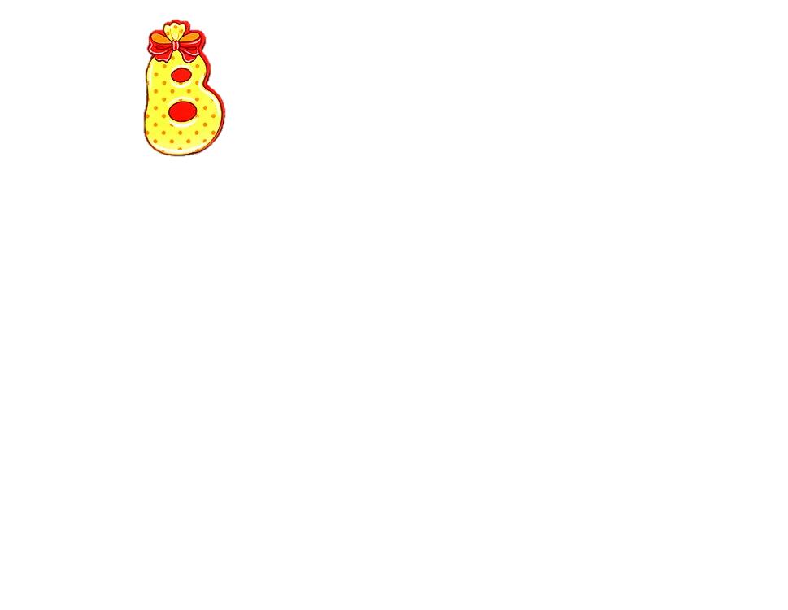



Guess the letter

Slide 13
Oh, no………
O
M
N
P
Q
R

Slide 14
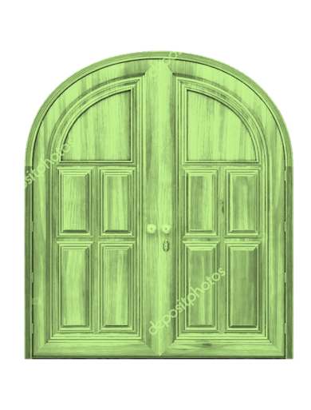
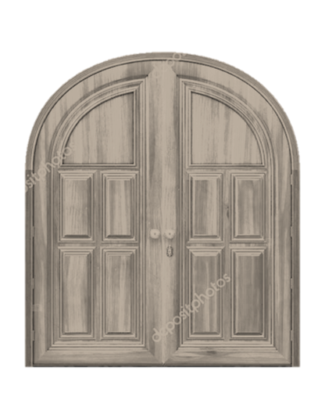
Do the task and then you’ll get
the money!
S
T
U
V
W
X

Slide 15
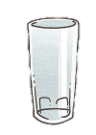




Choose the correct word
sheep
swim
glass
some
shop
queen
class
plum
ship
cue
bless
thumb
Great job!!!

Slide 16

Oh, no………
U
S
T
V
W
X

Slide 17

And now
the last task….
Are you ready to have tea with me?
Y
Z

Slide 18
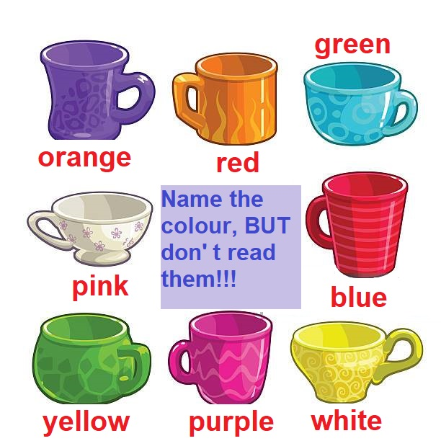
Great job!!!

Slide 19

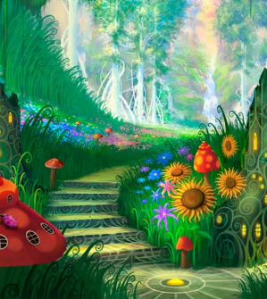
Oh, no………
Y
Z

Slide 20
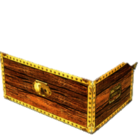
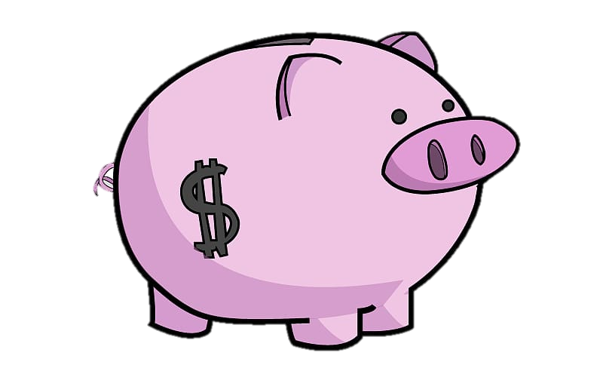
OK OK!
Now you are free!!!
Get all your money
And get the prize!!!
H
K
J
W
W
U
X
L
T
Z
N
G
T
X
S
Q
O
M
U
R
E
Y
V
P
A
V
S
B
C
I
D
F
Great job!!!

Slide 22
Well done!

