Slide 1

Английский
с Анной
SPOTLIGHT 2
8 A
I CAN JUMP!
START

Slide 2

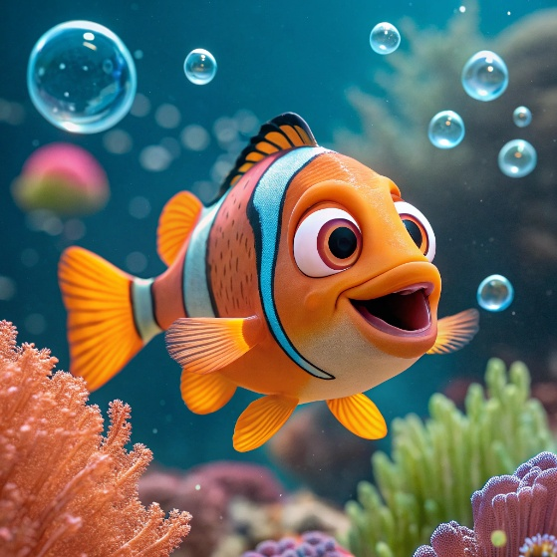
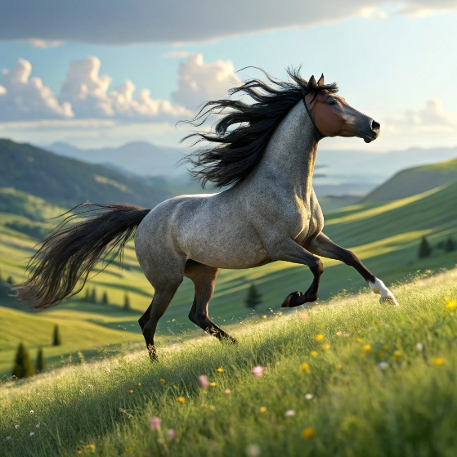
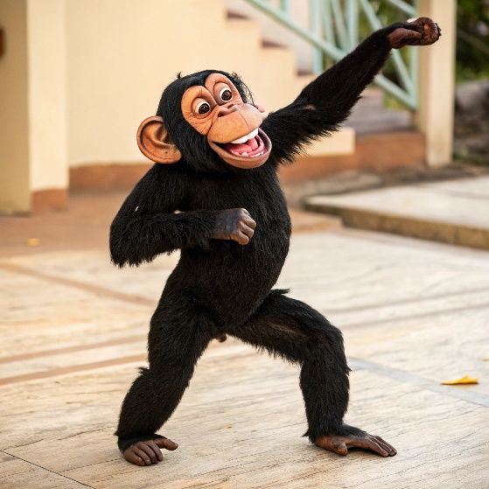

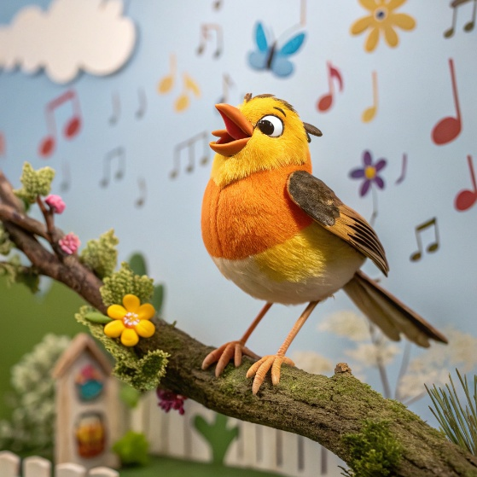
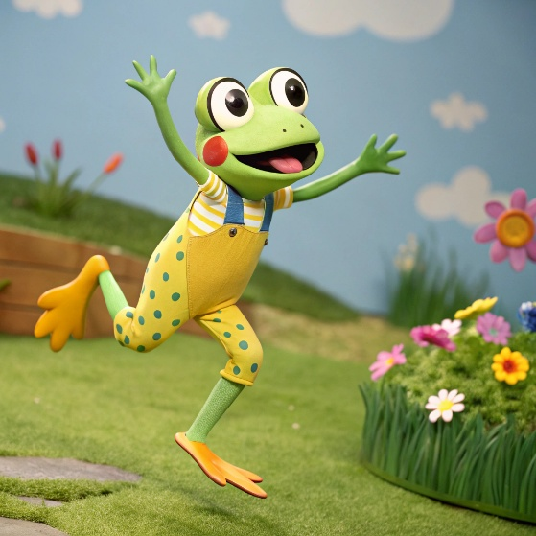
Click, listen and repeat
swim
run
dance
sing
jump

Slide 3
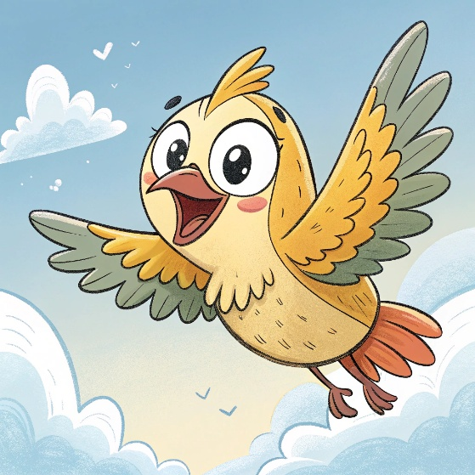
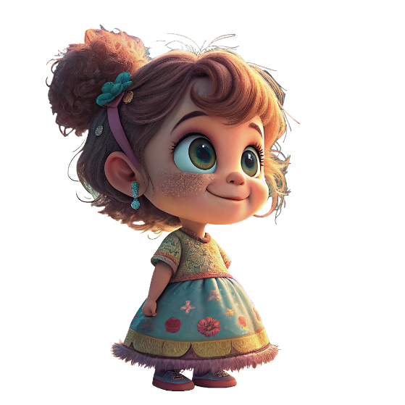
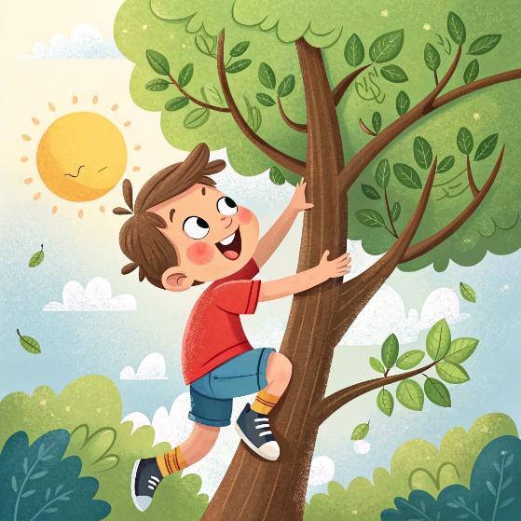
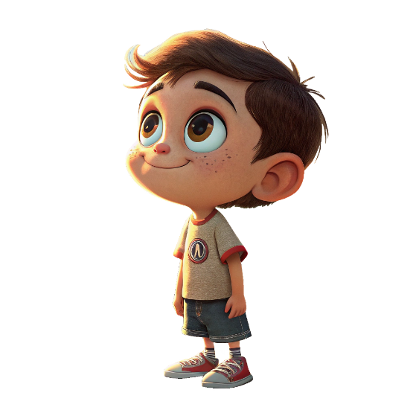

Click, listen and repeat
fly
girl
climb
boy

Slide 4
CAN – могу, умею
CAN`T – не могу, не умею
it
I
she
can
can`t
you
he
we
they
swim
run
fly
dance
jump
climb
sing

Slide 5
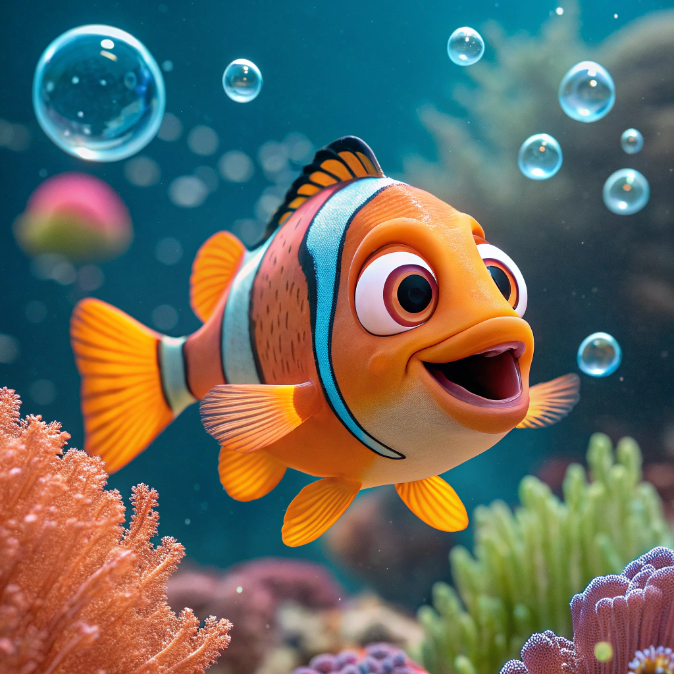
Can you swim?
Yes, I can.
No, I can`t

Slide 6

Can you jump?
Yes, I can.
No, I can`t

Slide 7

Can you sing?
Yes, I can.
No, I can`t

Slide 8

Can you run?
Yes, I can.
No, I can`t

Slide 9

Can you dance?
Yes, I can.
No, I can`t

Slide 10

Can you fly?
Yes, I can.
No, I can`t

Slide 11
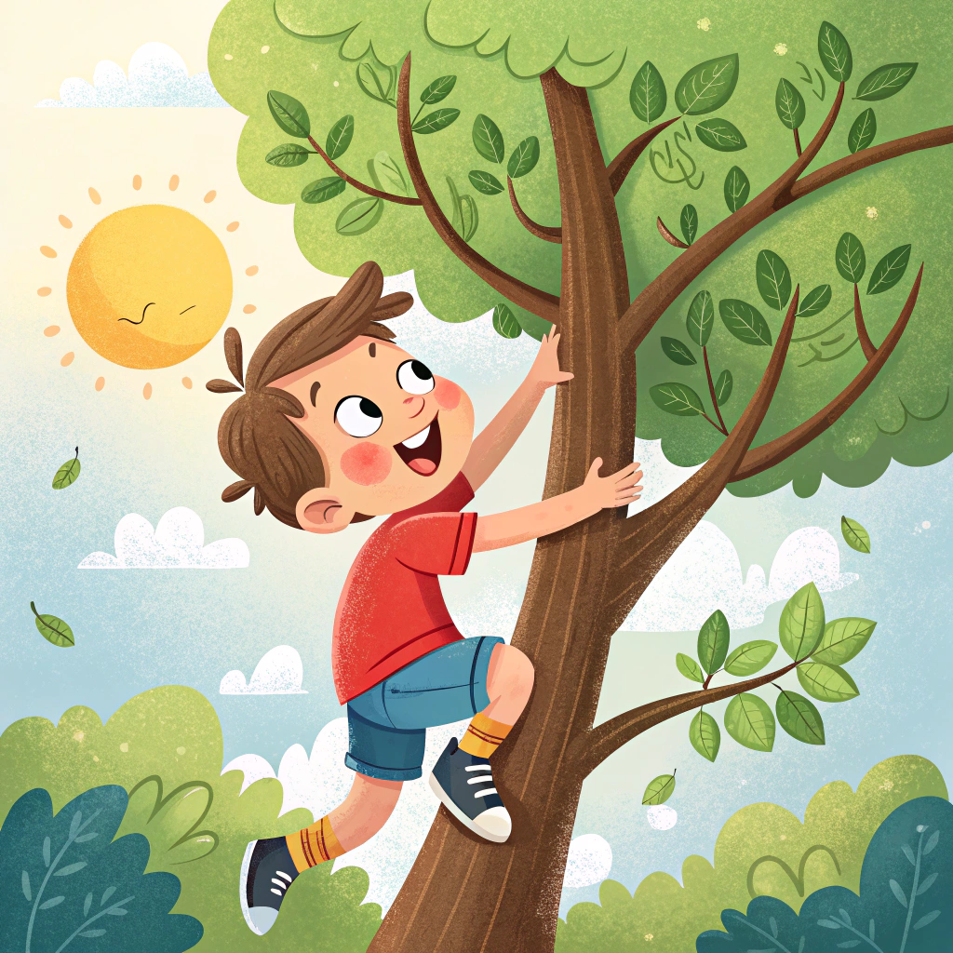
Can you climb?
Yes, I can.
No, I can`t

Slide 12
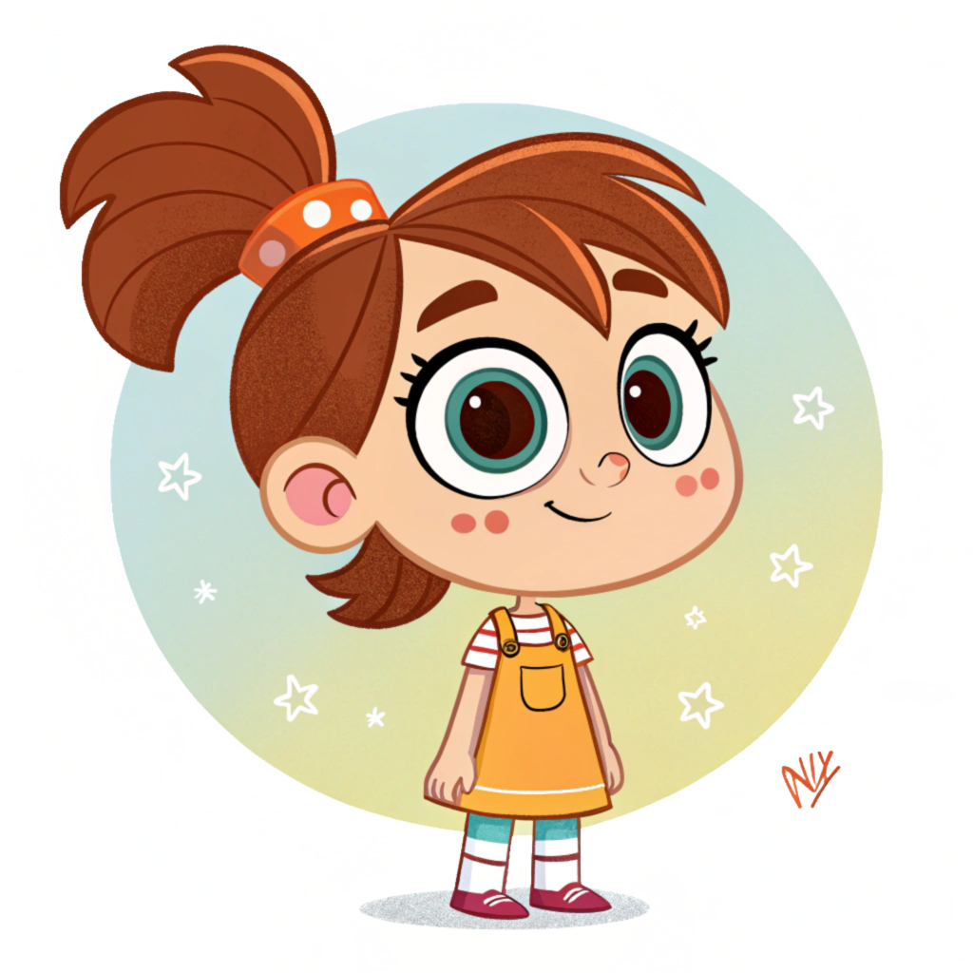

My name is Mary. I am seven. I can swim, but I can`t sing.
Mary
7
swim
sing

Slide 13
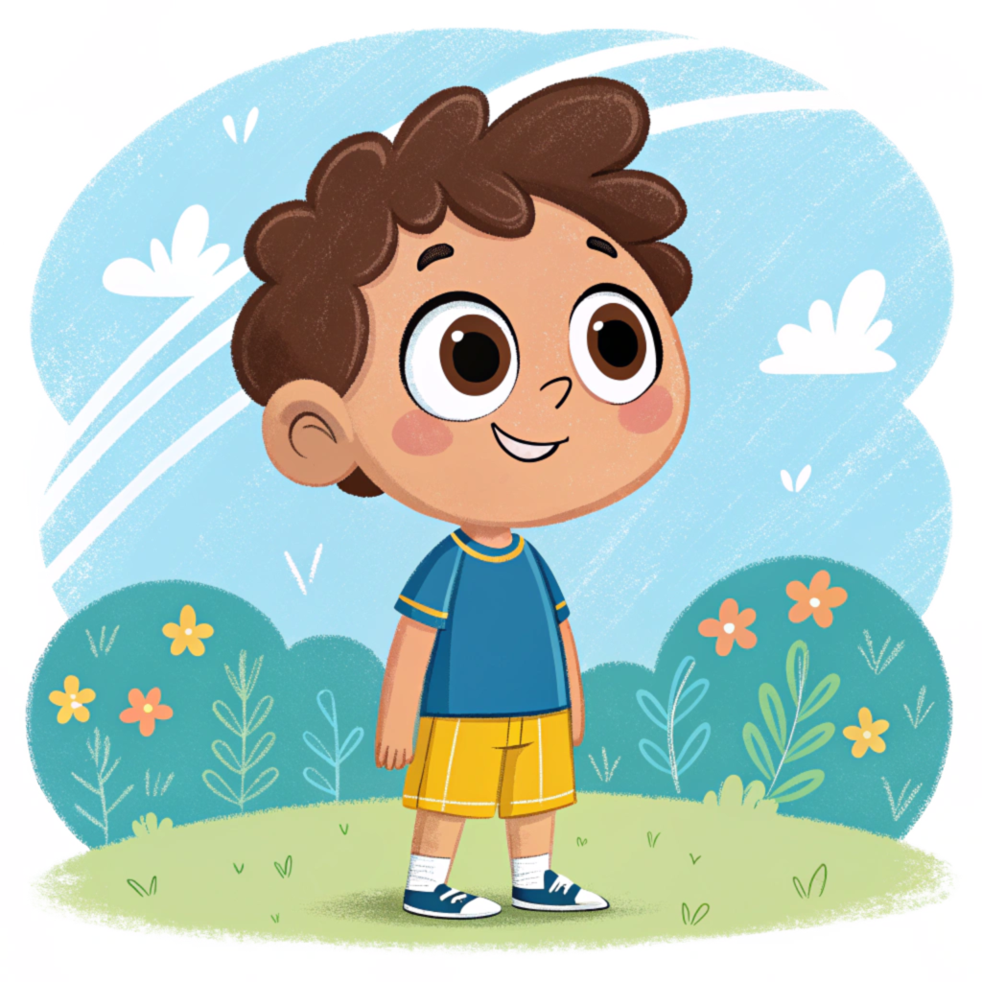
My name is _____. I am ______. I can ____, but I can`t _____.
Tom
8
jump
dance

Slide 14
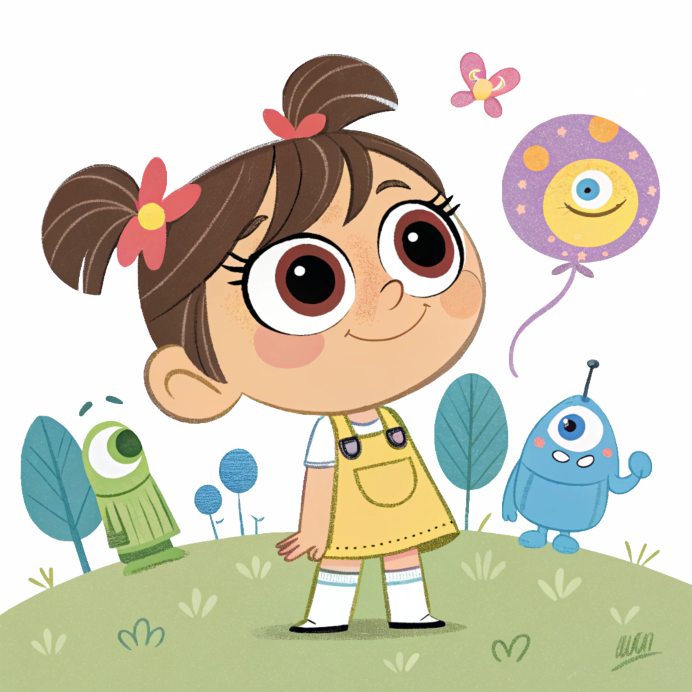
My name is _____. I am ______. I can ____, but I can`t _____.
Kim
6
run
climb

Slide 15
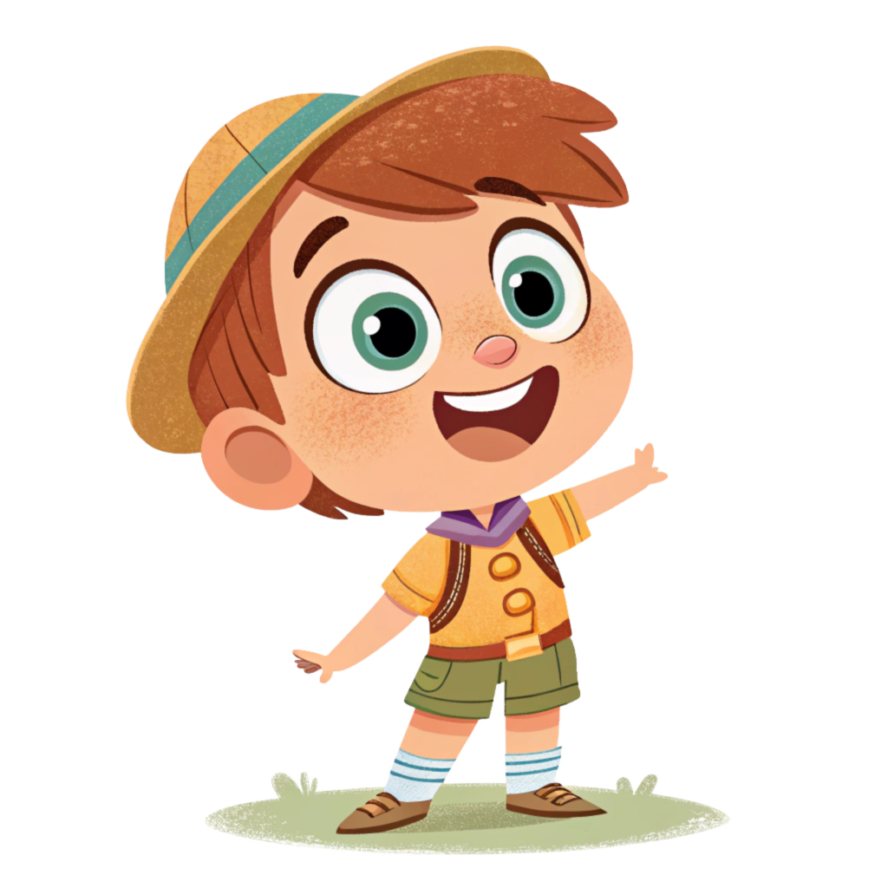
My name is _____. I am ______. I can ____, but I can`t _____.
Sam
10
sing
fly

Slide 16
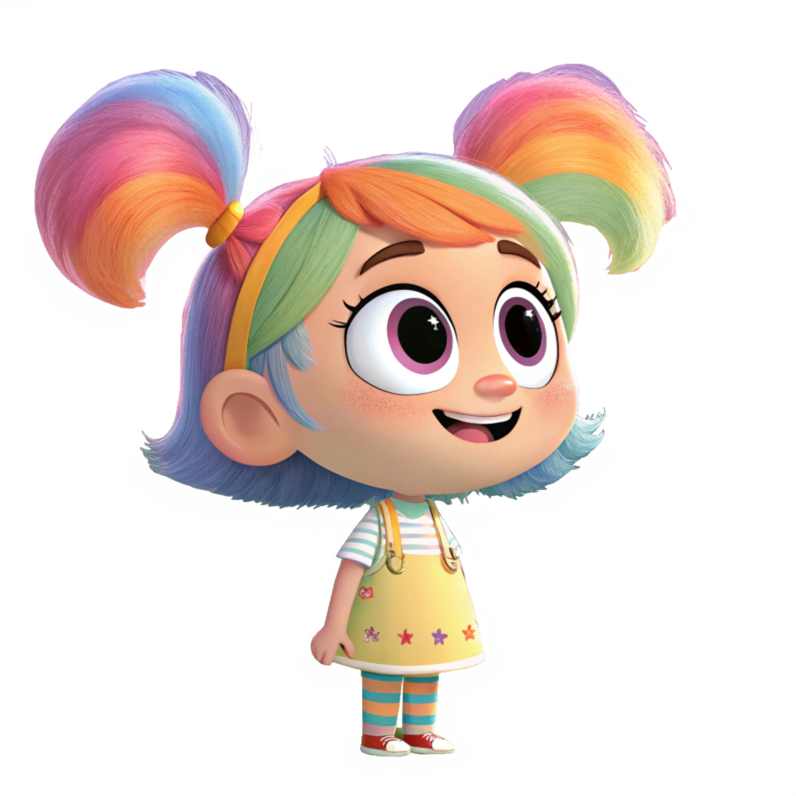
My name is _____. I am ______. I can ____, but I can`t _____.
Meg
9
dance
swim

