Slide 1
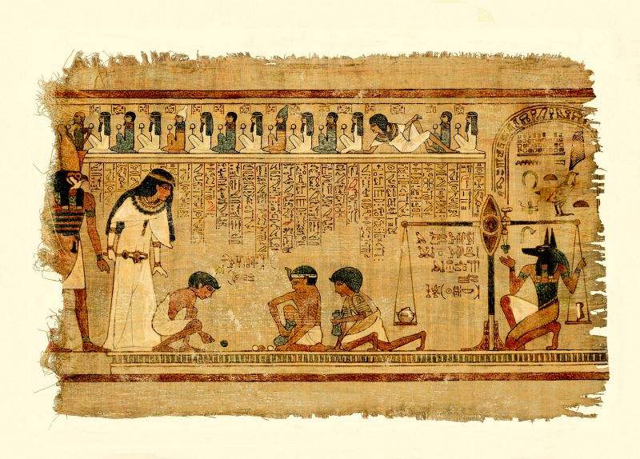
The Ancient Egyptians

Slide 2








Ancient Egyptians 5 thousand years ago. They didn’t have paper.
People clay tablets to write on.
The tablets very heavy. And people each tablet only one time.

Slide 3





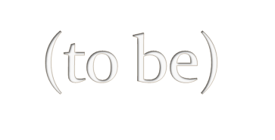


The Ancient Egyptians to make paper. So they to use papyrus. It difficult to make and it expensive. Only rich people it.

Slide 4






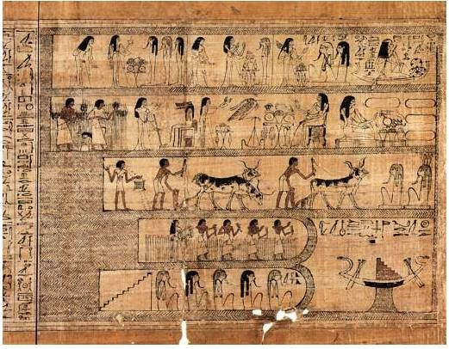
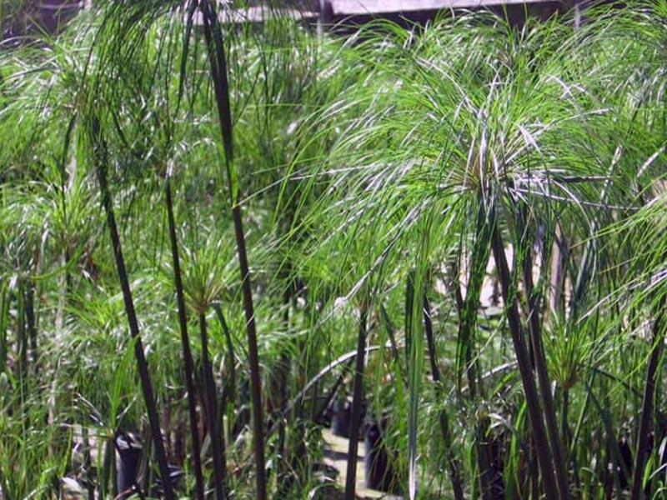
the papyrus and it

