Slide 1
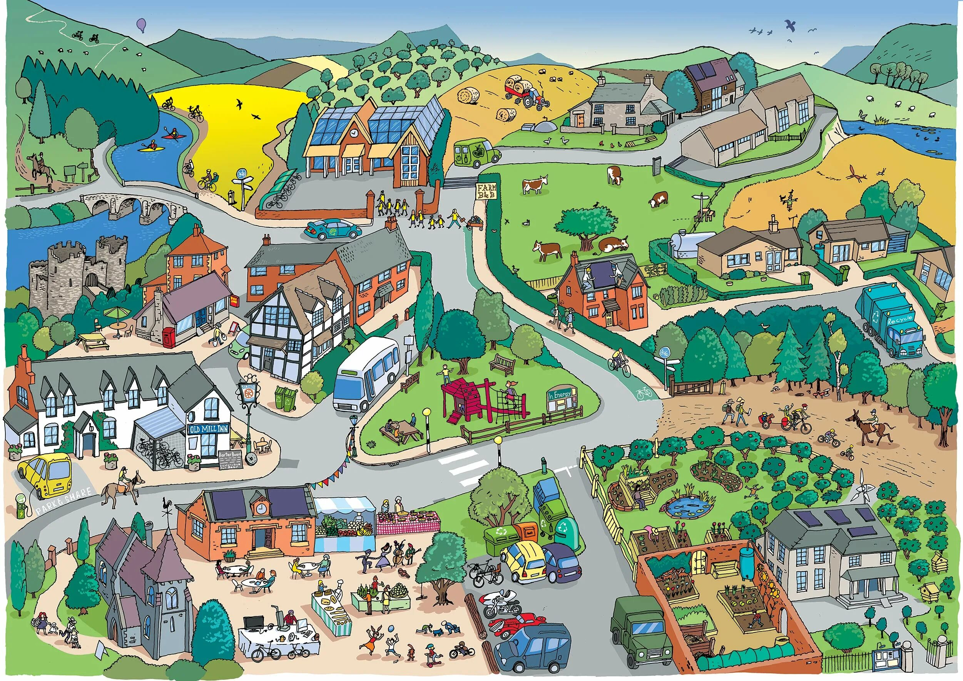
OUR
TOWN
Incredible English 3 unit 6
Енацкая Стефания, педагог доп.
образования
ГБОУ ДО ДДЮТ «На Ленской»,
г. Санкт-Петербург

Slide 2
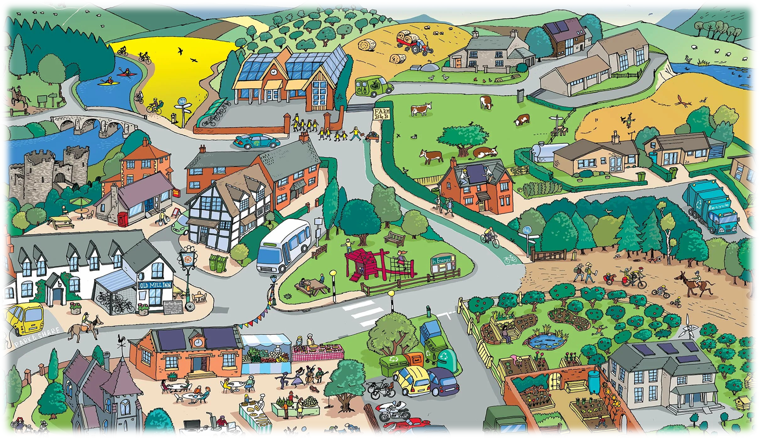
TODAY’S PLAN:
To learn new vocabulary
To repeat the prepositions of place
To repeat the «Where’s…» question
To try the map description using items above

Slide 3

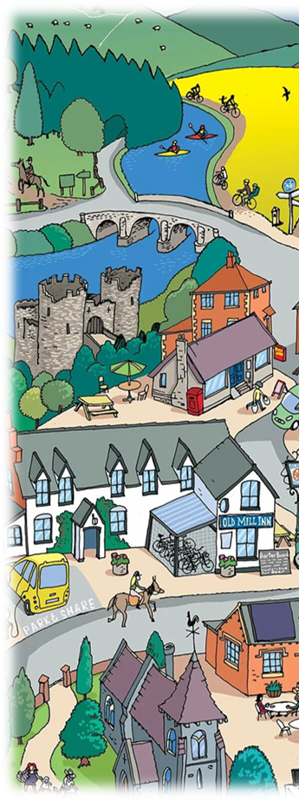
VOCABULARY
Cinema – кинотеатр
Swimming pool – бассейн
School – школа
Park – парк
Restaurant – ресторан
Library – библиотека
Supermarket – супермаркет
Shopping centre – тц
Car park – парковка
Post office – почта
Bus station - автобусная остановка
Let’s listen, read and translate!

Slide 4
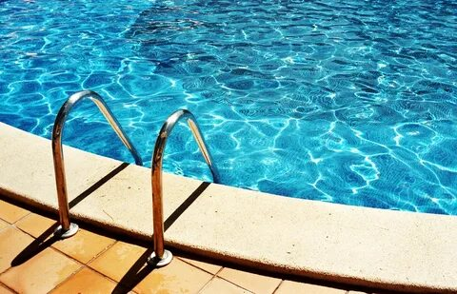
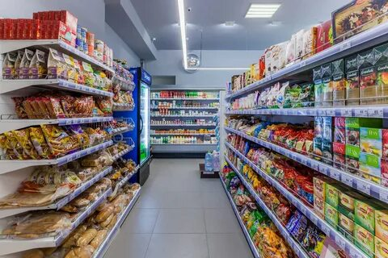
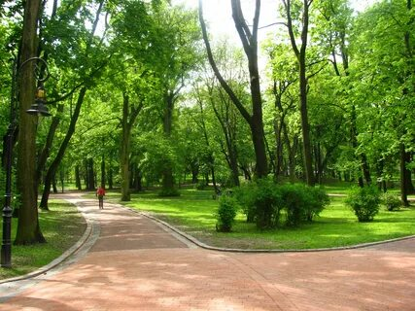
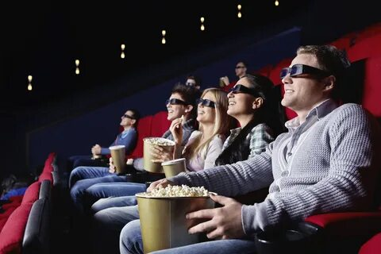
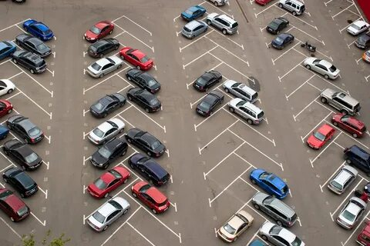
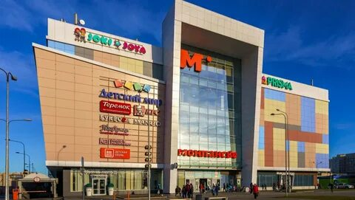
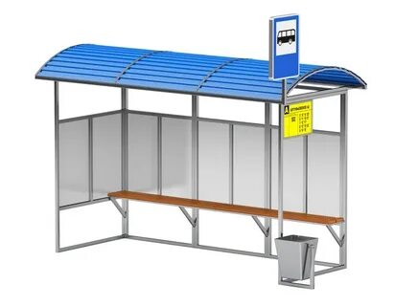
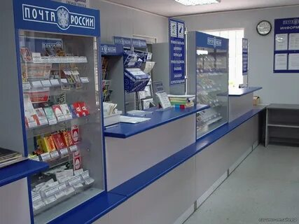

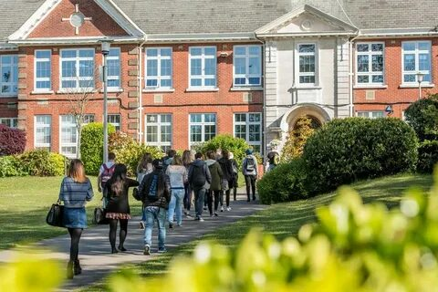
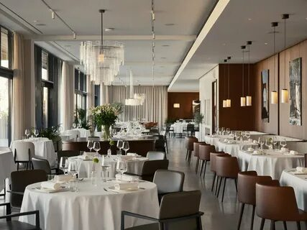
Let’s repeat!
Write the number
Cinema – кинотеатр
Swimming pool – бассейн
School – школа
Park – парк
Restaurant – ресторан
Library – библиотека
Supermarket – супермаркет
Shopping centre – тц
Car park – парковка
Post office – почта
Bus station - автобусная остановка

Slide 5
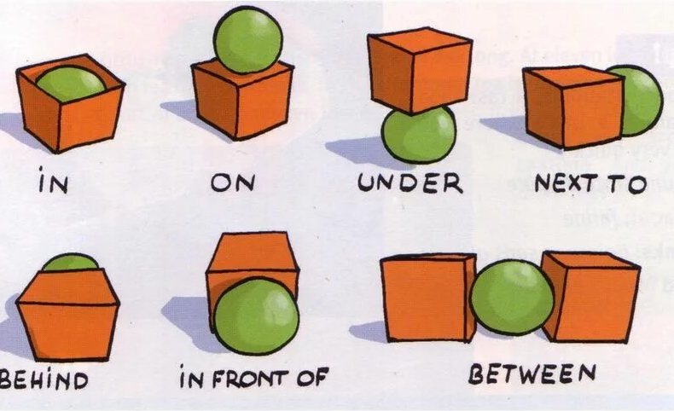
Prepositions of place
Let’s make sentences adding the prepositions
The ball IS …
…the box/ …2 boxes

Slide 6
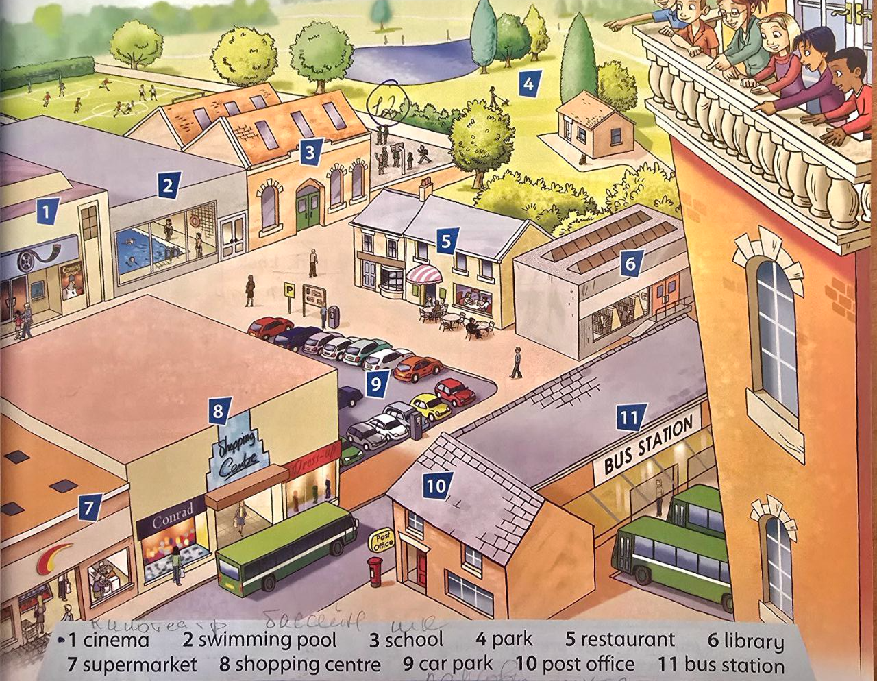
Let’s practice
Page 45 Class Book
Make the sentences using prepositions of place
The post office is… the bus station
The swimming pool is… the cinema and the school
The supermarket is… the shopping centre
…
Now, make your own sentences!

Slide 7
Where’s…?
Page 45 Class Book
Look at the picture and ask some questions. Try to answer
Where’s the post office?
Where’s the swimming pool?
Where’s the supermarket?
…
Now, make your own questions!

Slide 8
Where’s…?
Page 45 Class Book
Read and match
Where’s the post office?
Where’s the swimming pool?
Where’s the supermarket?
It is next to the bus station
It is between the cinema and the school
It is next to the shopping centre

Slide 9
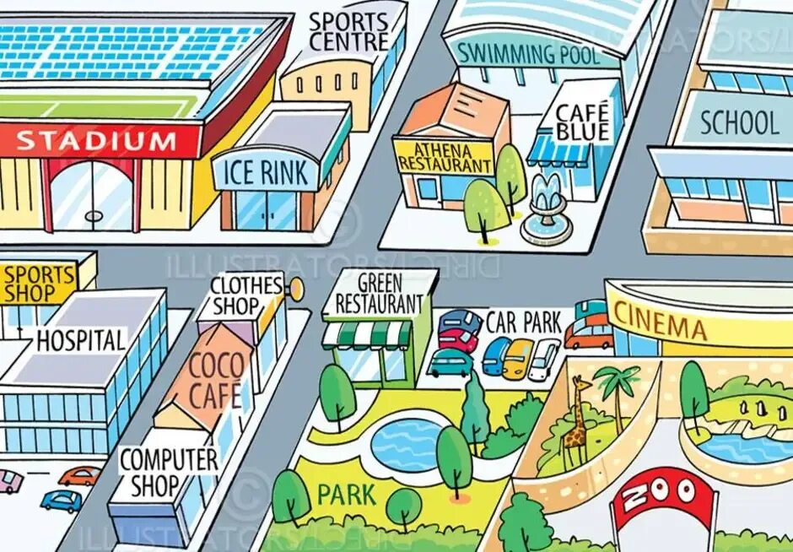
Map description
Make the questions and ask.
Try to describe as much as you can
The cinema is…
Where’s the cinema?

Slide 10


