Slide 1

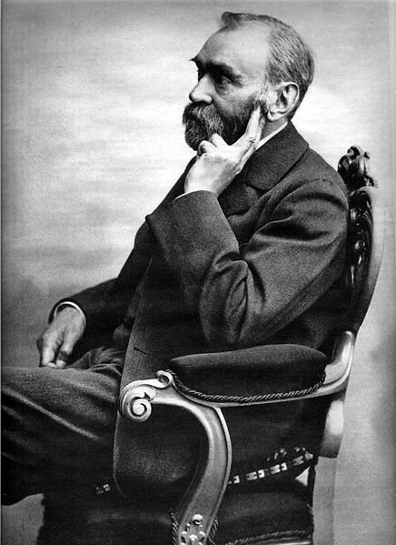
Alfred
nobel
(1833-1896)
Медиаурок-презентация
Для учащихся 10-х классов
Подготовила Урманова О.А.
учитель английского языка
МБОУ «Школа № 14» г. Рязань

Slide 2

Fill in the gaps. One word is extra:
Medal, sum, awarding (награждение), inventor, ceremony, originally, winners, anniversary (годовщина), report, inventing, contributions
After 1…… dynamite, Swedish born Alfred Nobel became a very rich man. He foresaw (предвидел) its destructive power too late. Nobel preferred not to be remembered as the 2…… of dynamite. In 1895 just two weeks before his death, he created a fund to be used for 3…… prizes to people who will make worthwhile 4…… to mankind. 5…… there were five awards: literature, physics, chemistry, medicine and peace. Economics was added in 1968, sixty-seven years after the first 6……. Nobel’s original legacy of nine million dollars was invested, and the interest (процент) on this 7…… is used for the awards, which vary from $ 30,000 to $ 125,000. Every year, on December 10, the 8 …… of Nobel’s death, the awards (gold 9……, diploma and money) are presented to the 10…… .

Slide 3
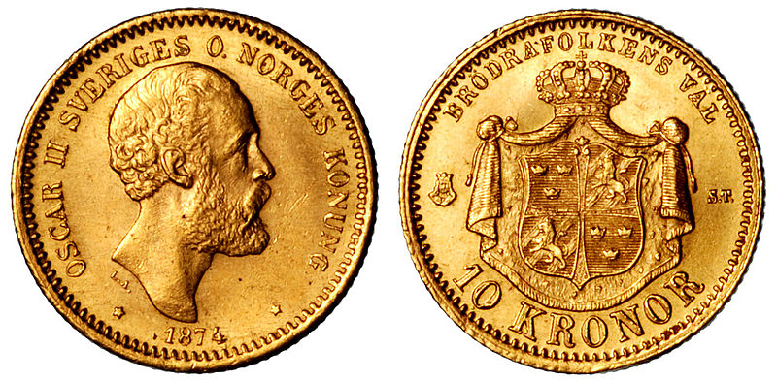
ALFRED NOBEL
After inventing dynamite, Swedish born Alfred Nobel became a very rich man. He foresaw its destructive power too late. Nobel preferred not to be remembered as the inventor of dynamite. In 1895 just two weeks before his death, he created a fund to be used for awarding prizes to people who will make worthwhile contributions to mankind. Originally there were five awards: literature, physics, chemistry, medicine and peace. Economics was added in 1968, sixty-seven years after the first ceremony. Nobel’s original legacy of nine million dollars was invested, and the interest (процент) on this sum is used for the awards, which vary from $ 30,000 to $ 125,000. Every year, on December 10, the anniversary of Nobel’s death, the awards (gold medal, diploma and money) are presented to the winners.

Slide 4
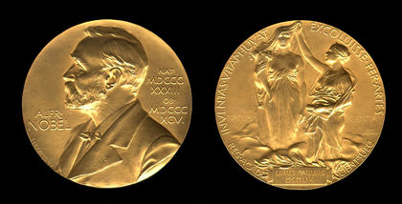
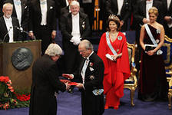
Alfred Nobel established
the Nobel Prize
for the world beneficial inventions
in physics, chemistry, physiology and medicine, economics, literature and peace consolidation.

Slide 5
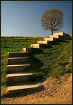
Steps to follow
Read the theme and paraphrase it
Decide on what your opinion is
Give arguments for your opinion
Think of another point of view
Give arguments against the other point of view
Sum up but respect all points of view

Slide 6
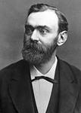
Topic to discuss ??????
Alfred Nobel
The Nobel Prize
awarded only in 6 fields of science and life
a worldwide fame
“bloody millionaire”
“king of dynamite”
refuse to get money

Slide 7
Topic to discuss

Slide 8

What is your opinion?
Although there exist different opinions on this question, my opinion is that …

Slide 9


Arguments for
Arguments against

Slide 10
Will you sum up?
Surely it will be impossible
to give full justice
to the problem
but I strongly believe that …

Slide 11
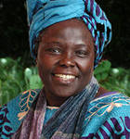
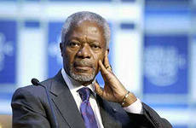
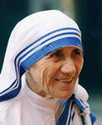
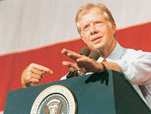
Speak about
some Nobel Peace Prize Winner

