Slide 1
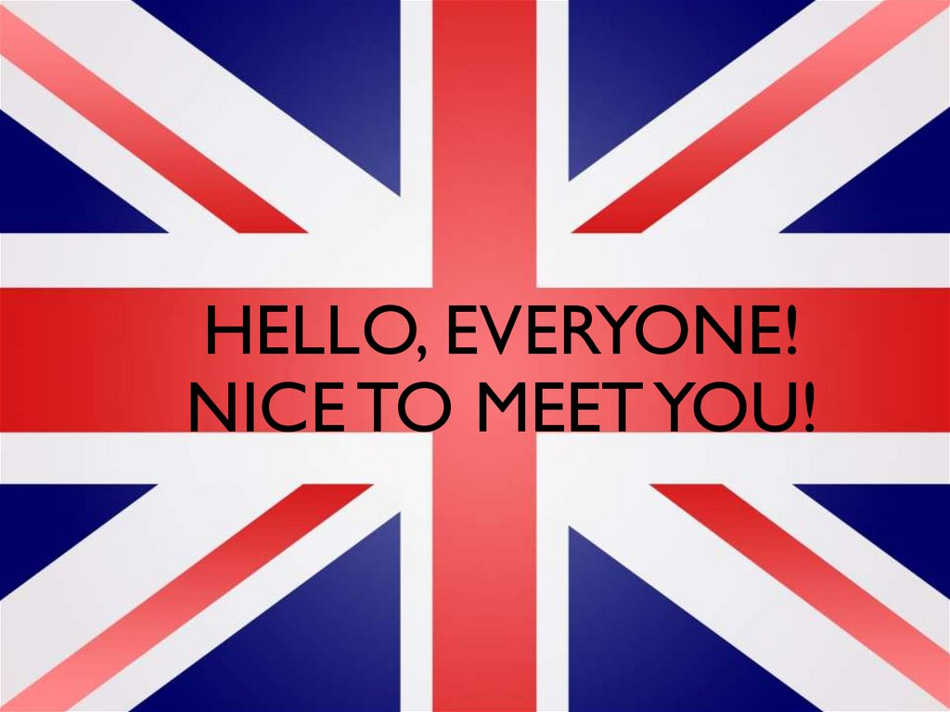

Slide 2
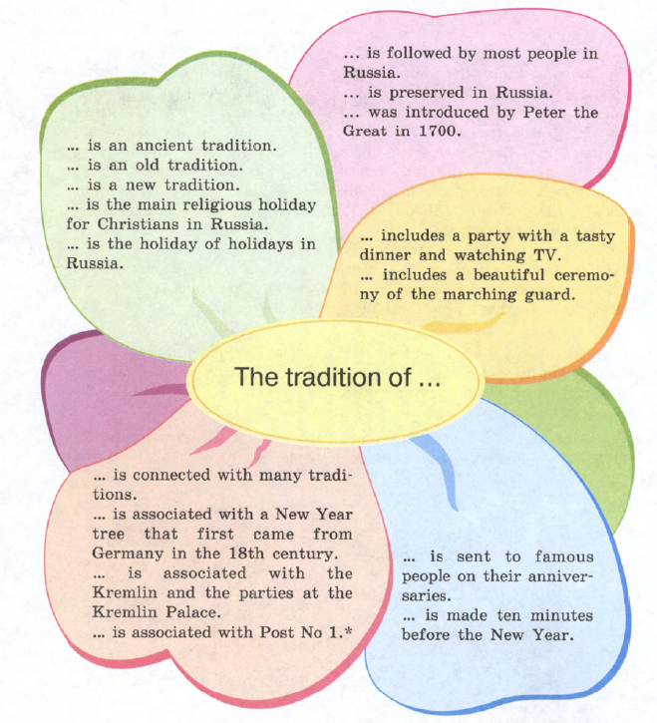
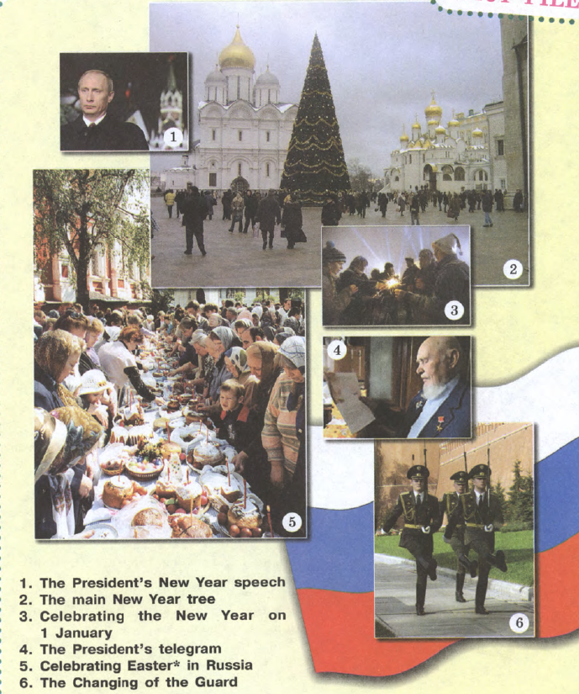

Slide 3
Social Etiquette in the UK

Slide 4
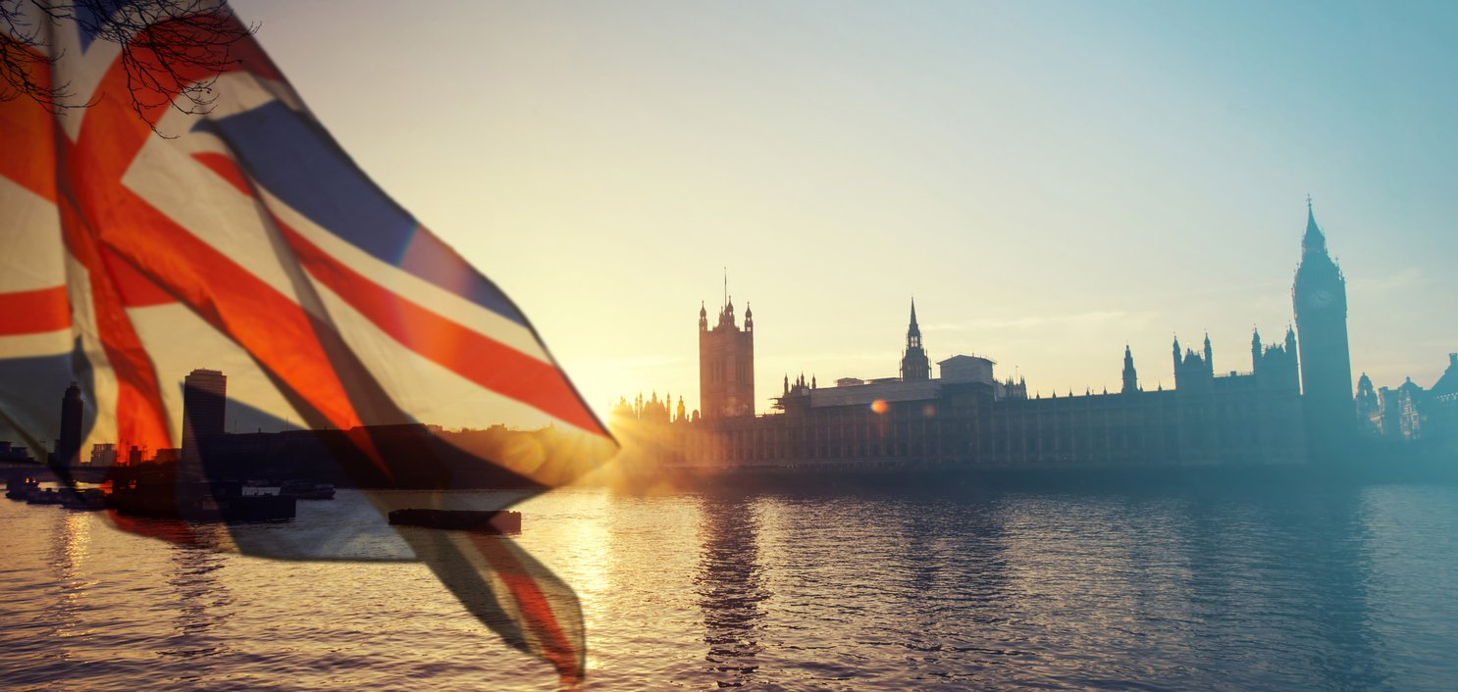

Slide 5




As you know, The United Kingdom consists of four countries: England, Scotland, Wales and Northern Ireland. This is important not only in terms of geography; one must remember about the strongest sense of national pride inherent in each of these peoples.
It is also don’t remembering that Northern Ireland borders the Republic of Ireland - these are different countries. Northern Ireland is part of the United Kingdom, Ireland is not. It would be a mistake and almost an insult to call a resident of Ireland British.

Slide 6

British people are famous for their language, politeness, self-discipline and sense of humour . As any other nation, they have their own social customs.

Slide 7
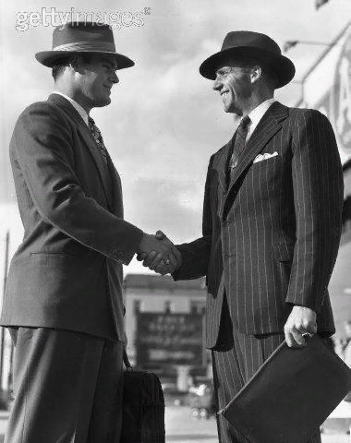
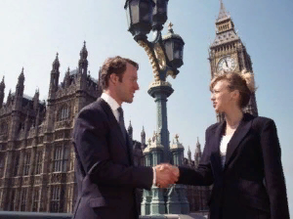
Regarding greetings it should be said that it is proper to shake hands with everyone to whom you are introduced, both men and women.

Slide 8
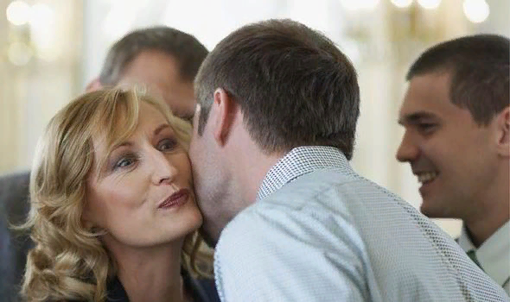
When you greet close friends or relatives , you can kiss them on the cheek or hug them.

Slide 9
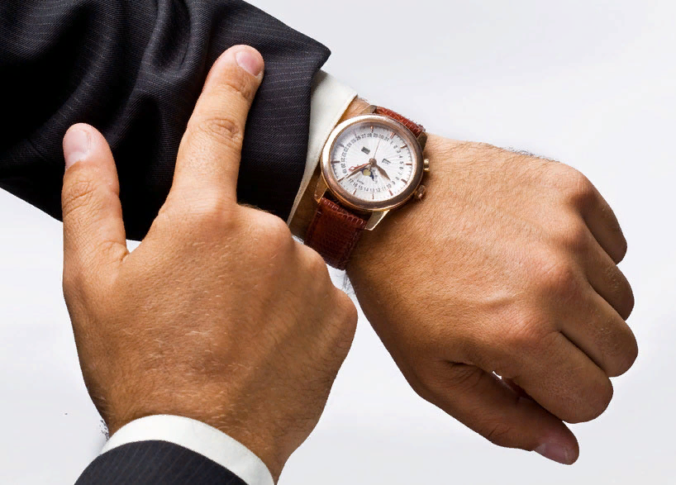
The British place considerable value on punctuality. People make great effort to arrive on time. It is often considered impolite to arrive even a few minutes late.

Slide 10
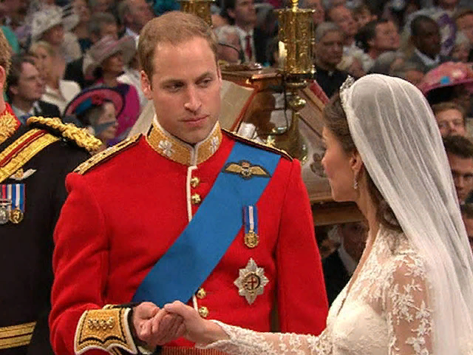
And it’s better to arrive a few minutes early for public meetings, concerts, movies, church services and weddings.

Slide 11
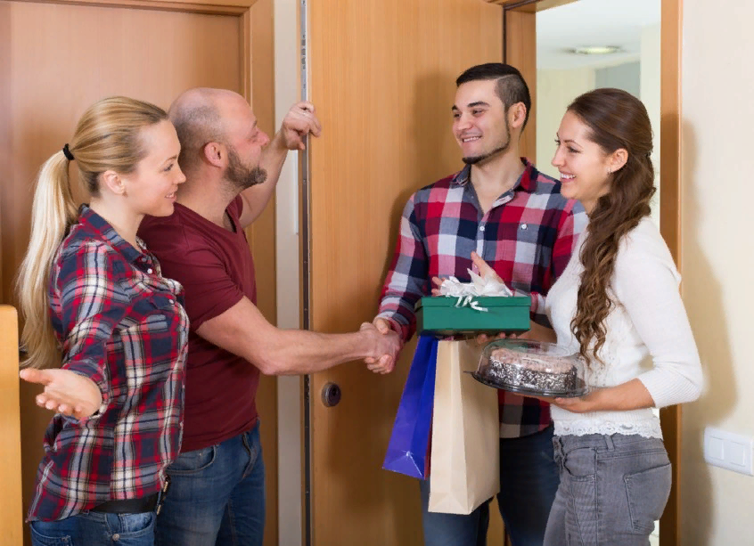
If you want to visit someone at home, it is a good manner to telephone in advance . When you visit people at home , make sure you are on time.
It is considered polite to give a gift to your host, especially if you have been invited for a meal. Flowers, chocolate, or a small gift are all appropriate. It will be nice of you to send a thank-you note or to make a telephone call after the visit.

Slide 12
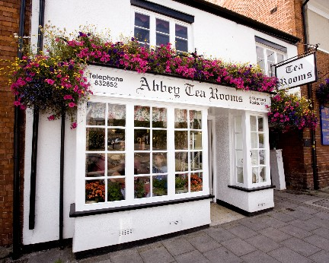
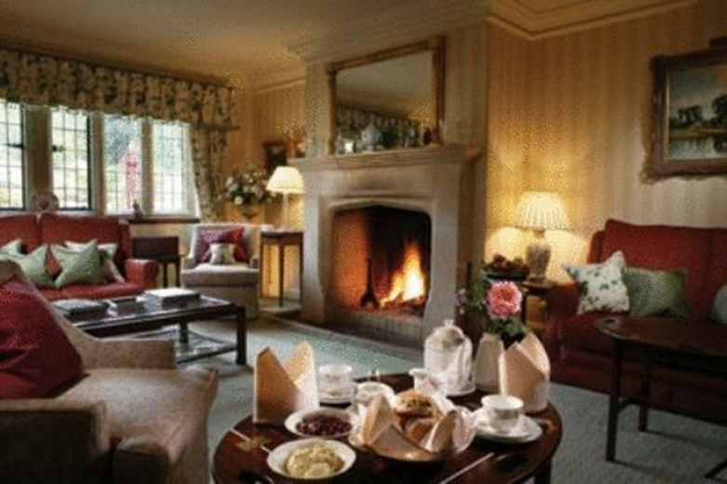
Take off your shoes when you enter the house

Slide 13
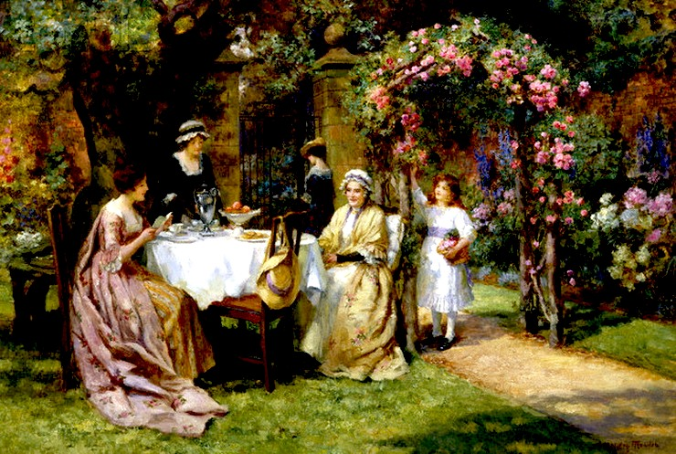
Take flowers if you are invited to visit your friend for dinner

Slide 14

It is considered indecent to arrive earlier than the appointed time, but being late is also considered bad form. You need to be at the right time
Неприличным считается приходить раньше назначенного времени, но и опоздание считается плохим тоном. Нужно являться в точно назначенное время
come in time

Slide 15

The British like their privacy , so not all topics are safe for small talk. Which topics should be avoided? Age , personal gossip, marital status ,appearance and weight ,money ,politics , criticisms , complaints ,jokes that might offend , previous or current relationships.

Slide 16
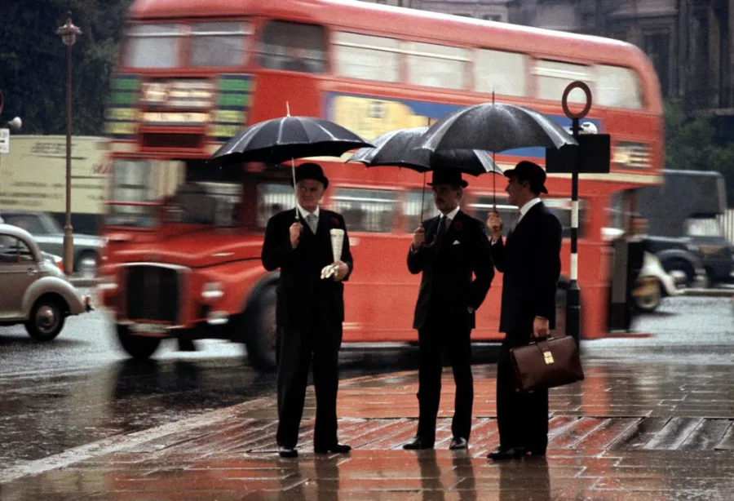
Acceptable small talk topics are family , films, sport, food , hobbies , studies ,television and weather.

Slide 17
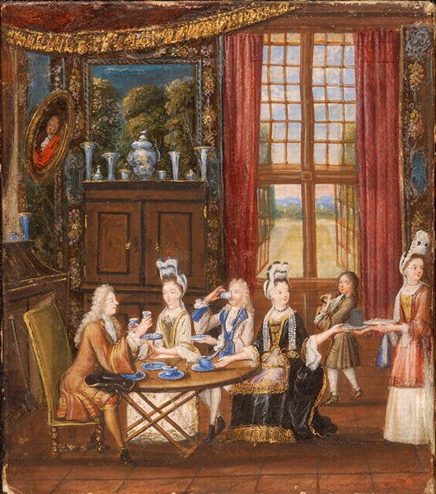
‘’Thank you’’
When you leave the table after dinner don’t forget to say…

Slide 18
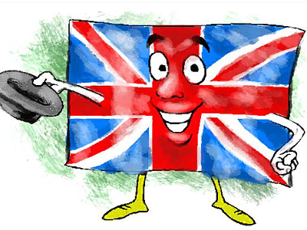
Social rules are an important part of the culture as they passed down through history. The British have an expression for following these «unwritten rules»: «When in Rome, do as the Romans do».

Slide 19
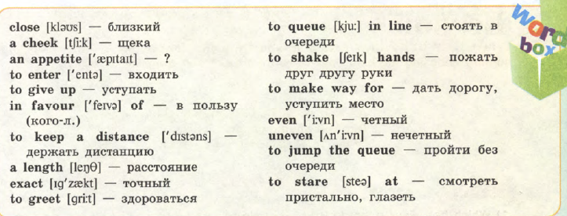

Slide 20
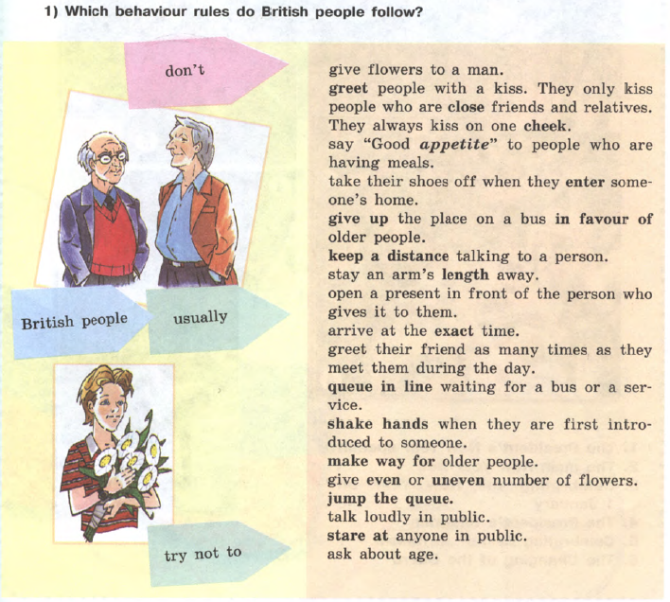

Slide 21
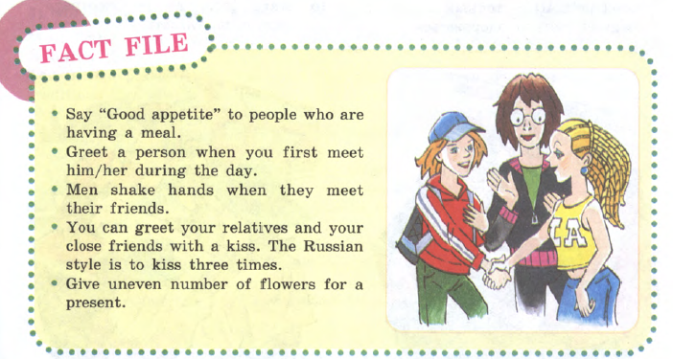

Slide 22

Составить 5 предложений об английском этикете опираясь на упр.1 стр.42

