Slide 1
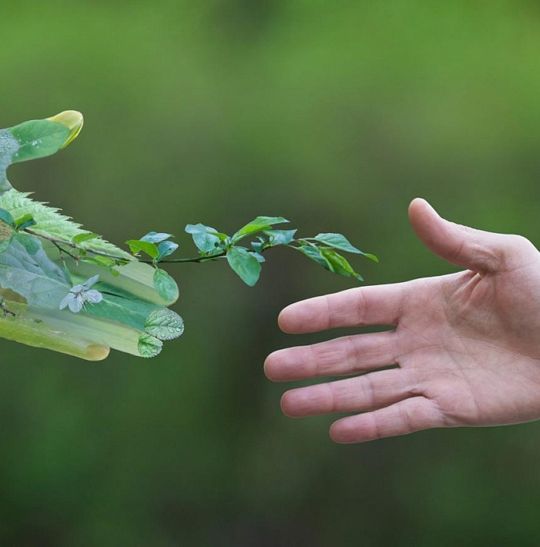
Защита окружающей среды

Slide 2
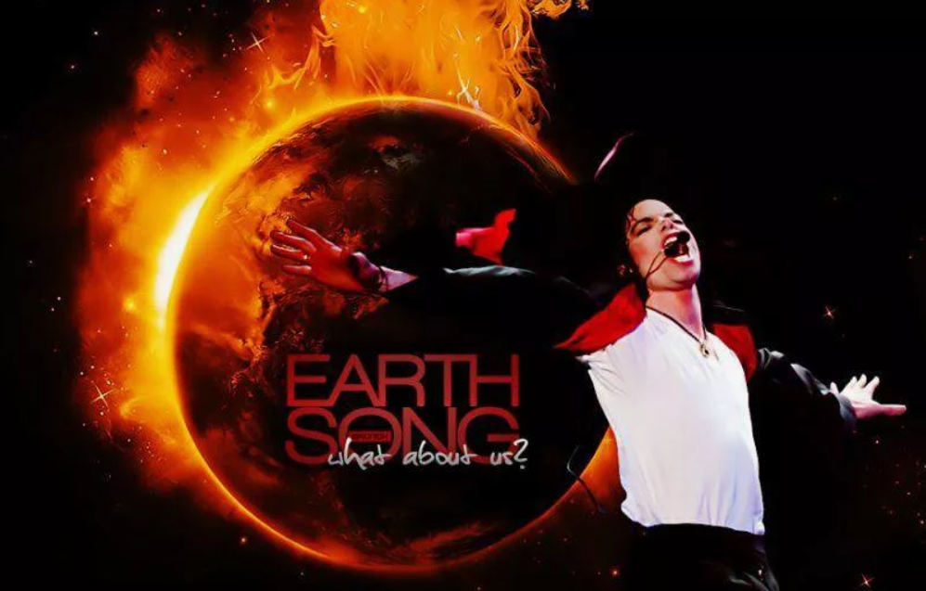
Michael Jackson - Earth Song (Official Video) - поиск Яндекса по видео (yandex.ru)

Slide 3
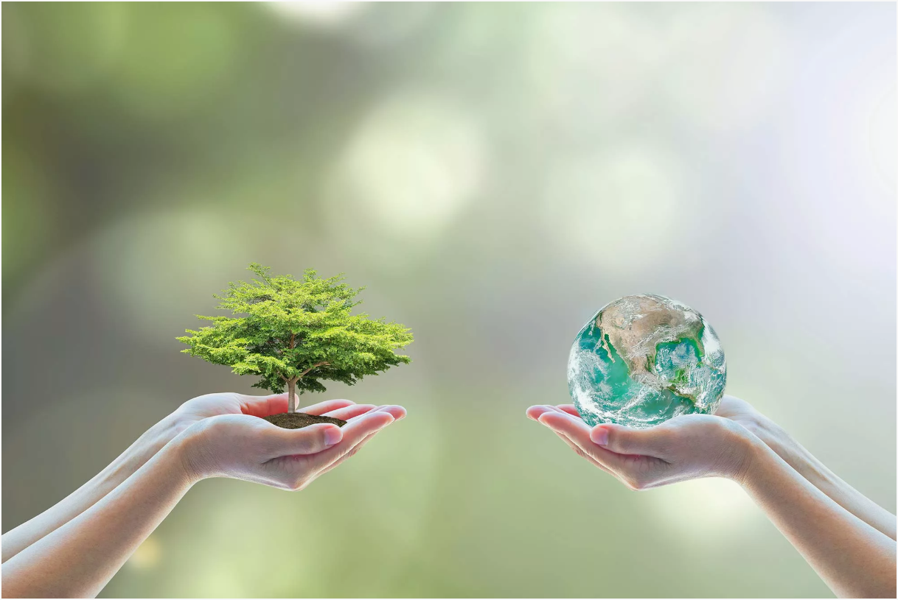
The Environmental Protection

Slide 4
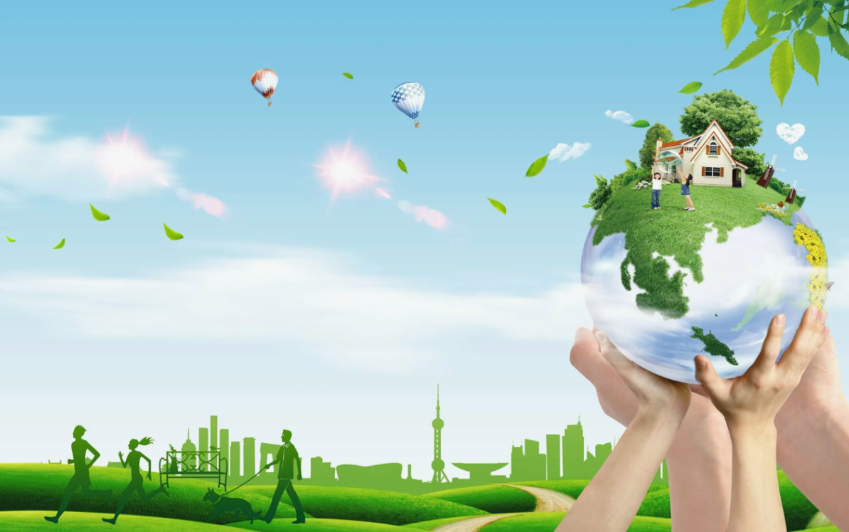
The aims of our lesson are:
- to speak about “The Environmental Protection”;
- to revise the vocabulary on “The Environmental Protection”;
- to express our personal opinion;
- to learn treating the nature carefully and so on.

Slide 5
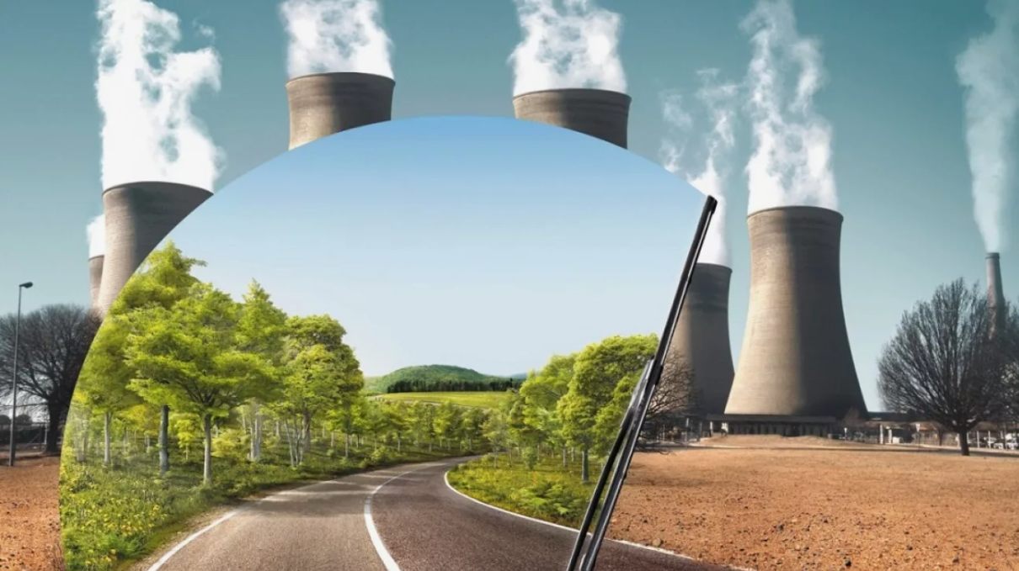
What is environment ?
It means what is around us.
Some people live in a town environment, for others their environment is the countryside.
The air we breathe, the soil on which we stand, the water we drink are parts of the environment.

Slide 6
Vocabulary
nature - природа
ecology - экология
environment – окружающая среда
protection - защита
pollution – загрязнение
ecological problems – экологические проблемы
to solve problems – решать проблемы

Slide 7
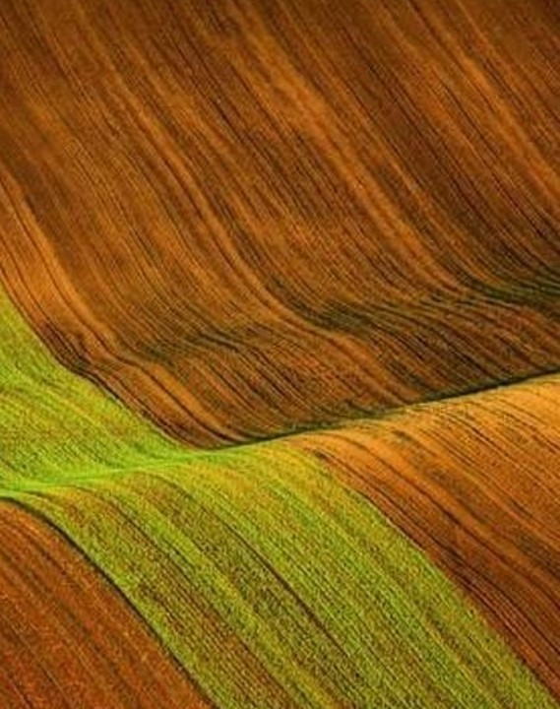
Match the words to make a phrase
a national …
a nature …
to protect the …
a unique …
air …
… tourist places
to damage …
park
reserve
wildlife
place
pollution
popular/interesting
nature

Slide 8
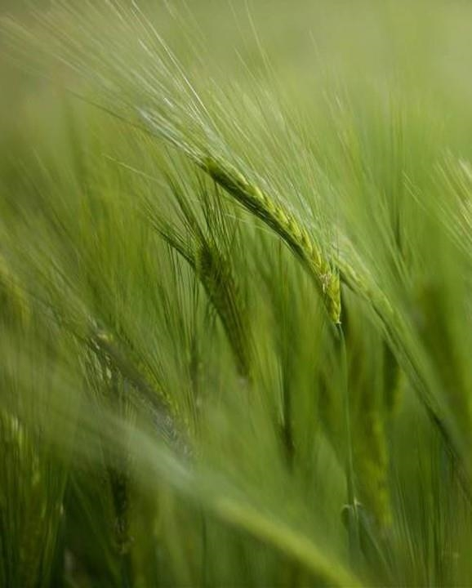
What science studies nature?
Ecology

Slide 9
1. Read and fill the gaps.
throw (a), sea (b), plants (c), wildlife (d), protect (e), water (f)
There are a lot of factories and (1)__________in my city. They (2)________ a lot of chemicals into the air and into the (3)_________. They poison water into the (4)________. Fish can’t live in it. (5)____________ is destroyed. We must (6)___________ nature as we can.

Slide 10
Match the words on the left with the definitions on the right.
Environment | It’s the place where animals, birds and plants are protected.
Hunters | b) The material which pollutes rivers, lakes and forests.
The Еarth | c) Everything that is around us.
A Nature reserve | d) People who kill animals for their meat and fur.
Litter | e) A planet where we live.

Slide 11
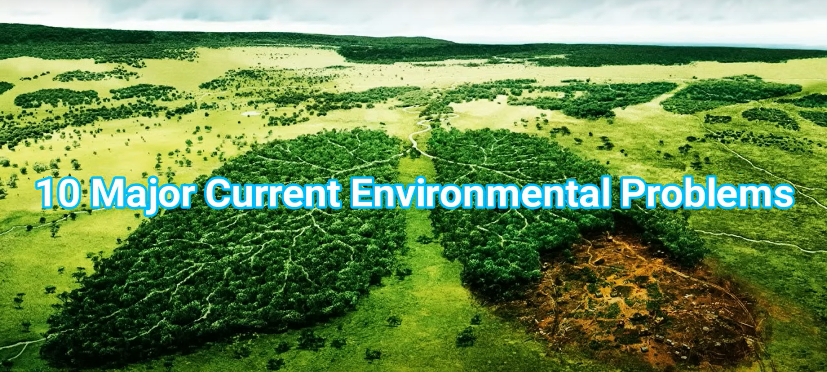
10 Major Current Environmental Problems - поиск Яндекса по видео (yandex.ru)

Slide 12
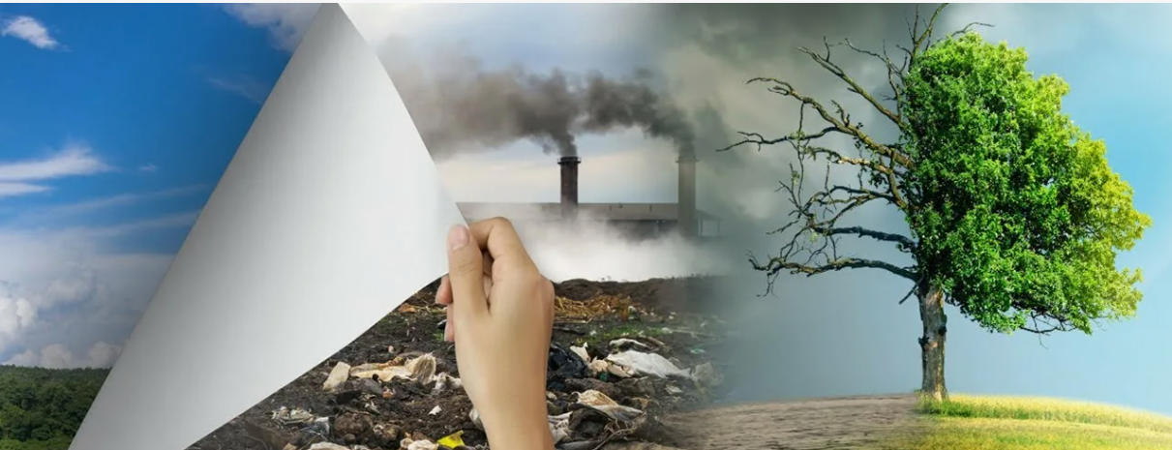
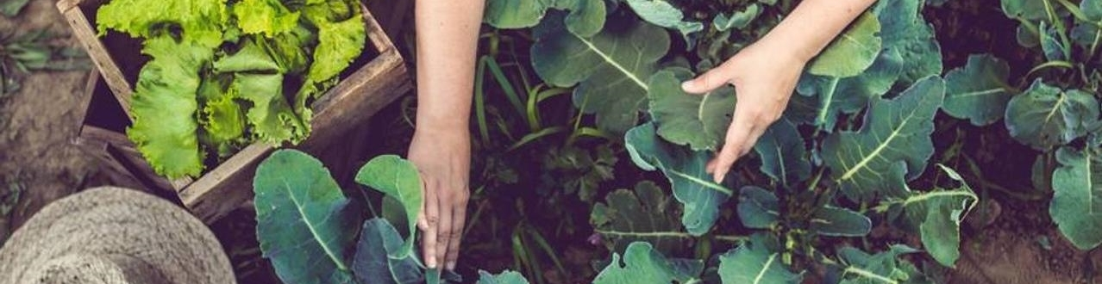
The range of environmental problems is rather wide nowadays. What ecological problems can you name?

Slide 13
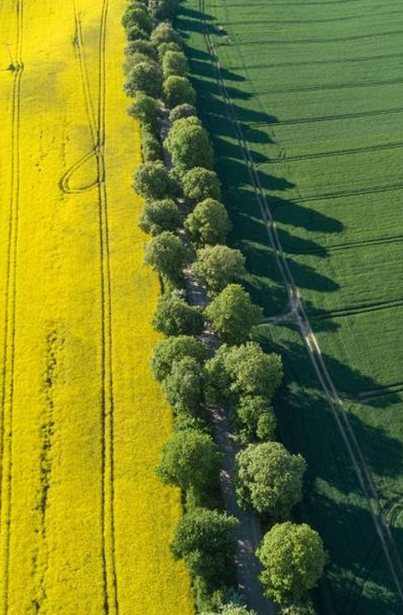
10 environmental problems are:
Pollution - Загрязнение окружающей среды
Global warming – Глобальное потепление
Overpopulation - Перенаселение
Natural resource depletion – Истощение природных ресурсов
Waste disposal - Утилизация отходов
Climate change - Изменение климата
Loss of biodiversity - Утрата биоразнообразия
Deforestation - Вырубка леса
Urban sprawl - Разрастание городов
Ozone layer depletion - Разрушение озонового слоя

Slide 14
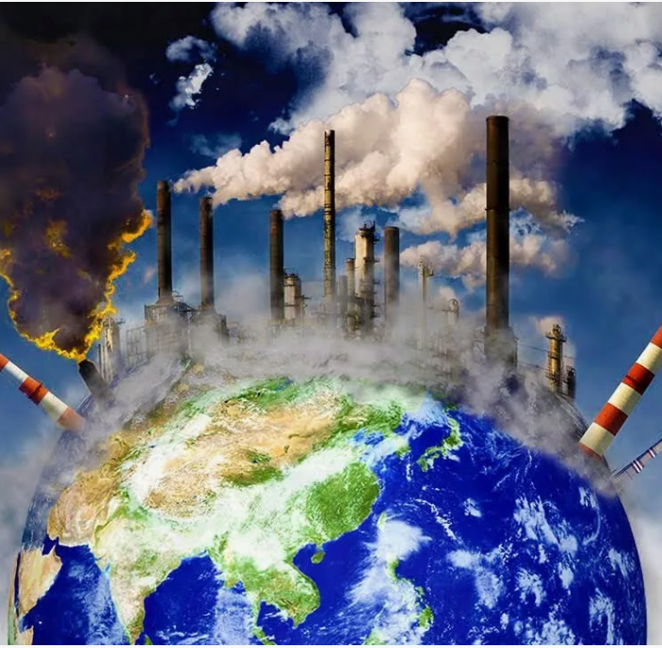
WHAT ARE THE RESULTS OF OUR INFLUENCE ON THE ENVIRONMENT?
We pollute the air. – We change the climate.
We leave a fire. – We destroy the forest.
We drop plastic bottles. – We damage nature.
We leave litter in the forests. – We hurt animals.
We break trees. – We disturb birds.
We don’t recycle paper. – We cut down trees to make new paper.
We throw litter in the rivers and seas. – We cause water pollution.
We leave glass bottles in the forest. – We hurt animals and people.

Slide 15
WHAT ARE THE RESULTS OF OUR INFLUENCE ON THE ENVIRONMENT?
The air is polluted. – The climate is changed.
A fire is left. – The forest is destroyed.
Plastic bottles are dropped. – Nature is damaged.
Litter is left in the forests. – Animals are hurt.
Trees are broken. – Birds are disturbed.
Paper is not recycled. – Trees are cut down to make new paper.
Litter is thrown in the rivers and seas. – Water pollution is caused.
Glass bottles are left in the forest. – Animals and people are hurt.

Slide 16
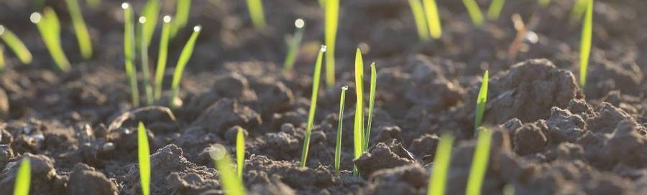
Watch the video
Our planet is so beautiful. Can we allow dying such beauty?
What can we do to protect the Earth?
We are watching the video. After watching this video tell me please what we can do to solve the ecological problems!
How to Take Care of the Environment - 10 Ways to Take Care of the Environment (youtube.com)

Slide 17
What can we do to protect nature?
reduce traffic/ use bikes instead of cars
air and water cleaners;
recycle rubbish (newspapers, bottles and metal cans);
try to avoid buying plastic. It’s hard to recycle.
stop hunting;
environmental movements/ to support ecological organizations, Protect wildlife, plants and trees. Keep all water clean
stop cutting down trees
feed birds in winter
don’t dump waste in the forest
don’t use chemicals in the garden.
don’t cut wild flowers.
don’t destroy the habitats of birds and animals
turn off the light when you leave the room.
don’t pour toxic wastes into our rivers, seas and oceans and
to plant as more trees and flowers as we can

Slide 18
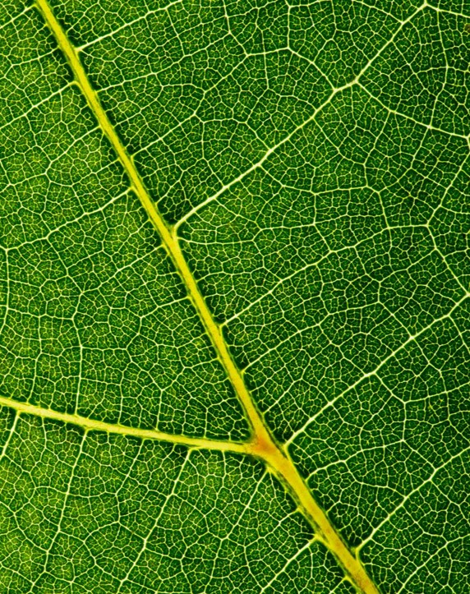
As you can see, there is a long list of environmental problems, which need to be solved. Otherwise, our planet Earth may get fully destroyed. People should start dealing with these problems immediately. The most important thing they can do is to change their attitude towards the environment.

Slide 19


