Slide 1
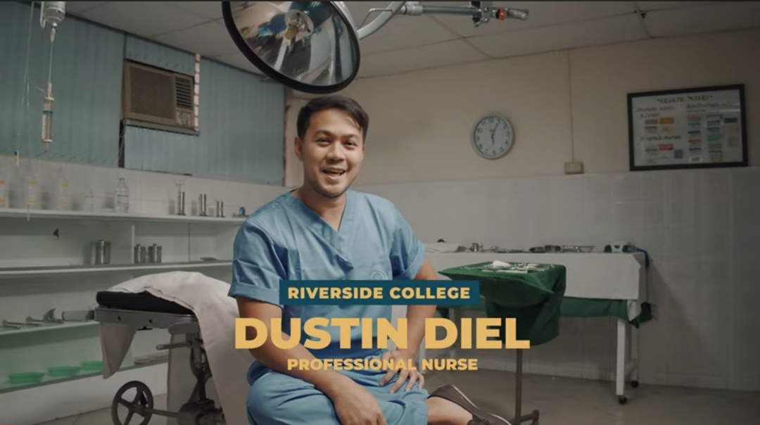
Министерство здравоохранения Тверской области
ГБПОУ Кашинский медицинский колледж
«Лексическое пособие для студентов III курса медицинского колледжа по теме:
«В операционной (In the operating room)»
Преподаватель английского языка
Ларионова О.С.

Slide 2
Цели электронного пособия:
1.Ознакомление студентов с профессиональной терминологией по теме «Хирургическое отделение».
2.Развитие навыков монологической и диалогической речи по теме «Хирургическое отделение».
3.Развитие навыков чтения англоязычных текстов профессиональной направленности.
4. Развитие умений извлекать необходимую информацию из текста.
5.Развитие коммуникативных навыков студентов по данной теме, развитие навыков говорения и выполнения коммуникативной задачи в условиях дифицита языковых средств.

Slide 3
Warm-up
Ex 1: Put the word stress. Listen and check. Проставьте ударения в словах
1colostomy 4 encephalography
2 tracheostomy 5 endoscope
3 encephalograph 6 endoscopy
Ex 2 Underline the part of the word you think is stressed. Listen and check. Подчеркните ударную часть слова.
1 vasectomy 5 radiography
2 laparotomy 6 cardiograph
3 oesophagostomy 7 cystoscopy
4 microbiology 8 ophthalmoscope

Slide 4
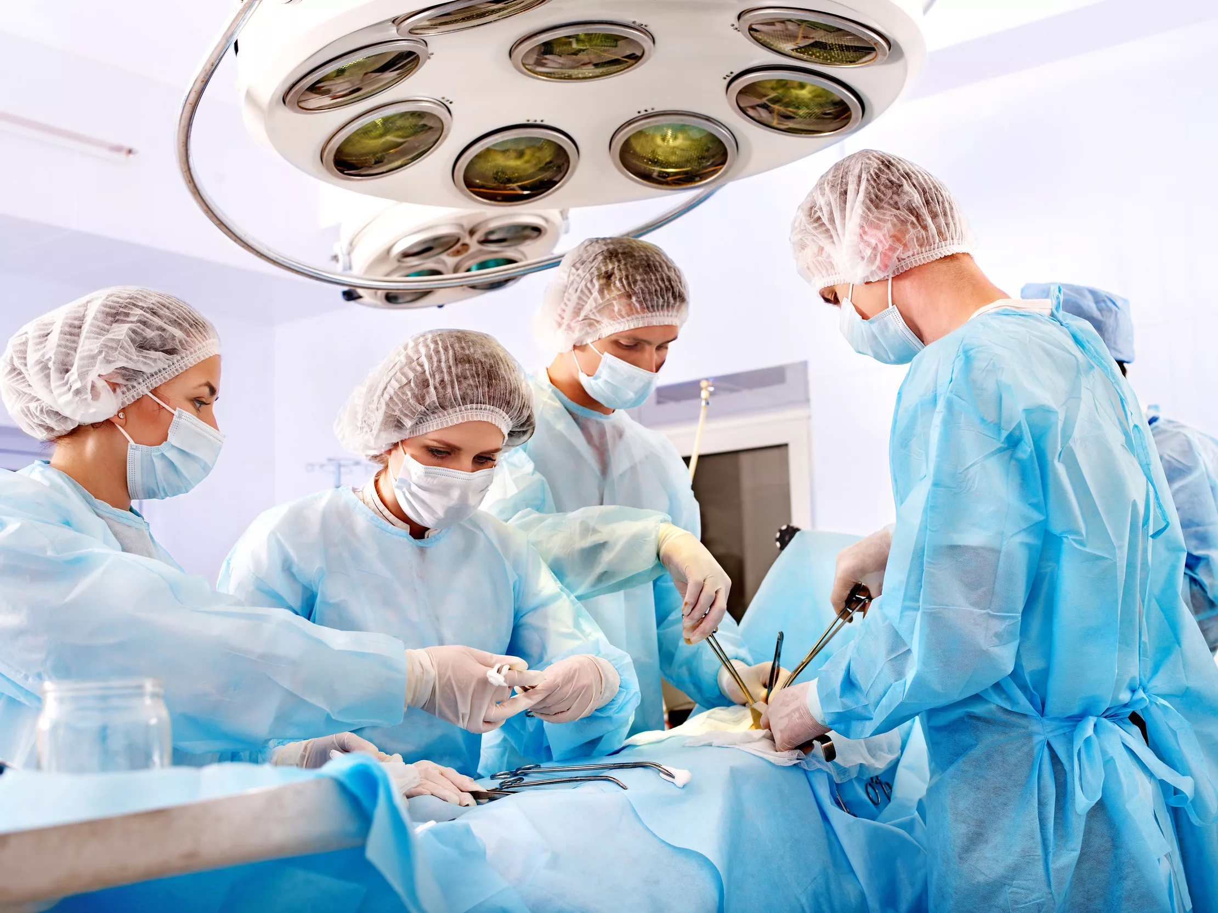
Surgery (from the Greek: χειρουργική cheirourgikē, via Latin: chirurgiae, meaning "hand work") is a medical specialty that uses operative manual and instrumental techniques on a patient to investigate and/or treat a pathological condition such as disease or injury, to help improve bodily function or appearance, or sometimes for some other reason.
An act of performing surgery may be called a surgical procedure, operation, or simply surgery. In this context, the verb operating means performing surgery. The adjective surgical means pertaining to surgery; e.g. surgical instruments or surgical nurse. The patient or subject on which the surgery is performed can be a person or an animal. A surgeon is a person who performs operations on patients. Surgery can last from minutes to hours.

Slide 5
Learn the Vocabulary
Vocabulary
surgery – хирургия
surgical – хирургический
a scrub nurse ( a theatre nurse)– хирургическая сестра
a surgeon – хирург
operating room (theatre ) – операционный зал
sterile – стерильный
operating environment – операционная зона
to scrub up – мыть руки перед операцией на хирургическом уровне
to prepare the patient for the operation - готовить пациента к операции
the prepping procedure – подготовительная процедура
an operation site (field)– операционной поле
to make an incision – сделать надрез
an equipment - оборудование
a scalpel - скальпель
forceps – пинцет
a retractor -ретрактор, крючок
artery forceps –артериальный пинцет
dissecting forceps – анатомический пинцет
scissors – ножницы
drapes -стерильные шторы, простыни
a blade – лезвие (синоним скальпеля)
a swab - тампон
a scar - шрам
a clamp - зажим
suction – отсасывание
a sucker- отсос
sutures – швы
staples - скобы
ligatures - лигатуры
a drain- дренаж
diathermy plates- электроды
a wound – рана
a dressing – повязка
to paint with iodine (to put iodine on smth) – обрабатывать йодом, мазать йодом
Local anesthesia- местный наркоз, анастезия
To wheel -катить на каталке
To remove -удалять
to cut - резать , разрезать

Slide 6
Use your active Vocabulary
Ex.1 Translate the sentences using your active vocabulary.
1. Хирург работает в хирургическом отделении. 2. Медсестра, которая работает в операционной, называется операционная медсестра. 3. Операционная медсестра готовит операционную к операции и следит, чтобы операционная среда была стерильной. 4.Операционная сестра отвечает за оборудование во время операции. 5. Она ассистирует хирургу, предугадывая его действия, и подает ему все необходимые инструменты, такие как скальпель, щипцы, ретраткор, анатомический пинцет, артериальный пинцет, ножницы. 6. Для того,чтобы закрыть рану, хирург использует швы или скобы.7. При необходимости хирург использует дренаж. 8. В конце хирургическая рана накрывается повязкой. 9. Хирургическая операция может выполняться под местной или общей анастезией. 10. После операции медсестра отвозит пациента на каталке в палату.
Ex.2 Complete the sentences with the correct words .
1. A …. works in a …..department. 2.The nurse, who works in the …..., is called a ….... 3. A …... nurse prepares the …... for the operation and cares for operating environment to be …...4. A scrub nurse is responsible for the ….. during the operation. 5. She assists the surgeon anticipating his actions and gives him all the necessary …... such as a ….., …..., a …... , ….., ….., ….... 6. To close the ….. the surgeon uses ….. o …….. 7. The surgeon uses the ….. if it is necessary.8. In the end the surgical wound is covered with a ….... 9. The surgical operation may be performed under ...or general …... 10. After the operation the nurse .. the patient into a ward…..

Slide 7
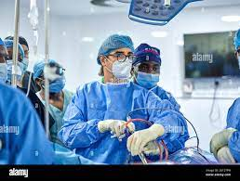
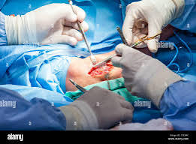
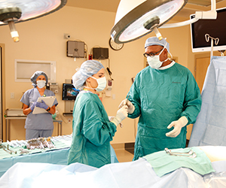
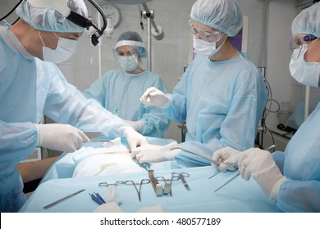
Ex.3Describe the pictures using your active vocabulary.

Slide 8
THE OPERATING THEATRE.
Words and combinations to the text:
Surgery – хирургия, хирургическое вмешательство
to carry out - выполнять
to scrub up – мыть руки перед операцией на хирургическом уровне
prepping (preparing) the patient– подготовка пайциента
to cover - закрывать
drapes -стерильные шторы, простыни
to be exposed – быть под воздействием, подвергаться воздействию
to make an incision – сделать надрез
bleeding - кровотечение
to soak up – промакивать, вытирать
a mechanical device механический прибор
to seal – запечатывать, закрывать
an electric current – электрический ток
to insert – помещать, вводить
to carry away fluid – выводить жидкость
a culture medium – питательная среда
to be responsible for – отвечать за
equipment - оборудование
to ensure - удостовериться
environment – среда, пространство
a duty - обязанность
to involve - вовлекать
imaging – методы исследования с использованием изображения
to anticipate - предвидеть
to watch over - наблюдать
a complication -осложнение
to monitor - наблюдать

Slide 9
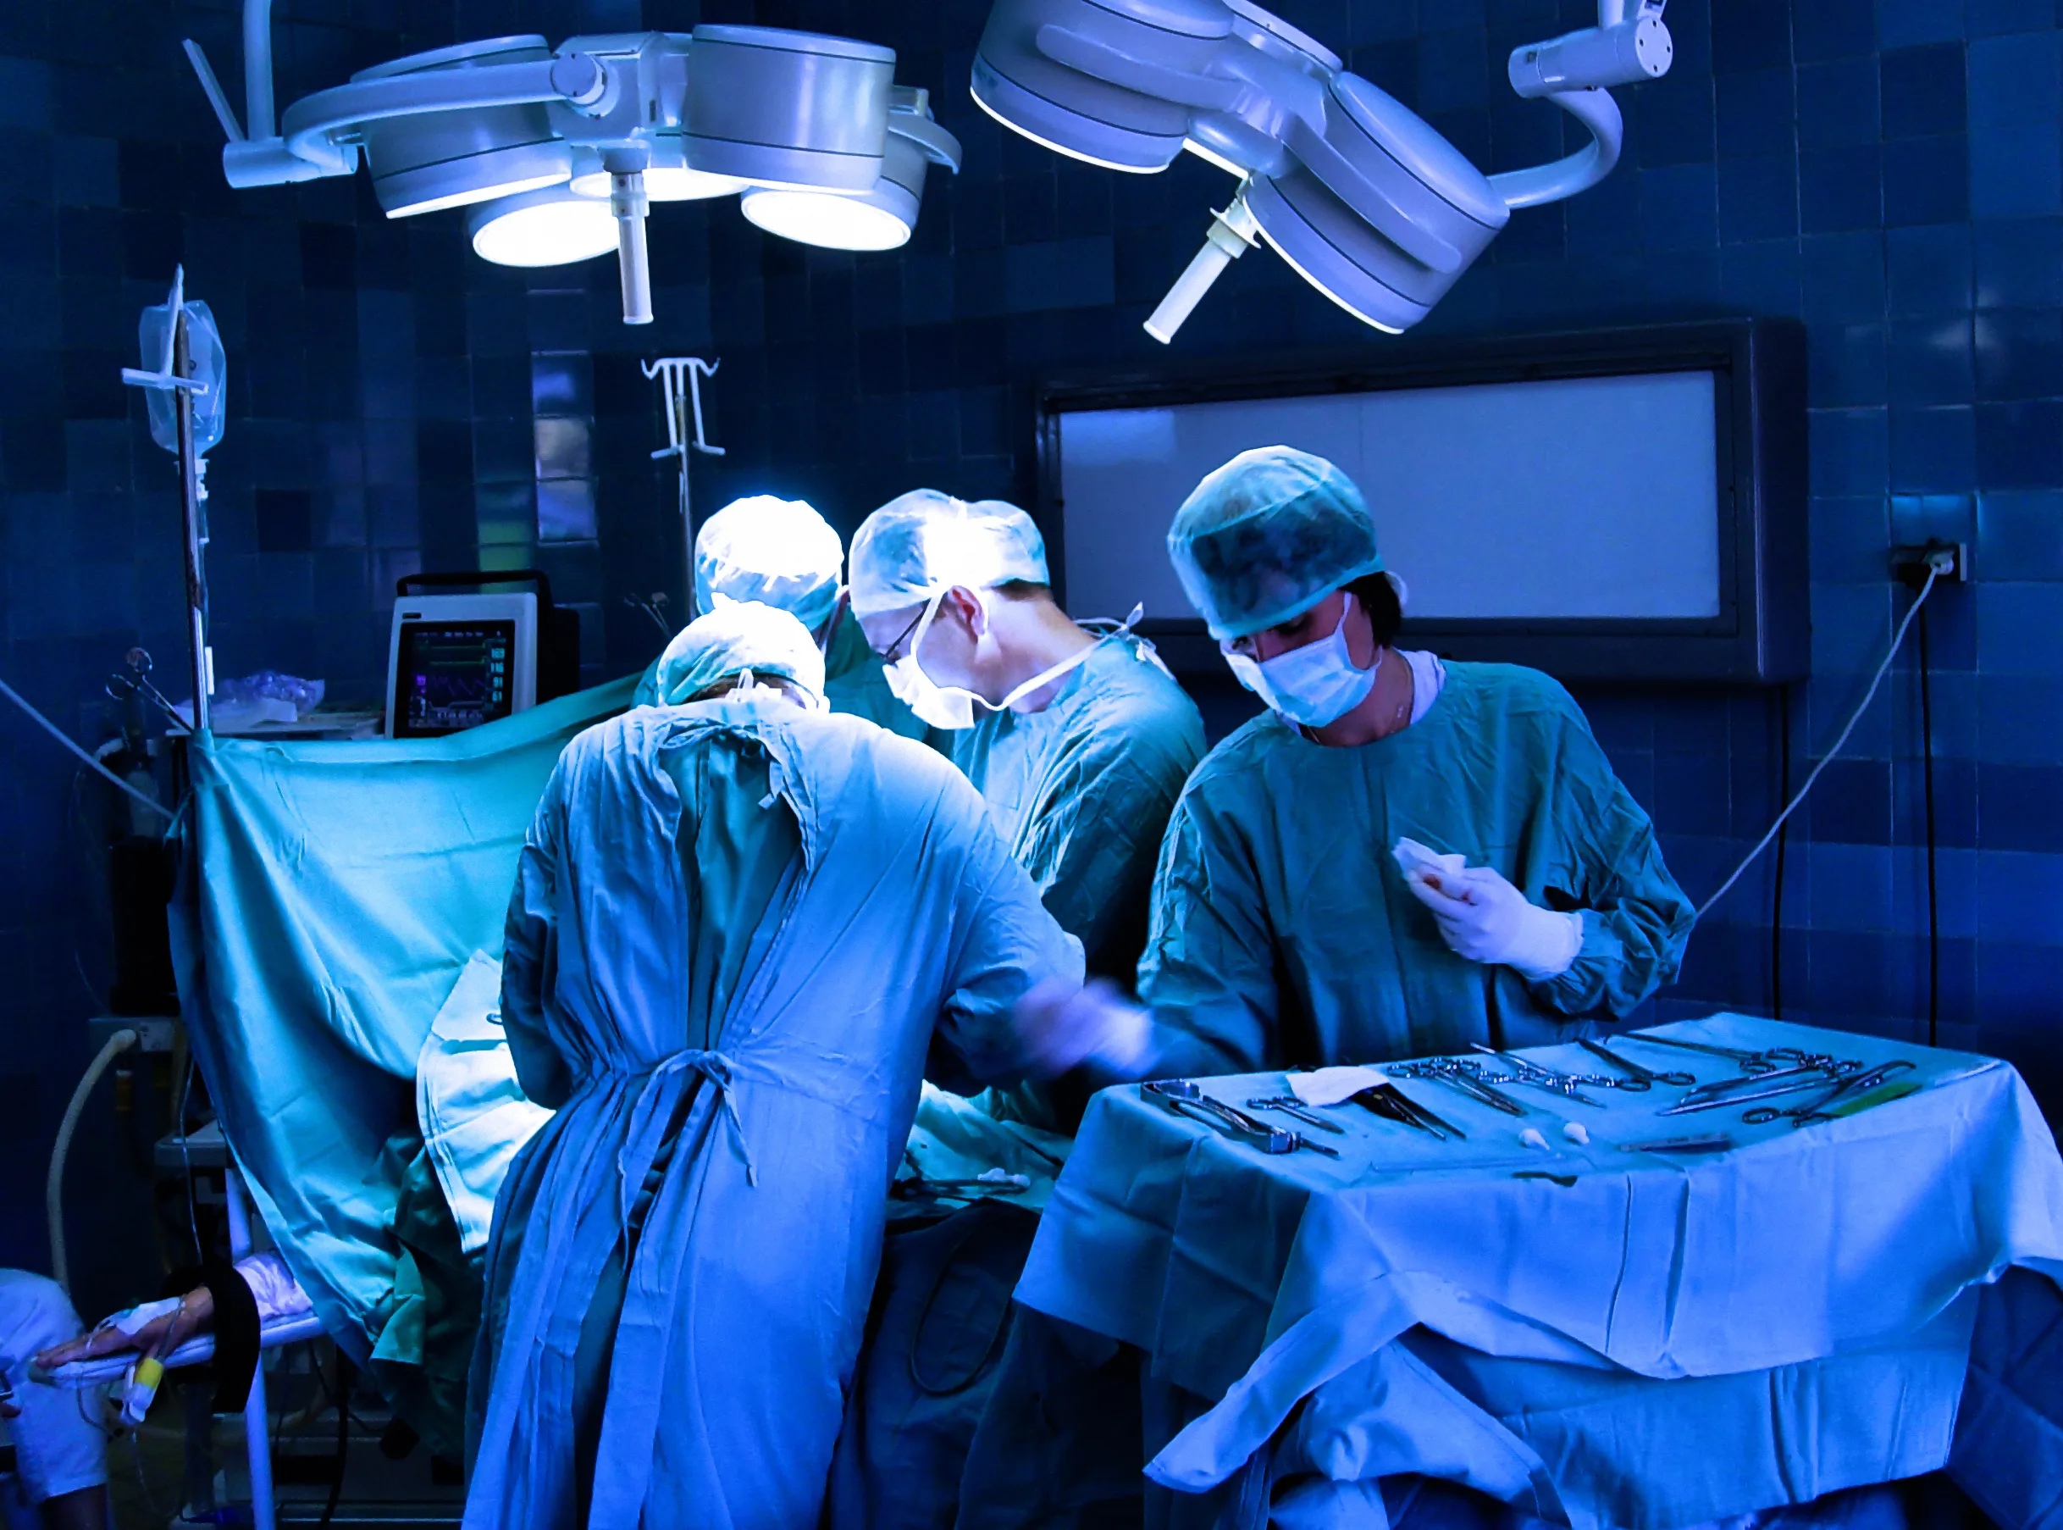
TEXT 1
The operating theatre.
Surgery is carried out in an operating theatre. Great care is taken to make sure that operations take place in sterile conditions – free from microorganisms. The surgeon and his assistant wash or scrub up, and put on surgical gowns, masks, and gloves. The patient’s skin is prepared by disinfecting it with antiseptic solution. This is known as prepping (preparing) the patient. They are then covered with sterile drapes, so that only the area of the operation is exposed.
The operation begins when the surgeon makes an incision or cut. Control of bleeding is very important. A swab is a pad of cotton or other material used to soak up blood from the operation site. A sucker is a mechanical device which aspirates –sucks up - blood. Bleeding vessels are tied with ligatures or sealed by an electric current (diathermy). Drains may be inserted to carry away fluid which might act as a culture medium for bacteria. Various methods are used to close the wound, for example sutures (also known as stitches), or staples. Finally, the wound is covered with a dressing.
Scrub nurses who work in a surgery are responsible for sterilizing equipment and ensuring that the operating environment is aseptic. Their pre-operative duties involve preparing the patients for surgery by following site surgery protocols, getting information about allergies and compiling pathology results, and imaging.. In the operating theatre they assist by anticipating what the surgeons are doing to do next and watching over the patient, checking complications. When patients leave the operating theatre, nurses monitor them very closely during the critical post-operative period.

Slide 10
Ex 2.Match the sentences with their translation.
 | Surgery is carried out in an operating room. | Стерильны – означает с микроорганизмами.
 | The prepping (preparing) the patient is when the patient’s skin is prepared by disinfecting it with antiseptic solution. | Для закрытия ран используются различные методы.
 | The operation begins when the surgeon scrubs up. | После операции рана закрывается повязкой.
 | Control of bleeding is not very important. | Медсестры должны наблюдать за пациентом после операции.
 | After the operation the wound is covered with a dressing. | Операция начинается, когда хирург моет руки.
 | Various methods are used to close the wound. | Подготовительная процедура пациента – это когда кожа пациента обрабатывается антисептическим раствором.
 | Scrub nurses are responsible for sterilizing equipment and ensuring that the operating environment is aseptic. | В операционной хирургические сестры иногда ассистируют хирургам предугадывая, что хирург будет делать дальше.
 | In the operating theatre nurses sometimes assist by anticipating what the surgeons are doing to do next. | Хирургические сестры отвечают за стерилизацию оборудования и асептику операционной среды.
 | Nurses must monitor the patient after the operation | Контроль за кровотечением не очень важен.
 | Sterile means with microorganisms. | Хирургическое вмешательство приводится в операционной.

Slide 11
Exercises to the text ex. № 3
Say which statements are TRUE or FALSE .-
1
Surgery is carried out in an operating room.
Хирургическое вмешательство приводится в операционной.
2
The prepping (preparing) the patient is when the patient’s skin is prepared by disinfecting it with antiseptic solution.
Подготовительная процедура пациента – это когда кожа пациента обрабатывается антисептическим раствором.
3
The operation begins when the surgeon scrubs up.
Операция начинается, когда хирург моет руки.
4
Control of bleeding is not very important.
Контроль за кровотечением не очень важен.
5
After the operation the wound is covered with a dressing.
После операции рана закрывается повязкой.
6
Various methods are used to close the wound.
Для закрытия ран используются различные методы.
7
Scrub nurses are responsible for sterilizing equipment and ensuring that the operating environment is aseptic.
Хирургические сестры отвечают за стерилизацию оборудования и асептику операционной среды.
8
In the operating theatre nurses sometimes assist by anticipating what the surgeons are doing to do next.
В операционной хирургические сестры иногда ассистируют хирургам предугадывая, что хирург будет делать дальше.
9
Nurses must monitor the patient after the operation.
Медсестры должны наблюдать за пациентом после операции.
10
Sterile means with microorganisms.
.
Стерильны – означает с микроорганизмами.

Slide 12
Text 2
In the surgical department
Words and combinations to the text :
a sharp pain – острая боль
an iliac region– подвздошная область
an attending doctor – лечащий врач
acute appendicitis – острый аппендицит
iodine- йод
anesthesia- анестезия
an abdominal incision – надрез в брюшной полости
to remove — удалять
inflamed — воспаленный
to suture — зашивать
in layers- послойно
to wheel the patient - транспортировать пациента на каталке

Slide 13
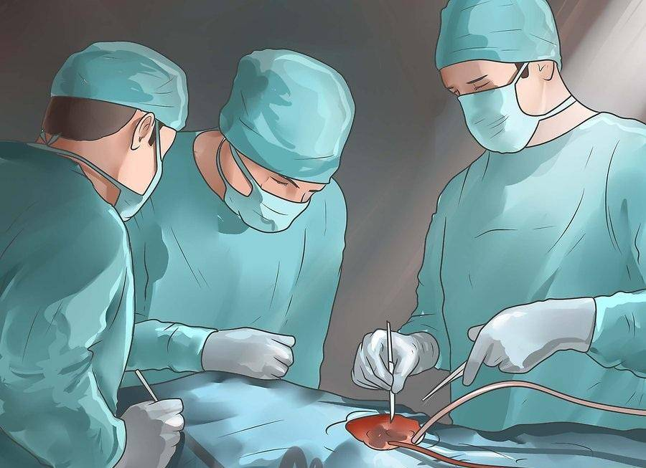
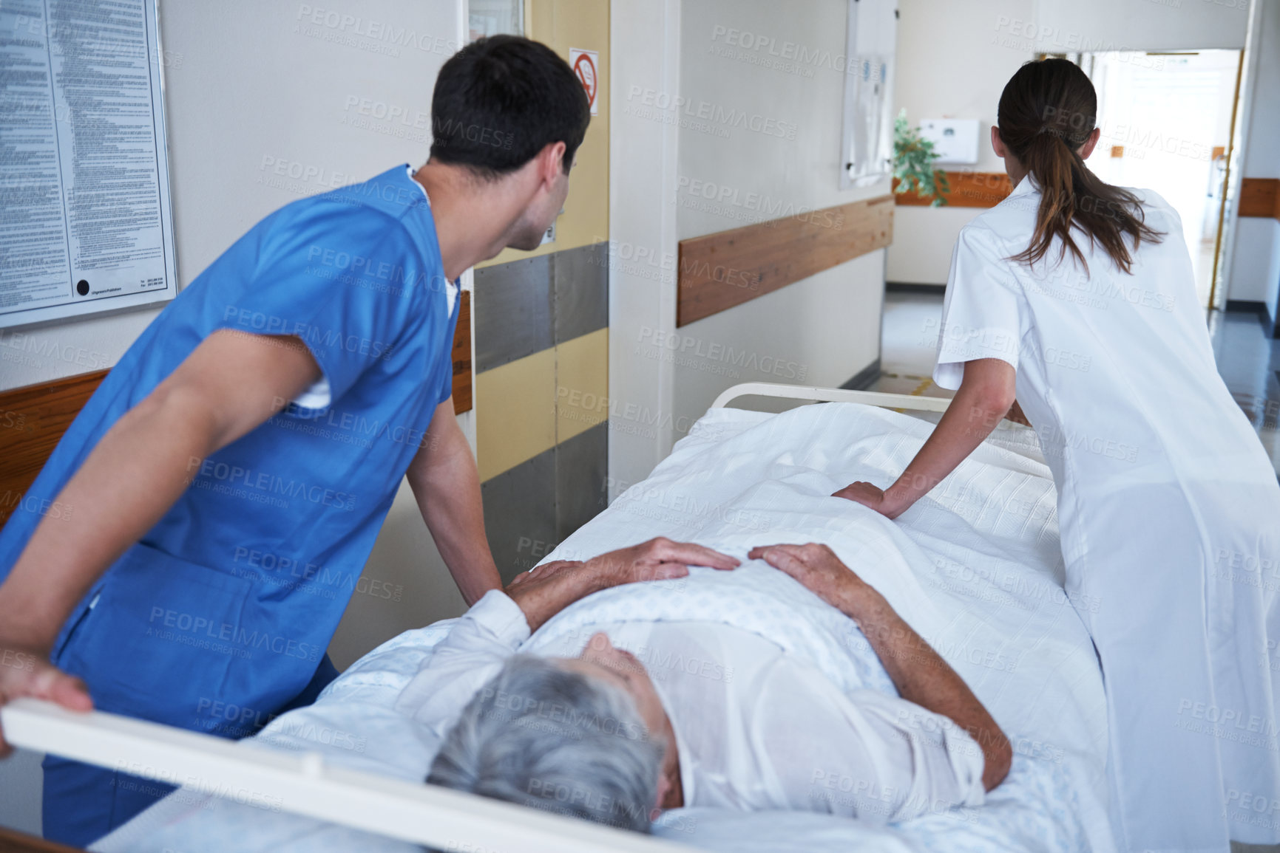
In the surgical department
Mr. Young is a new patient in the surgical department. He has a sharp pain in the right iliac region. Dr. H.Simms his attending doctor thinks he has acute appendicitis.
Now Mr. Young is in the operating theatre. He is lying on the operating table. Dr. Simms is scrubbing before the operation. The assistant is preparing the operating field. He is painting the operating field
with iodine.
Now everything is ready for the operation. The surgeon is coming up to the operating table. The assistant is giving the patient local anesthesia. The operation begins. The surgeon is now making an abdominal incision and he is removing an inflamed appendix. Now he is suturing the surgical wound in layers.The operation is over. The nurse is wheeling the patient into the ward.

Slide 14
Ex № 2
Read the text “In the surgical department ” and answer the following questions.
1
Who is a new patient in the surgical department?
Кто новый пациент в хирургическом отделении?
2
What are his complaints?
Каковы его жалобы?
3
What is Dr.Simms ‘s diagnosis?
Какой диагноз Доктора Симса?
4
Where is he lying?
Где он лежит?
5
Where is Mr.Young now?
Где сейчас находится Мистер Янг?
6
What is Dr.Simms doing?
Что делает Доктор Симс?
7
What is his assistant doing?
Что делает его ассистент?
8
What is he painting the operating field with?
Чем он мажет операционное поле?
9
Is everything ready for the operation now?
Все ли готово для операции?
10
What is the surgeon doing?
Что делает хирург?
11
What is the assistant giving the patient?
Что дает пациенту ассистент?
12
What incision is the surgeon making?
Какой надрез делает хирург?
13
What is he removing?
Что он удаляет?
14
How is the surgeon suturing the wound?
Как хирург зашивает рану?
15
What is the nurse doing after the operation?
Что делает медсестра после операции?

Slide 15
Ex 3 to the text
It’s my job
Ex № 3
a) Read the text «It’s my job» and write down the instruments which Mathew use.
b) Read the text «It’s my job» and answer the questions.
1
How does the theatre nurse count pieces of equipment?
Как хирургическая сестра считает оборудование?
2
How does the theatre nurse care for the patient on the operating table?
Как хирургическая сестра заботится о пациенте на операционном столе?
3
Why does the theatre nurse need to watch the operation carefully?
Почему хирургическая сестра должна внимательно следить за ходом операции?
4
What is the theatre nurse’s first job after the operation?
Какова основная работа хирургической сестры после операции?
5
How has Mathew’s job changed ?
Как поменялась работа Мэтью?

Slide 16
Ex 4. Complete the sentences
1. My job as a …. is to prepare the …....
2. I check all the electrical …....
3. I count all the ….., ….., ….before the operation.
4. I must make sure that the patients aren’t …. when the are on the operating table.
5. After the operation I wheel the patient into a ……..
6. We also perform a lot of …....
7…... machine is used for cutting or …...

Slide 17
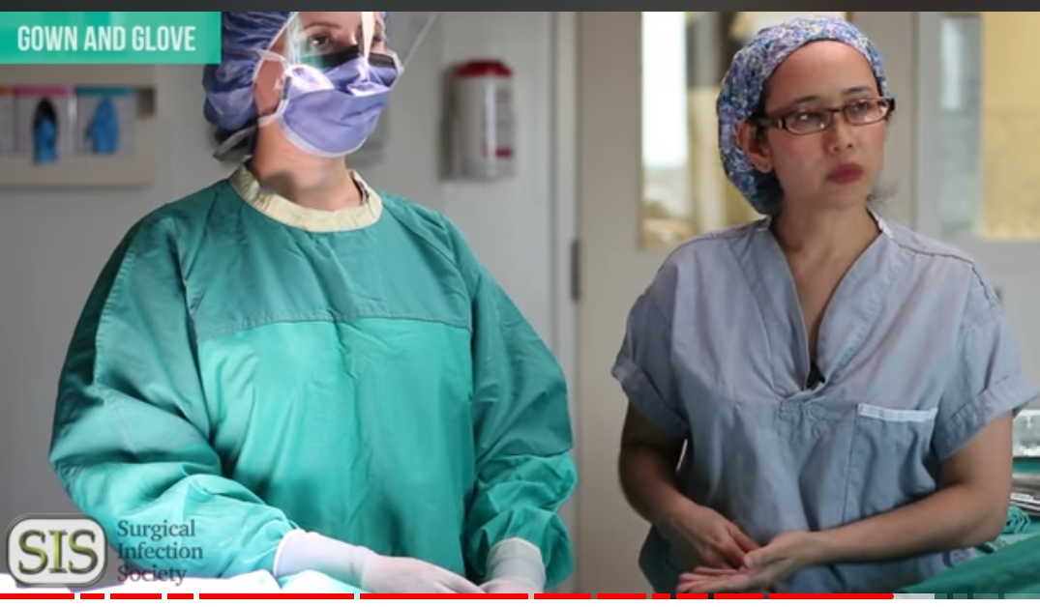
Unit 5
Watch a video
Ex 1. Name 8 steps of Sterile Surgical Technic 1
2
3
4
5
6
7
8
Watch a video “Teach Sterile Surgical Technic” .
https:www.youtube.com/watch?v=R8eQ9T0CZNw

Slide 18
What are the steps of scrub technique?
1) dress in clean scrub, tuck shirt into pants.
2) Natural nails (no false nails, nail polish)
3) Shoe covers or hospital-only shoes
4)Remove all the jewelry.
5)Surgical cap, tuck you hair in.
6)Eye protection.
7)Hospital ID is all you need.
8)Wear a clean mask
water-based scrub:
1) scrub forearm for 30 sec each arm
2)repeat steps 3-6 for opposite hand
4)scrub nails for 30 sec
5) rinse hands and arms
6)wet scrub brush again – start timer
3)scrub fingers for 30 sec
7) wet and soap hands/arms clean nails
8)scrub palm for 30 sec

Slide 19
Continue doing the task
waterless scrub:
1)rub hands until dry
2)dispense scrub solution to the palm
3)dispense scrub solution to palm (3rd pump)
4)scrub fingers and hands
5)repeat steps 2-4 with opposite hand
6)scrub nails,cuticles
7)spread excess to the opposite hand, arm elbow
8)wash hands and nail pick

Slide 20
Continue doing the task
Gown:
1)put the gown on
2)ask someone to tie back of the gown
3)enter or with forearms tilted upwards
4)dry hands with sterile towel if needed
doffing:
1)ask someone to untie the back ties
2)undo the front tie on gown
3)wash hands
4)remove and discard mask
5)remove and discard gloves
6)remove and discard the gown

Slide 21
Unit 6 watch the video and do the tasks
Watch a video “A Day In A Life of an Operating Room Nurse”

Slide 22
Exercises to the video
Ex1. Answer the questions.
1) how do we call an operative nurse?
2) which two types of nurse are called operative nurse?
3) what does a sterile in surgery mean? (free from bacteria, well-desinfected, germ-free)
4) What does a scrub nurse do before the operation?
5) What features of character are important for OR nurse?
Ex 2. Give a short summary of the video.

Slide 23
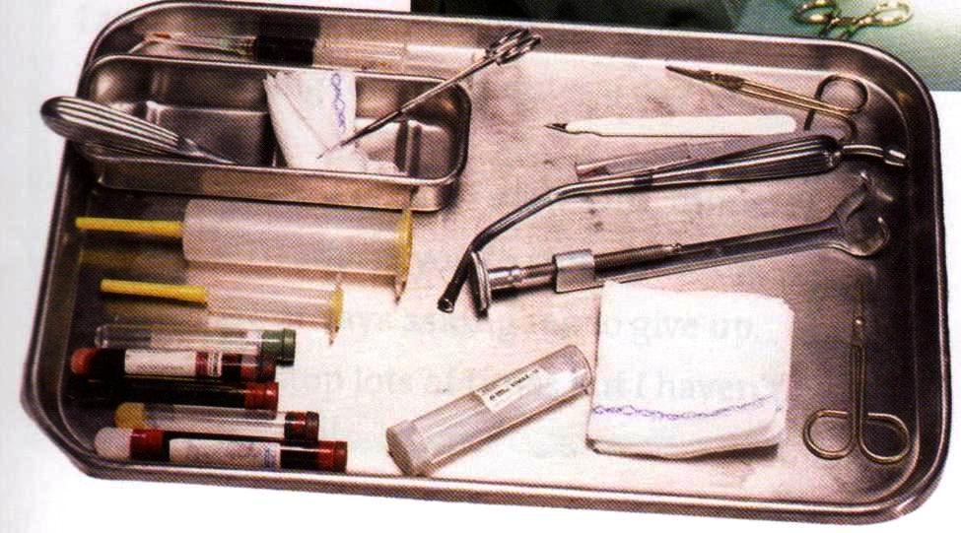
Terminology revising exercises
Ex 1 Match each word with its description. How many of the items can you find in the pictures.
A drapes
B forceps
C an implant
D a swab
E retractors
F a scalpel
G a scar
H a clamp
I suction
J sutures
K diathermy plates
L a gown
M an incision
N staples
A a tool with a sharp blade for cutting
B a scissor -like tool for gripping tissue
C tubes attached to a pump for removing blood or other fluid from the surgical site
D a device or artificial part that is inserted into the body, for example to replace or assist the defective part.
E Stitches that are inserted to close the wound
F Sterile covers for the parts of the patient’s body not involved in the operation
G Small pieces of wire that are pushed with a machine into each side of a wound
H Tools that hold organs out of the way to allow the access to the surgical site
I A mark that remains after a cut has healed.
J A loose , sterile piece of clothing worn by people in the operating theatre
K A tool for holding a blood vessel closed to prevent bleeding
L Tools that use the heat to close the ends of blood vessels to prevent bleeding
M A piece of material, such as cotton, that used to absorb blood during the surgery
N A cut made by a surgeon to allow access inside the body

Slide 24
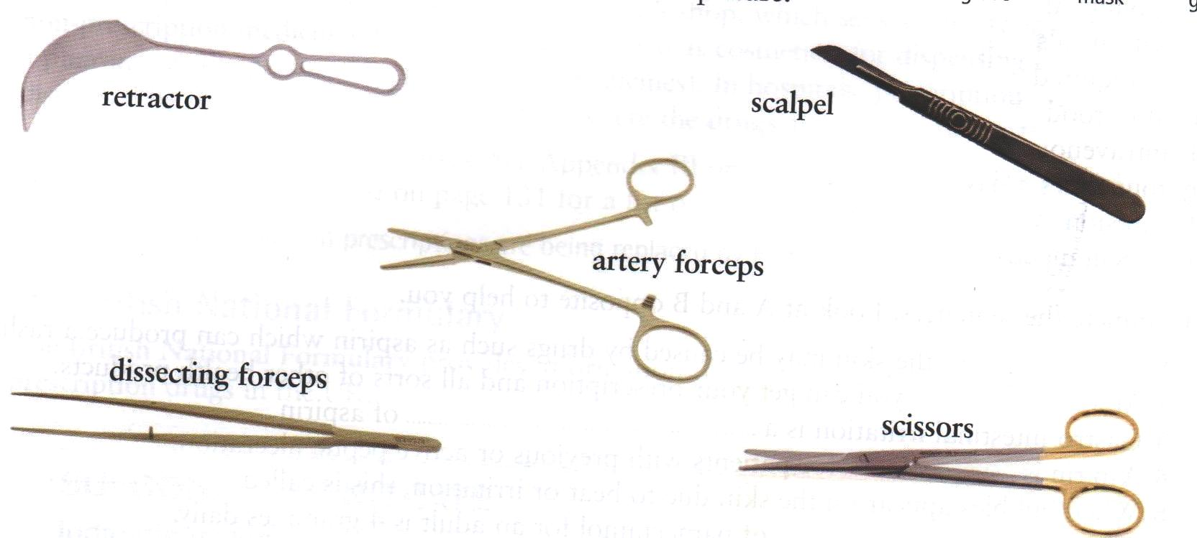
Ex № 2
Which of the instruments shown in the picture is needed for each of the following procedures?
making an incision
Проведение разреза, вскрытия
keeping the sides of the wound open
Раскрытия краев раны
cutting sutures
Снятие швов
holding the cut ends of the blood vessels before they are tied
Зажатие отрезанных концов артерии перед тем как их перевяжут

Slide 25
Ex № 3 A surgeon is talking to a medical student about the assisting at operations. Complete his advice using words.
Assistant, sterile , swabs, drapes,, ligatures, sutures, prepping (preparing), retractor, sucker, drain.
An ___1___ must be able to carry out the following tasks to help the surgeon. Firstly, he or she must help in ___2____ the patient and putting the ___3_____ in place to provide____4____ conditions. Expert handling of a ___5____ is essential to allow the surgeon to see what he is doing. The assistant must also keep the operation site free of blood, by careful use of the ____6______ or ____7_____. The surgeon also needs assistance with tying and cutting ___8_____, and with insertion of a ___9_____, if necessary. Finally, the assistant may be asked to close the wound with ____10_____ or other devices.

Slide 26
Control exercises
Ex № 1 Match the words with the translations.
1 a scrub nurse
2 operating room (theatre)
3 to scrub up
4 an incision
5 drapes
6 a swab
7 a scar
8 a clamp
9 sutures
10 staples
11 ligatures
12 a drain
13 diathermy plates
14 a dressing
15 To remove
A повязка
B швы
C шрам
D стерильные шторы, простыни
E зажим
F удалять
G надрез
H мыть руки перед операцией на хирургическом уровне
I скобы
J электроды
K тампон
L хирургическая сестра
M дренаж
N операционный зал
O лигатуры

Slide 27
Ex № 2 Say which statements are TRUE or FALSE
1
It is no very important that operations take place in sterile conditions.
Очень важно, чтобы операция проходила в стерильных условиях.
2
The surgeon and his assistant must scrub up, and put on surgical gowns, masks, and gloves before the operation.
Хирург и его ассистент должны вымыть руки на хирургическом уровне надеть хирургические халаты, маски и перчатки перед операцией.
3
When the patient’s skin is disinfected it with antiseptic solution it is known as prepping the patient.
Когда кожа пациента дезинфицируется антисептическим раствором – это известно как подготовка пациента.
4
The operation begins when the surgeon takes a scalpel.
Операция начинается, когда хирург берет скальпель.
5
Control of bleeding is not important.
Контроль за кровотечением не важен.
6
A swab is a pad of sterile material used to soak up blood from the operation site.
Тампон – это стерильный материал используемый для впитывания крови с операционного поля.
7
There is only one to close the wound – sutures.
Существует только один способ закрытия раны – наложение швов.
8
Scrub nurses who work in a surgery are responsible for sterilizing equipment and ensuring that the operating environment is aseptic.
Хирургическая сестра, которая работает в хирургическом отделении отвечает за стерилизацию оборудования и поддержание операционного пространства в асептическом состоянии.

Slide 28
Ex. № 3 Answer the following questions.
1
What is the surgery?
Что такое хирургия?
2
What are the duties of the scrub nurse?
Каковы обязанности хирургической сестры?
3
How must the patient be prepared for the operation?
Как пациент должен быть подготовлен к операции?
4
What are the methods of closing the surgical wounds?
Какие существую методы закрытия хирургической раны?
5
What instruments are used during the operation?
Какие инструменты используются во время операции?

Slide 29
Ex № 4 Find 16 words describing the surgical department .
G | O | N | M | T | R | E | T | R | A | C | T | O | R | J
Z | S | U | R | G | E | O | N | L | R | S | A | I | B | C
E | T | P | A | Y | T | O | O | L | G | D | V | N | O | O
S | E | W | O | F | W | O | U | N | D | V | W | C | U | T
C | R | C | O | T | T | O | N | T | R | E | E | I | S | T
A | I | T | S | W | A | B | D | I | E | H | K | S | L | E
L | L | H | U | K | I | L | L | A | S | A | W | I | N | F
P | E | E | T | O | V | N | D | O | S | B | U | O | Z | O
E | X | N | U | H | S | E | R | D | I | L | P | N | K | R
L | O | D | R | A | I | N | A | G | N | A | M | E | A | C
M | O | P | E | X | L | B | P | I | G | D | A | N | C | E
F | A | Y | S | C | A | R | E | F | H | E | P | O | N | P
C | L | A | M | P | M | E | S | W | I | M | E | D | I | S

Slide 30
Keys :
Unit 1.
Ex.1
1. A surgeon works in a surgical department. 2.The nurse, who works in the operating room, is called a scrub nurse. 3. A scrub nurse prepares the operating room for the operation and cares for operating environment to be sterile.4. A scrub nurse is responsible for the equipment during the operation. 5. She assists the surgeon anticipating his actions and gives him all the necessary instruments such as a scalpel, forceps, a retractor , an artery forceps, dissecting forceps, scissors . 6. To close the wound the surgeon uses sutures or staples. 7. The surgeon uses the drain if it is necessary.8. In the end the surgical wound is covered with a dressing. 9. The surgical operation may be performed under local or general anesthesia. 10. After the operation the nurse wheels the patient into a ward.
Ex.2
1. A surgeon works in a surgical department. 2.The nurse, who works in the operating room, is called a scrub nurse. 3. A scrub nurse prepares the operating room for the operation and cares for operating environment to be sterile.4. A scrub nurse is responsible for the equipment during the operation. 5. She assists the surgeon anticipating his actions and gives him all the necessary instruments such as a scalpel, forceps, a retractor , an artery forceps, dissecting forceps, scissors . 6. To close the wound the surgeon uses sutures or staples. 7. The surgeon uses the drain if it is necessary.8. In the end the surgical wound is covered with a dressing. 9. The surgical operation may be performed under local or general anesthesia. 10. After the operation the nurse wheels the patient into a ward.
Ex.3 Students’ own answers.

Slide 31
Unit 2
Unit 2
Ex. 2
1
Surgery is carried out in an operating room.
Хирургическое вмешательство приводится в операционной.
2
The prepping (preparing) the patient is when the patient’s skin is prepared by disinfecting it with antiseptic solution.
Подготовительная процедура пациента – это когда кожа пациента обрабатывается антисептическим раствором.
3
The operation begins when the surgeon scrubs up.
Операция начинается, когда хирург моет руки.
4
Control of bleeding is not very important.
Контроль за кровотечением не очень важен.
5
After the operation the wound is covered with a dressing.
После операции рана закрывается повязкой.
6
Various methods are used to close the wound.
Для закрытия ран используются различные методы.
7
Scrub nurses are responsible for sterilizing equipment and ensuring that the operating environment is aseptic.
Хирургические сестры отвечают за стерилизацию оборудования и асептику операционной среды.
8
In the operating theatre nurses sometimes assist by anticipating what the surgeons are doing to do next.
В операционной хирургические сестры иногда ассистируют хирургам предугадывая, что хирург будет делать дальше.
9
Nurses must monitor the patient after the operation
Медсестры должны наблюдать за пациентом после операци
10
Sterile means with microorganisms.
Стерильны – означает с микроорганизмами.
Ex.3
Surgery is carried out in an operating room. - TRUE
The prepping (preparing) the patient is when the patient’s skin is prepared by disinfecting it with antiseptic solution. - TRUE
The operation begins when the surgeon scrubs up. FALSE
Control of bleeding is not very important. FALSE
After the operation the wound is covered with a dressing. - TRUE
Various methods are used to close the wound. - TRUE
Scrub nurses are responsible for sterilizing equipment and ensuring that the operating environment is aseptic. TRUE
In the operating theatre nurses sometimes assist by anticipating what the surgeons are doing to do next. FALSE
Nurses must monitor the patient after the operation. - TRUE
Sterile means with microorganisms. FALSE
Ex. 4 Students’ own answers.

Slide 32
Unit 3
7 | What is his assistant doing? | The assistant is preparing the operating field.
8 | What is he painting the operating field with? | He is painting the operating field with iodine.
9 | Is everything ready for the operation now? | Now everything is ready for the operation.
10 | What is the surgeon doing? | The surgeon is coming up to the operating table.
11 | What is the assistant giving the patient? | The assistant is giving the patient local anesthesia
12 | What incision is the surgeon making? | The surgeon is now making an abdominal incision.
13 | What is he removing? | He is removing an inflamed appendix.
14 | How is the surgeon suturing the wound? | He is suturing the surgical wound in layers
15 | What is the nurse doing after the operation? | The nurse is wheeling the patient into the ward after the operation.
1 | Who is a new patient in the surgical department? | Mr. Young is a new patient in the surgical department.
2 | What are his complaints? | He has a sharp pain in the right iliac region.
3 | What is Dr.Simms ‘s diagnosis? | Dr. H.Simms thinks he has acute appendicitis.
4 | Where is Mr.Young now? | Now Mr. Young is in the operating theatre.
5 | Where is he lying? | He is lying on the operating table.
6 | What is Dr.Simms doing? | Dr. Simms is scrubbing before the operation

Slide 33
Unit 4
Ex.1 a)
Cleaning : soap, a brush, a waste bag.
Cutting : a scalpel, forceps, blade.
Dealing with bleeding: swabs, clamps, sutures.
Clothes: gowns, gloves.
Other : an operating table, an equipment tray, TV screen, laser machine.

Slide 34
Unit 4
Ex 1 b)
How does the theatre nurse count pieces of equipment?
Write it on the white board.
How does the theatre nurse care for the patient on the operating table?
Make sure the patient is in a safe and comfortable position.
Why does the theatre nurse need to watch the operation carefully?
In order to have the next piece of equipment ready for the surgeon.
What is the theatre nurse’s first job after the operation?
Count in all equipment that’s been used
How has Mathew’s job changed ?
New technology has come in.
Ex 2.
1. My job as a theatre nurse is to prepare the theatre.
2. I check all the electrical equipment.
3. I count all the swabs, sutures, blades before the operation.
4. I must make sure that the patients aren’t injured when the are on the operating table.
5. After the operation I wheel the patient into a recovery room.
6. We also perform a lot of keyhole surgery.
7.Laser machine is used for cutting or removing tissue.

Slide 35
Unit 5
Ex.1
I)
1) dress in clean scrub, tuck shirt into pants.
2) Hospital ID is all you need.
3) Surgical cap, tuck you hair in.
4)Eye protection.
5)Wear a clean mask
6)Remove all the jewelry.
7)Natural nails (no false nails, nail polish)
8)Shoe covers or hospital-only shoes
Ex.2
water-based scrub:
1) wet and soap hands/arms clean nails
2)wet scrub brush again – start timer
3)scrub nails for 30 sec
4)scrub fingers for 30 sec
5) scrub palm for 30 sec
6)repeat steps 3-6 for opposite hand
7) scrub forearm for 30 sec each arm
8)rinse hands and arms
waterless scrub:
1)wash hands and nail pick
2)dispense scrub solution to the palm
3)scrub nails,cuticles
4)spread excess to the opposite hand, arm elbow
5)repeat steps 2-4 with opposite hand
6)dispense scrub solution to palm (3rd pump)
7)scrub fingers and hands
8)rub hands until dry
Gown:
1)enter or with forearms tilted upwards
2)dry hands with sterile towel if needed
3)put the gown on
4)ask someone to tie back of the gown
Glove:
1) insert one hand into opened glove
2)insert left hand into the glove, adjust the gloves
3)double glove (optional)
4)intie front knot, get help to wrap then tie
doffing:
1)undo the front tie on gown
2)ask someone to untie the back ties
3)remove and discard the gown
4)remove and discard gloves
5)remove and discard mask
6)wash hands

Slide 36
Unit 6
Unit 6
Ex.1
1) OR nurse
2) circulating and scrub nurse
3) free from bacteria, well-desinfected, germ-free
4) hands washing and hands scrubbing, gowning and gloving
5) critical thinking and foresight, attention to details, undivided attention, being a team player
Ex.2 Students’ own answers

Slide 37
Unit 7
Revision exercises
Ex.1
drapes - Sterile covers for the parts of the patient’s body not involved in the operation
forceps - A scissor -like tool for gripping tissue
an implant - A device or artificial part that is inserted into the body, for example to replace or assist the defective part.
a swab - A piece of material, such as cotton, that used to absorb blood during the surgery
retractors – Tools that hold organs out of the way to allow the access to the surgical site
a scalpel - A tool with a sharp blade for cutting
a scar - A mark that remains after a cut has healed.
a clamp - A tool for holding a blood vessel closed to prevent bleeding
suction - Tubes attached to a pump for removing blood or other fluid from the surgical site
sutures - Stitches that are inserted to close the wound
diathermy plates - Tools that use the heat to close the ends of blood vessels to prevent bleeding
a gown - A loose , sterile piece of clothing worn by people in the operating theatre
an incision - A cut made by a surgeon to allow access inside the bodystaples
14. staples - Small pieces of wire that are pushed with a machine into each side of a woun
Ex.2 making an incision | a scalpel
keeping the sides of the wound open | a retractor
cutting sutures | scissors
holding the cut ends of the blood vessels before they are tied | artery forceps

Slide 38
Ex 3
An __1_Assistant ___ must be able to carry out the following tasks to help the surgeon. Firstly, he or she must help in ___2 prepping (preparing)____ the patient and putting the ___3 drapes _____ in place to provide____4 sterile ____ conditions. Expert handling of a ___5 retractor ____ is essential to allow the surgeon to see what he is doing. The assistant must also keep the operation site free of blood, by careful use of the ____6 swabs ______ or ____7 sucker _____. The surgeon also needs assistance with tying and cutting ___8 ligatures _____, and with insertion of a ___9 drain _____, if necessary. Finally, the assistant may be asked to close the wound with ____10, sutures _____ or other devices.

Slide 39
Unit 8
Control exercises
Ex.1 Match the words with the translations.
a scrub nurse – хирургическая сестра
operating room (theatre) – операционный зал
to scrub up – мыть руки перед операцией на хирургическом уровне
an incision –надрез
drapes -стерильные шторы, простыни
a swab - тампон
a scar - шрам
a clamp - зажим
sutures – швы
staples - скобы
ligatures - лигатуры
a drain - дренаж
diathermy plates - электроды
a dressing – повязка
To remove-удалять

Slide 40
Ex.2 Say which statements are TRUE or FALSE .
It is no very important that operations take place in sterile conditions. - FALSE
The surgeon and his assistant must scrub up, and put on surgical gowns, masks, and gloves before the operation. - TRUE
When the patient’s skin is disinfected it with antiseptic solution it is known as prepping the patient. - TRUE
The operation begins when the surgeon takes a scalpel. - FALSE
Control of bleeding is not important. - FALSE
A swab is a pad of sterile material used to soak up blood from the operation site. - TRUE
There is only one to close the wound – sutures. - FALSE
Scrub nurses who work in a surgery are responsible for sterilizing equipment and ensuring that the operating environment is aseptic. - TRUE

Slide 41
Ex № 3 Answer the following questions. – Ответьте на следующие вопросы
1. What is the surgery?
Surgery is a medical specialty that uses operative manual and instrumental techniques on a patient to investigate and/or treat a pathological condition such as disease or injury, to help improve bodily function or appearance, or sometimes for some other reason. An act of performing surgery may be called a surgical procedure, operation, or simply surgery.
2. What are the duties of the scrub nurse?
Scrub nurses who work in a surgery are responsible for sterilizing equipment and ensuring that the operating environment is aseptic. Their pre-operative duties involve preparing the patients for surgery by following site surgery protocols, getting information about allergies and compiling pathology results, and imaging.. In the operating theatre they assist by anticipating what the surgeons are doing to do next and watching over the patient, checking complications.
3.How must the patient be prepared for the operation?
The patient’s skin is prepared by disinfecting it with antiseptic solution. This is known as prepping (preparing) the patient. They are then covered with sterile drapes, so that only the area of the operation is exposed
4.What are the methods of closing the surgical wounds?
Various methods are used to close the wound, for example sutures (also known as stitches), or staples.
5.What instruments are used during the operation?
Surgeons use different instruments during the operation: scalpels, scissors, forceps, blades, drains…..

Slide 42
Ex. 4 Find 16 words describing the surgical department .
G | O | N | M | T | R | E | T | R | A | C | T | O | R | J
Z | S | U | R | G | E | O | N | L | R | S | A | I | B | C
E | T | P | A | Y | T | O | O | L | G | D | V | N | O | O
S | E | W | O | F | W | O | U | N | D | V | W | C | U | T
C | R | C | O | T | T | O | N | T | R | E | E | I | S | T
A | I | T | S | W | A | B | D | I | E | H | K | S | L | E
L | L | H | U | K | I | L | L | A | S | A | W | I | N | F
P | E | E | T | O | V | N | D | O | S | B | U | O | Z | O
E | X | N | U | H | S | E | R | D | I | L | P | N | K | R
L | O | D | R | A | I | N | A | G | N | A | M | E | A | C
M | O | P | E | X | L | B | P | I | G | D | A | N | C | E
F | A | Y | S | C | A | R | E | F | H | E | P | O | N | P
C | L | A | M | P | M | E | S | W | I | M | E | D | I | S

Slide 43
Thank you!

