Slide 1
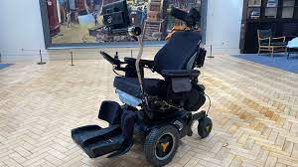
English presentation Wheelchairs
Done by: 206 (1) group
Specialty: nursing
Teacher: Safarova A.M.

Slide 2
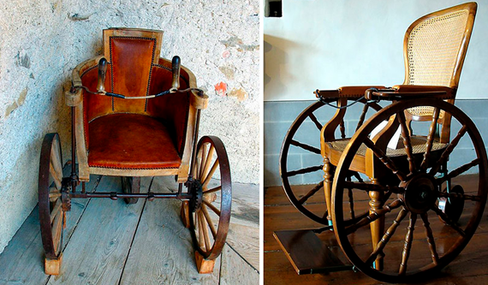
Wheelchairs
Modern wheelchairs are a big improvement on the first wheelchairs, which were just wheelbarrows like the ones we use in the garden.

Slide 3
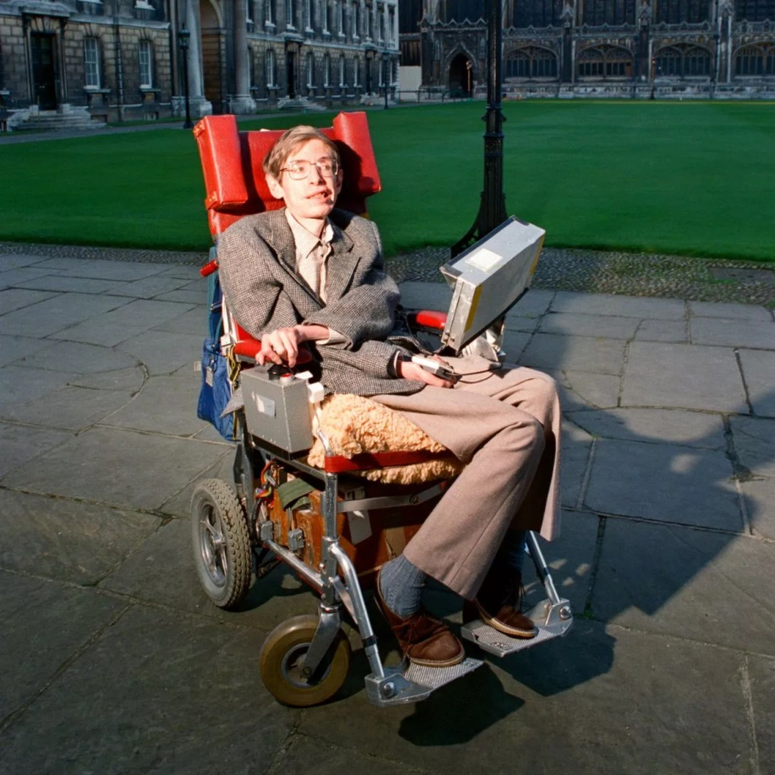
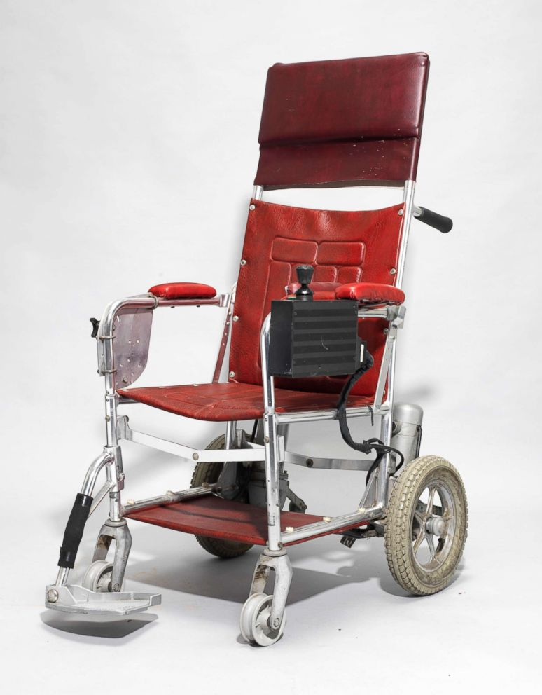
Professor Stephen Hawking`s wheelchair
Professor Stephen Hawking`s wheelchair, for example, is a vehicle, an office, and a domestic servant, all in one.

Slide 4
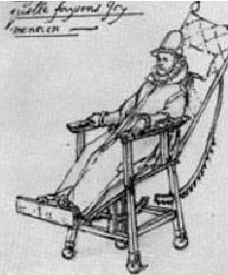
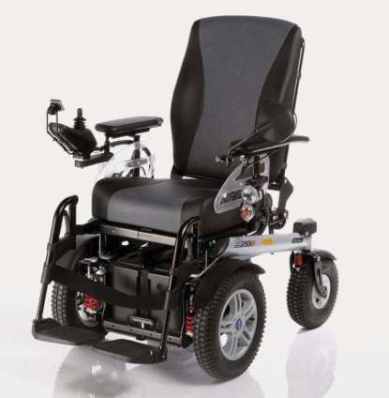
The first real wheelchair was owned by King Philip of Spain in the sixteen century.
It had the latest technology – removable arm rests and leg rests – and was made of wood
. Modern wheelchairs are made from the same strong, light metal as aircraft, and electric engines mean that users don`t need to use their arms or have someone to push.

Slide 5
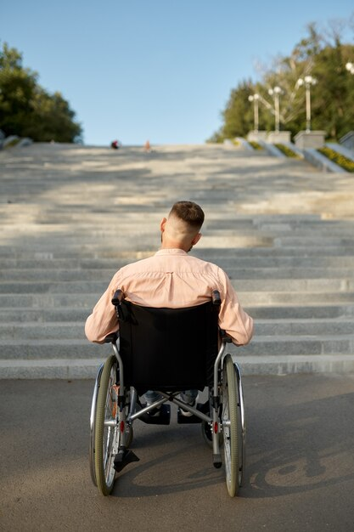
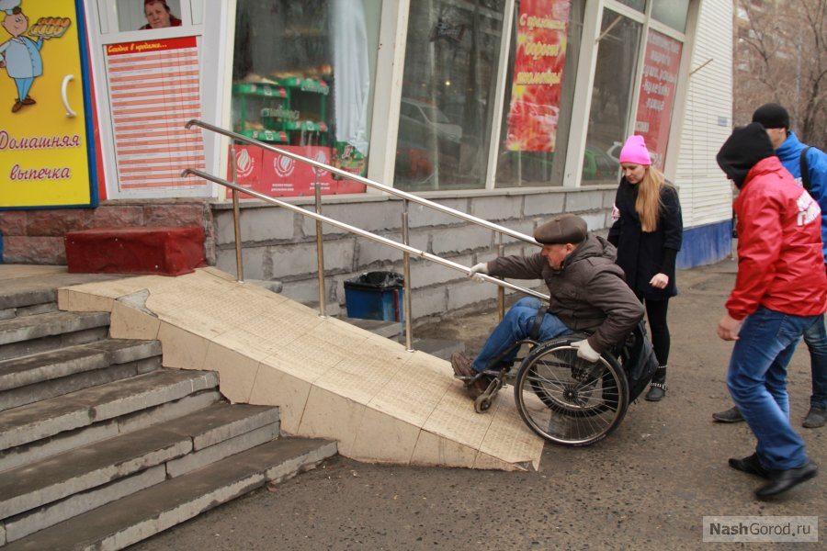
The probles for disabled people
Some things that able-bodied people do without thinking can be a major problem for disabled people, for example climbing stairs, entering and leaving buildings, and using toilets

Slide 6
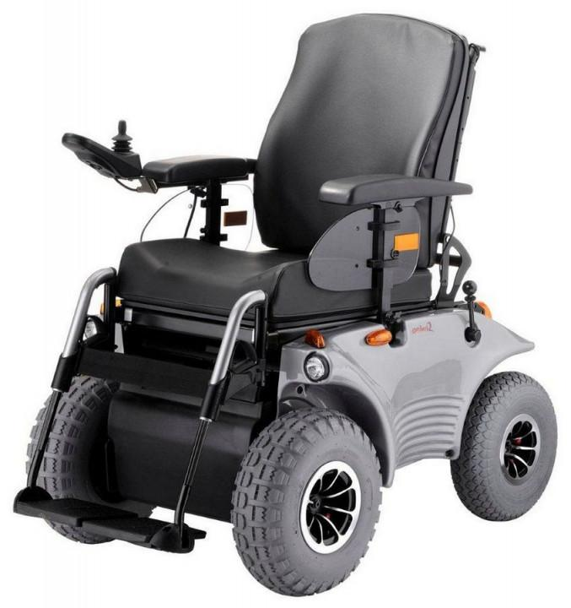
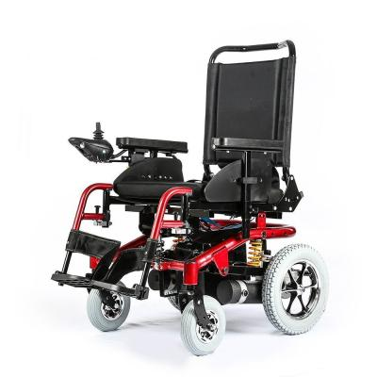
A computer technology
For users who cannot speak, computer technology also makes it possible to manoeuvre a machine by small movements of head, hand, tongue and breath.

Slide 7
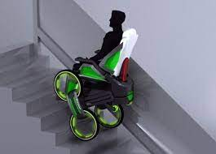
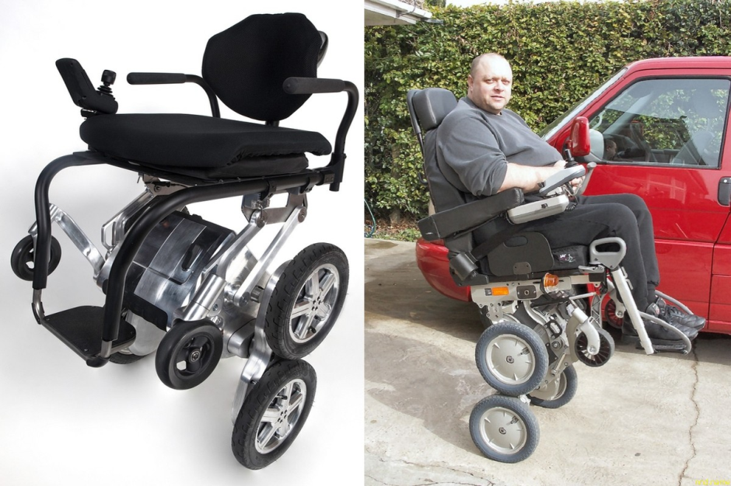
The iBOT claims to solve many of the problems of standard wheelchairs
It is a highly advanced, all-purpose wheelchair that can travel up stairs, raise the user to reach high shelves, and balance on two wheels in the shower. It is great fun to use, but beware the price – the iBOT costs as much as a luxury car.

Slide 8
Thank you for your attention!!!

