Slide 1
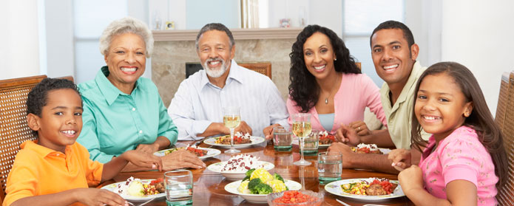

Slide 2
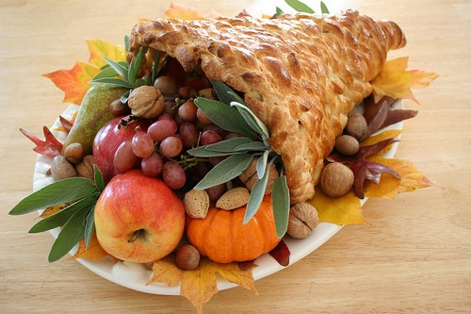
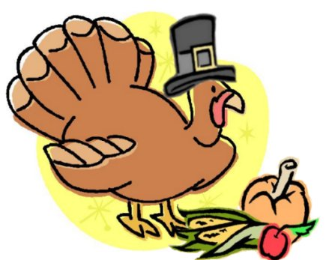
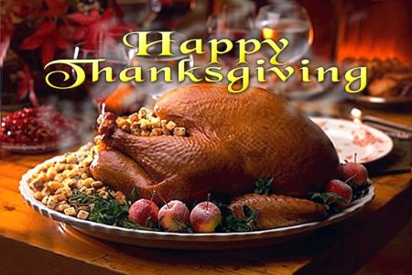
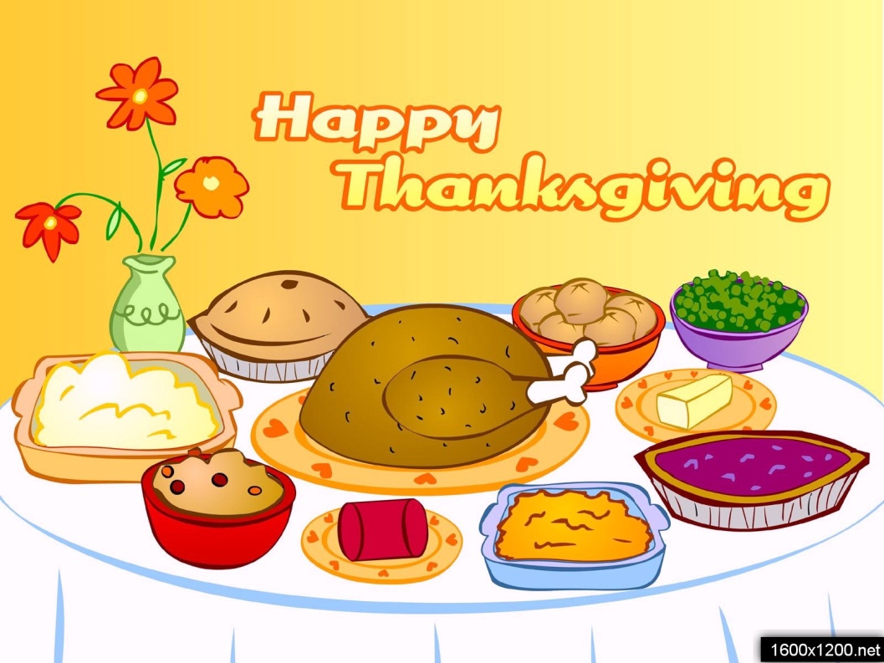
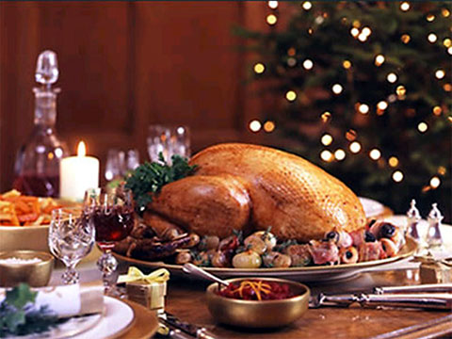

Slide 3
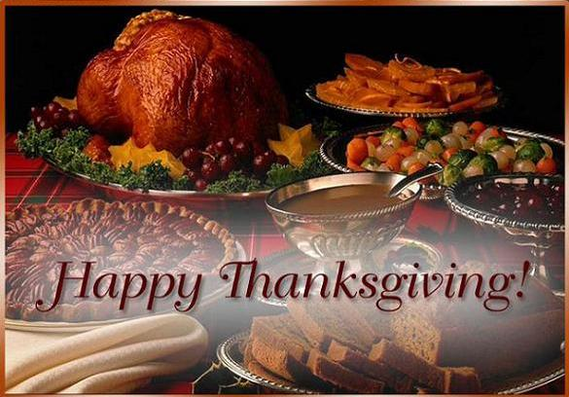

Slide 4
Thanksgiving Day
Преподаватель английского языка : И.А. Прошкина
Филиал ОГБПОУ «РПК» в г. Касимове:

Slide 5
Цель урока: совершенствовать знания по теме « День Благодарения»
Задачи урока:
Практическая: развивать навыки монологической и диалогической речи, аудирования, чтения и письма.
Развивающая: активизировать творческие способности учащихся.
Воспитательная: развивать познавательный интерес к традициям и обычаям страны изучаемого языка.
Тип урока:
По содержанию – урок применения полученных знаний.
По форме – урок – игра(соревнование команд)
Частные методы и приемы: беседа, выбор правильного варианта ответа, подбор соответствий, наглядный
( использование иллюстраций), викторина.
Основной дидактичечский метод – проблемно-поисковый
Оборудование: компьютер, экран, проектор, раздаточный материал.

Slide 6
Т for time to be together, turkey, talk, and tangy weather
H for harvest stored away, home, and hearth, and holiday
A for autumn's frosty art, and abundance in the heart
N for neighbors', and October, nice things, new things to remember
К for kitchen, kettles' croon, kith and kin expected soon
S for sizzles, sights, and sounds, and something special that
abounds

Slide 7
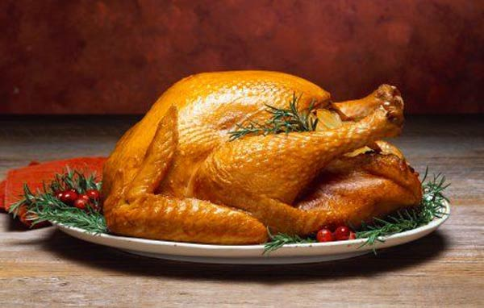
Symbols of Thanksgiving Day

Slide 9
Let’s check
1 – cook food
2 – exchange gifts
3 – light bonfires
4 – decorate houses
5 – set off fireworks
6 – have parades
7 – celebrate the festival
8 – dress up in costumes

Slide 10
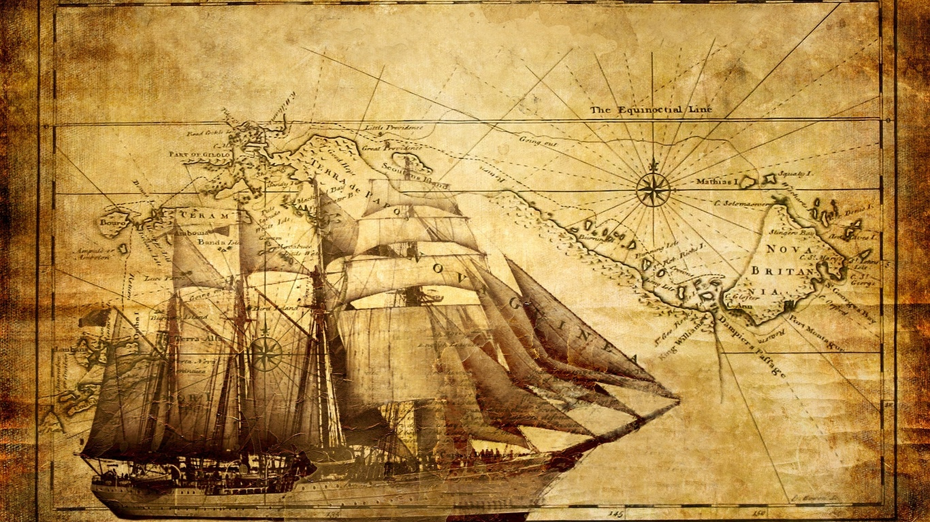
The May flower ship. 1620.

Slide 11
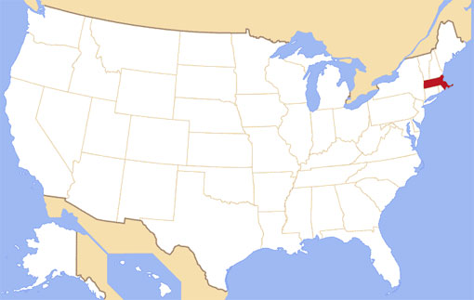
A ship named Mayflower brought 102 English men to Massachusetts

Slide 12
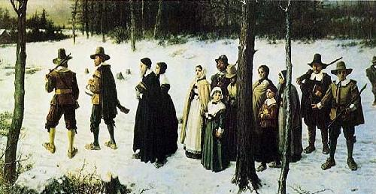
The winter was cold

Slide 13
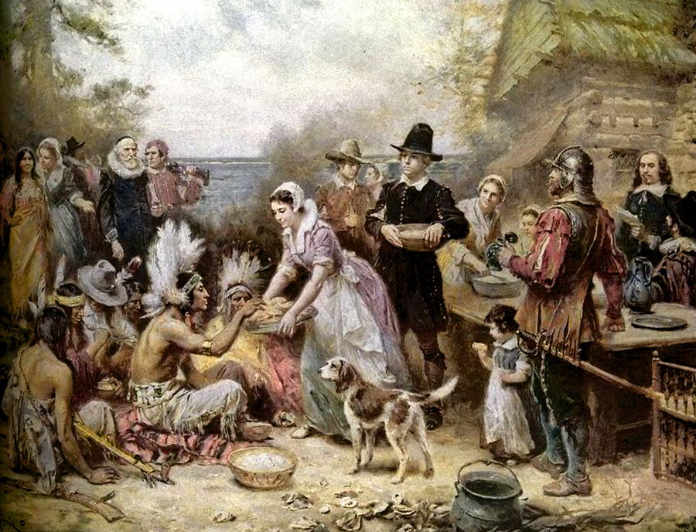
The First Thanksgiving Day in October 1620

Slide 14
1. When was the first Thanksgiving Day celebrated?
2.What did the Pilgrims sail from England for?
3.What was the name of the ship?
4.What did the native Indians teach the Pilgrims?
5.How many Pilgrims were there in the ship?
6.Why did the Pilgrims invite their Indian friends for the feast?
7.What was the menu of the feast?
8.When is Thanksgiving Day celebrated in the USA?

Slide 15
Complete the sentences
1) The pilgrims sailed to America from…
2) They were among the first…
3) The name of the ship was the "…
4) They landed at…
5) The Indians came to America about…
6) They hunted,…
7) Some pilgrims died…
8) They had a great…
9) They invited the Indians…
10) Americans celebrate Thanksgiving Day…
P1: 25.000 years ago.
P2: Settlers.
P3: Mayflower.
P4: Plymouth Rock.
P5: On the 4th Thursday in November.
P6: Fished, farmed to survive.
P7: Without fresh food.
P8: harvest.
P9: To the feast.
P10: Plymouth.

Slide 16
Complete the sentences
1) The pilgrims sailed to America from Plymouth.
2) They were among the first Settlers.
3) The name of the ship was the «Mayflower».
4) They landed at Plymouth Rock.
5) The Indians came to America about 25.000 years ago.
6) They hunted, fished, farmed to survive.
7) Some pilgrims died without fresh food .
8) They had a great harvest.
9) They invited the Indians to the feast.
10) Americans celebrate Thanksgiving Day on the 4th Thursday in November.

Slide 17
celebrate festival decorate dress family
special have set off exchange dessert
Dear friends,
Every Thanksgiving Day my family and I ________ together. We________ up and _________ the house. I help my mum to make _____ food. Usually we cook turkey and a pumpkin pie for _____. In the evening we have a ______ dinner. We have a tradition: after dinner we _______ gifts. On this day some cities _______ street parades, people ____ fireworks. Thanksgiving Day is my favorite _____.
What’s your favorite holiday? Why? Do you always celebrate it?
Love,
Sarah

Slide 18
Dear friends,
Every Thanksgiving Day my family and I celebrate together. We dress up and decorate the house. I help my mum to make special food. Usually we cook turkey and a pumpkin pie for dessert. In the evening we have a family dinner. We have a tradition: after dinner we exchange gifts. On this day some cities have street parades, people set off fireworks. Thanksgiving Day is my favorite festival.
What’s your favorite holiday? Why? Do you always celebrate it?
Love,
Sarah

Slide 19
Thanksgiving
Thank you for all my hands can hold
– apples red and
melons old,
yellow corn both ripe and sweet,
peas and beans so good to eat!
Thank you for all my eyes can see
Lovely sunlight, field and
tree,
white cloud – boats in sea-deep sky
and butterfly
Thank you for all my ears can hear –
birds song echoing far and near,
songs of little stream, big sea,
cricket, bullfrog, duck and bee!

Slide 20
Cinquain poem
Line 1: write a noun Thanksgiving Day
Line 2: write two adjectives describing the noun on line 1
Line 3 : write three verbs describing the noun on line 1
Line 4: write a phrase describing the noun on line 1
Line 5: write a synonym of the word on line 1.

Slide 21
THANKSGIVING QUIZ
1.What year did the Pilgrims have their first Thanksgiving Feast?
A)1619 B) 1620 C) 1621
2. Who were the first colonists in New England?
A) the Indians B) the Americans C) the Pilgrims
3. Thanksgiving Day is ……..holiday.
A) a German B) a British C) an American
4. What food was probably not on the Pilgrims Thanksgiving menu ?
A) potatoes B) turkey C) pumpkin
5. Which president first established the date of Thanksgiving Day as a national celebration?
A) Thomas Jefferson B) Abraham Lincoln C) John Adams

Slide 22
Thanksgiving day today.
Thank you for your attention!

