Slide 1
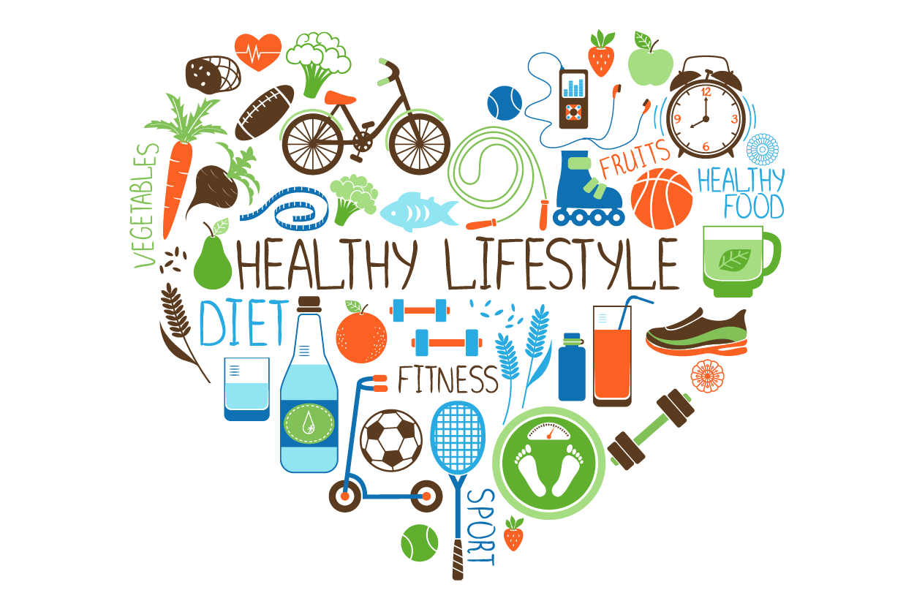
Healthy lifestyle

Slide 2


Slide 3

Warm-up: Read and translate 3 statements. Express your thoughts.
You are what you eat.
The health of a person is
the main value in the life.
You eat to live, but don’t live to eat.

Slide 4

What is the "healthy lifestyle" exactly?
You hear a lot about living a healthy lifestyle, but what does that mean? In general, a healthy person doesn't smoke, eats healthy and does exercises. Sounds simple, doesn't it? The trick to healthy living is making small changes...taking more steps, adding fruit to your cereal, having an extra glass of water...these are just a few ways you can start living healthy without drastic changes.

Slide 5
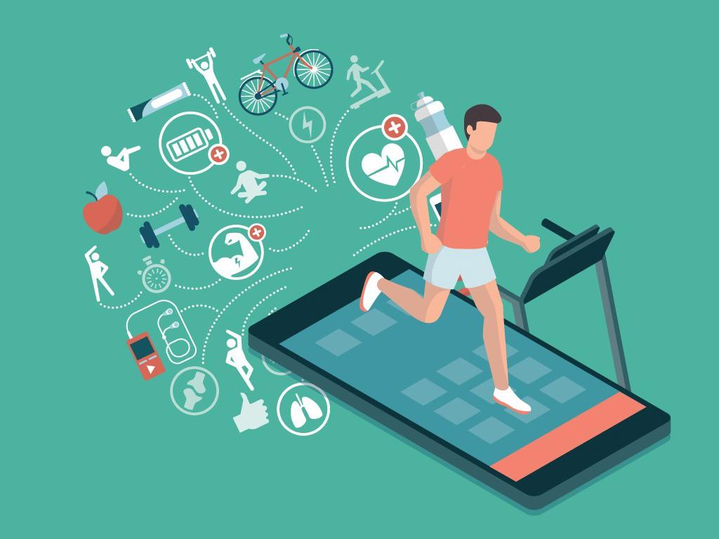
Healthy Living is about taking responsibility for your decisions and making smart health choices for today and for the future.

Slide 6
Vocabulary:
Read the words, write them down into your exercise books and make a sentence with each of them.
a healthy person – здоровый человек
a healthy lifestyle – здоровый образ жизни
to make small changes – вносить маленькие изменения
a step – шаг
drastic change – кардинальные изменения
to take responsibility – взять ответственность
a decision – решение
to make a choice – сделать выбор

Slide 7
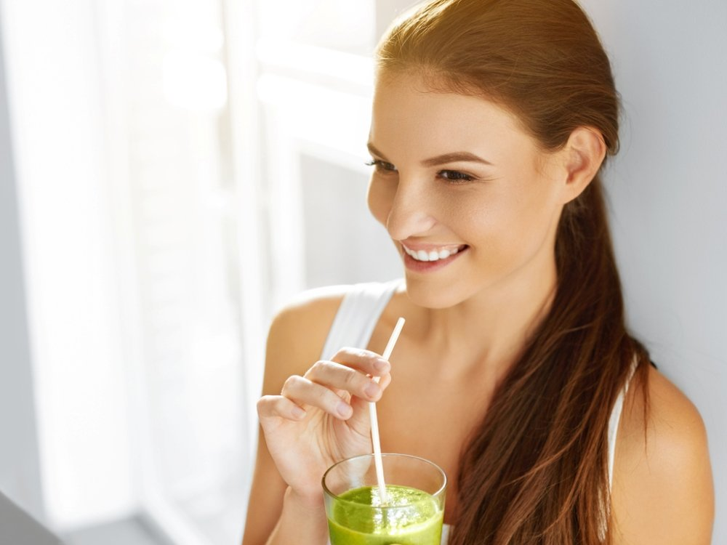
Answer some questions
about your lifestyle?
Are you living a healthy lifestyle?
Do you wake up with enthusiasm for the day ahead?
Do you have the high energy you need to do what you want?
Do you laugh easily and often, especially at yourself?
Do you have a circle of warm, caring friends?

Slide 8

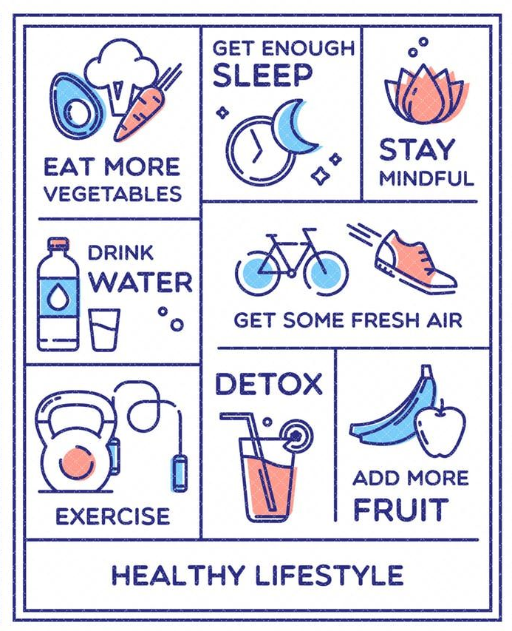
Healthy lifestyle habits:
Discuss the healthy lifestyle habits you see in the picture and below:
Screen-time Free
Manage stress
Eat less sugar
Don’t eat until you’re full
Say “No” to smoking
Say “No” to alcohol
Get some moves, play sports
Socialize
Go outside

Slide 9


Slide 10
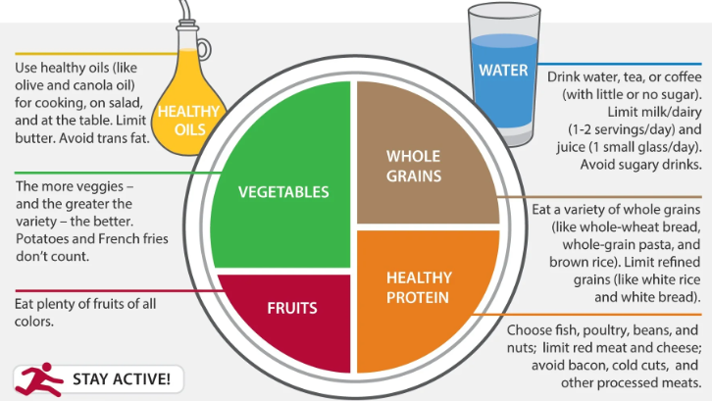
Eat healthy: more vegetables and fruit, less sugar

Slide 11

Drink water
You have to drink 1,5-2 liters water a day! It’s very important.
• Researches show that the average person drinks half liter a day. It's not enough!
• The water safe your health, so drink every day 6 glasses of water.

Slide 12
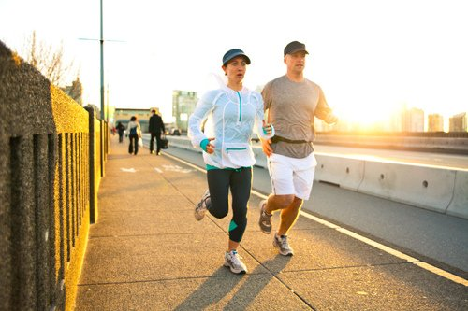
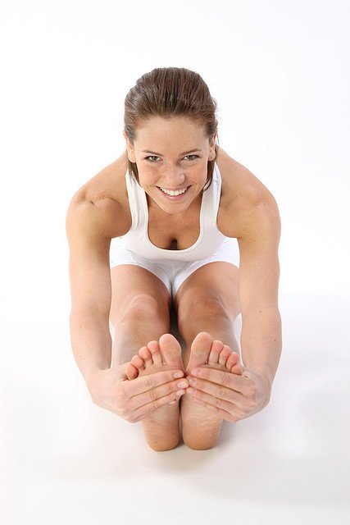
Get some moves, play sports
  The modern people are very lazy. Your body needs a little sport: For good health you should do exercises for 30-60 minutes a day.

Slide 13
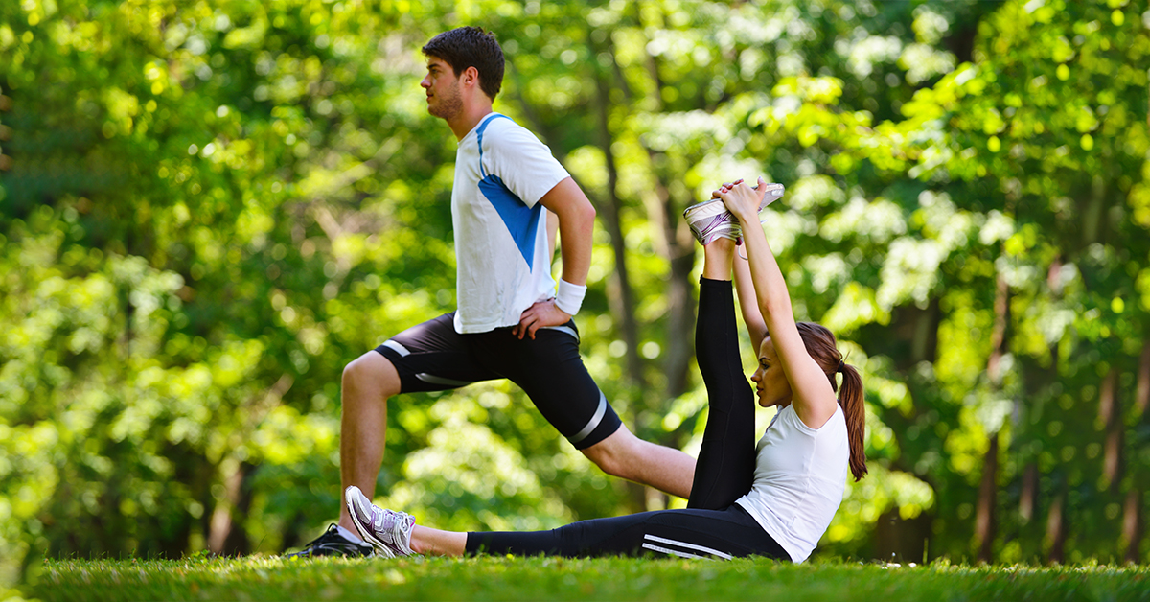
You need to include fitness as part of your life. Physical fitness keeps your weight in check, helps you sleep better at night, prevents heart attacks and strokes and other health problems, and generally prolongs your life.

Slide 14
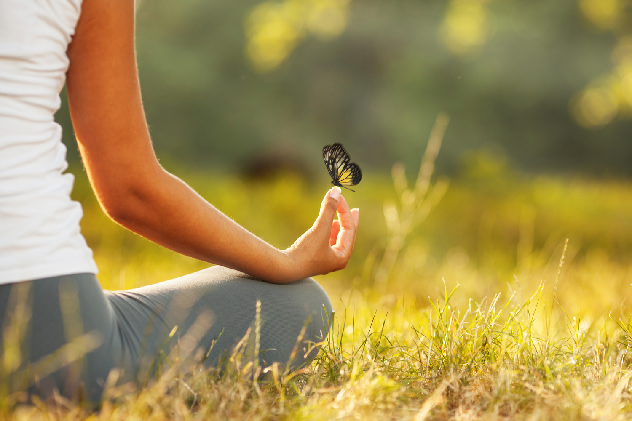
Stress Management
Emotional stress plays an important role in many illnesses, both directly and indirectly. People are also more likely to smoke, overeat, drink too much, work too hard, argue with others and so on, when they are feeling stressed.

Slide 15

Your organization require the fresh air every day. It's ensure your fresh mental and physical state. Three times every day, calm down and breathe for 1-2 minutes.

Slide 16
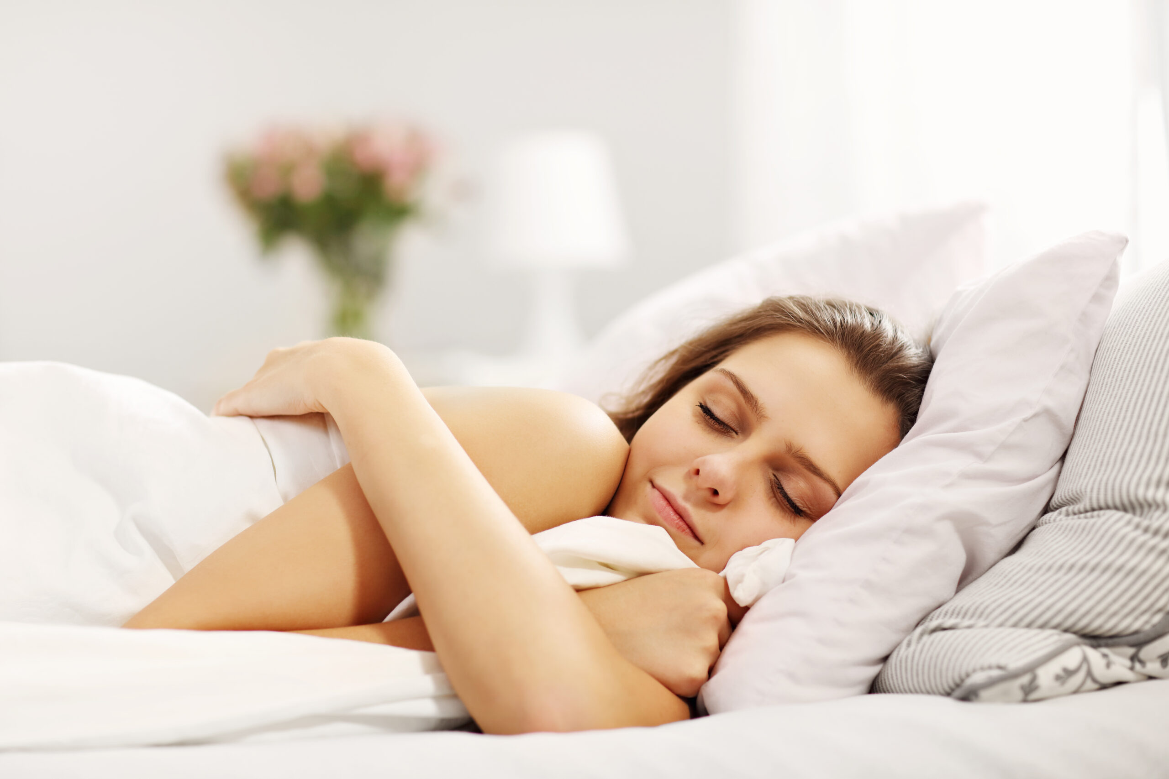
Get enough sleep
Your organization needs to relax!
• You have to relax 6-8 hours a day.
• Sleeping is the most effective before midnight, so you should go to your bed around 10 pm.
• When your brain is fresh, then it's much faster!

Slide 17
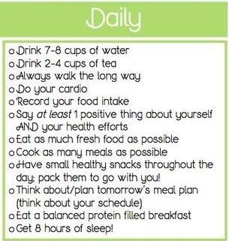
Hometask:
Make your own daily healthy habits checklist. You have an example in the picture.

Slide 18
Reflection
Now I can:
Speak about…
Say my opinion on…
Explain the problem…
Give arguments…
Understand the information…

Slide 19
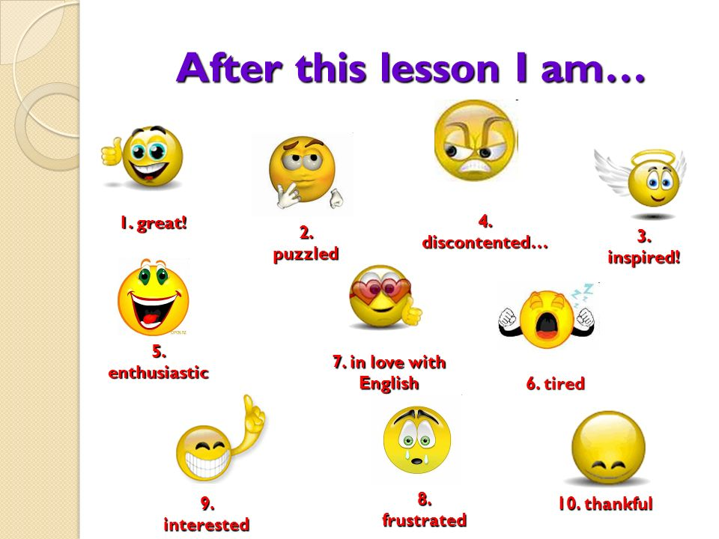

Slide 20


Slide 21


