Slide 1
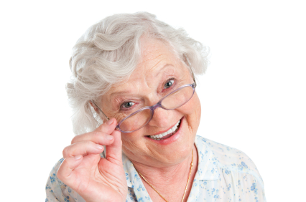
MY GRANDMA
HELEN IS MY GRANDMA.
SHE’S 65 YEARS OLD.
SHE’S KIND AND FUNNY.
SHE CAN SPEAK CHINESE BUT SHE CAN’T USE A MOBILE PHONE.

Slide 2
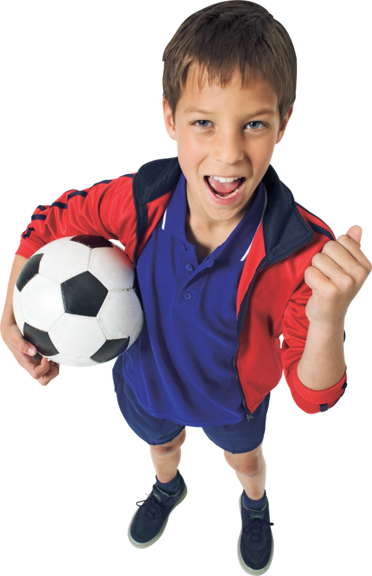
Alex, 10

Slide 3

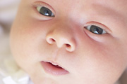
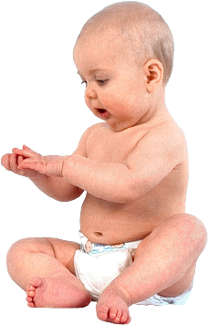
MY BODY
Моё тело

Slide 4
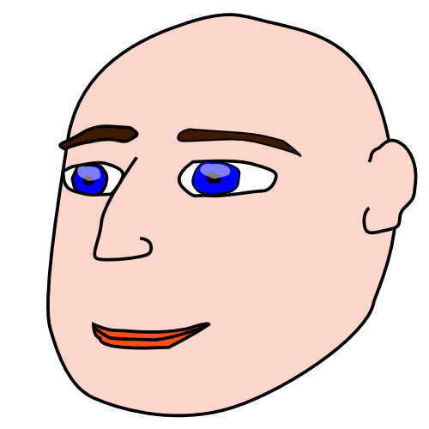
ГОЛОВА

Slide 5
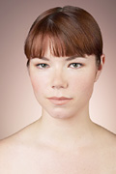
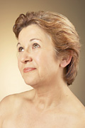
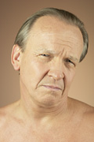
HEAD

Slide 6
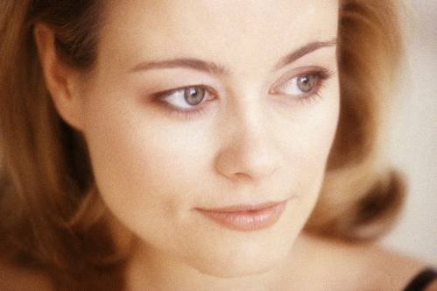
ЛИЦО

Slide 7
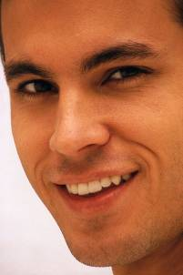
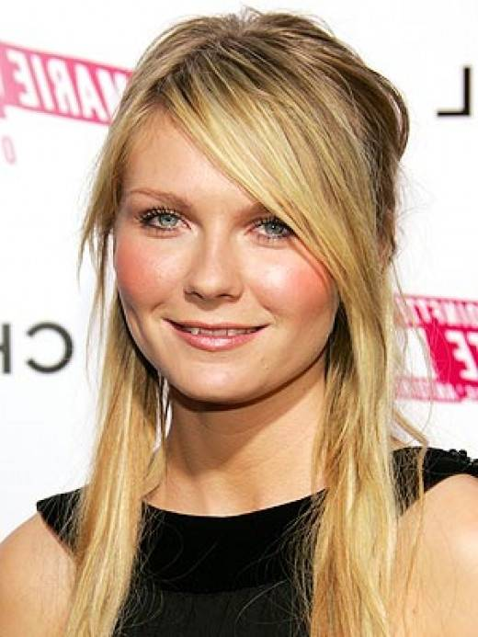
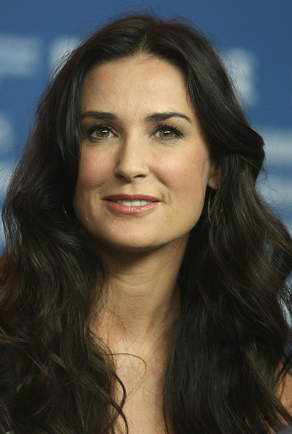
FACE

Slide 8
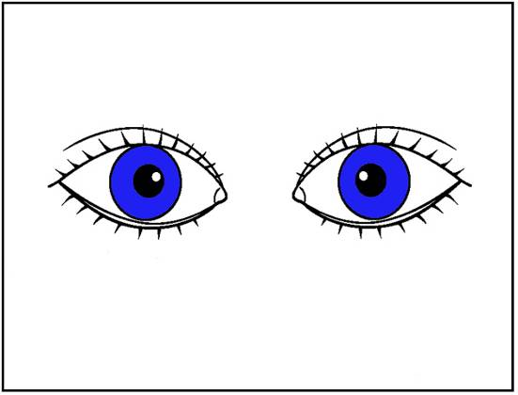
ГЛАЗА

Slide 9
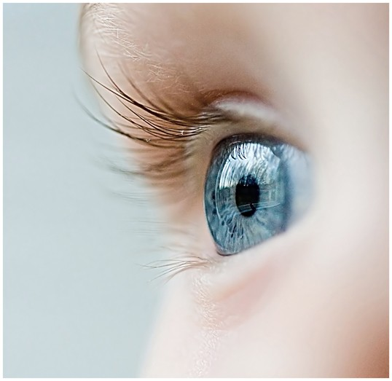
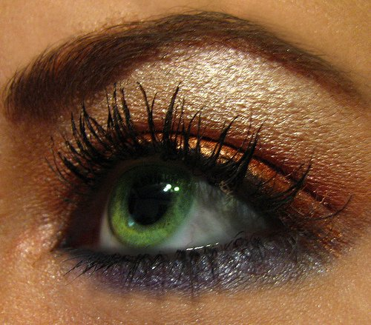
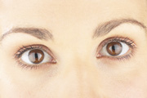
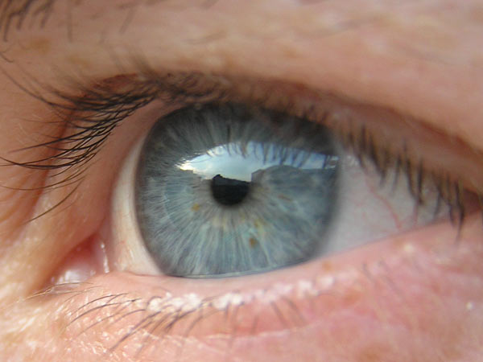
EYES
blue
green
grey
hazel

Slide 10
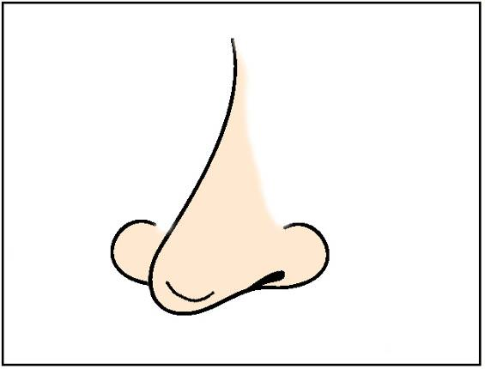
НОС

Slide 11
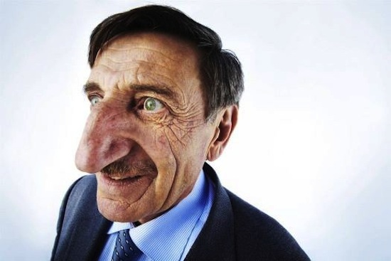
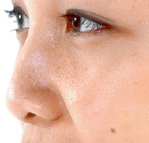
NOSE
big
small

Slide 12
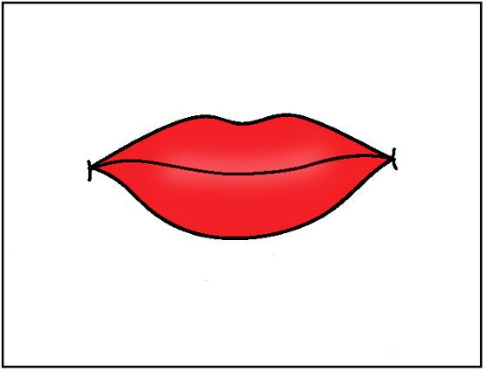
РОТ

Slide 13
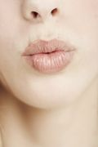
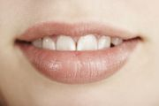
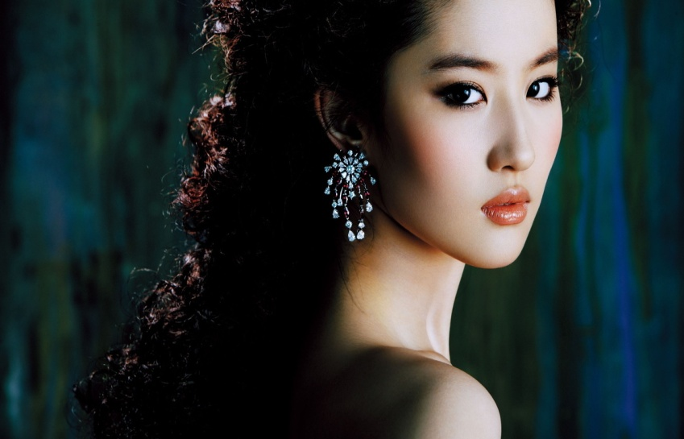
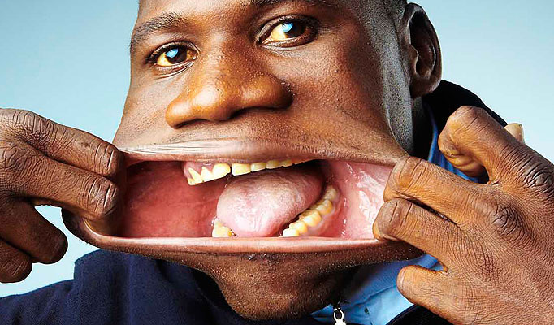
MOUTH
small
big

Slide 14
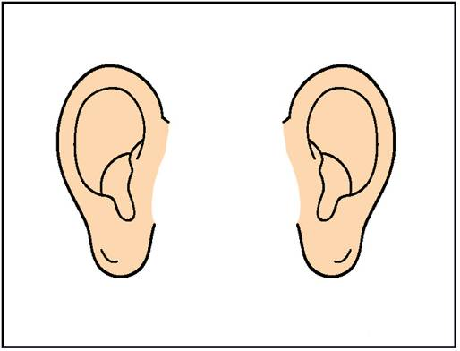
УШИ

Slide 15
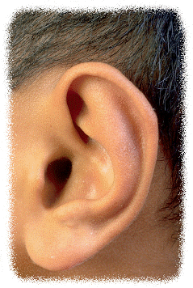
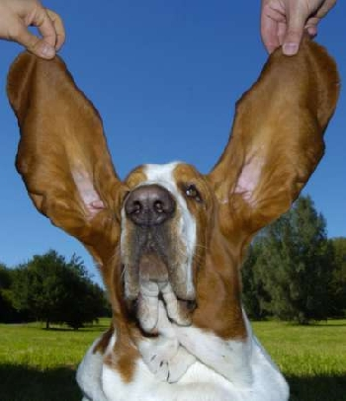
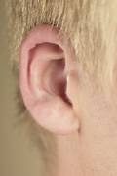
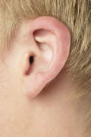
EARS
big
small
long

Slide 16
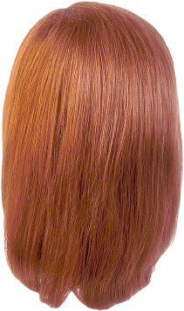
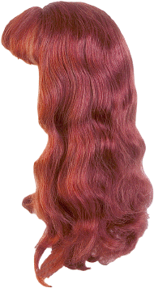
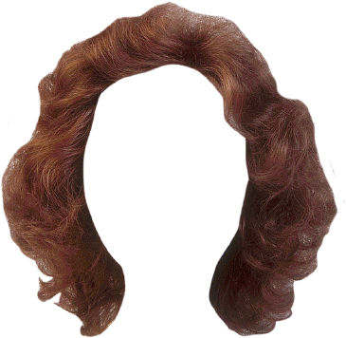
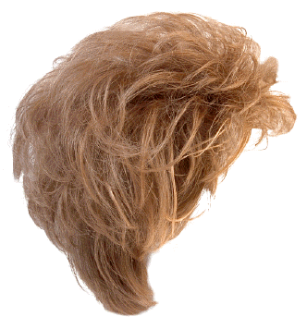
ВОЛОСЫ

Slide 17
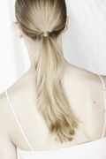
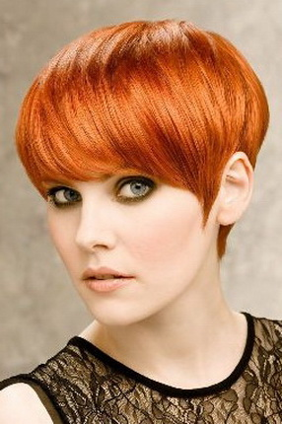
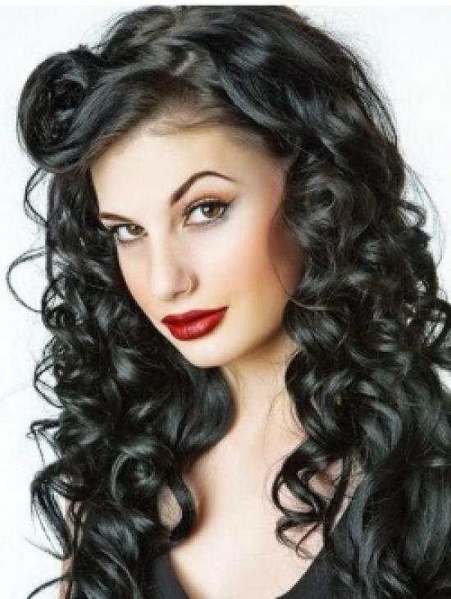
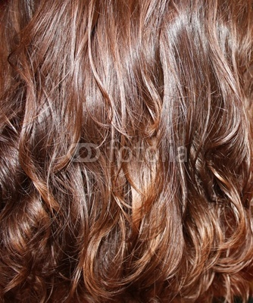
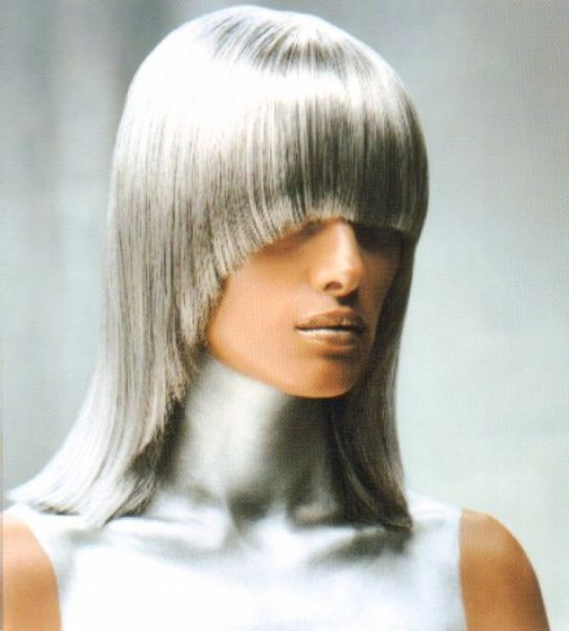
HAIR
long, fair
short, red
curly, black
wavy, brown
straight, grey

Slide 18
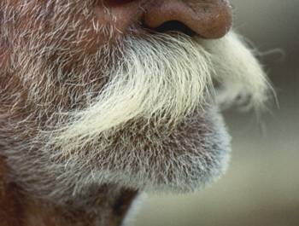
УСЫ

Slide 19
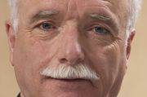
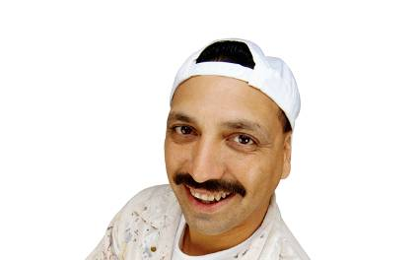
MOUSTACHE

Slide 20
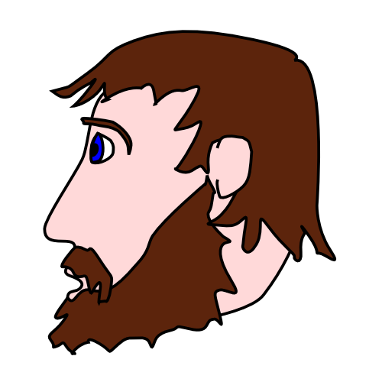
БОРОДА

Slide 21
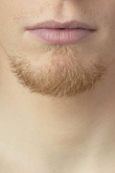
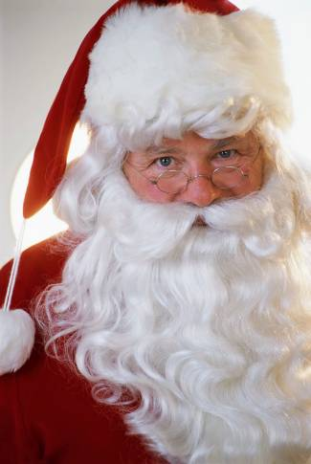
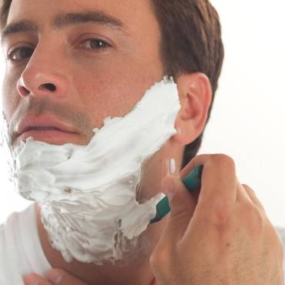
BEARD

Slide 22
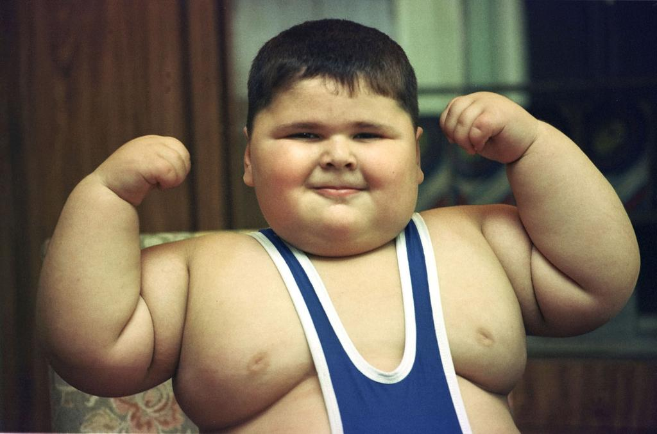
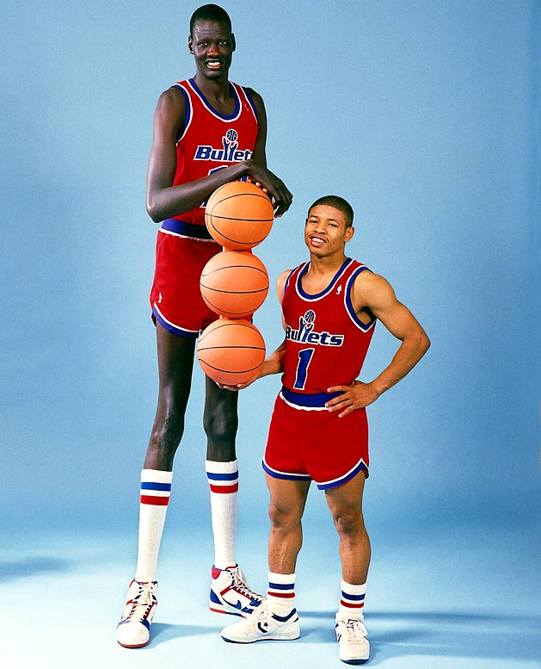
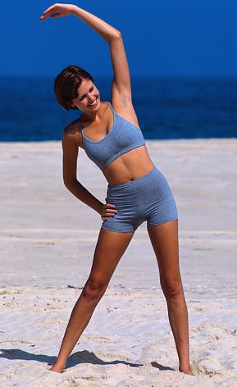
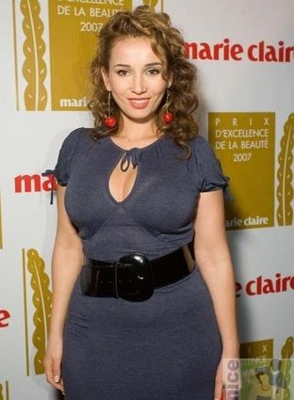

BODY
fat
tall and short
thin
plump
strong

Slide 23

ШЕЯ

Slide 24


NECK

Slide 25

РУКИ

Slide 26




ARMS

Slide 27

КИСТЬ

Slide 28


HAND

Slide 29

НОГИ

Slide 30





LEGS

Slide 31

СТУПНЯ

Slide 32





FOOT/
FEET

Slide 33
CAN
I CAN SING.
CAN YOU SING?
YES, I CAN.
NO, I CAN’T.
I CANNOT SING.

Slide 34
CAN
A CAT / FLY
A DOG / TALK
A FISH / WALK
AN ELEPHANT / RIDE A BICYCLE
MY FRIEND / PLAY THE PIANO
MY MUM / DRIVE A CAR

Slide 35

Describe the people:
Kate is 12. She’s tall and slim. She’s got brown hair, green eyes and a big mouth. She can speak English, dance and play the guitar. She can’t play basketball. She’s very kind and clever.

Slide 36

Mrs. Smith, 68

Slide 37

Mr. Black, 49

Slide 38






The End

Slide 39

I know…
Now I can…
It was interesting to…(V)
It was difficult to…(V)
I was good at…(Ving)

Slide 40
RATE YOURSELF
- Excellent!
- Good!
- Work harder!

