Slide 1

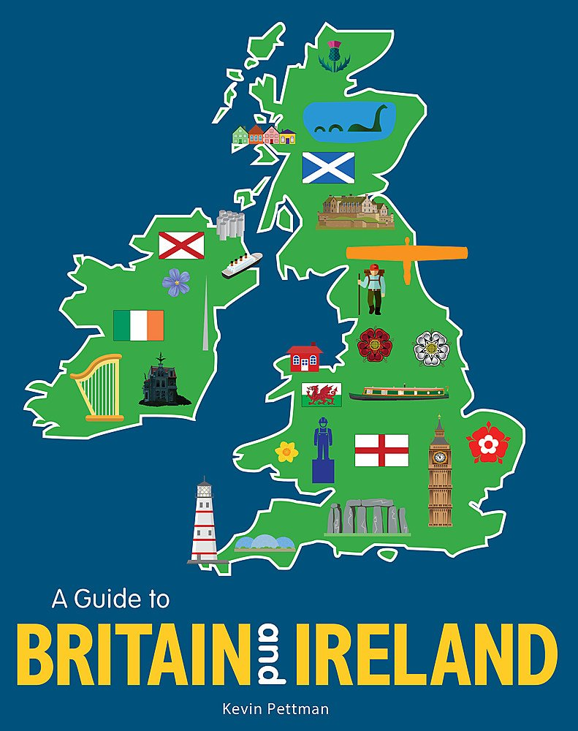
Landmarks of the British Isles
Lesson
1
d
Module
1

Slide 2





The British Isles
Northern Ireland
(Belfast)
England
(London)
Scotland
(Edinburgh)
Wales
(Cardiff)

Slide 3
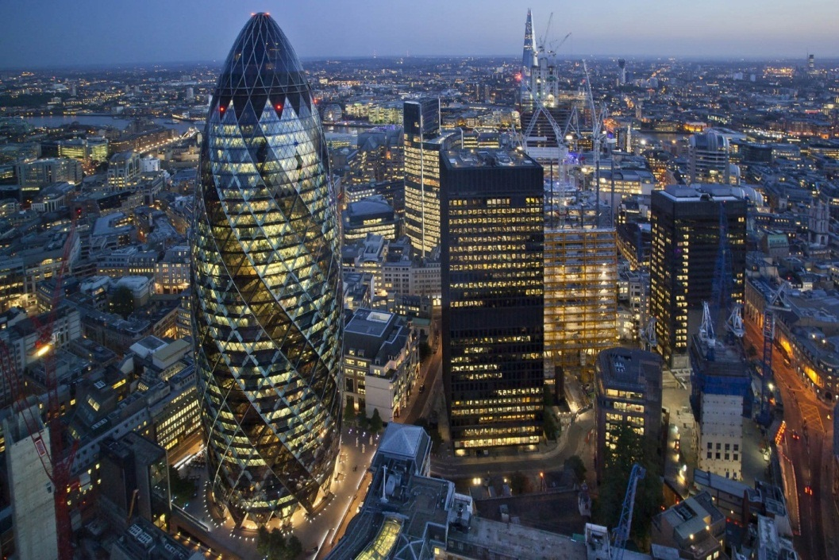
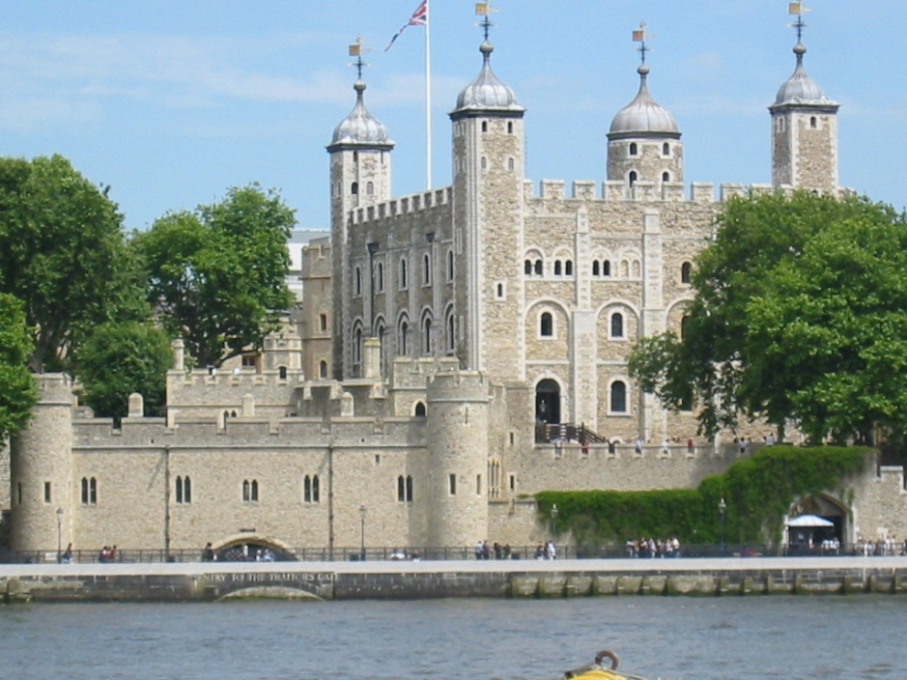
The capital of England is London

Slide 4
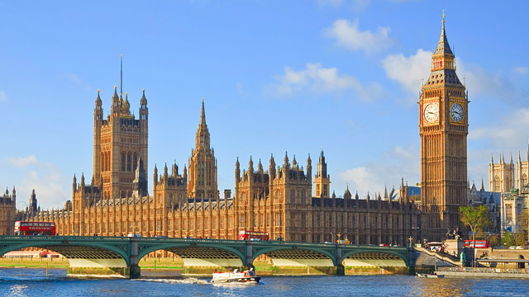
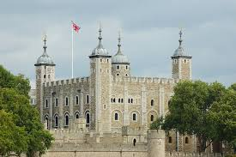
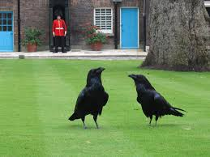
Landmarks of England:
Tower, Big Ben

Slide 5
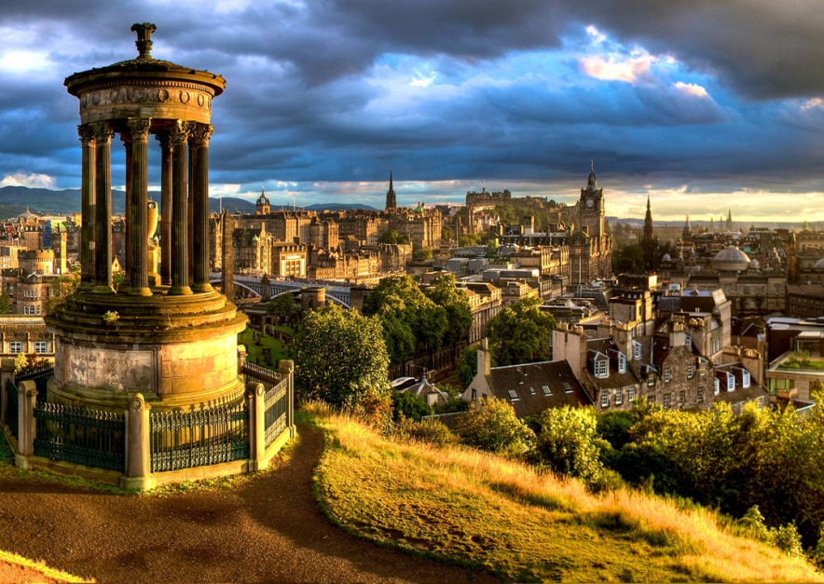
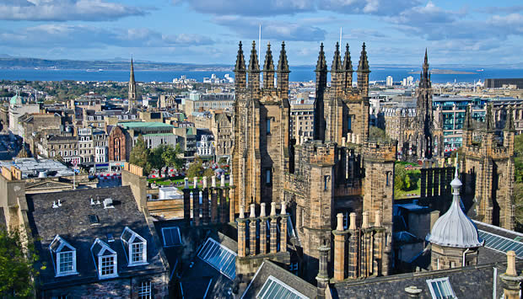
Edinburgh is the capital of Scotland

Slide 6
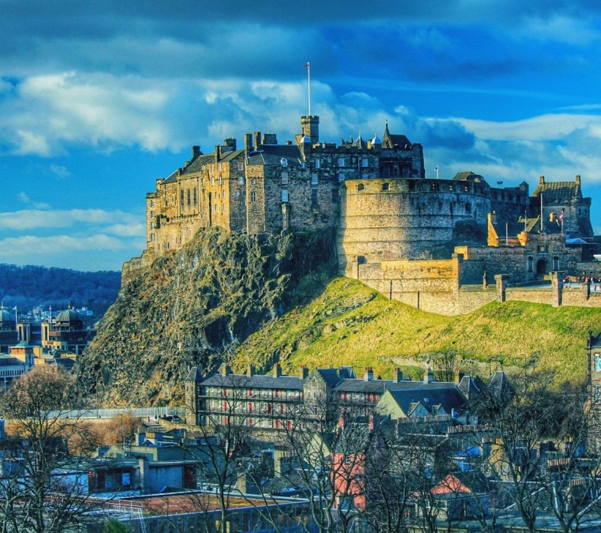
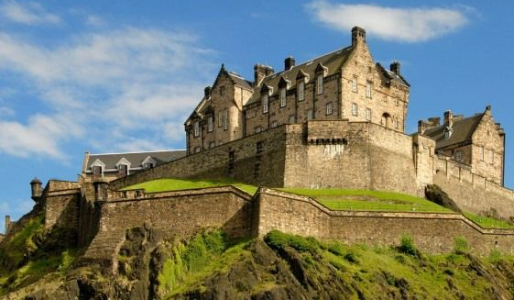
Edinburgh castle

Slide 7
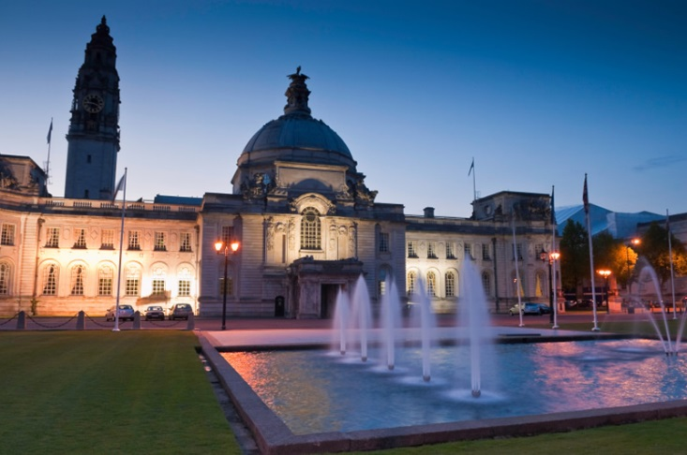
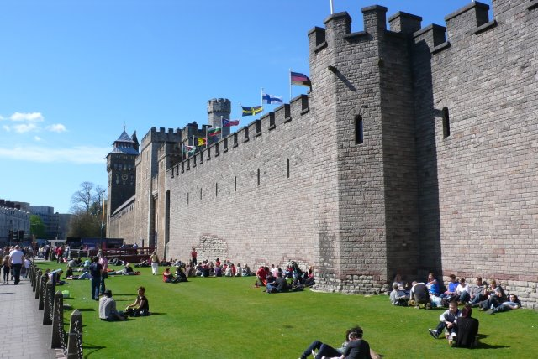
Cardiff is the capital of Wales

Slide 8
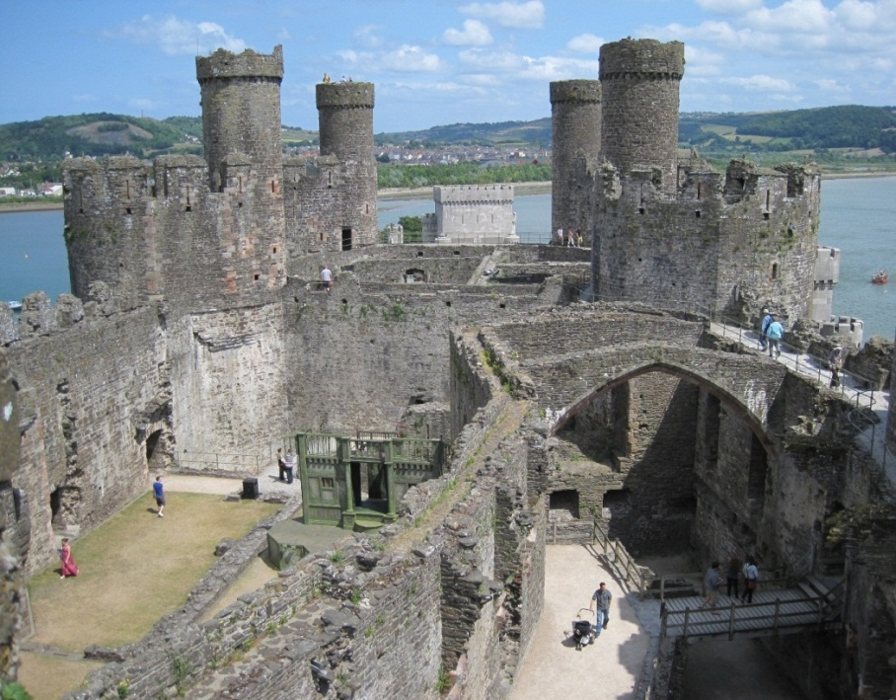
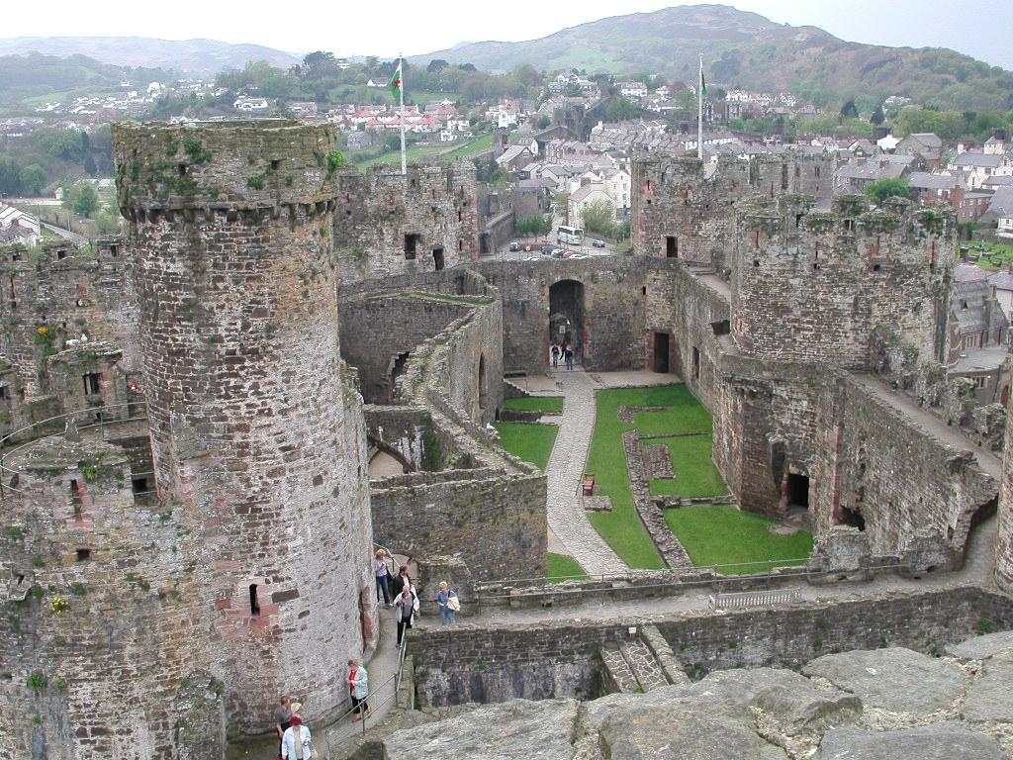
Conway Castle in Wales

Slide 9
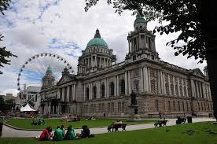
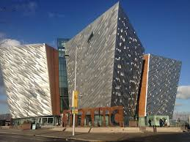
Belfast is the capital of the Northern Ireland

Slide 10
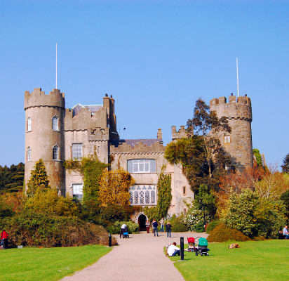
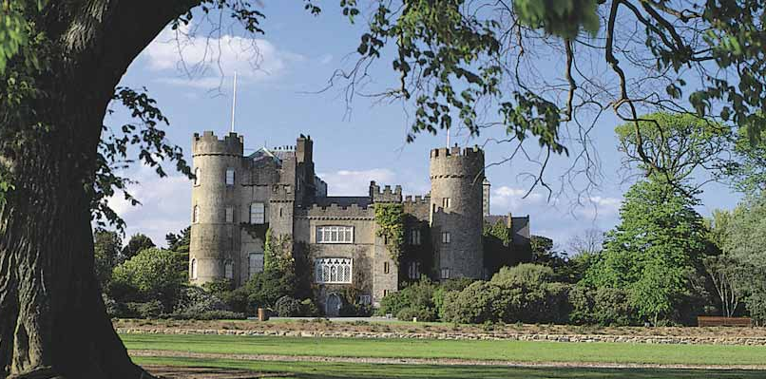
Malahide Castle in Ireland

Slide 11
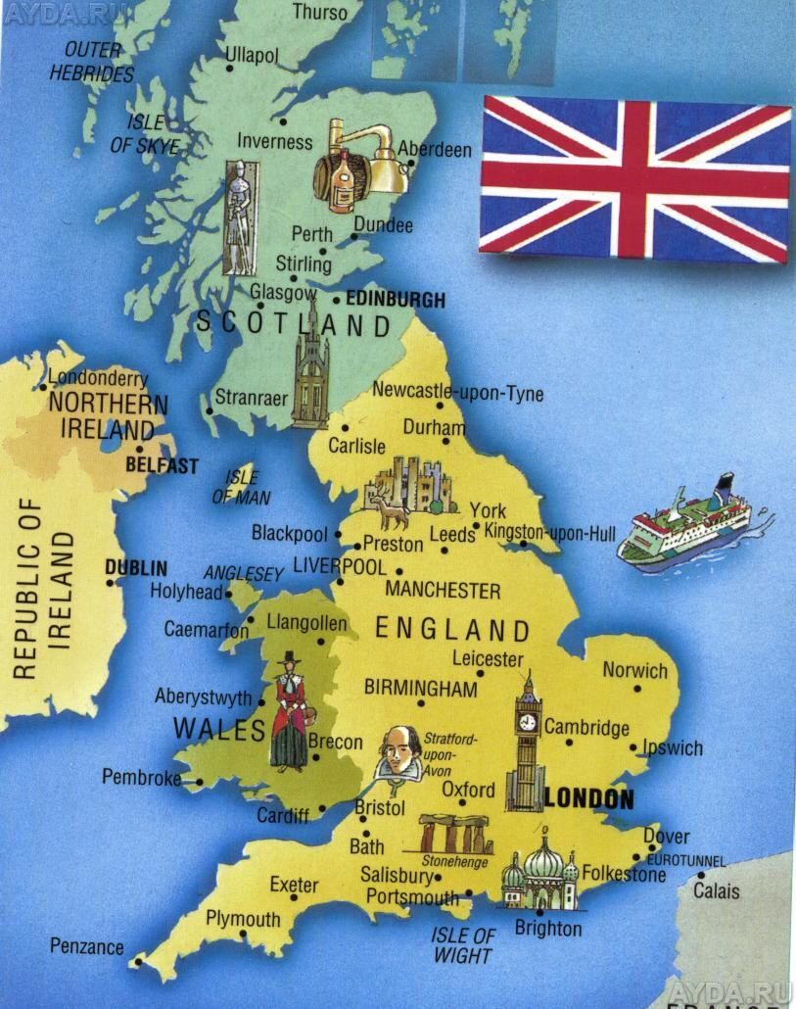
- Map
- Capital
- Country
- Landmark

Slide 12

Date back- относится к (о времени)
Fortress- крепость
Spooky- страшный
Ghosts- привидение
Unique-уникальный
Extinct volcano-потухший вулкан
Medieval-средневековый
Guarded by-охраняется
Ravens-вороны

Slide 13
Remember the words
date back
fortress
spooky
ghost
medieval
tower
view
raven
volcano
masterpiece
a. шедевр
b. башня
c. относиться к …
d. ворон
e. вид
f. средневековый
g. вулкан
h. жуткий
i. призрак
j. крепость
Do the quiz

Slide 14

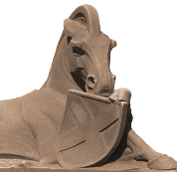






Question 1
Where ‘s Malahide Castle?
Scotland
England
Wales
Ireland

Slide 15
Question 2
Where ‘s Conwy Castle?
Scotland
England
Wales
Ireland

Slide 16
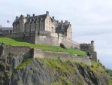
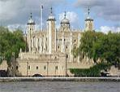
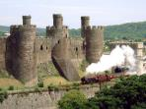
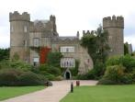
Question 3
Which castle is
a spooky place?
Edinburgh Castle
Tower of London
Conwy Castle
Malahide Castle

Slide 17
Question 4
Which castle will fall down
if the ravens fly away ?
Edinburgh Castle
Tower of London
Conwy Castle
Malahide Castle

Slide 18
Question 5
Which castle was built on top of the volcano?
Edinburgh Castle
Tower of London
Conwy Castle
Malahide Castle

Slide 19
Question 6
Which castle was used as a fortress and a family home?
Edinburgh Castle
Tower of London
Conwy Castle
Malahide Castle

Slide 20
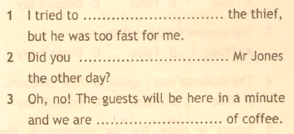
Complete the sentence with the correct phrasal verb.

Slide 21
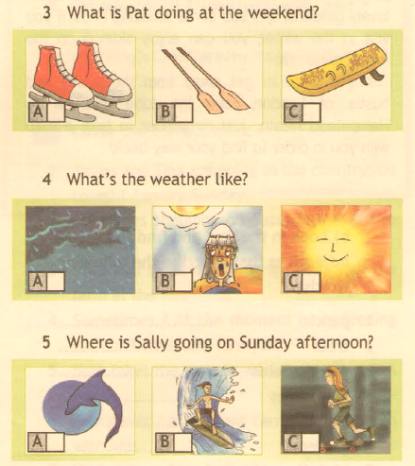
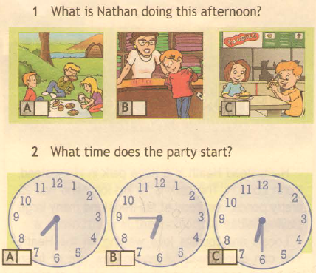
Listen and tick the correct picture.
Notes:
Workbook page 7 ex 4

Slide 22

HOMETASK. TOPIC 1d.
Students book page 11

Slide 23
Ваше задание на следующий урок.
Повторить правило на сравнение времен Present Simple и Present Continuous.
Повторить правило на суффикс –ly и модальный глагол should.
Выучить новые слова и повторить уже изученные (будет опрос).
Выполнить упражнения.
* ВСЕ ДОМАШНИЕ РАБОТЫ ВЫПОЛНЯЕМ В ТЕТРАДИ ДЛЯ ДОМАШНИХ РАБОТ.

Slide 24
Date back- относится к (о времени)
Fortress- крепость
Spooky- страшный
Ghosts- привидение
Unique-уникальный
Extinct volcano-потухший вулкан
Medieval-средневековый
Guarded by-охраняется
Ravens-вороны

Slide 25
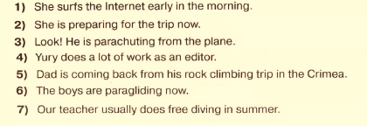
Task 1. Make sentences negative and interrogative. Use present simple or present continuous.

Slide 26
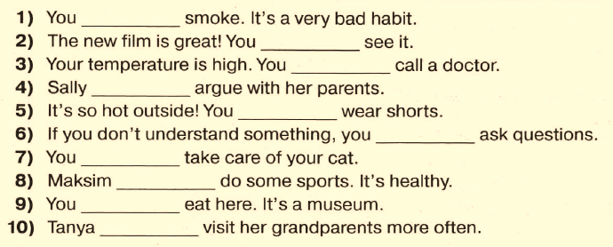
Task 2. Fill in should or shouldn’t.

