Slide 1


Slide 2
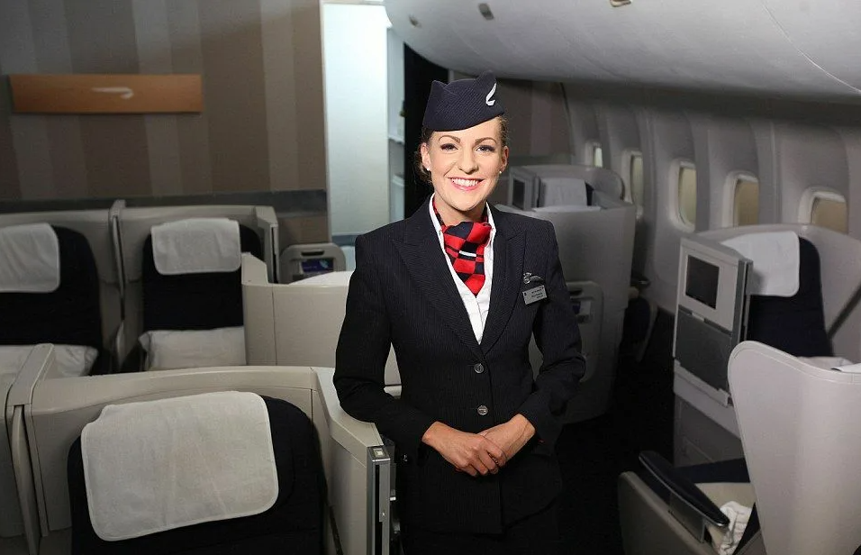


Must
Mustn’t

Slide 3


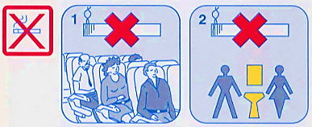
Safety instructions
Mustn’t
1. You ______________ smoke on the plane or in the lavatory.

Slide 4
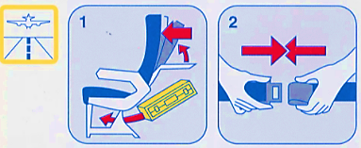
Safety instructions
Must
2. You ______________________ sit straight and buckle up before taking off and while landing.

Slide 5
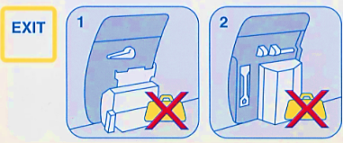
Safety instructions
Mustn’t
3. You ______________ put your baggage in front of
the exit.

Slide 6
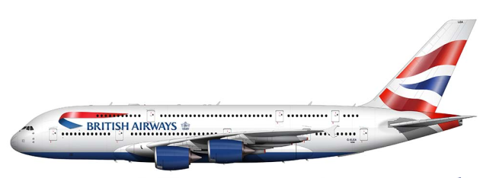
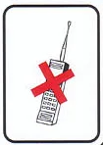


Safety instructions
Mustn’t
4. You ________________use any devices while taking off and landing.

Slide 7
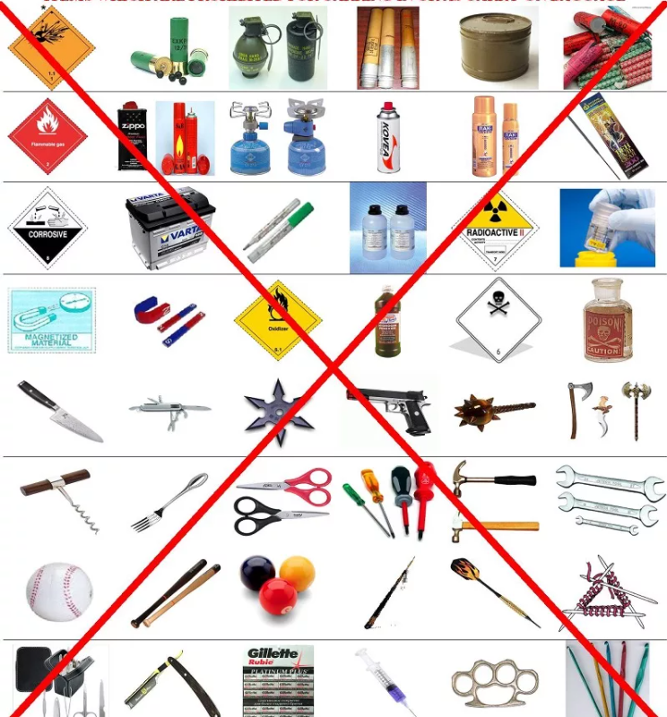
Safety instructions
5. You ______________ take dangerous things with
you on board.
Mustn’t

Slide 8
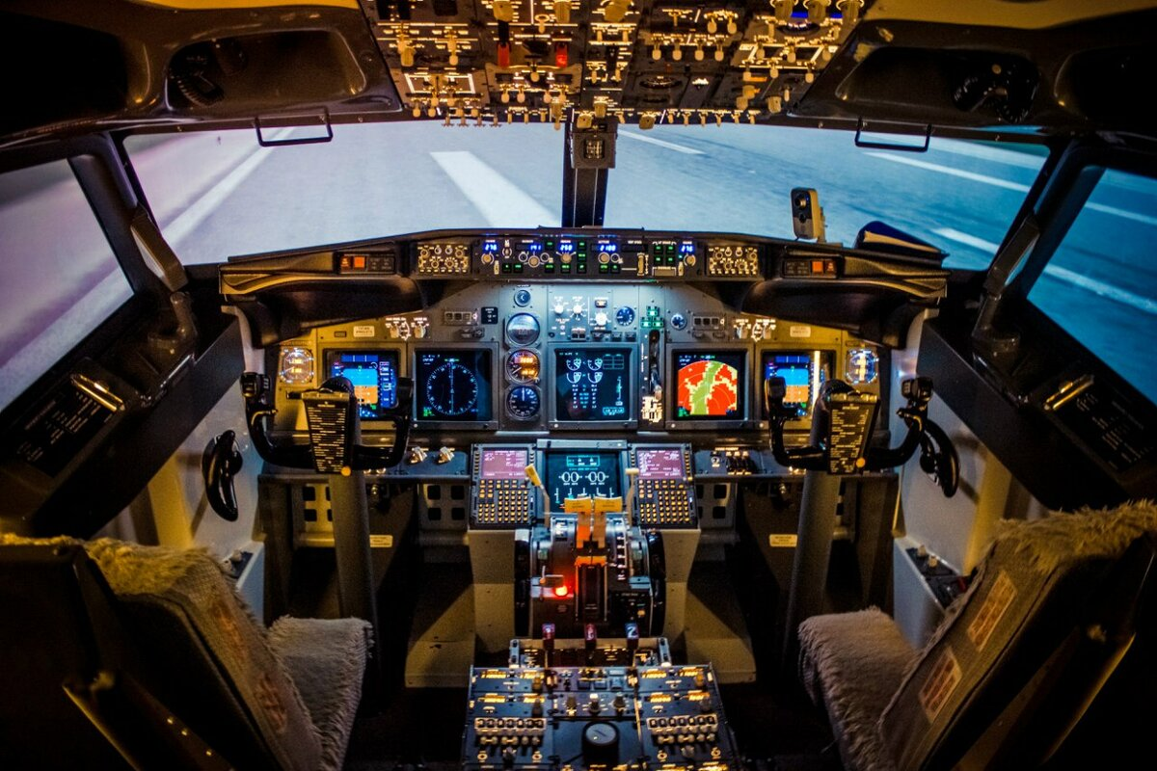
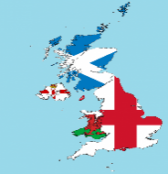

???
The UK
England
Great Britain

Slide 9
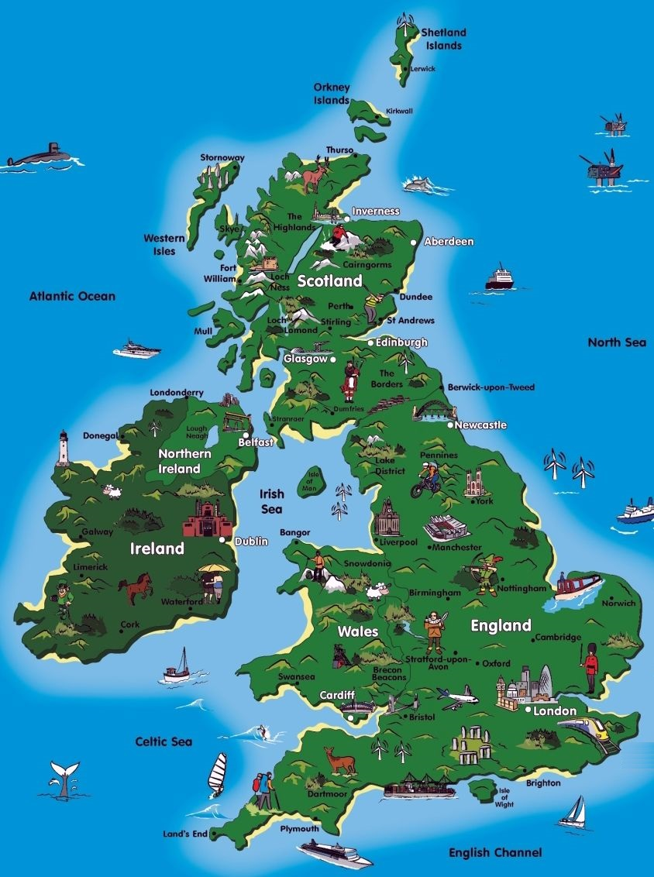







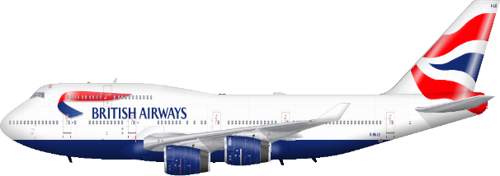

Slide 10
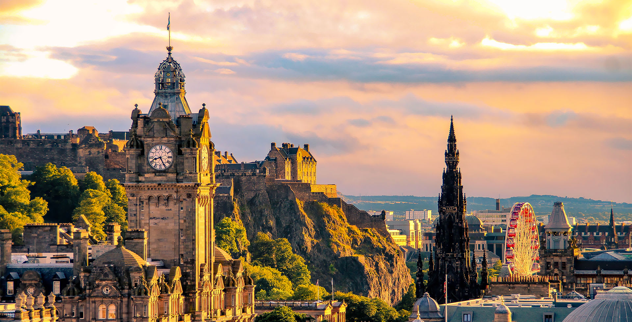


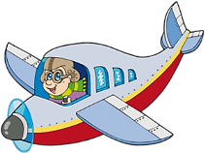
If you go to Scotland …
… you will see…………..

Slide 11
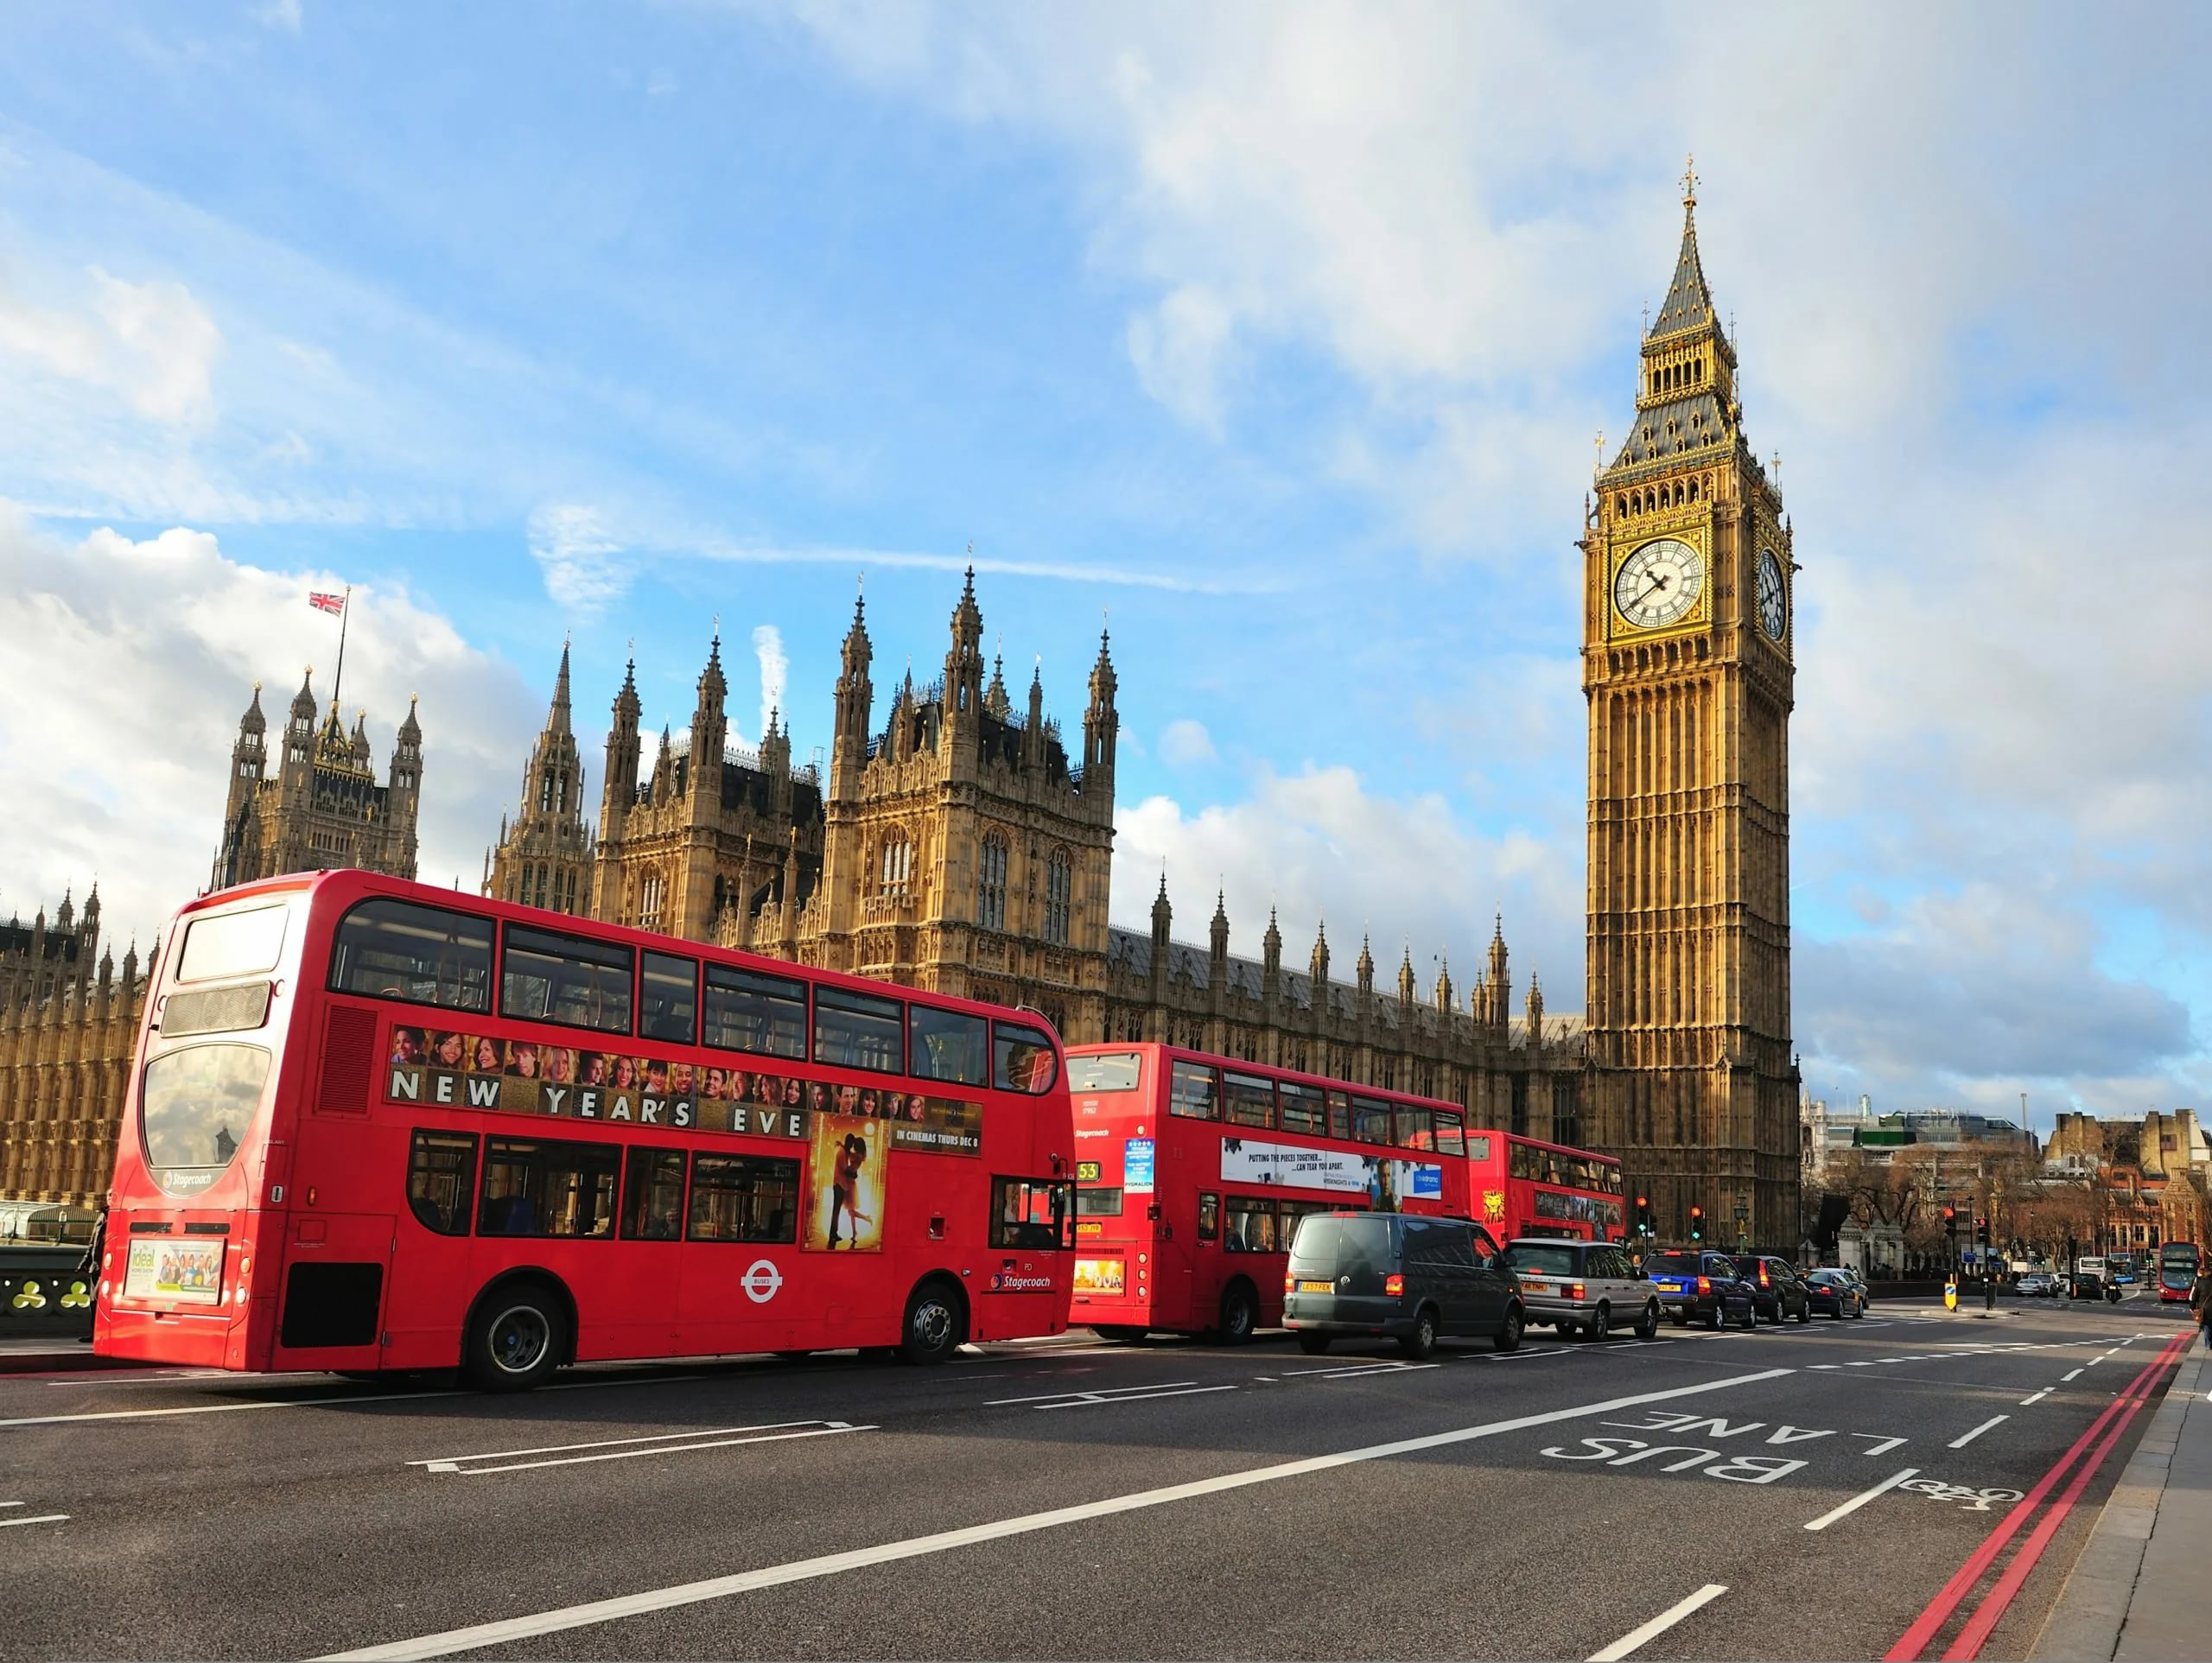
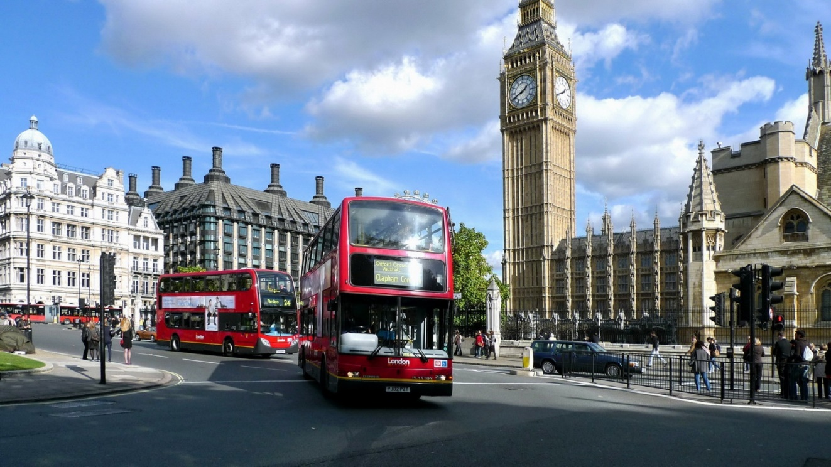
If you go to England …
… you will see…………..

Slide 12
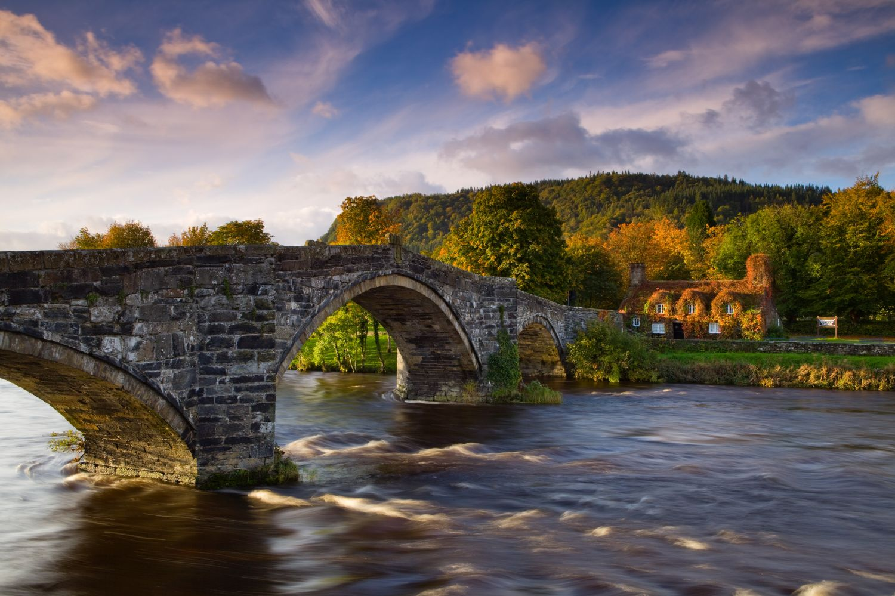
If you go to Wales …
… you will see…………..

Slide 13
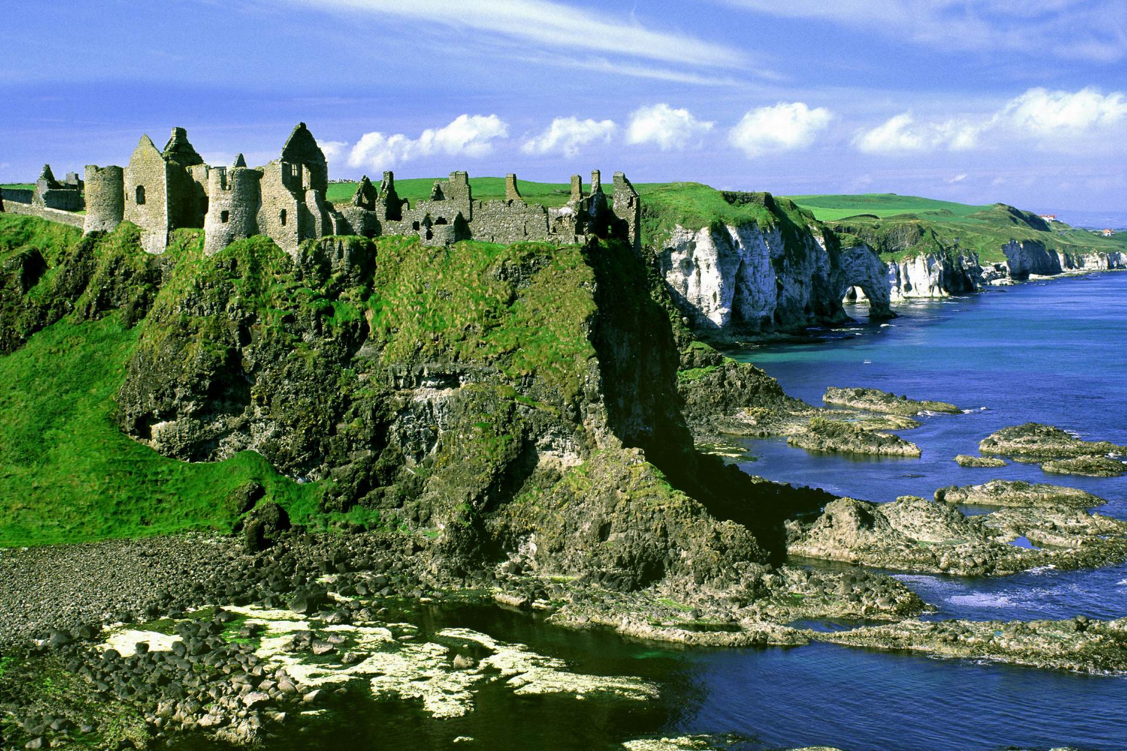
If you go to Ireland …
… you will see…………..

Slide 14

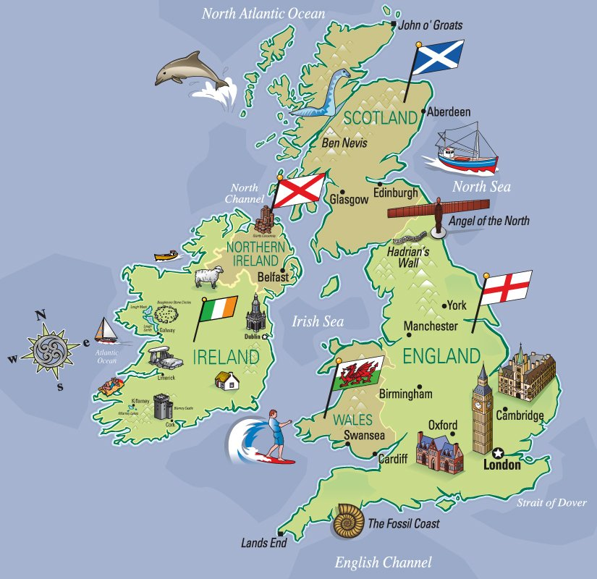

the
……. British Isles
the
……. English Channel
the
……. Atlantic Ocean
the
……. Irish Sea

Slide 15
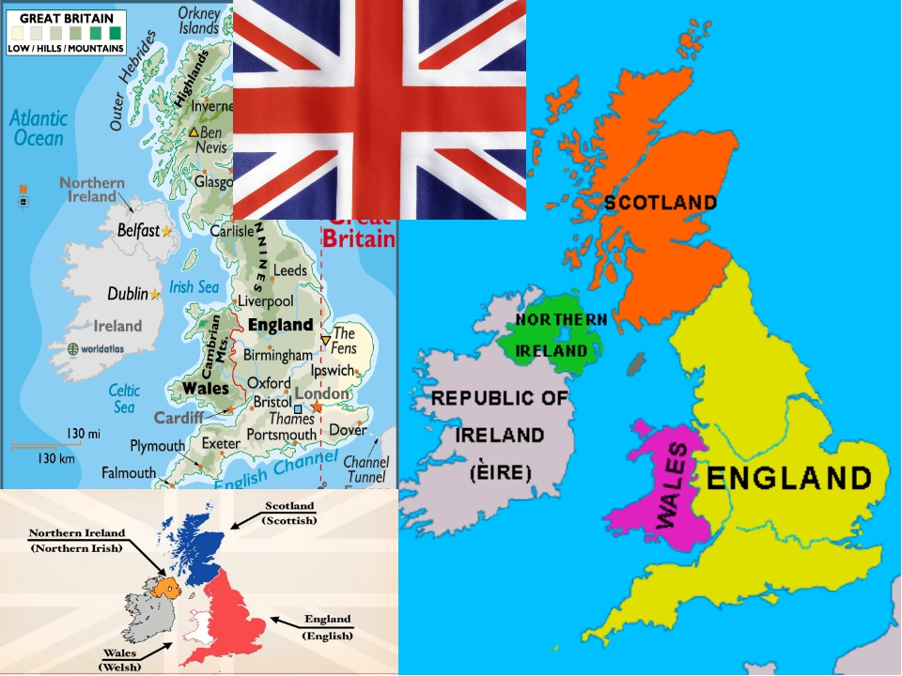

-
……. Great Britain
-
…. Northern Ireland
-
…. Wales
-
…. Scotland
-
…. England

Slide 16
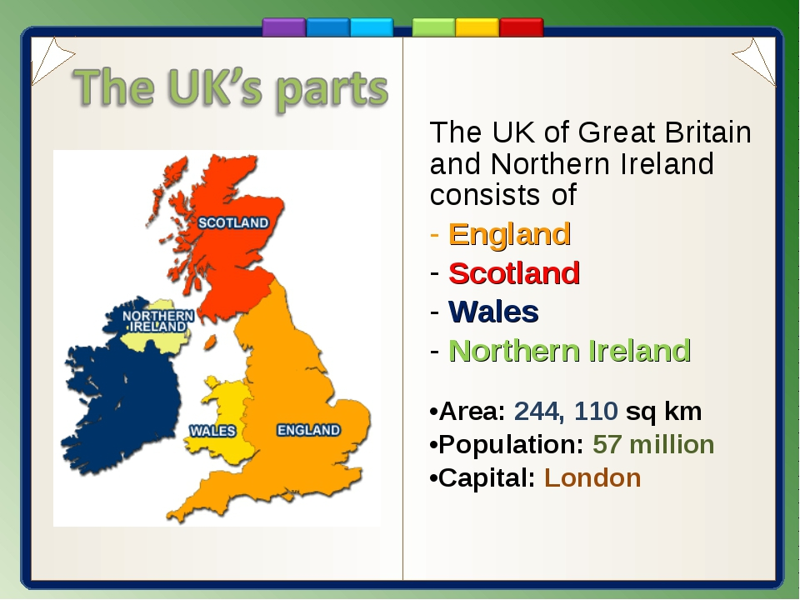
the
……. United Kingdom= ……UK
the

Slide 17

Where would you like to fly:
to Britain or England or the UK?
Why?

