Slide 1
The 22nd of January
Plan
About myself
Review animals
Learn verb was|were
Байсувакова Юлия Ришатовна

Slide 2
Hello! Nice to meet you!
My name is Yuliya Rishatovna.
I am an English teacher.
I’m 30 years old.
I can swim and sing.
What about you?

Slide 3
About myself
My name is….
I am a student.
I’m …years old.
I can…(swim, ski, skate, sing, read, play football/hockey)

Slide 4
Funny animals

Slide 5
What animals do you know?

Slide 6
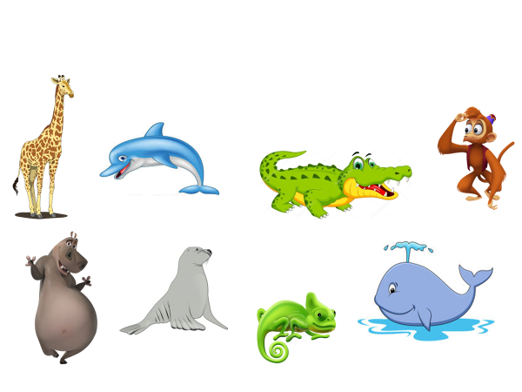

Slide 7
Where can you see animals?

Slide 8
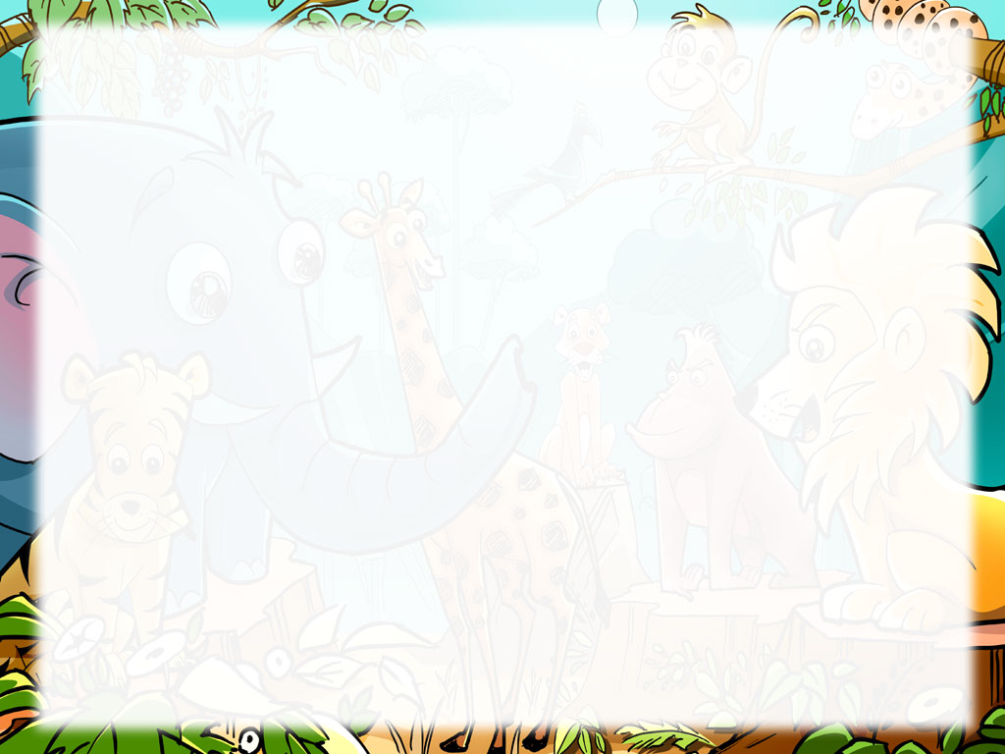
Welcome to the zoo!
I can go to the zoo,
I can see a kangaroo,
I can see a tiger too,
When I go to the zoo.

Slide 9
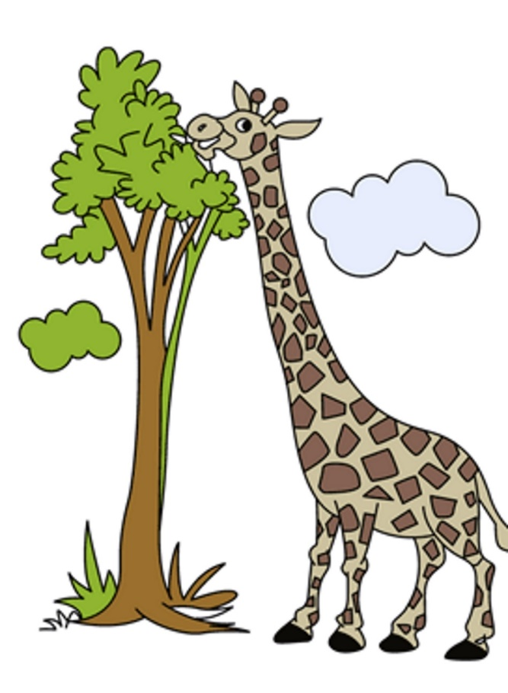
a tall giraffe

Slide 10
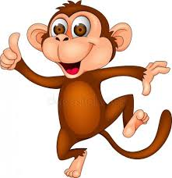
a silly monkey

Slide 11

a clever dolphin

Slide 12
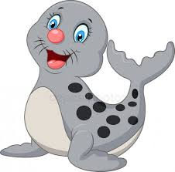
a little seal

Slide 13

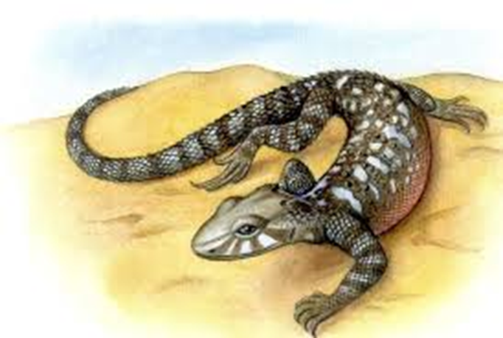
a lazy lizard

Slide 14

a big whale

Slide 15
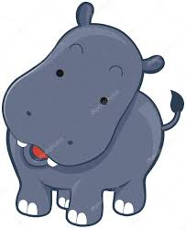
a baby hippo

Slide 16
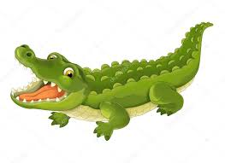
It is a crocodile
It is…
It has got…

Slide 17
Read and match
a baby hippo a) умный дельфин
a lazy lizard b) высокий жираф
a big whale с) ленивая ящерица
a clever dolphin d) бегемотик
a little seal е) большой кит
a silly monkey f) маленький тюлень
a tall giraffe g) глупая обезьяна

Slide 18
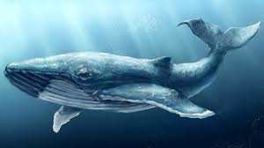
Guess the riddles
1. It is one of the biggest animal in the world. It lives in the water. It likes fish. Now it is swimming. It is having lots of fun.

Slide 19
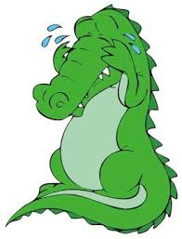
2. It is green. It has a long tail. It lives in the water. It can be very terrible and aggressive. It likes to eat meat and fish. Now it is crying because he has no friends.

Slide 20

3.It is taller than the hippo. It has a long neck. It lives in the warm countries. It likes to eat grass and leaves. Now it is eating from a tree.

Slide 21
I, She, He, It + was
You, They, We +were

Slide 22
was|were (был,были)
I was at home yesterday
He was at home
She was at home
It was at home
You were at home
They were at home
We were at home

Slide 23


