Slide 1






A magic trip to English Land

Slide 2

Dear friends, today you are passengers of this train. We are going to travel to English Land…

Slide 3
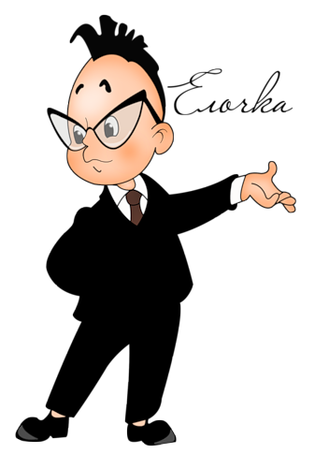
«Phonetic station»

Slide 4
1.Name the sounds
[t], [p], [s],[j],
[ai], [u:],[e],[æ],
[ei], [ks],[h],[w]

Slide 5
2.Name the sounds
[d],[r],[l],[z],
[b],[ʤ],[ai],[ju:],
[m],[t],[p],[əʊ]

Slide 6
Well
done!

Slide 7
2. Read the words in transcription
[faiv] [tri:] [laik] [blu:]
[foks] [pig]
[frendly] [smo:l]
[kju:t] [sili]

Slide 8
2. Read the words in transcription
[milk] [faiv] [sma:t]
[kaind] [kæt] [breiv] [ɒrinʤ] [fʌni] [gri:n] [maʊs]

Slide 9
Well
done!

Slide 10


Slide 11
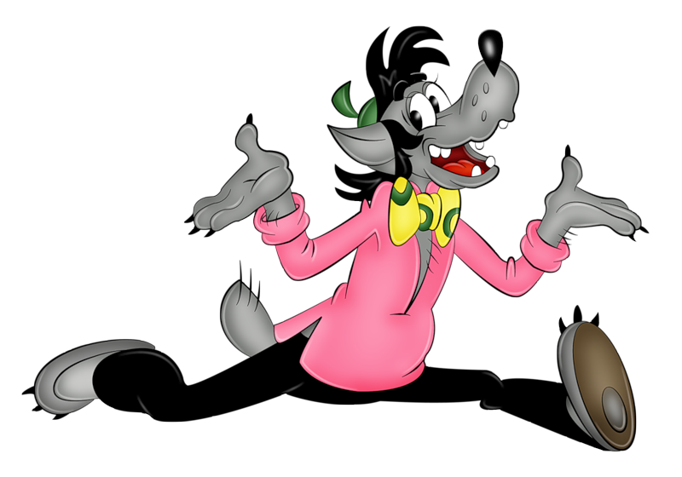
«Lexical station»/ «Лексическая станция»

Slide 12
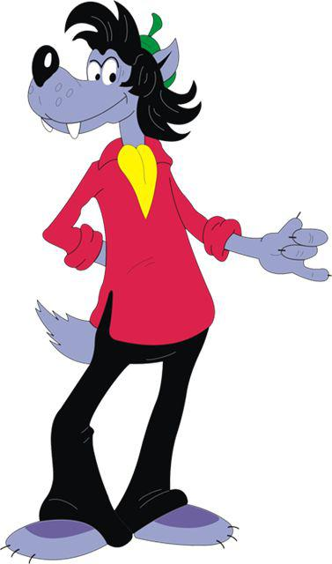
1. Guess the message.
Расшифруй предложение, используя код.

Slide 13
1.We are pupils.
2.Every day we go to school.
3.We love English.

Slide 15
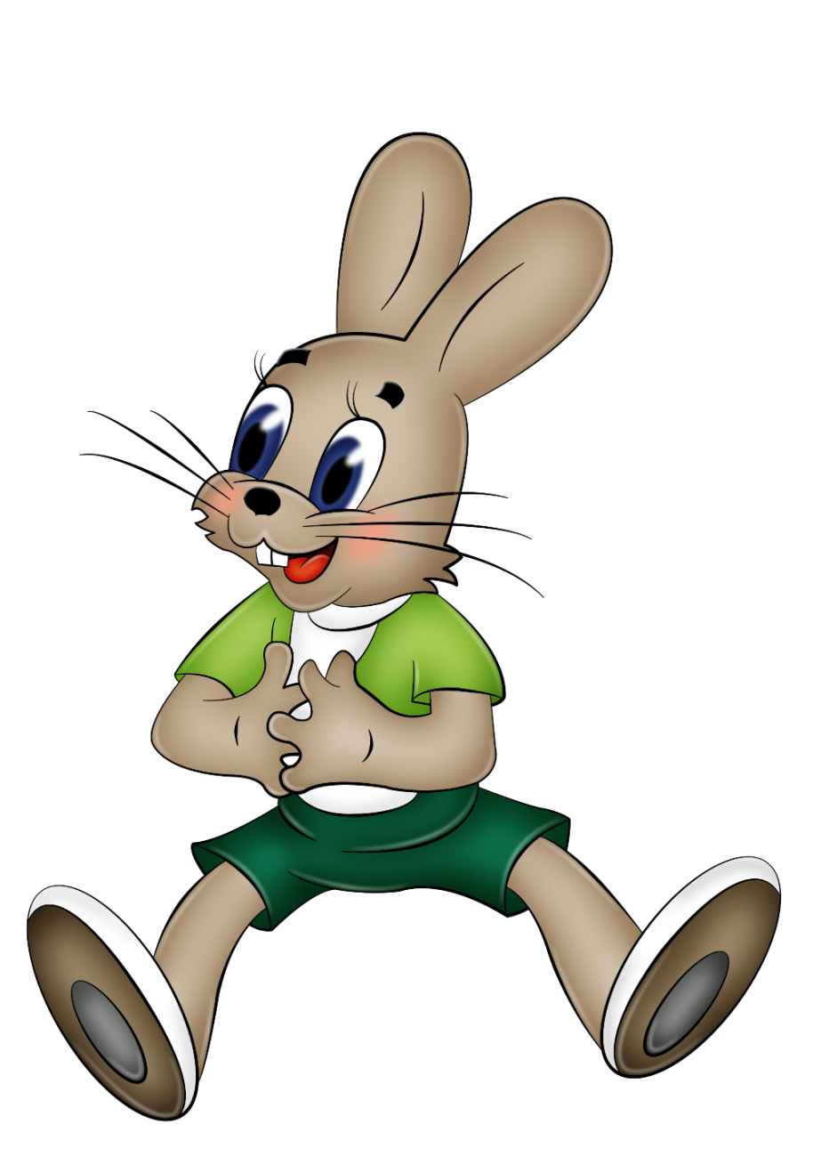

Find pairs.
Найди рифму
к словам

Slide 16
1-я команда:
для 2-я команда:
mouse – house
cat - hat
pen-hen- ten
hi-pie
name- game
box -fox
donkey-monkey
cock-clock
carrot-parrot
fine-nine
how-cow
my-bye

Slide 18
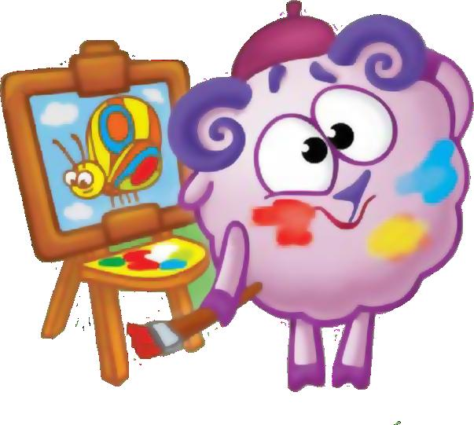
«Station of paintings»
Нарисуй инопланетянина по описанию:
He is not big. His body is long. His head is big.
He has big green eyes, a big mouth and a short nose. His ears are long. He has two long arms and two short legs. His feet and hands are big, his fingers and toes are long.

Slide 20
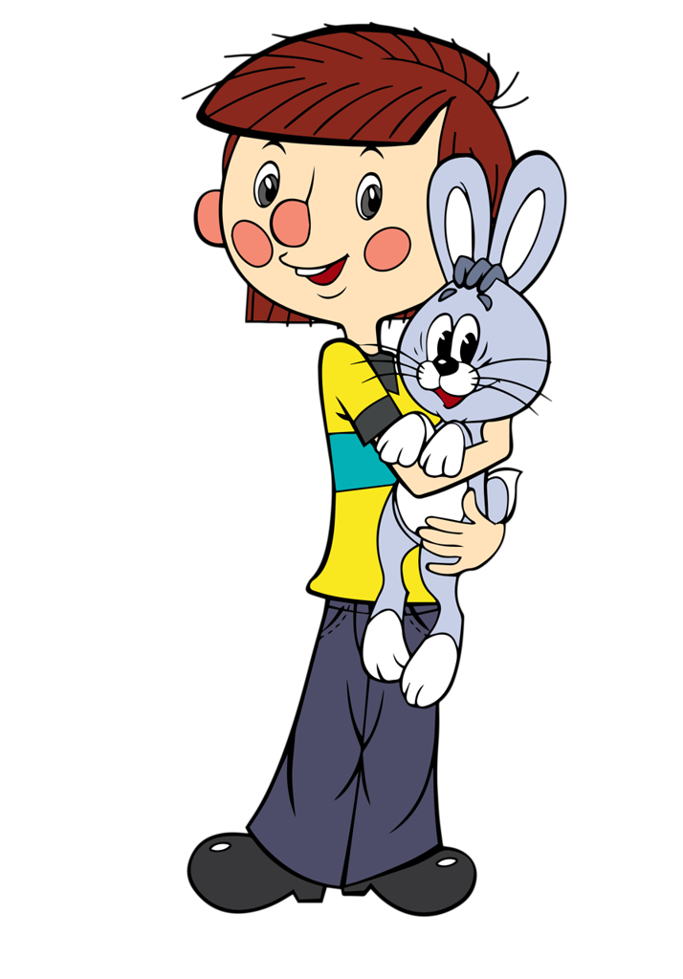
«Grammatical station»
Вставьте пропущенные слова в предложения:
to be (am /is /are);
Have got / has got

Slide 21
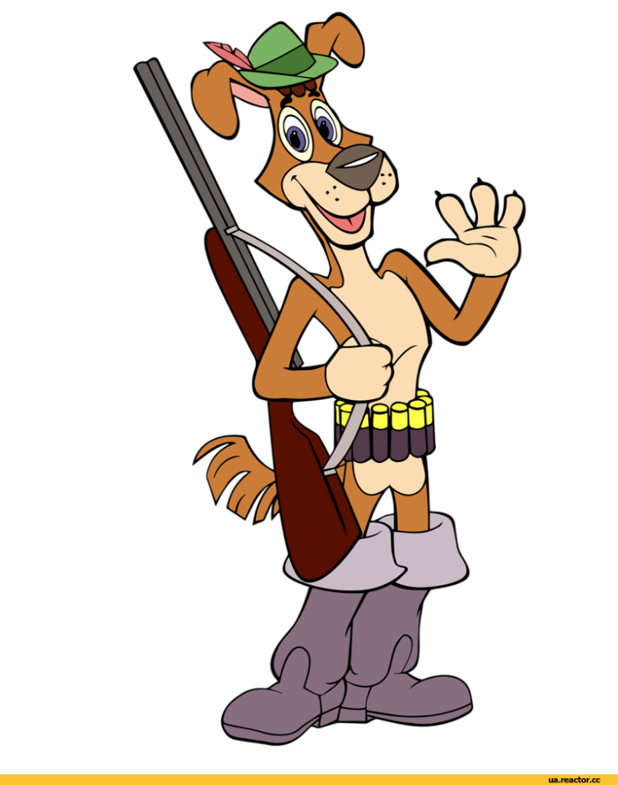
1. I _____ a dog.
2. My name __ Sharik.
3. I __ smart and strong.
4. My friend__Diadia Fiodor.
5. We __ friends.

Slide 22
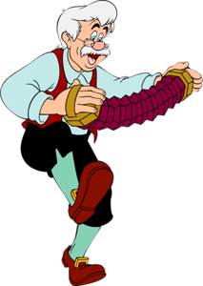
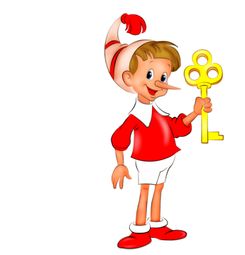
Buratino a father.
has got

Slide 23

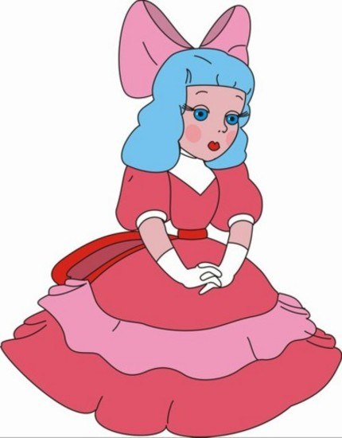
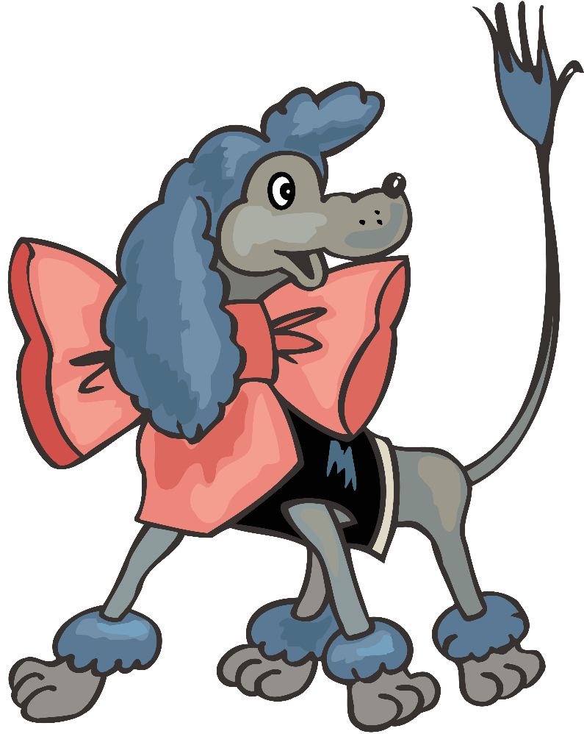
Malvina a dog.

Slide 24
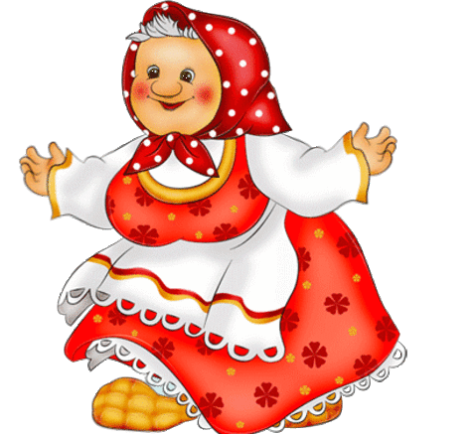
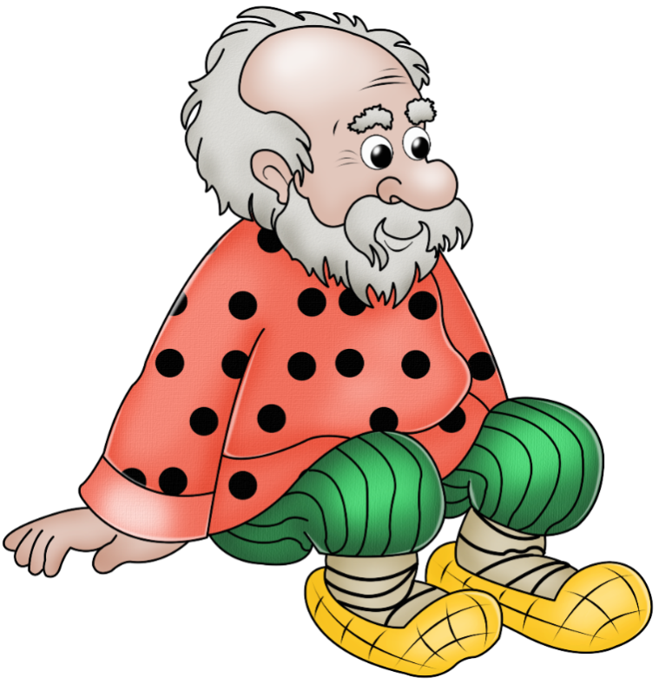

Koloboк grandparents.

Slide 25
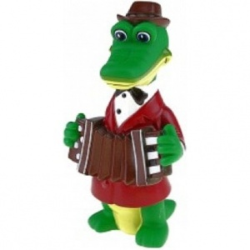

4. Cheburashka and Gena the Crocodile friends.
have got

Slide 26

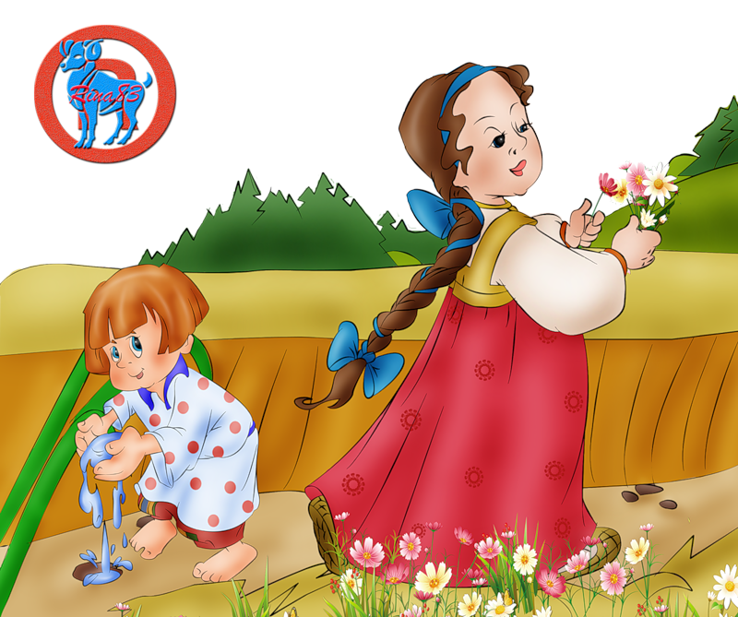
Alionushka a brother.

Slide 28
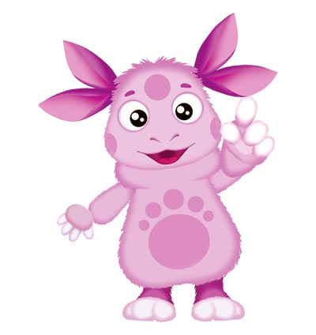
«Station of Riddles»/
Read the text and
guess the riddle.

Slide 29
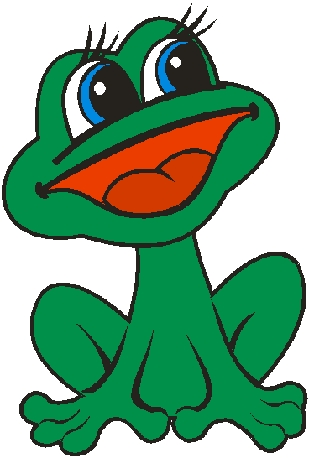
I am very little.
I am green. I can jump. I can swim.
I eat flies.
I can croak.
Who is it?

Slide 30
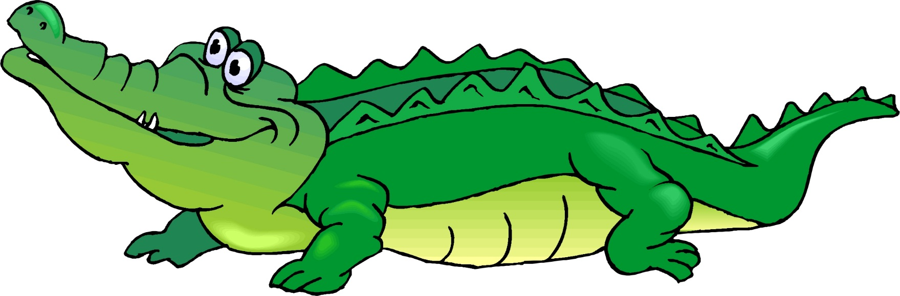
Who is it?
I am from Africa. I am green.
I am big. I am strong. I can swim very well. I like fish.

Slide 31
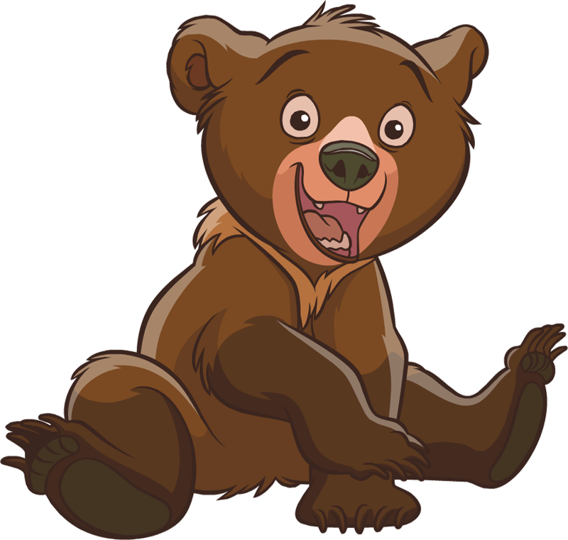
I am from Russia.
I am very big and brown. I can run, climb. I live in the forest. I like honey.
Who is it?

Slide 32
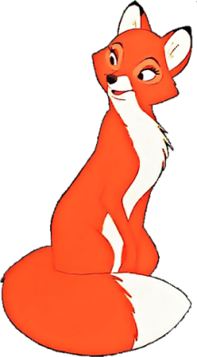
I am not big. I am not small. I am cunning.
I am orange. I like mice, chickens and hares.
Who is it?

Slide 33
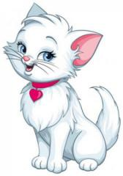
I am not small.
I am not big. I can run, jump, climb.
I like milk. I like mice. I live in the house.
Who is it?

Slide 34
«Station of proverbs»
Repetition – the mother
of learning.
The knowlege - the best
wealth.

Slide 35


Slide 36
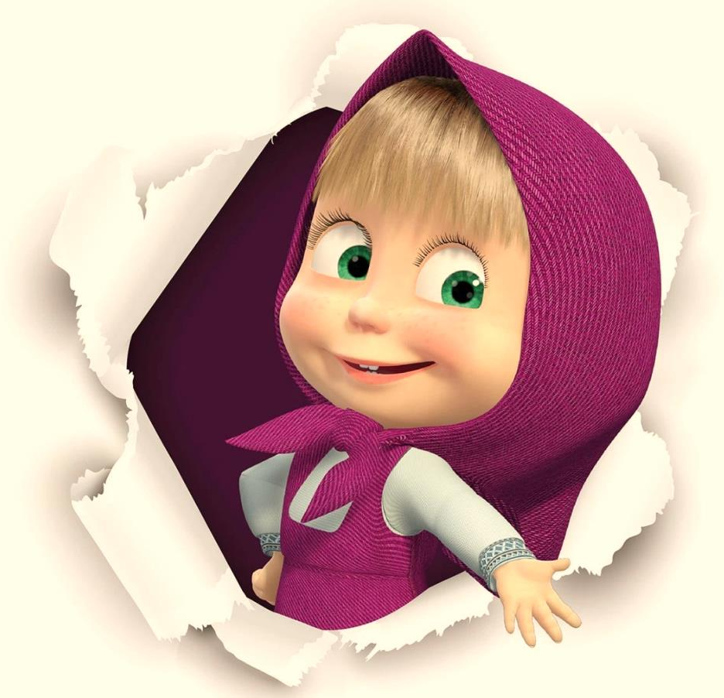
Thank you for the game. Keep it so! Good luck everybody!

