Slide 1
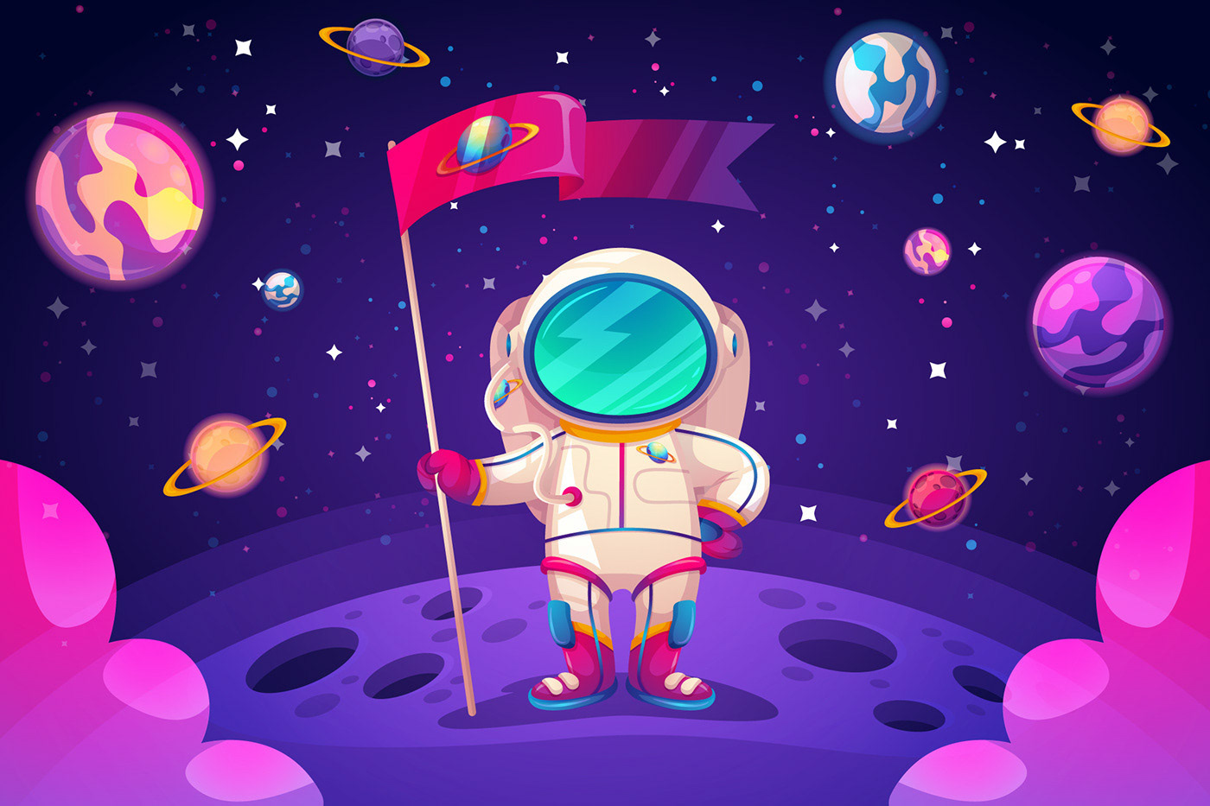
Past
Simple
start
Игру составила:
Учитель английского языка
Полякова С.С.

Slide 2

Dear boys and girls!
Let's go on an exciting space journey to distant planets and learn how to tell about past events.
start

Slide 3



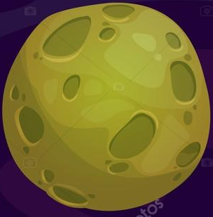



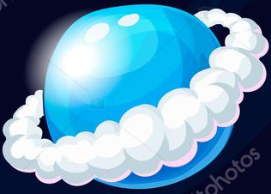
Exit

Slide 4
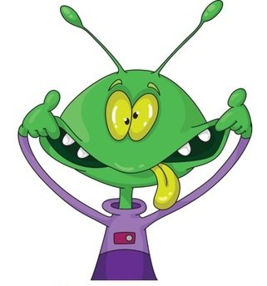
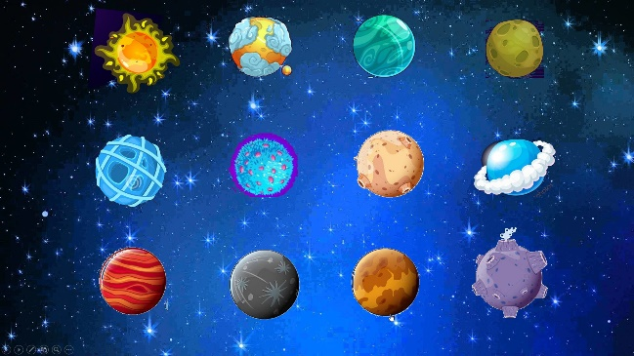
Нe……..funny.
were
was
are

Slide 5
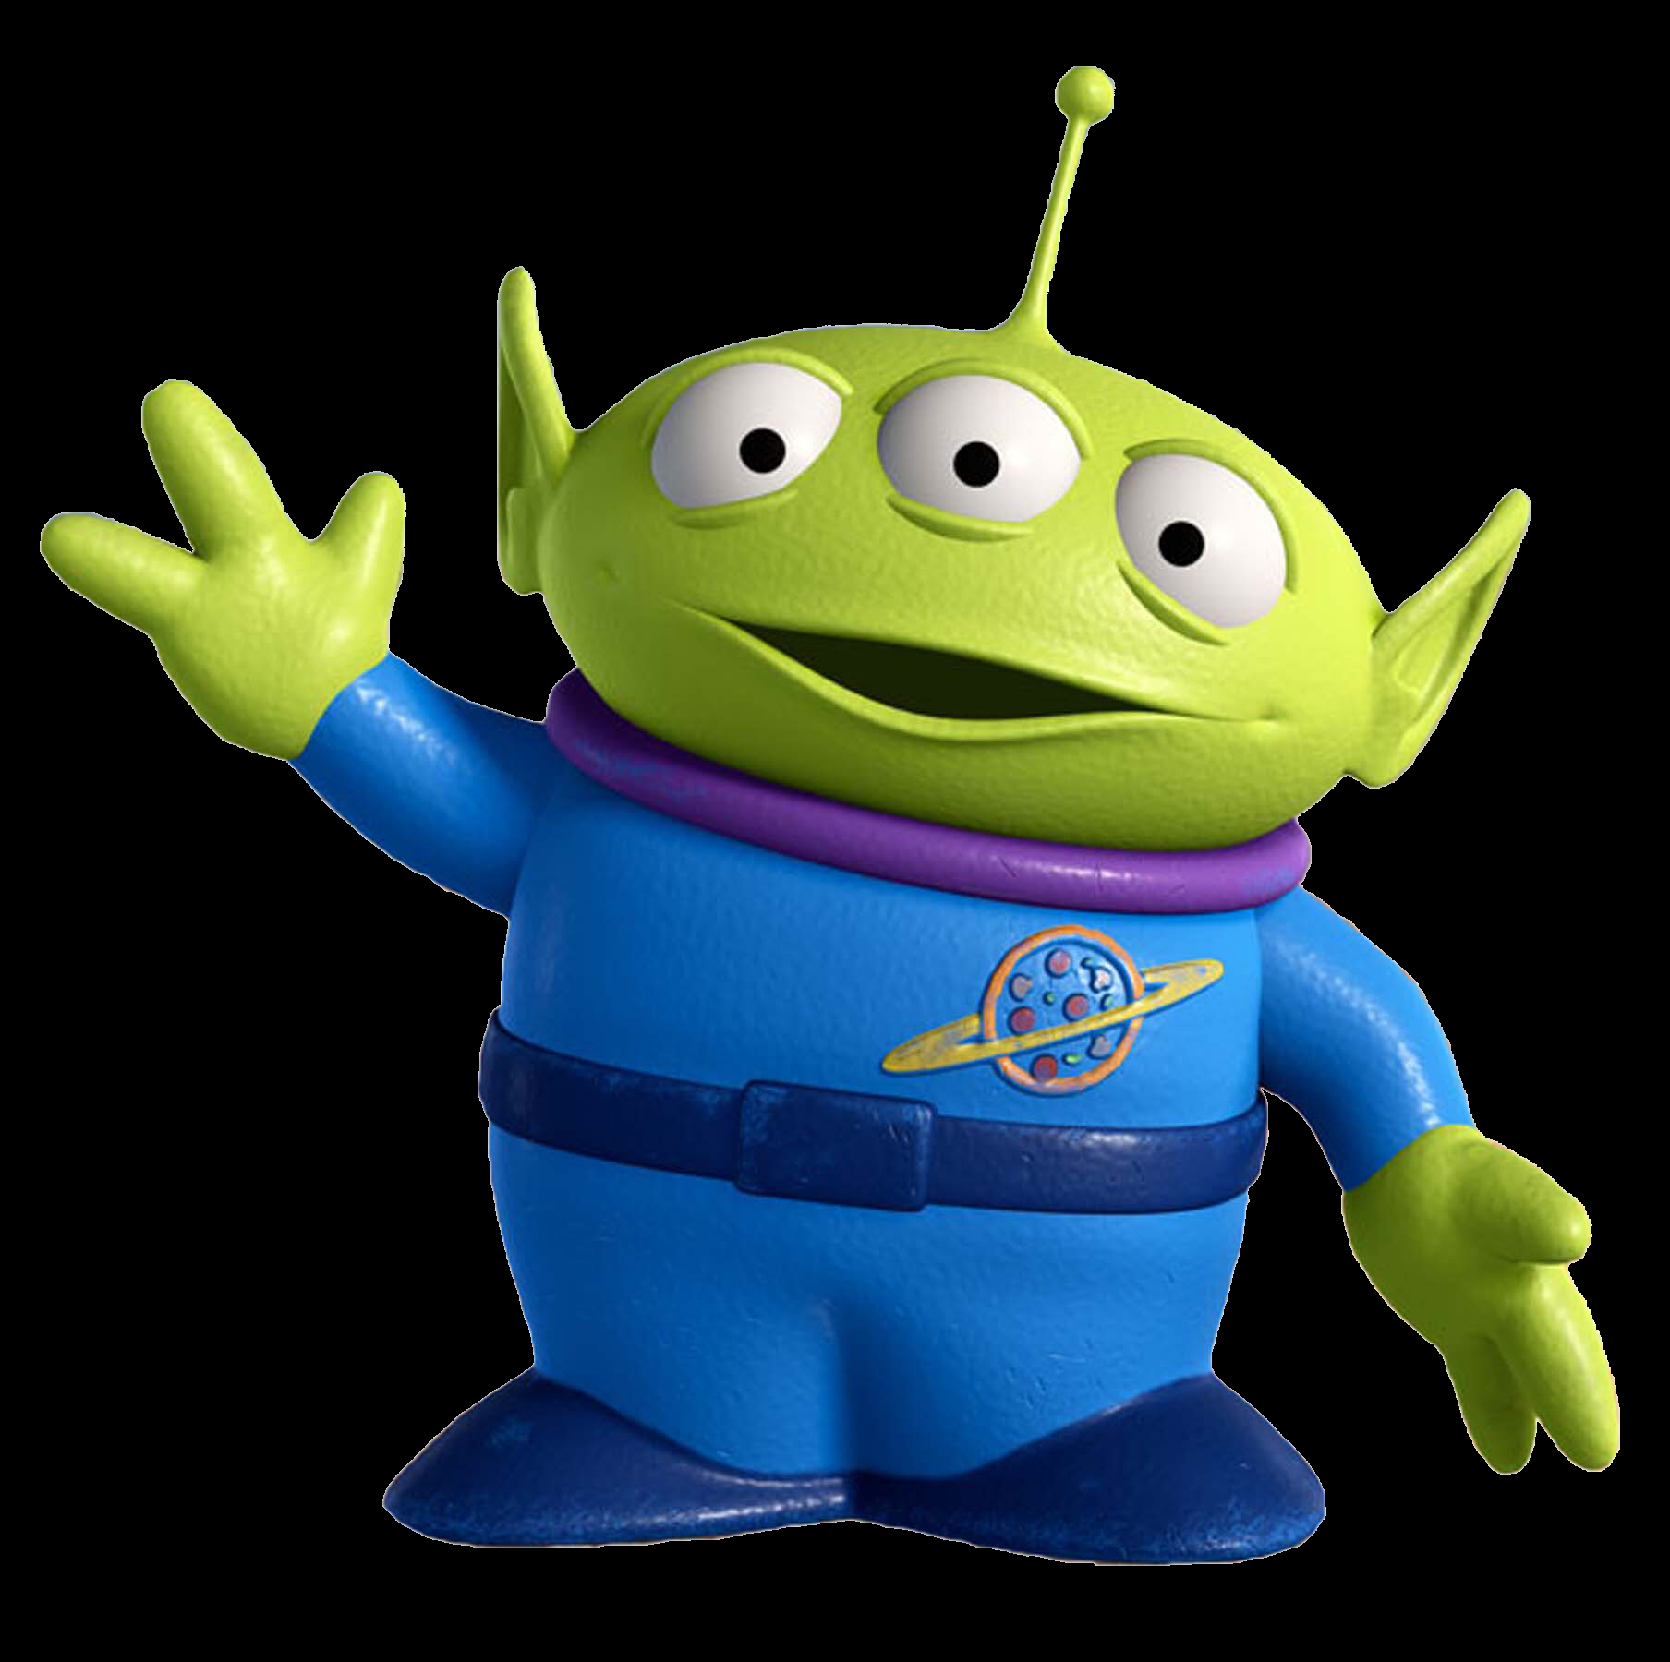
Нe……three eyes.
had
haved
haves

Slide 6

Нe……to music.
listened
listen
listens

Slide 7
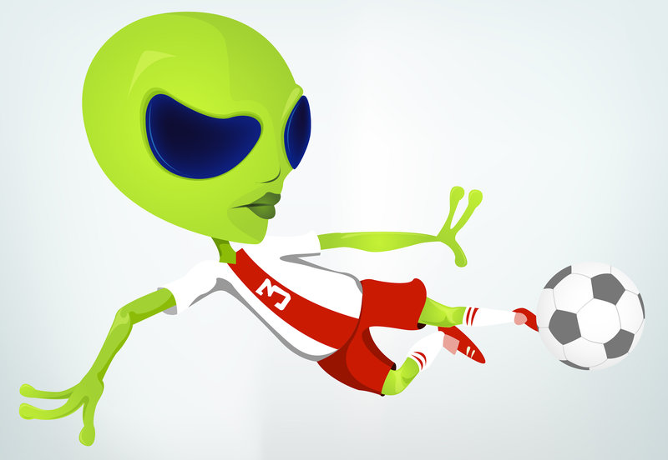
Нe……football
play
played
plays

Slide 8
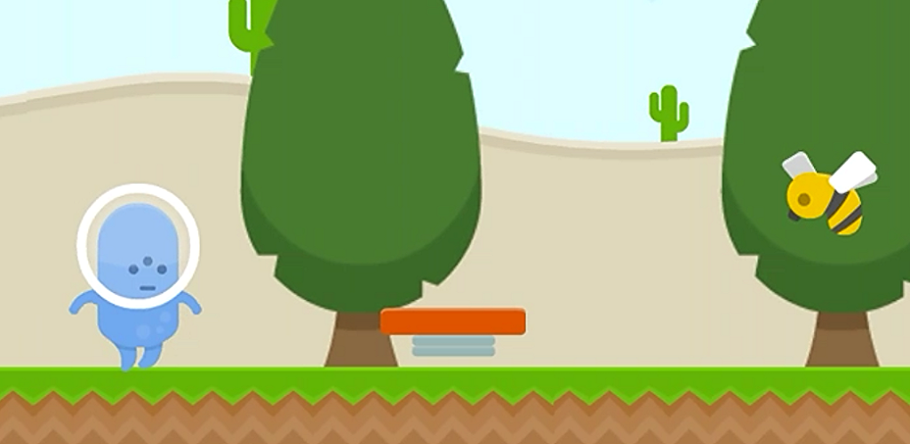
Нe……in the garden.
walk
walked
walking

Slide 9
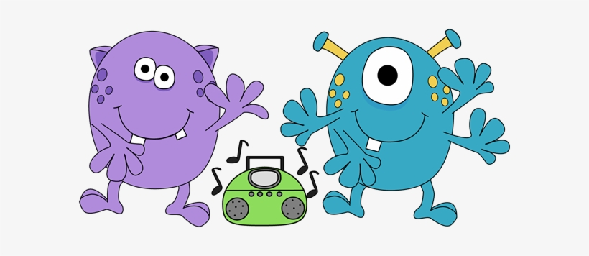
They……in space.
danced
dance
dances

Slide 10

He……in the cafe.
eated
ate
eats

Slide 11
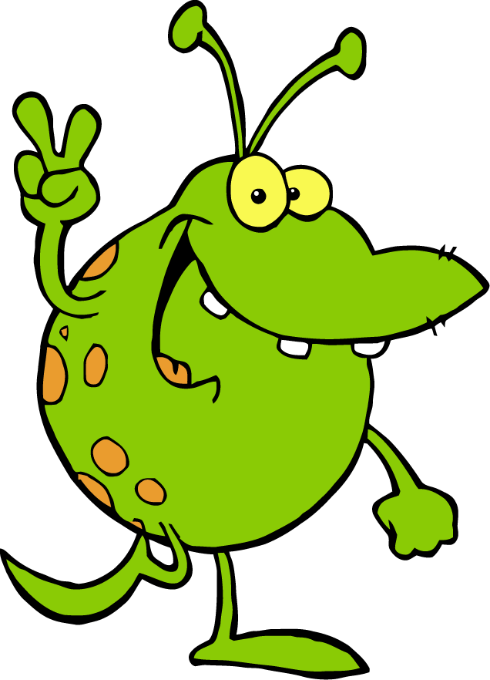
He…… «Hello!»
waves
waved
wave

Slide 12
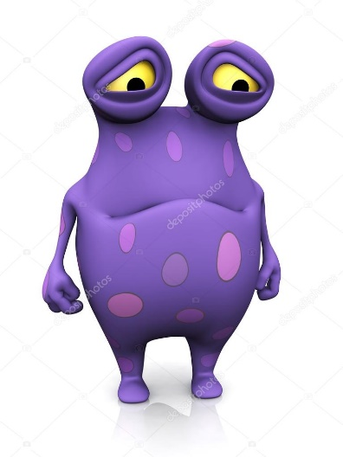
He…… very sad.
were
was
wased

Slide 13
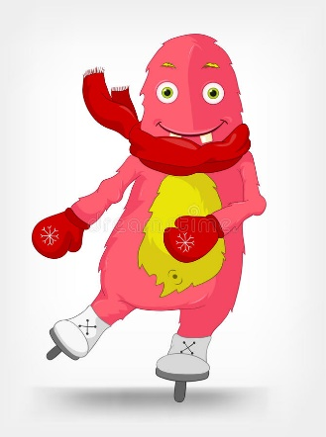
He…… very well.
scate
scated
skates

Slide 14
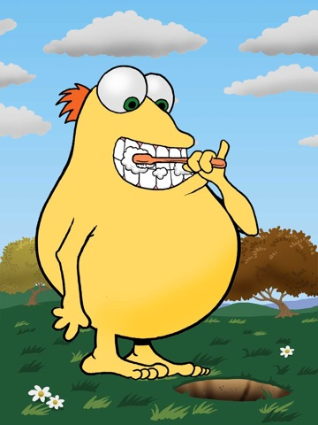
He…… his teeth.
brushes
brush
brushed

Slide 15
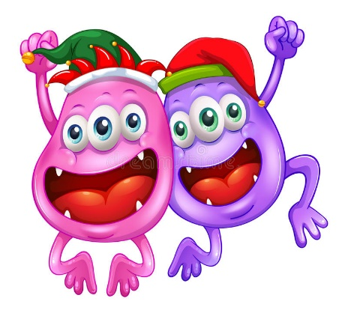
They…… happy.
were
was
are

Slide 16
You are winner!

