Slide 1
Stress free
МАОУ «Лицей №7»
Литвинчук Мария Сергеевна

Slide 2
Today we will speak about stress and we will learn how to deal with it.
So we are going to:
Discuss modal verb – should;
Discuss phrasal verb fall;
Listen and read the text;
Discuss the problem.

Slide 3


Slide 4
Переведите предложения и определите значение модального глагола (совет, обязанность, упрек, недоумение).
We should think twice before buying that yacht.
You should have thanked the teacher.
A real lady should be delicate in her words and doings.
Why should I wash their cups?
She shouldn’t be so light-minded.
They should inform the police immediately.
How should I know that?
You should have warned me beforehand.
The secretary should answer the phone-calls.
Your son should take part in this mathematical competition.

Slide 5
Найдите к каждой проблеме из левой колонки подходящий совет из правой.
He is 10 years younger than Sara.
My plants are dying.
I have put on 5 kilos lately.
Your hair looks greasy.
My telephone battery is getting low.
A. You should go and wash it.
B. She shouldn’t marry him.
C. You should connect the charger.
D. You shouldn’t eat so many sweets.
E. You should water them regularly.

Slide 6
Поставьте should или shouldn’t.
You … eat too much salt and sugar.
You … drive carefully.
It’s midnight. We … go home.
Your little daughter … spend so much money on toys.
It’s quite cold today. We … wear our jackets.
The service is awful here. We … complain to the manager.
Your shirt is dirty. You … change it.
The parcel is fragile. You … throw it.

Slide 7
apart
behind
fall
out with sb

Slide 8
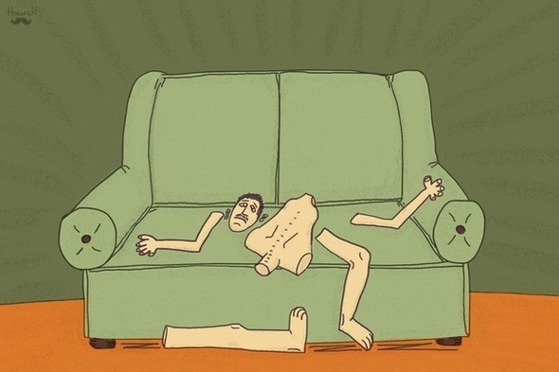
FALL APART
To collapse
To fall apart on the couch

Slide 9

FALL BEHIND
Not able to do sth on time

Slide 10

FALL OUT WITH SB
To quarrel and to stop being friends

Slide 11
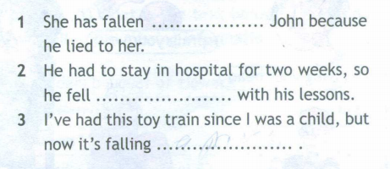

Slide 12
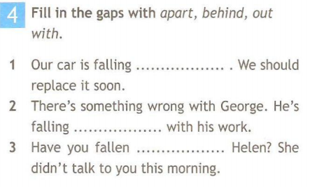

Slide 13


Psychologist
Which of the following stresses you the most?
Number the situations below from 1 (most stressful)
to 10 (least stressful) according to their stress factor!
to argue with a friend
to have a doctor’s appointment
to lose something valuable
to change schools
to move house
to sit tests/exams
to disagree with parents
to have too much homework
to have a party
to practice an instrument/sport
1- most stressful
5 - some stressful
10 - least stressful
?

Slide 14

Words
Click and open the words
Choose and click the words
бездельничать
вина
уйти от ответа
слухи
несправедливый
безвредный
болезненный
делать по-своему
разрешать
отделять
сотрудничать
sit round
blame
get away with
rumours
unfair
harmless
hurtful
have it your way
allow
separate
cooperate
cooperate
sit around
harmless
allow
separate
get away with
unfair
blame
hurtful
rumours
have it your way

Slide 15


Practice
Do’s
Learn to cooperate!
Make weekly plans!
Ask for help!
Get enough sleep!
Revise early for exams!
Take it easy!
Don’ts
Don’t believe everything you hear!
Don’t want it your way all the time!
Don’t leave things to the last minute!

Slide 16
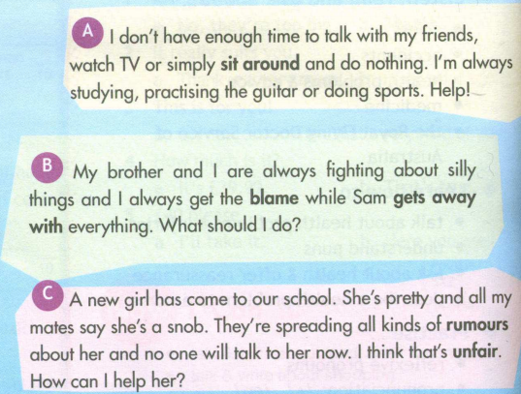
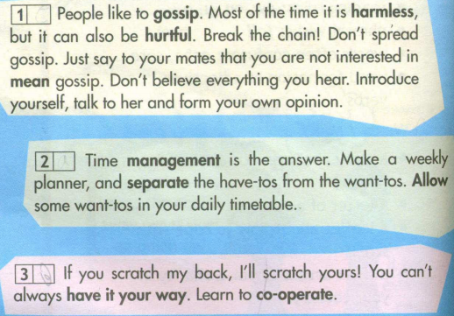

Slide 17
Home work
Make you own dialogue – You are in the stressful situation. Your partner gives you advices.

Slide 18


