Slide 1
Unit 2(8класс)
Food and Shopping

Slide 2
Match the words with the correct groups
vegetables
meat
fruits
potato
pineapple
banana
onion
pear
kiwi
pepper
melon
chicken
cucumber
apple
lamb
lettuce
orange
peach
beef
pork
cabbage
Notes:
Незнакомые слова записать в тетрадь!!!

Slide 3
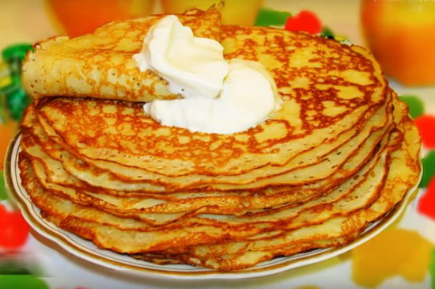
Russian national dish
Yummy!!!
Such a Russian national dish as blini should not be left unmentioned. Depending on the method of cooking and filling, blini can serve as a dessert or an appetizer. Blini are made of batter, which is poured on a hot frying pan and fried. Blini can be cooked of wheat, rye, oat, or buckwheat flour. They are served with run butter, sour cream, caviar, vinegar pickled mushrooms, berries or jam. Traditionally, blini have been cooked during the Maslenitsa festival, at the end of winter, before the Great Fast.

Slide 4
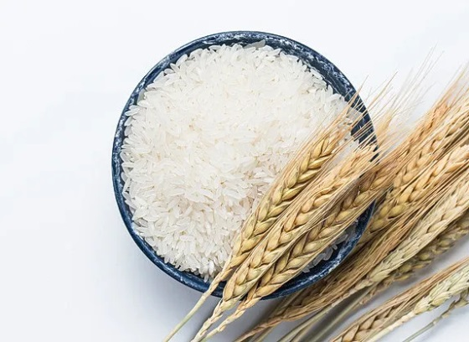
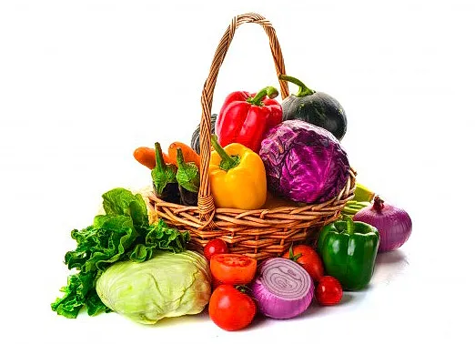
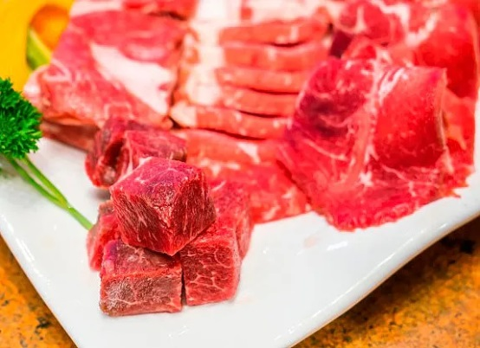









Ways of Cooking
Rice can be:
Vegetables can be:
Meat can be:
baked
baked
mashed
boiled
poached
boiled
fried
mashed
steamed
pickled
scrambled
scrambled
poached
steamed
pickled

Slide 5
Order of adjectives
Opinion
Size
Age
Shape
Colour
Pattern
Origin
Material

Slide 6
Phrasal verb
Go
down with заболеть
with подходить (об одежде)
up увеличивать
after преследовать
off
сломаться
through получить опыт
without справляться

Slide 7


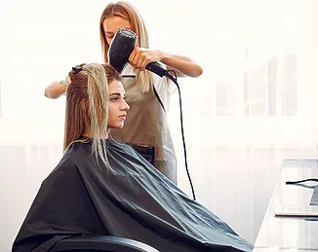

Which Place is It?
optician's
jeweller’s
bazaar
hairdresser’s

