Slide 1

Pension Fund of the Russian Federation
Презентационный материал
для обучающихся специальности
40.02.01 Право и организация социального обеспечения
преподаватель АНОО ВО «ВЭПИ»
Климова Е.В.

Slide 2
About Pension Fund
The Pension Fund of the Russian Federation (PFR) is a major social institution of the country. It is the biggest federal network rendering state services in the field of social security in Russia.
The Pension Fund structure is comprised of eight offices in federal districts of the Russian Federation, 84 Pension Fund offices in constituent territories of the Russian Federation including the town of Baikonur (Kazakhstan), and nearly 2,460 territorial offices in every region of the country. The PFR system employs over 100,000 specialists.

Slide 3
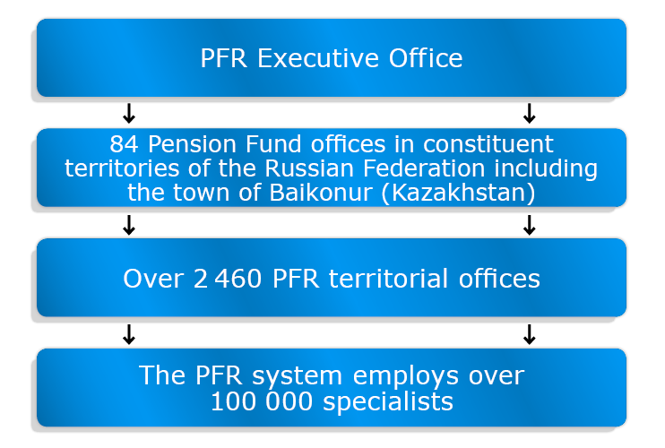

Slide 4
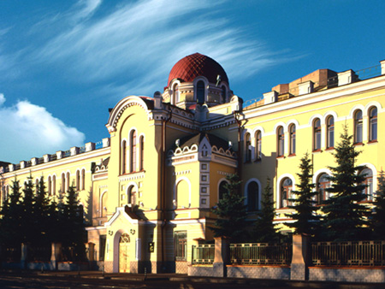
A new financial institution, the Pension Fund of the Russian Federation (PFR), founded on December 22, 1990, was entrusted with those tasks. The country created its first autonomous off-budget system to fund social benefits and to provide sources of pensions.
Offices of the Pension Fund of Russia opened in every constituent territory of the Federation in 1991-1992.

Slide 5
Pension System in the Russian Federation
The Pension Fund of the Russian Federation assigns and pays various types of pensions and social benefits to over 338,000 Russian citizens residing in 128 countries.
As of today, Russia has the following types of pensions:
Insurance pension (three types: old age, disability and loss of breadwinner);
State pension (four types: long service, old age, disability and loss of breadwinner);
Social pension;
Funded pension.
And social benefits:
Monthly benefits (including a package of social services);
Monthly supplement to benefits.

Slide 6
Types of Pensions
At present, Russia pays the following types of pensions:
An insurance pension;
  Old age;
  Disability;
  Loss of breadwinner;
A state pension (long service, old age, disability, loss of breadwinner);
A social pension;
A funded pension.

Slide 7
Pension Calculator
The main task of the pension calculator is to explain the emergence of your pension entitlements and the calculation of your insurance pension and to demonstrate how your insurance pension depends on:
the size of your wage;
the size of your income as self-employed citizen;
your pension plan in the mandatory pension insurance system;
years of employment (insurance record);
military service by conscription, maternity leave and other socially significant periods of your life;
pension claim filed after the standard retirement age.
Enter your monthly wage before deduction of your personal income tax:
Results of insurance payment calculation are strictly advisory and should not be viewed as the actual size of your future pension.

Slide 8
Types of Social Benefits
Pursuant to current laws of the Russian Federation, veterans, persons with disabilities, including children with disabilities, former underage prisoners of the Nazi and persons impacted by radiation in radiation accidents and nuclear tests are entitled to monthly benefits (MB) payable by PFR.
Monthly benefits are also provided to citizens of the Russian Federation from amongst following groups:
Awarded the title of the Hero of the Soviet Union, the Hero of the Russian Federation or the Glory Order of three degrees (the full Glory Order);
Family members of deceased (killed) Heroes or holders of the full Glory Order (widow (widower), parents, children younger than 18, children older than 18 who developed a disability before they reached the age of 18 and children younger than 23 studying full-time);
Awarded the title of the Hero of Socialist Labor, the Hero of Labor of the Russian Federation or the Labor Glory Order of three degrees (the full Labor Glory Order)

Slide 9
Источники:
https://pfr.gov.ru/en/pens_system/types_soc/
https://pfr.gov.ru/

Slide 10
Спасибо за внимание.

