Slide 1
Quiz on British and American culture
9 Grade
Масленникова Е.С.
Лицей №36
Г.Н.Новгород

Slide 2
Go on1 |  | Go on2
Go on3 |  | Go on4
The UK |  | The USA
10 | 10 | 10 | 10
30 | 30 | 30 | 30
50 | 50 | 50 | 50
75 | 75 | 75 | 75
100 | 100 | 100 | 100

Slide 3
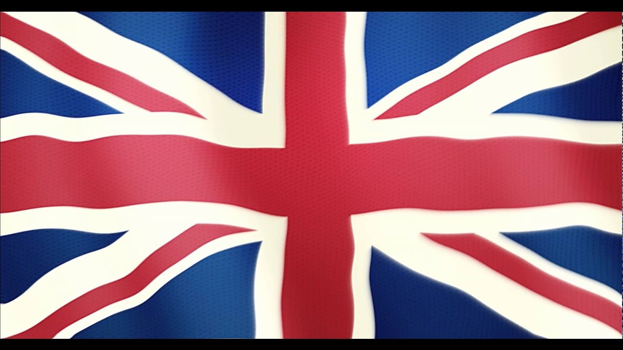
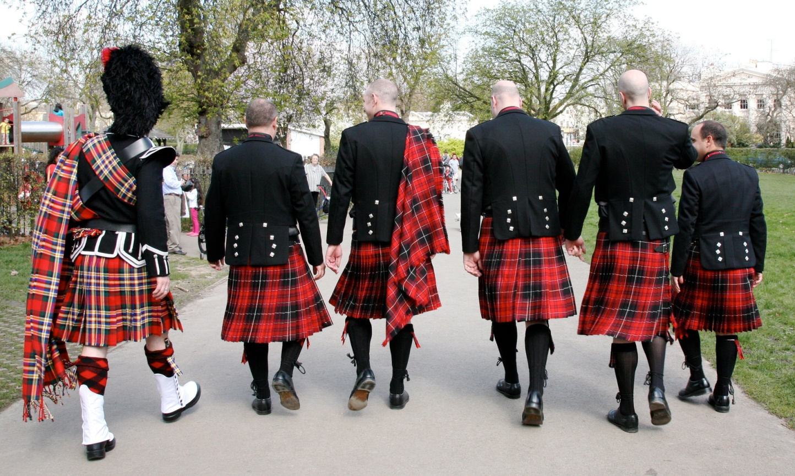
10
What is the national costume of Scottish men?
Kilt

Slide 4
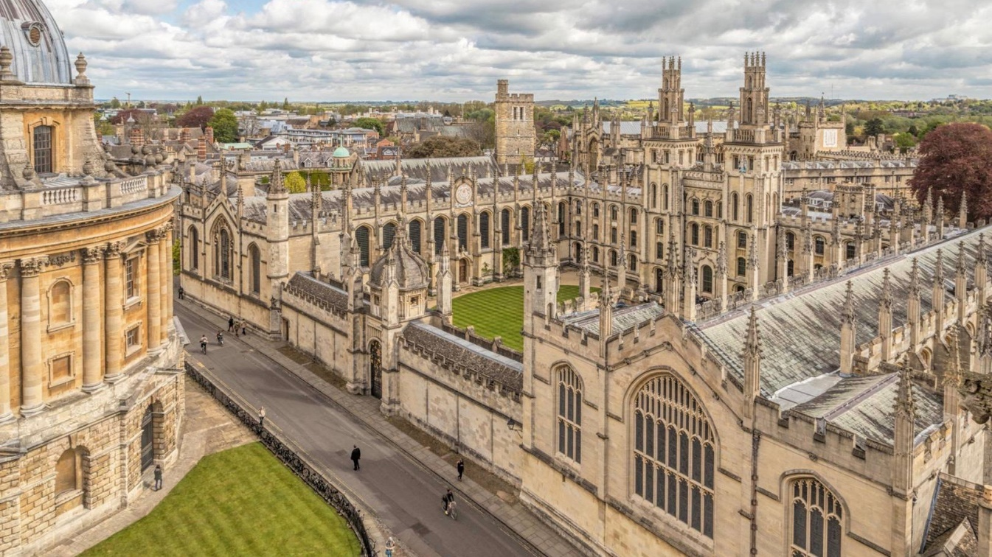
10
The university with history which goes back to 1096 and is considered to be one of the oldest
Oxford

Slide 5
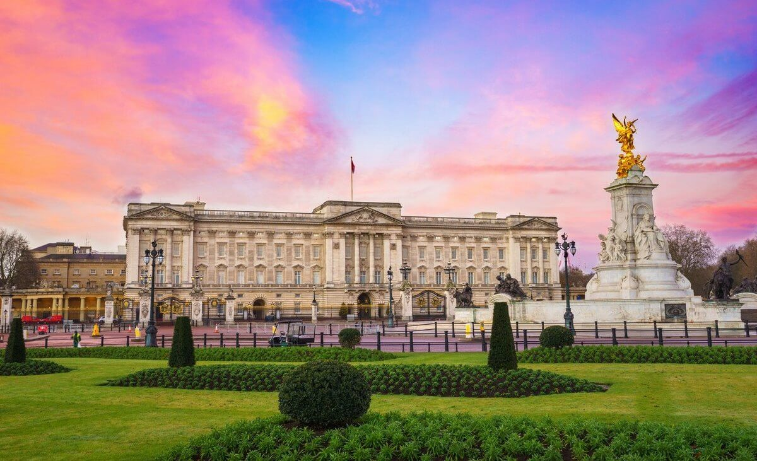
30
Where does the British Monarch live?
Buckingham Palace

Slide 6
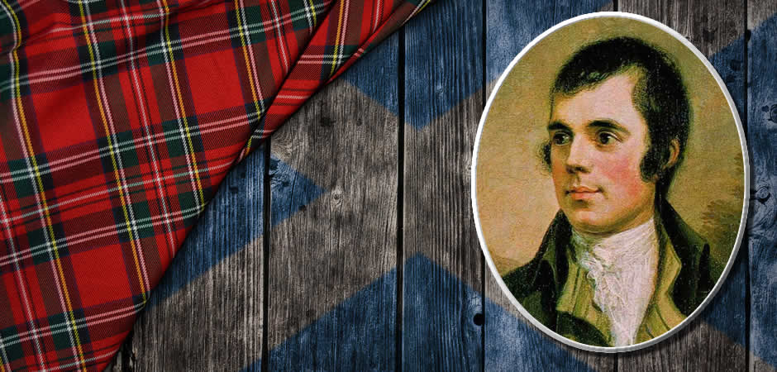
30
Traditional Skottish New Year song “Auld Lang Syne” was written by…
Robert Burns

Slide 7
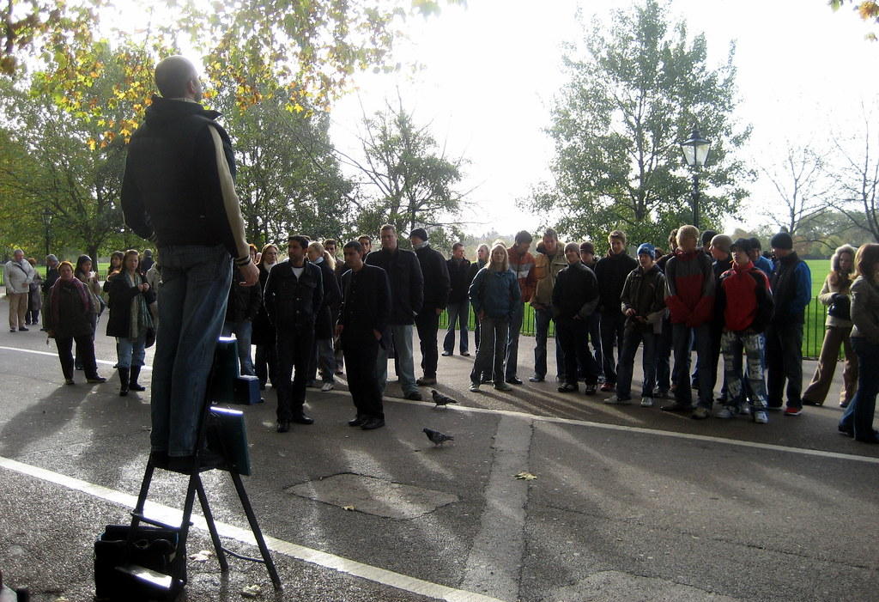
50
What’s the speakers’ corner in Hyde Park
The place where one can freely speak up their ideas

Slide 8
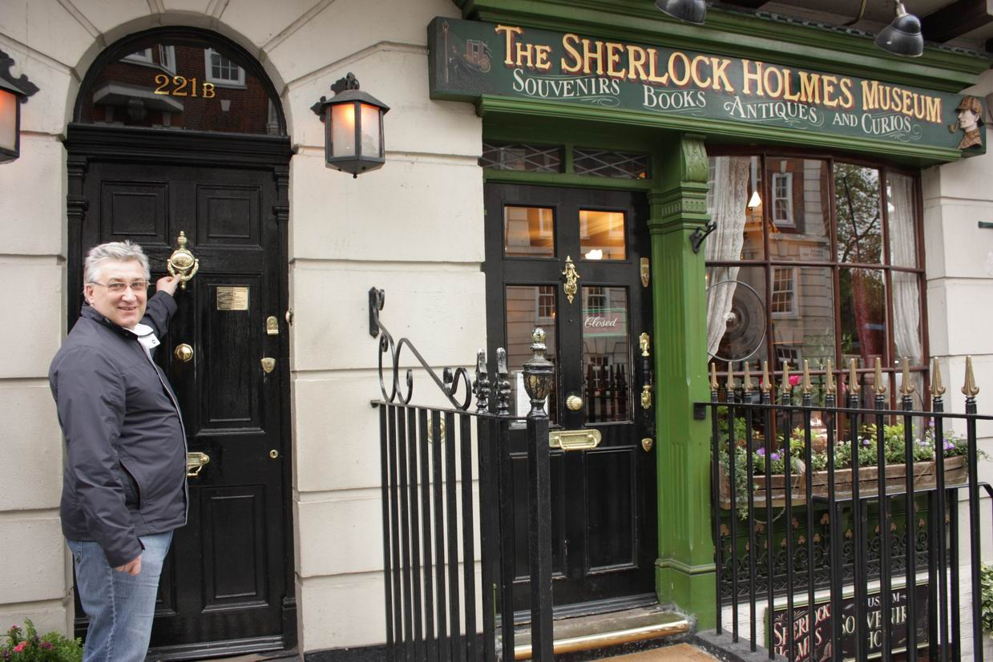
50
Name the street, where the main character of Arthur Conan Doyle’s detective stories Sherlock Holmes Lives
Baker’s street

Slide 9
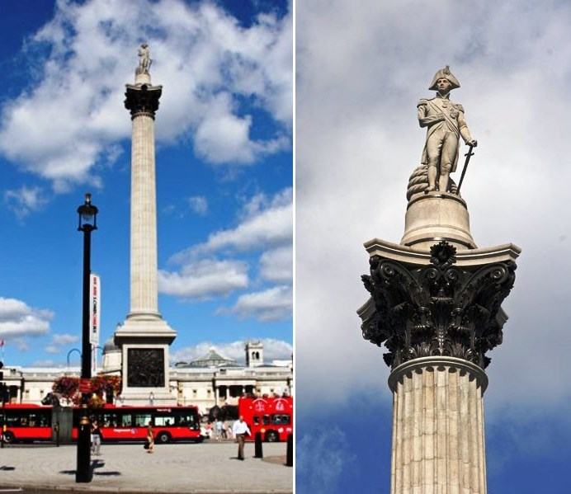
75
What’s there in the center of Trafalgar's square?
Nelson’s column

Slide 10
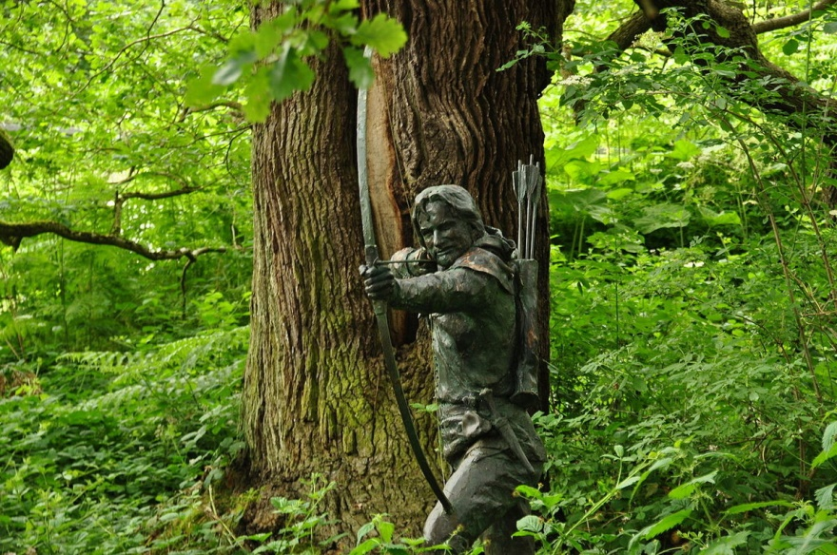
75
Name English forest which became famous thanks to Robin Hood, heroic outlaw originally depicted in English folklore.
Sherwood's forest

Slide 11
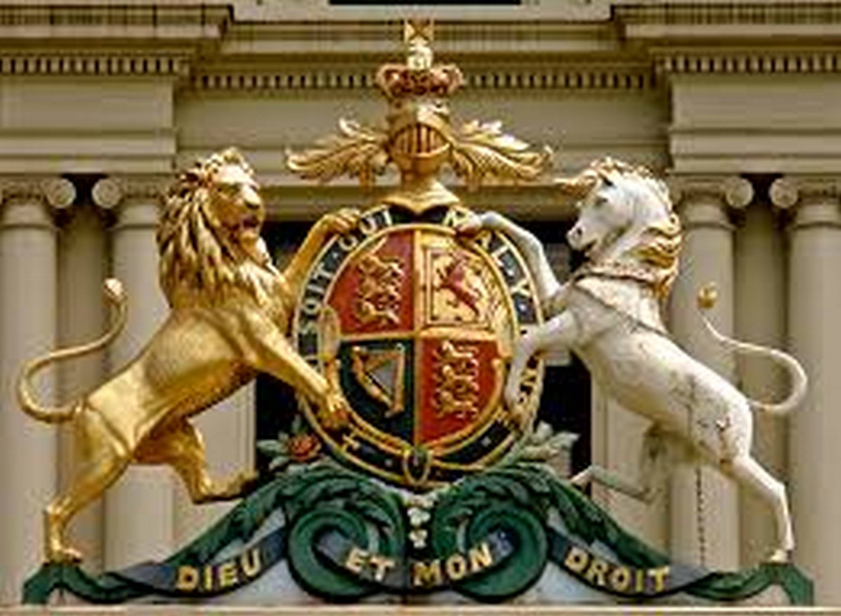
100
What animal, depicted on British coat of arms as the symbol of strength and might?
Lion

Slide 12
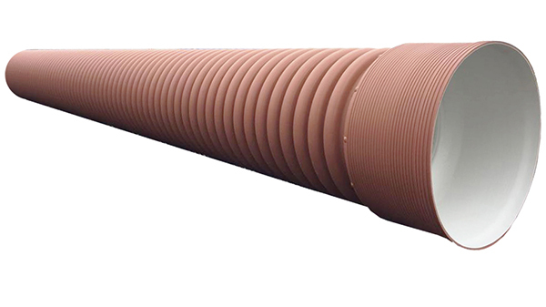
100
What’s “the tube”?
British underground

Slide 13
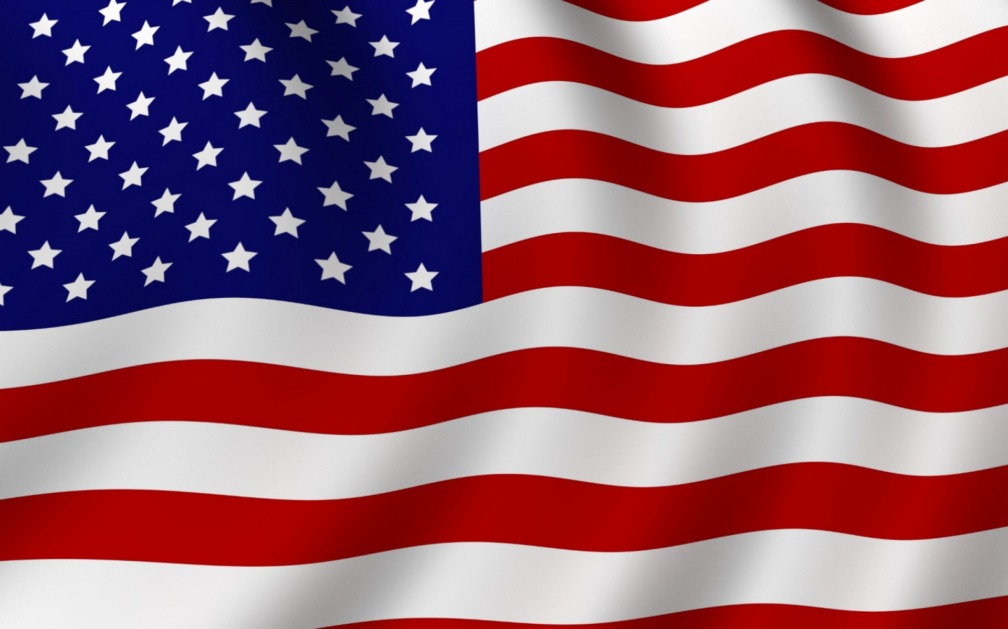
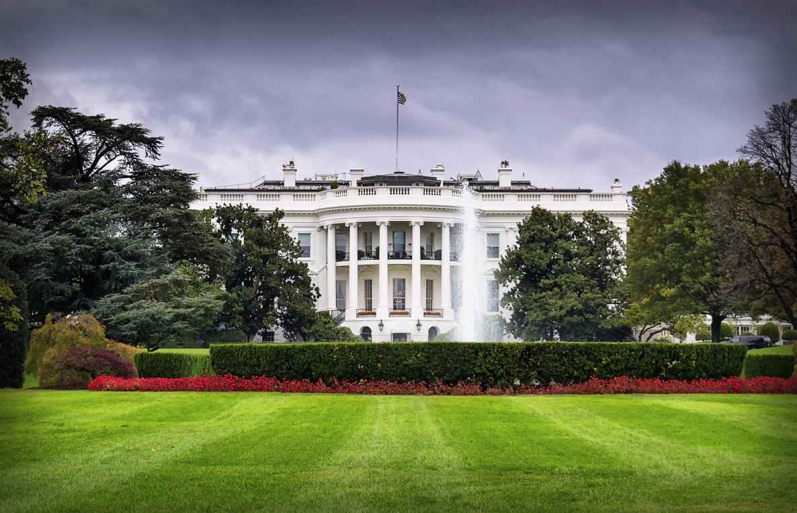
10
Name the place, where American president and the government sits?
The White House

Slide 14
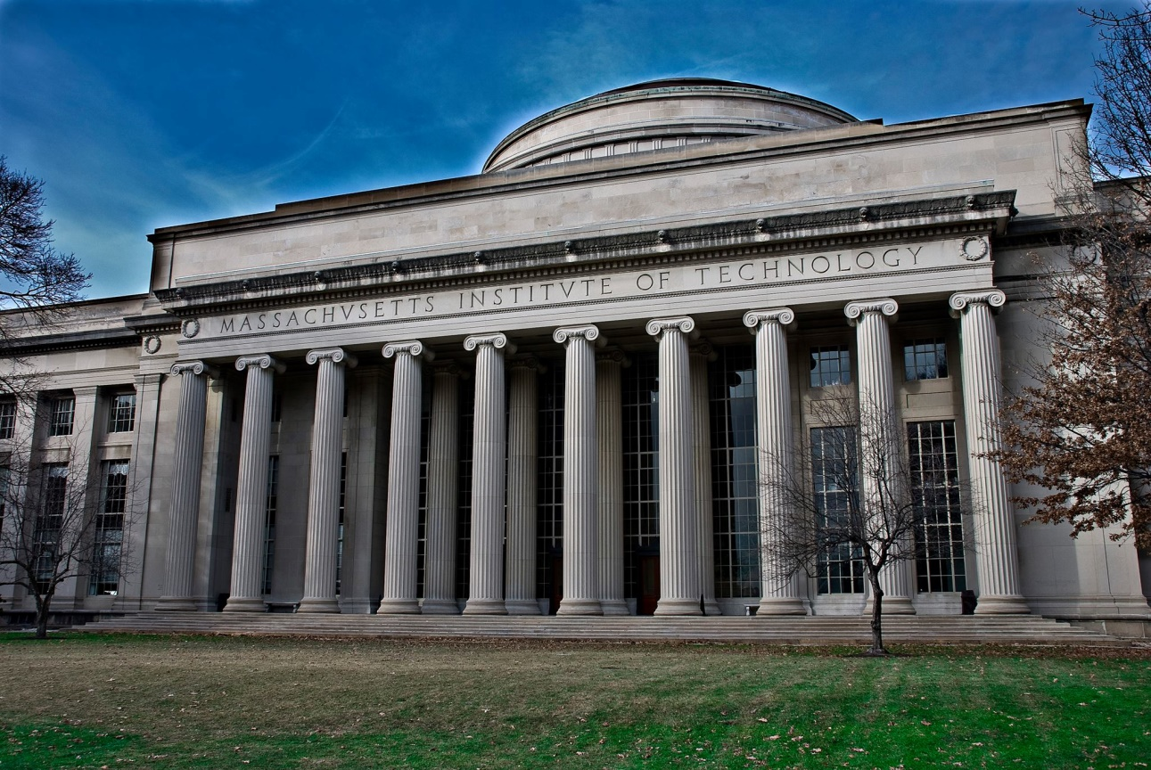
10
The university which is statistically considered to be the best technical university
MIT

Slide 15
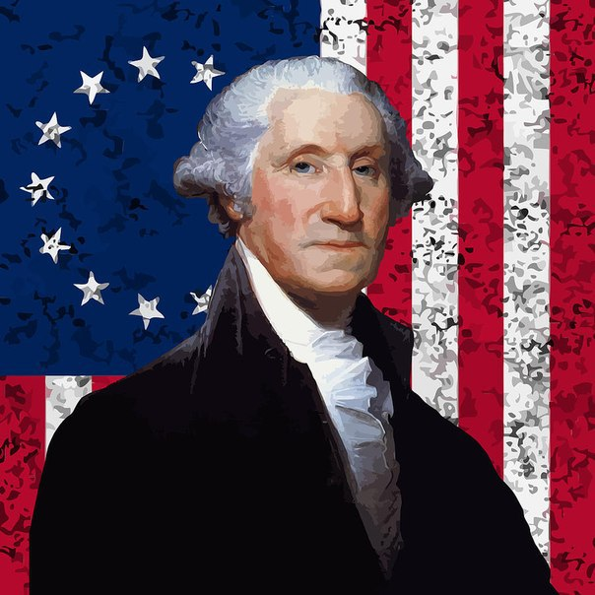
30
Who is the first American president?
George Washington

Slide 16
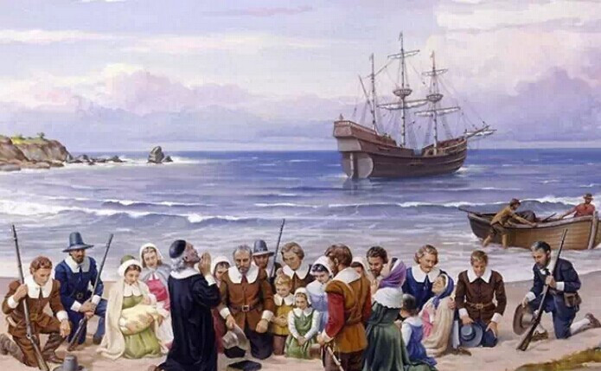
30
Name the first ship which came from Europe to America full of pilgrims?
Mayflower

Slide 17
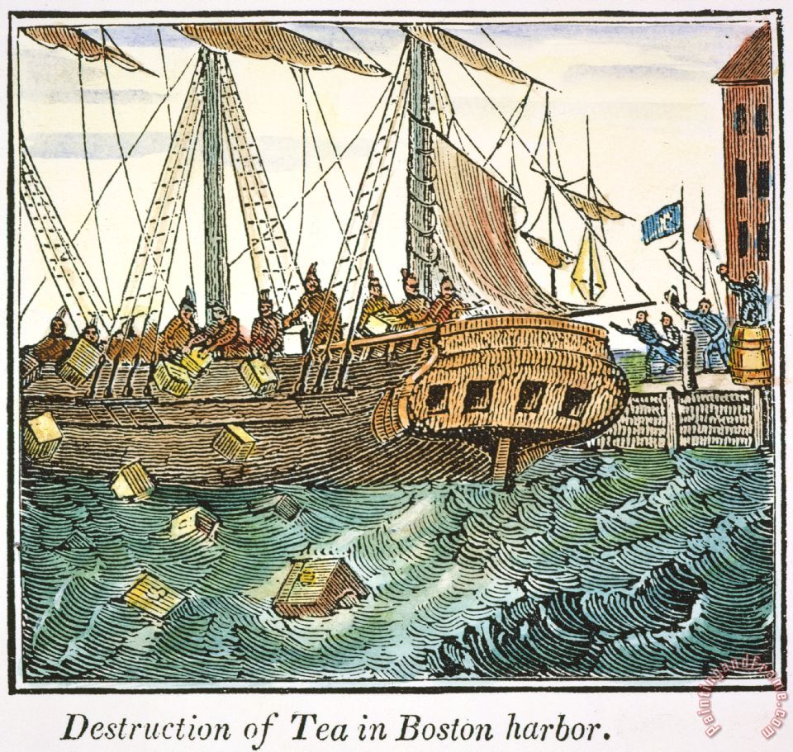
50
What “tea party” became a historical event and lead to the Independence War
Boston Teaparty

Slide 18
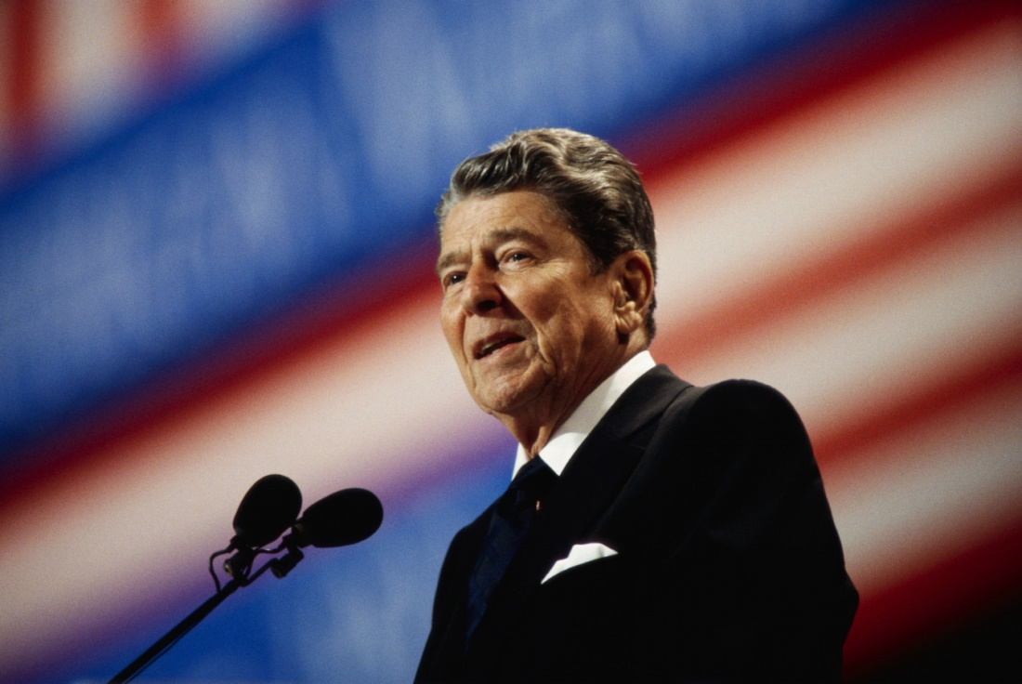
50
Before becoming an American President Ronald Ragon had been
An actor
cc

Slide 19
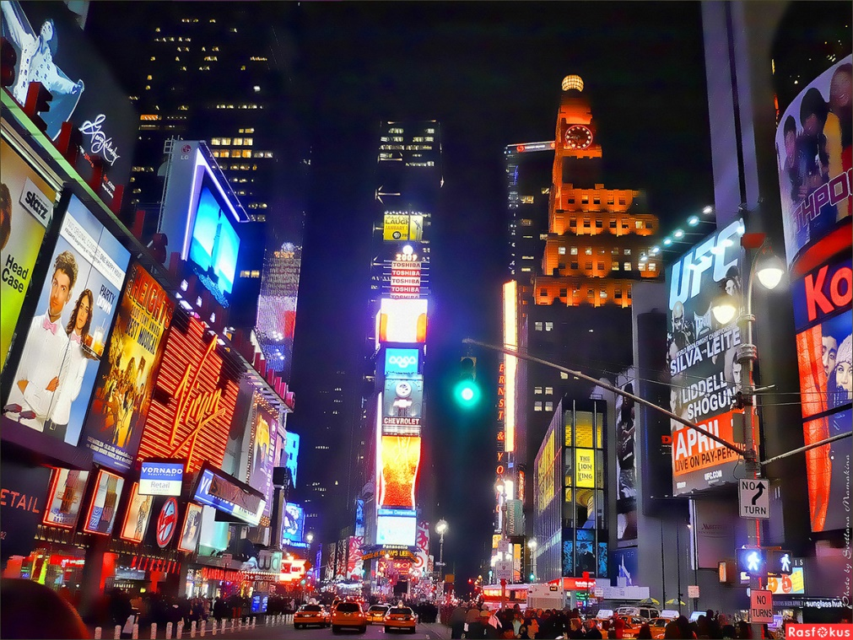
75
Name the longest street in New York, which length is over 50 kilometers
Broadway

Slide 20
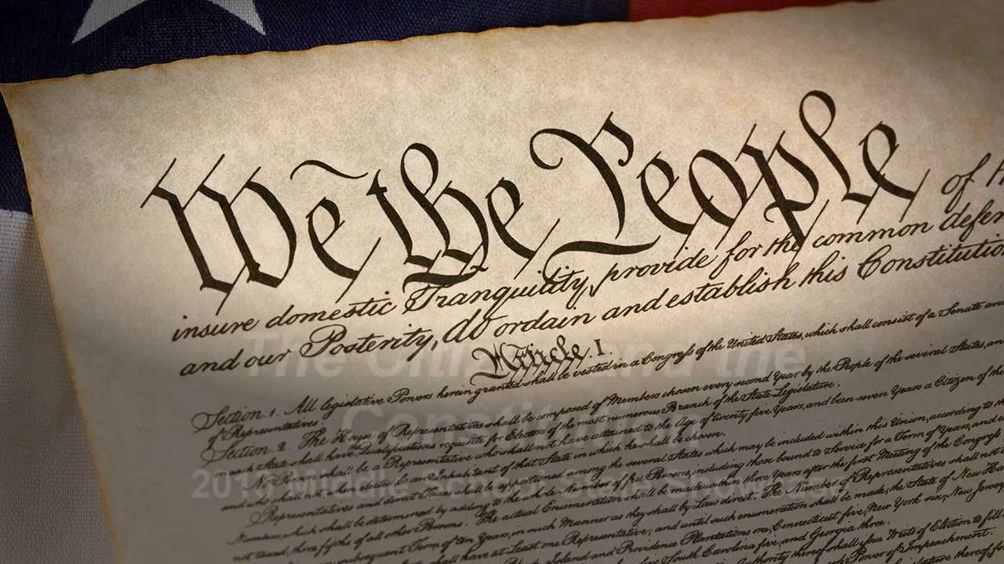
75
How many articles are there in the constitution of the USA?
7 Articles

Slide 21
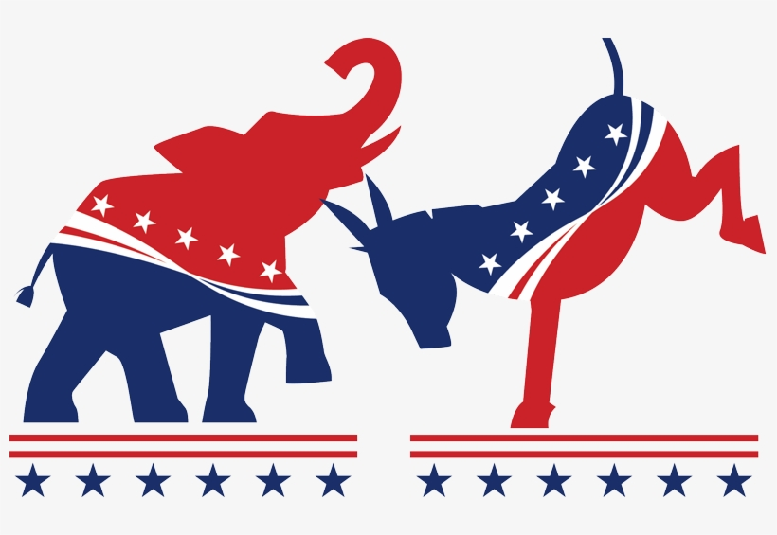
100
Republican party known as the party which protects stability and the strength of true Americans has long lasting leadership in parliament. What animal is the symbol of it?
Elephant

Slide 22
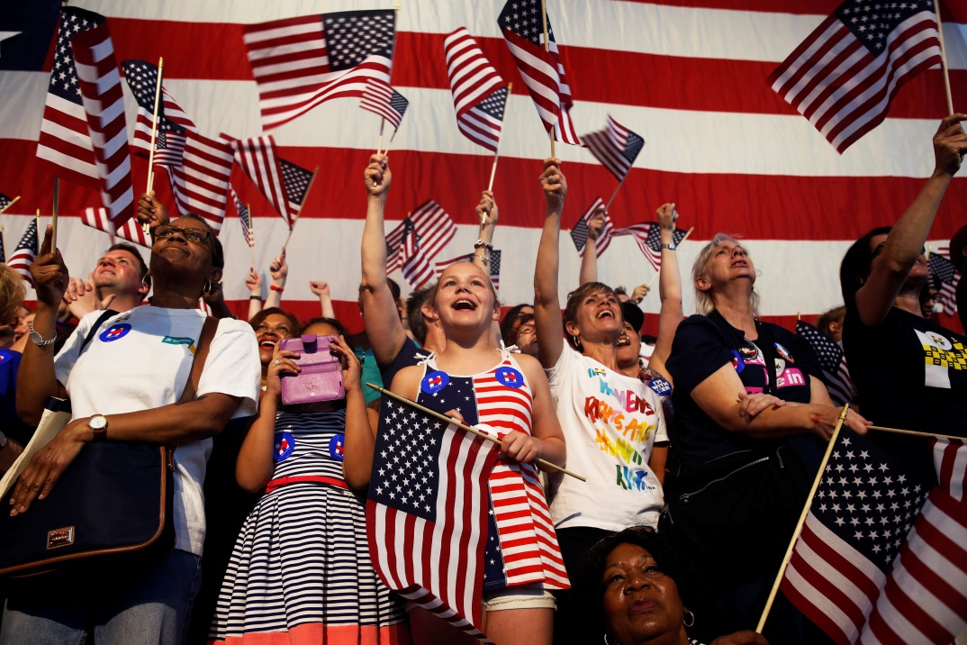
100
Which party in the USA stands more for the rights of individuals?
Democratic

Slide 23
What river does London stand on?
(The Thames)

Slide 24
Who is the head of the state in Great Britain?
(A monarch or a queen)

Slide 25
How many parts does the UK consist of?
(4 parts).

Slide 26
What is the American symbol of Freedom?
(The Statue of Liberty).

Slide 27
Who is the head of the state and government of the USA?
(The President).

Slide 29
How many states are there in the USA?
(50)

Slide 30
What birds live in the Tower of London?
(Ravens)

Slide 31
What’s “stripes and stars”
(The national flag of the USA)

Slide 32
Whose portraits are printed on American dollars?
(American presidents).

Slide 33
Who created Donald Duck?
(Walt Disney).

Slide 35
What is the double– decker?
(a bus that has two stores)

Slide 36
What is the “Union Jack”?
(The national flag of the UK)

Slide 37
When do the British celebrate Christmas?
(On the 25th of December)

Slide 38
What is the largest American state?
(Alaska)

Slide 39
What is the largest port of the USA?
(New York City)

Slide 41
Who discovered America?
(C. Columbus)

Slide 42
What is the longest river of the USA?
(The Mississippi)

Slide 43
What colours are there on the Brinish flag?
(blue, red, white)

Slide 44
What is Scotland traditional musical instrument?
(bagpipe)

Slide 45
How many stripes are there on American flag?
(13)

