Slide 1
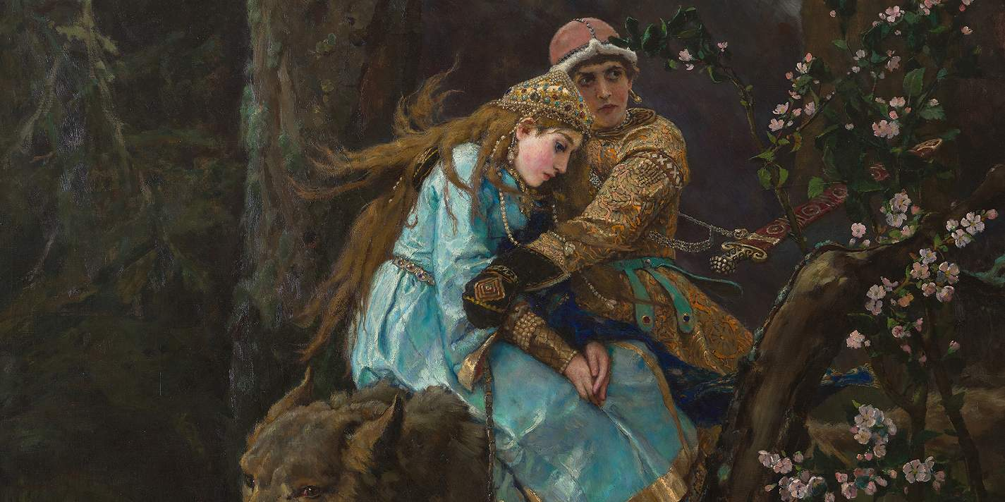
Famous Paintings

Slide 2
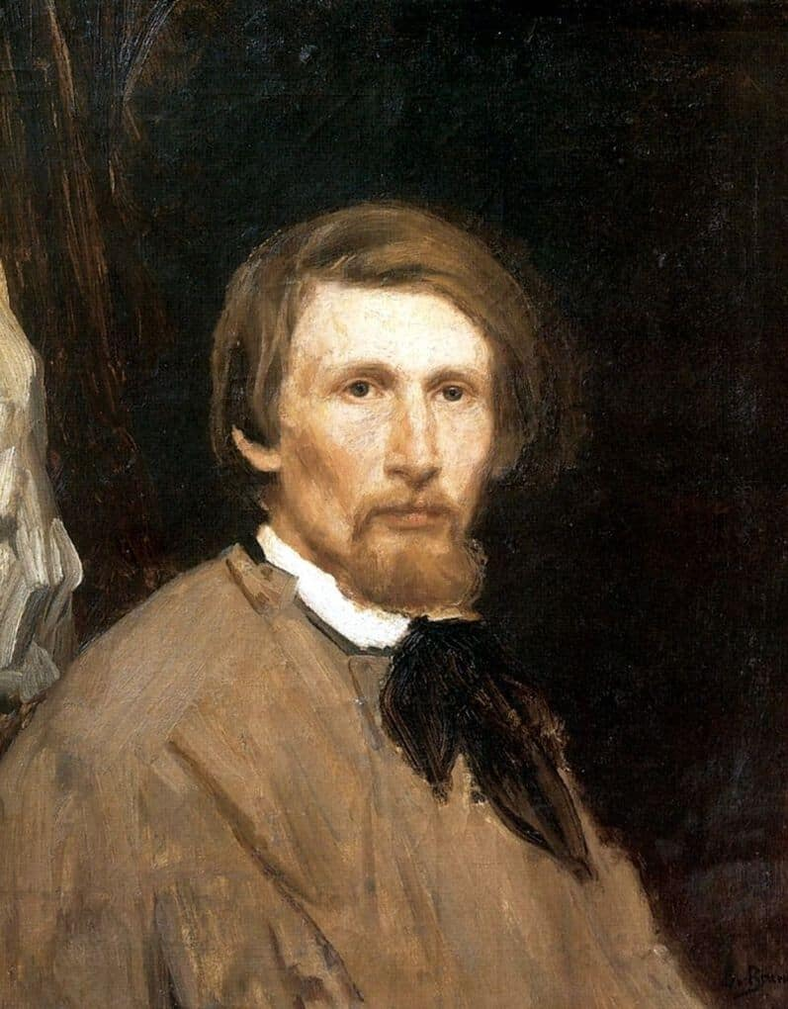
Viktor vasnetsov
Vasnetsov was born in 1848 in a small
village near Vyatka. They were 8 in the
family: his father, mother, 5 brothers and
Victor. When he was a boy,he liked drawing
and painting pictures.
In 1867 Vasnetsov moved to St. Petersburg.
He studied at the Academy of Arts.
We can see many paintings by Vasnetsov
in Tretyakov Art Gallery in Moscow.
He died in 1926 in his house in Moscow.
Now it’s the Vasnetsov House Museum.

Slide 3
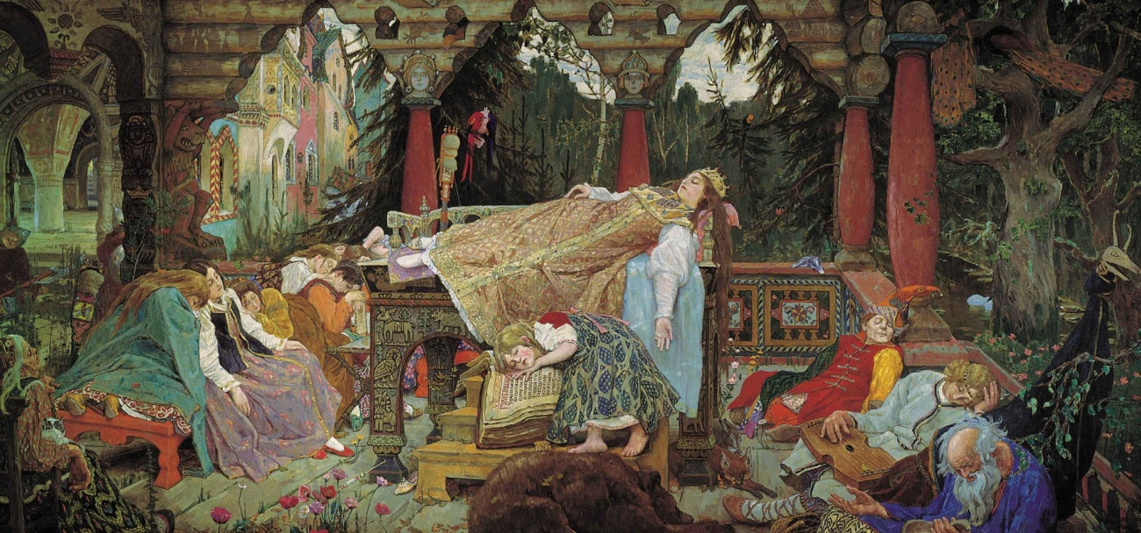
Sleeping princess(1900-1926)

Slide 4
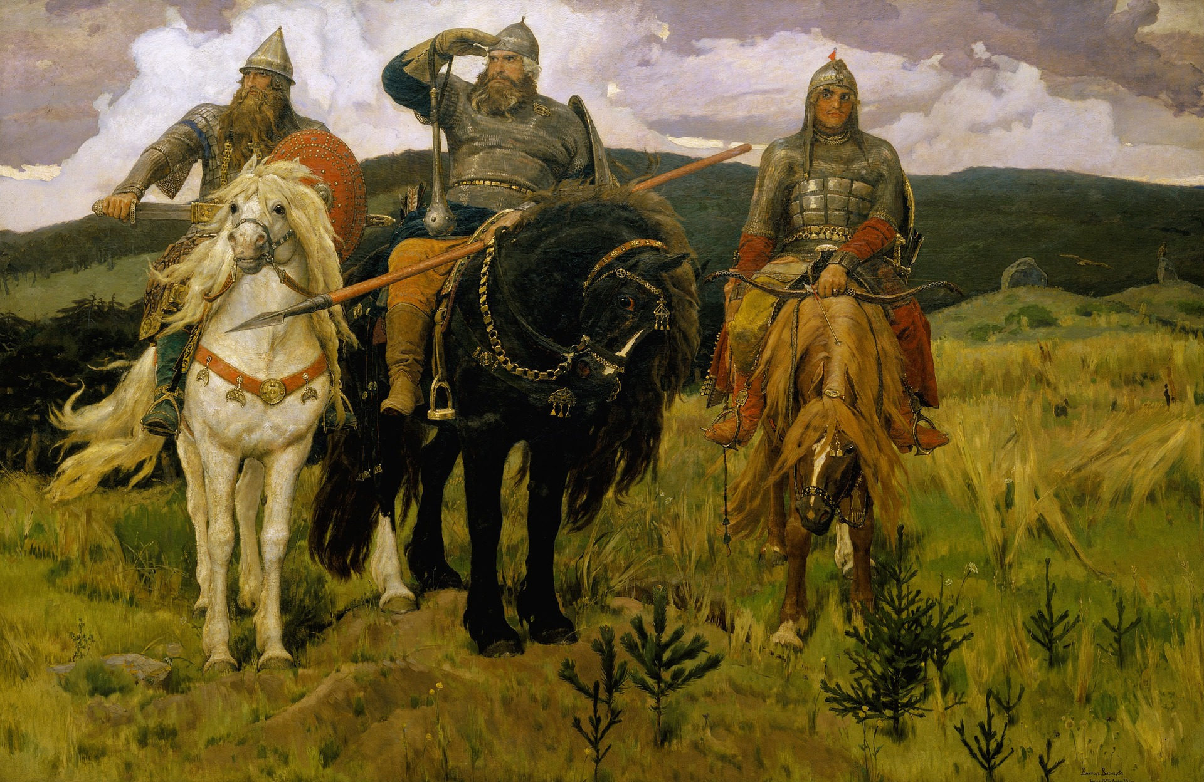
Bogatyrs(1898)

Slide 5
Prince Ivan on the Grey Wolf(1889)

Slide 6
Даты в английском языке
Чтобы назвать по-английски год, надо сначала произнести как двузначное число две первые цифры, а потом – две последние.
in 1889– in eighteen eighty nine
in 1848 – in eighteen forty eight
in 1926 – in nineteen twenty six

Slide 7
Say these dates
in 1812
in eighteen twelve
in 1885
in eighteen eighty five
in 1867
in eighteen sixty seven
in 1877
in eighteen seventy seven

Slide 8


