Slide 1

SCHOOL IS FUN!

Slide 2
Every week has seven days,
See how many you can say.
Tuesday,
Sunday,
Monday,
Wednesday,
Thursday,
Friday,
Saturday.
Tell me please,
What day is it today?

Slide 3
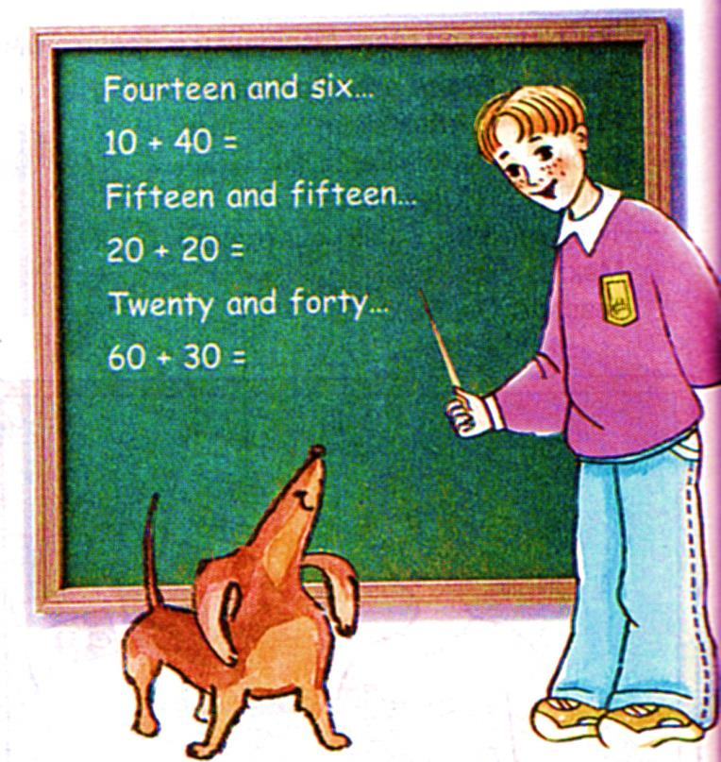

What subjects do you learn at school?

Slide 4
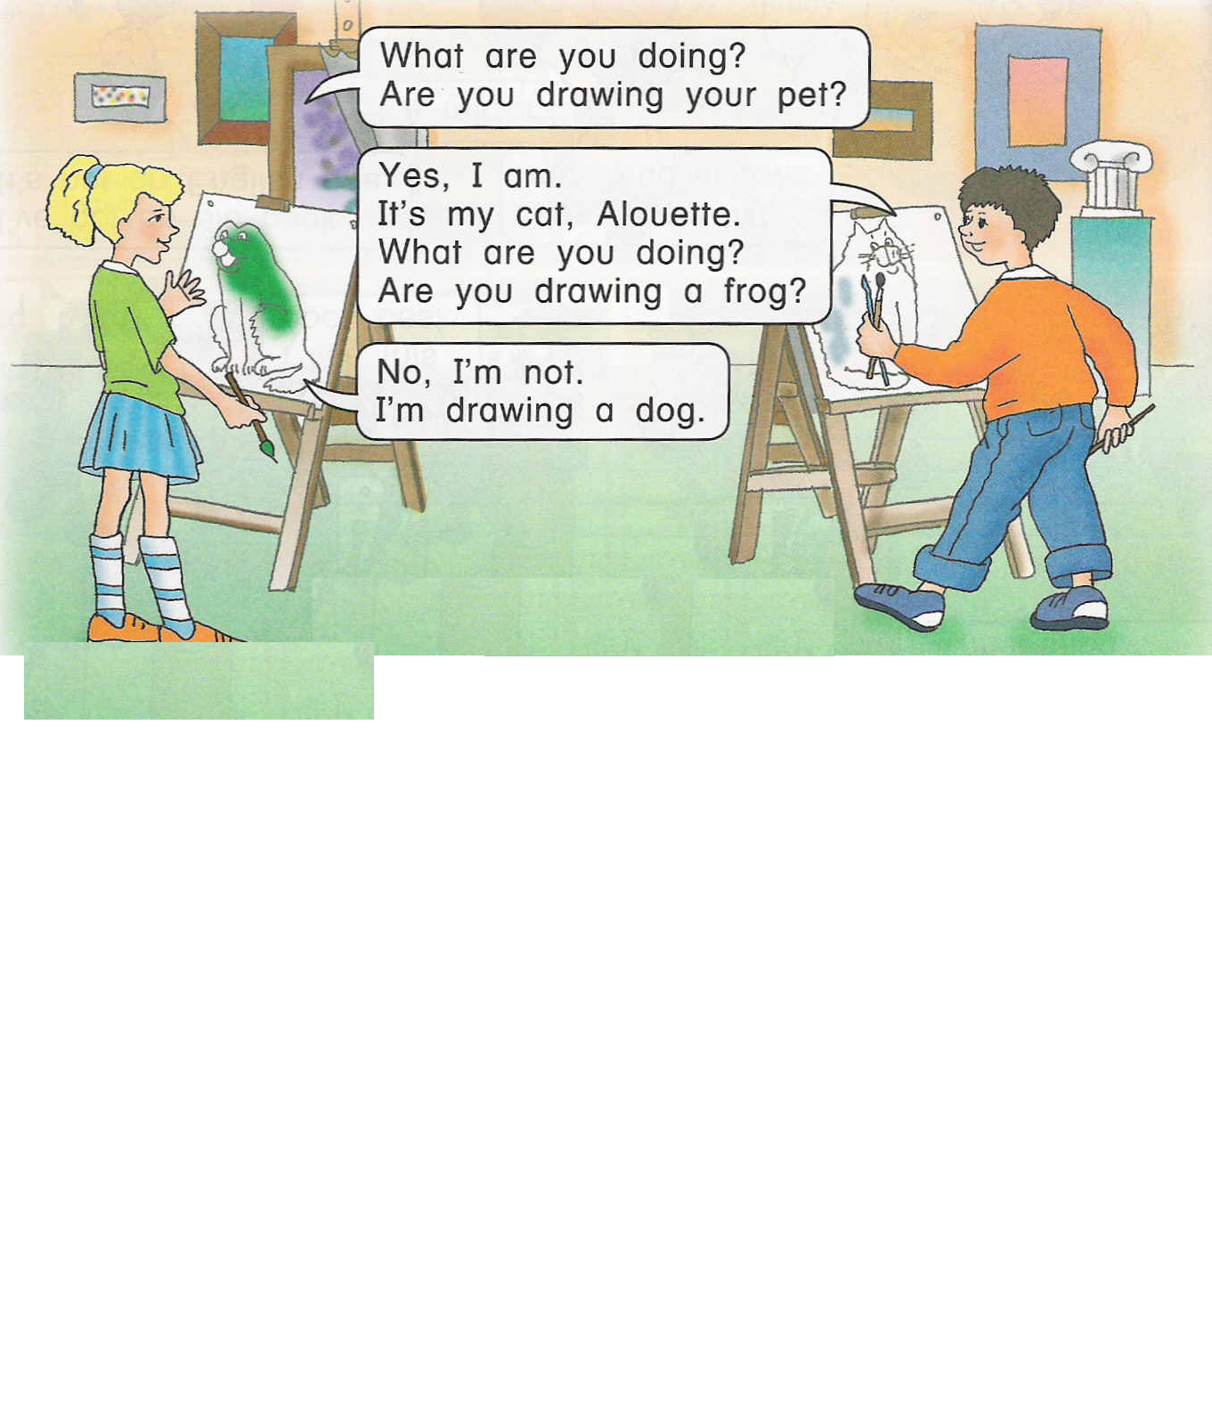
A R T
[ : t]

Slide 5
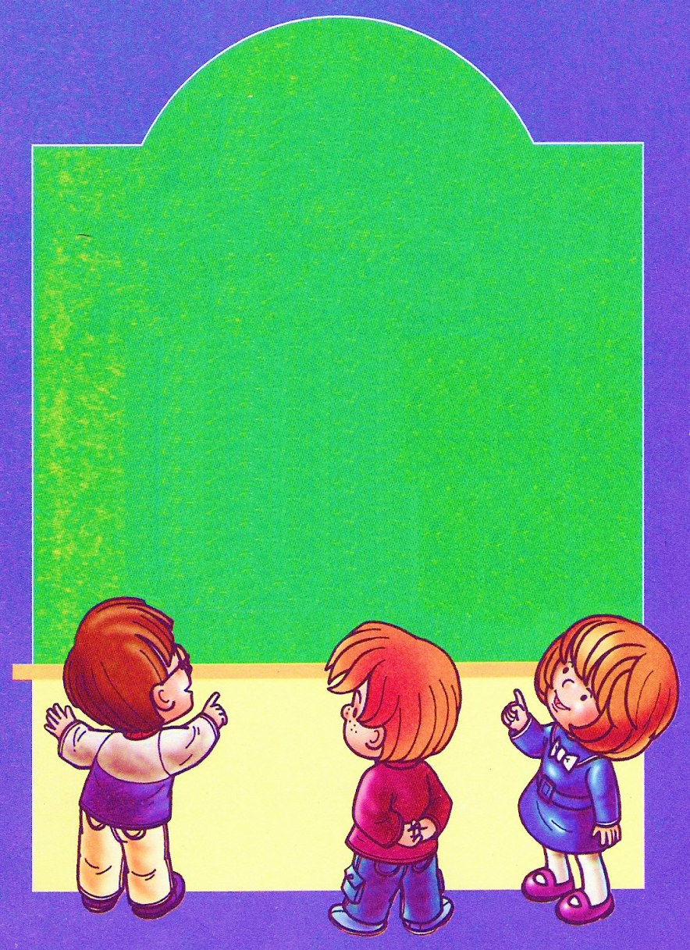


E N G L I S H
[‘eηglІ∫]

Slide 6

M A T H S
[mæθs]

Slide 7
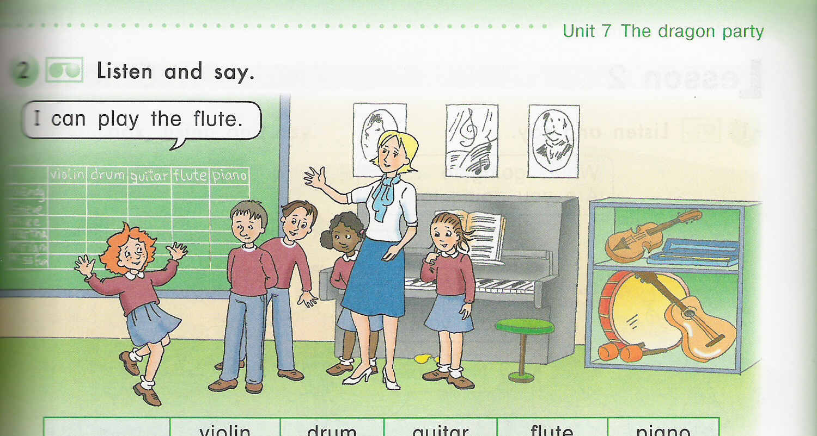
M U S I C
[‘mju:zІK]

Slide 8
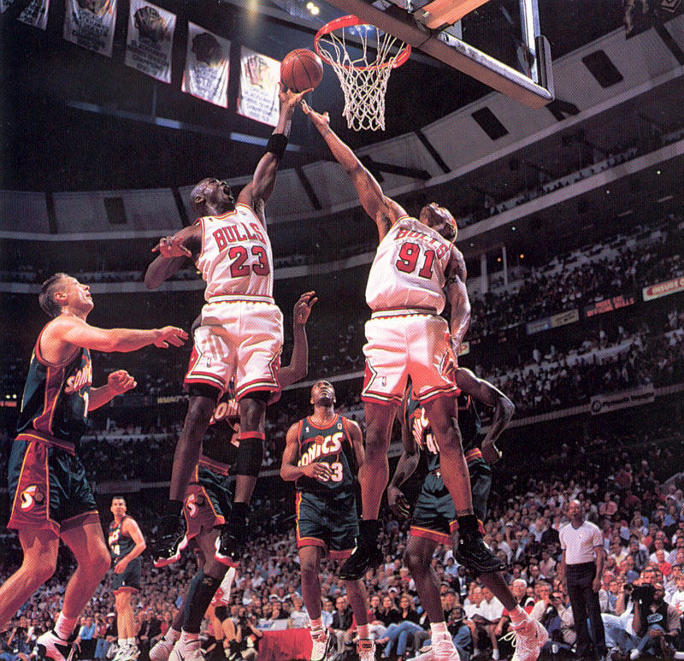
P E
[,fІZIKəl edjυ’keI∫n]

Slide 9

N A T U R E STUDY
[‘neIt∫ə ‘stΛdi]

Slide 10
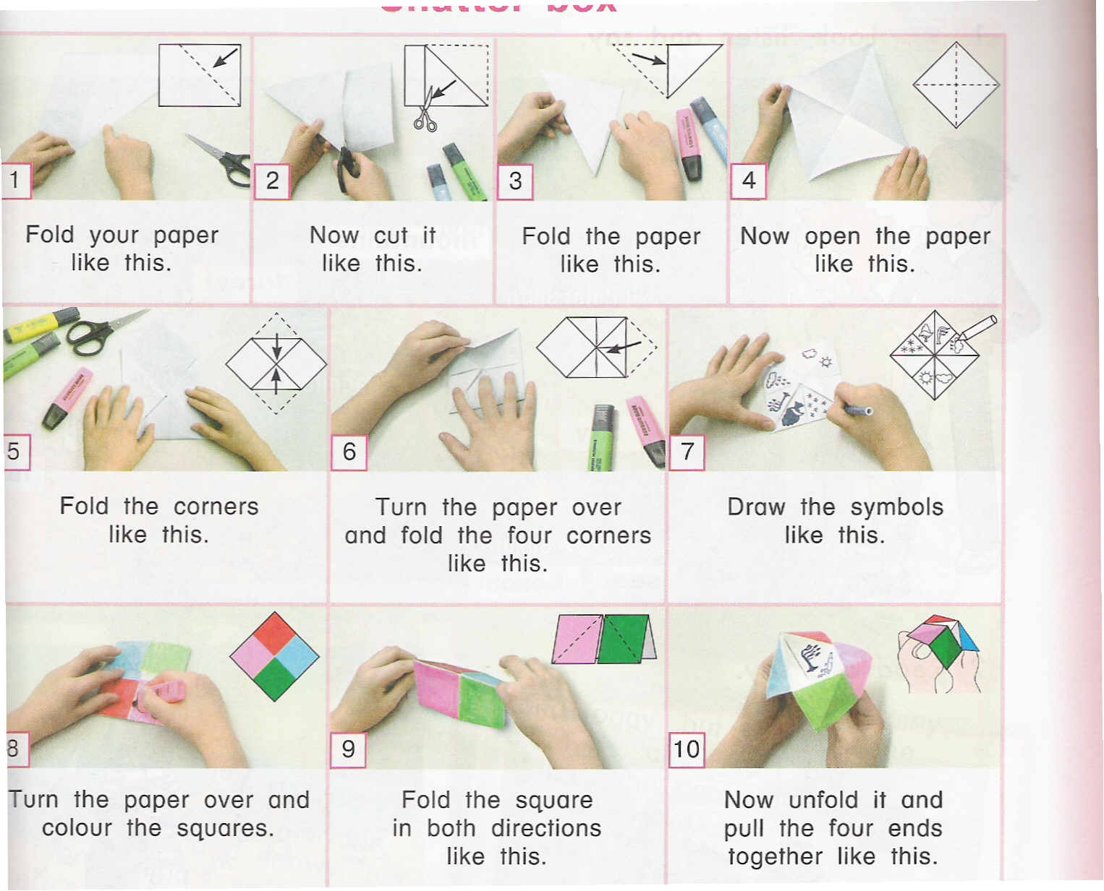
C R A F T S
[krΛfts]

Slide 11
Russian Literature
Crafts Geography
English History
Mathematics ( Maths)
Science Art Music Economics
Information Technology ( IT)
Physical Education (PE)

Slide 12
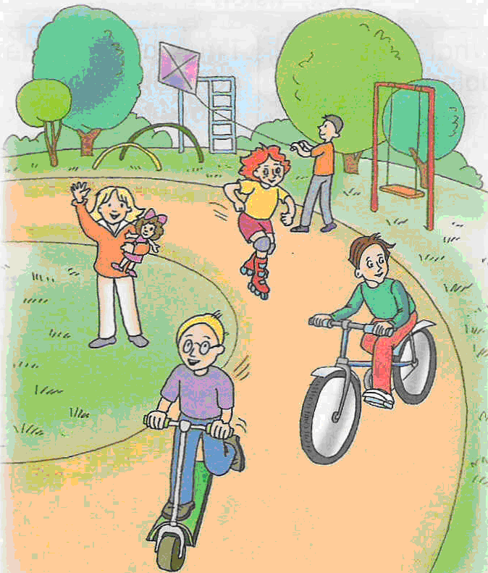
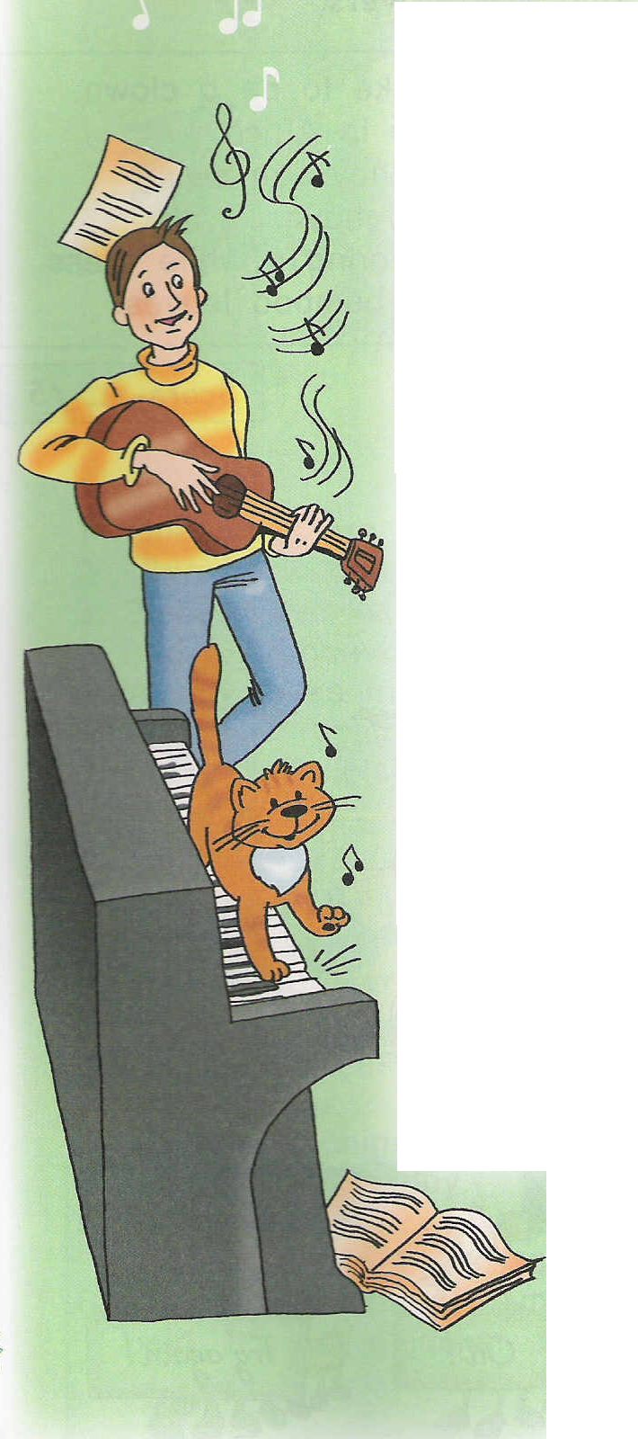
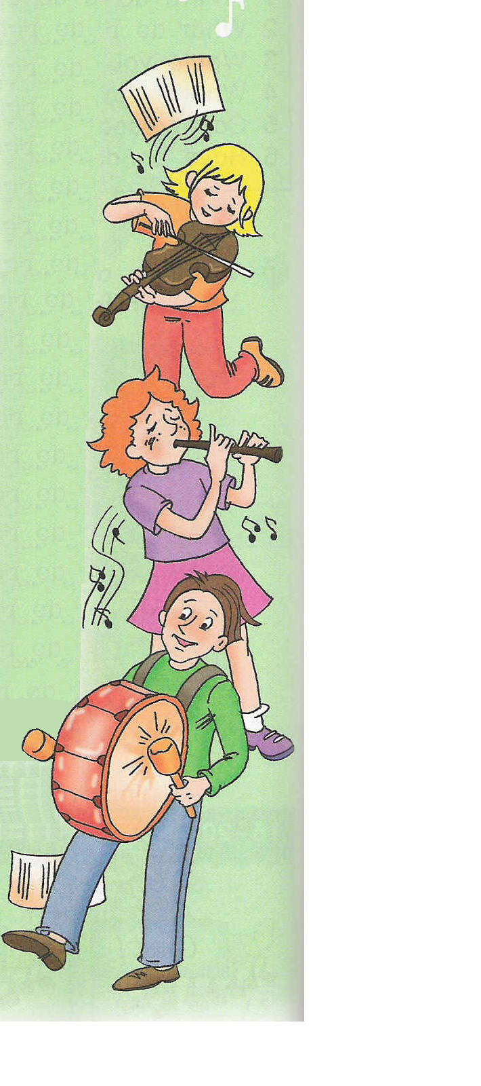
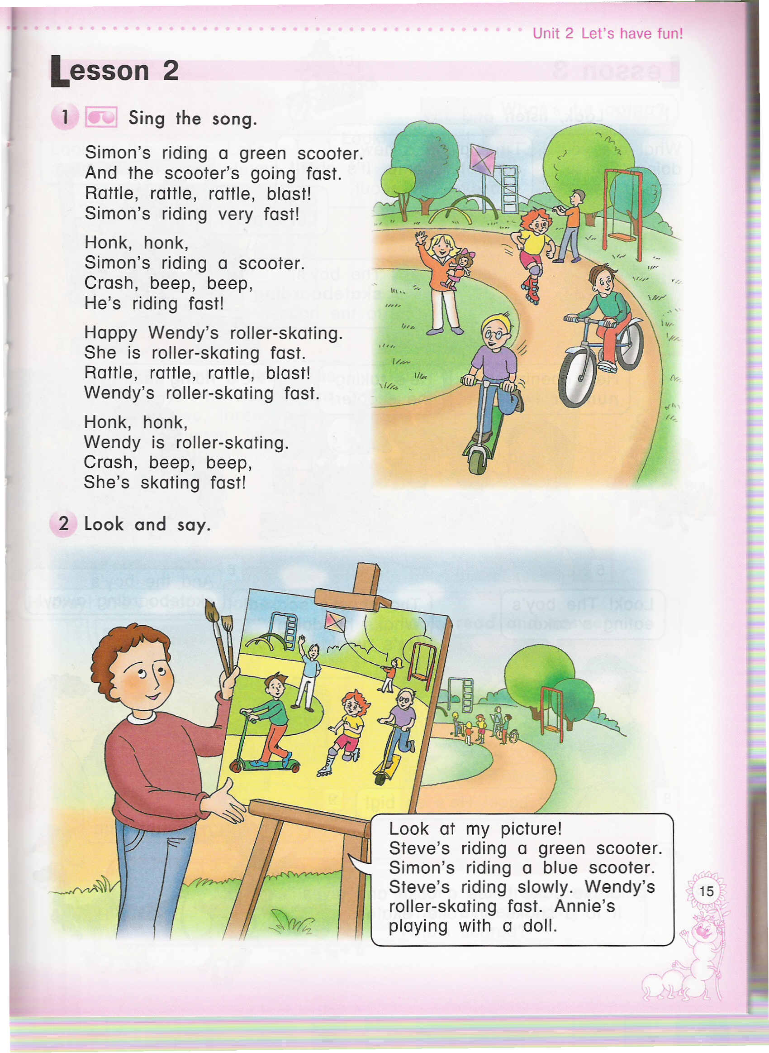
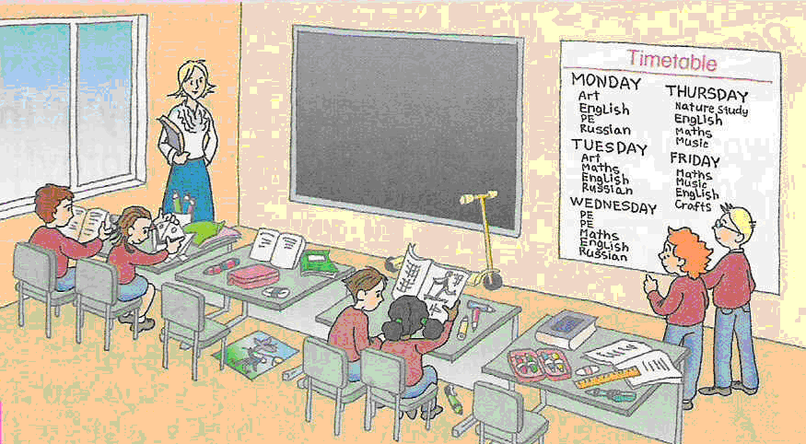

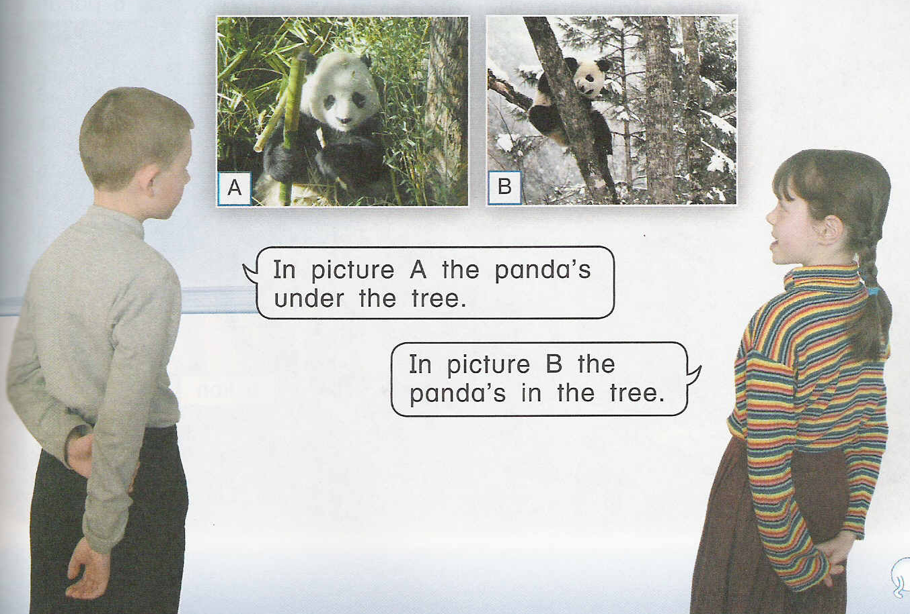
?
P
?
E
M
?
A
?
T
?
H
?
S
?
N
?
A
?
T
?
U
?
R
?
E
?
G
?
S
?
?
T
U
?
D
?
Y
?
L
?
I
?
I
?
C
?
R
?
A
?
F
?
TS
?
S
?
H
?

Slide 13


Look and guess what subject do the pupils learn

Slide 14
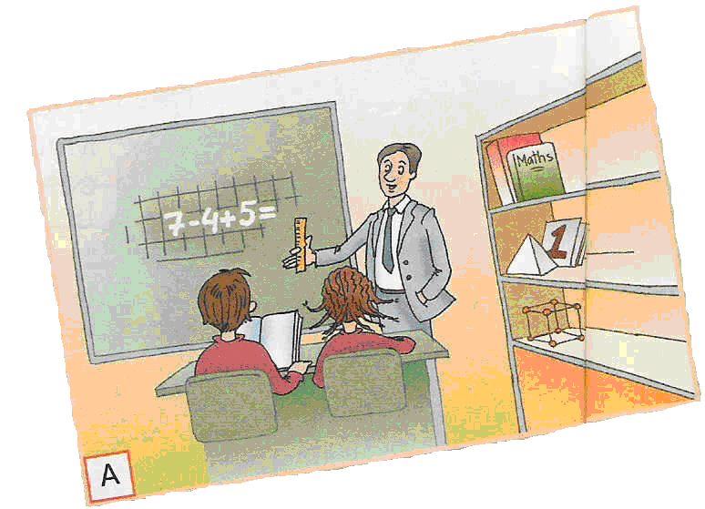
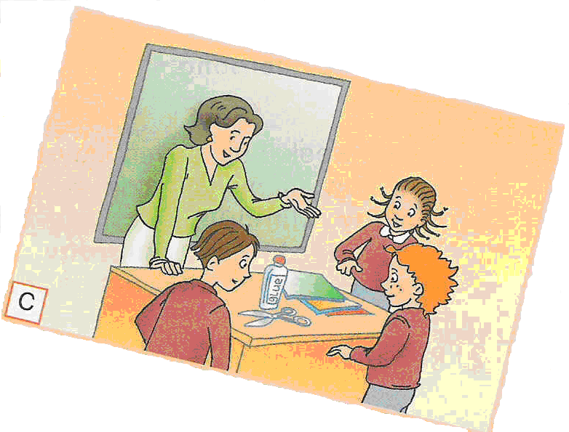
A
C

Slide 15
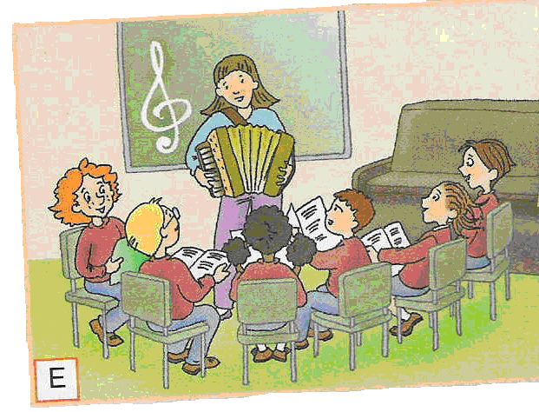
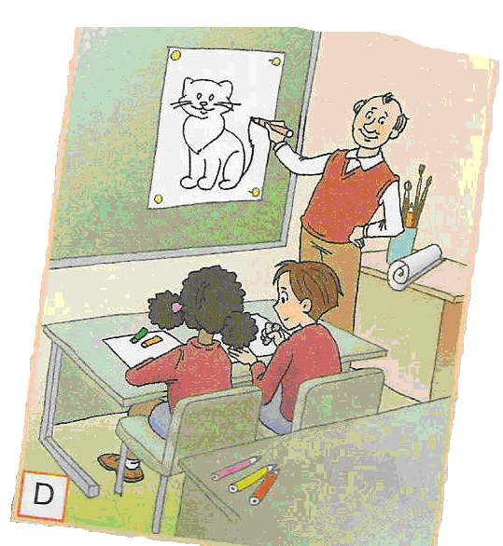
E
D

Slide 16
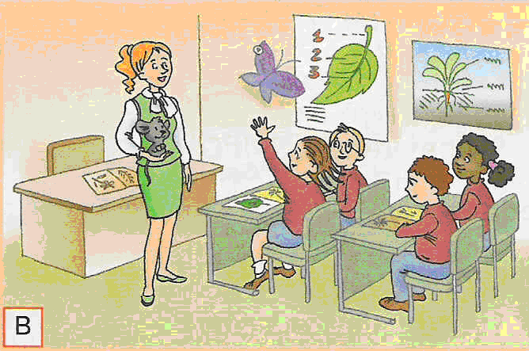
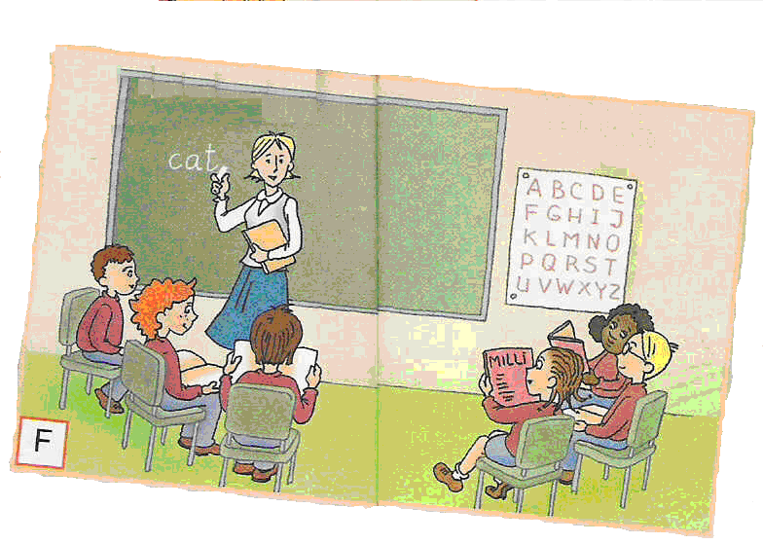
cat
B
F

Slide 17
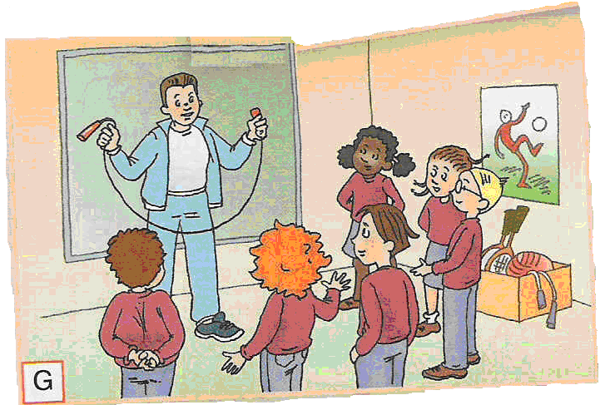
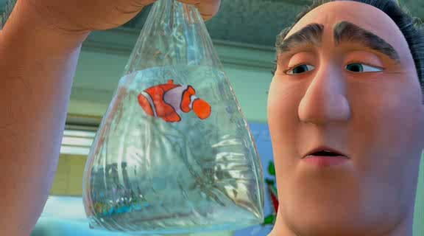
G
H

Slide 18

Now Guess what are the names of the teachers

Slide 19
Miss Fun
a Crafts teacher
Mr Draw
a Music teacher
Mr Five
an English teacher
Mr Run
a Maths teacher
Miss Paper
an Art teacher
Miss Song
a PE teacher
Miss Butterfly
a NS teacher

Slide 20

Well done!

Slide 21
Интерактивнй урок английского языка в 5 классе по теме
«School is fun»
Лаврентьева Елена Анатольевна
учитель английского языка
МБОУ СОШ УИП №3
г.Лабытнанги

Slide 22
Использованная литература и источники иллюстраций:
Кауфман К.И.,Кауфман М.Ю.,учебник английского языка для 5 класса общеобраз.учрежд.- Обнинск: Титул,2012.- с.126
Интернет-ресурсы:http://ru.wikipedia.org./

