Slide 1
Веб-квест для урока английского языка
Тема: семья

Slide 2
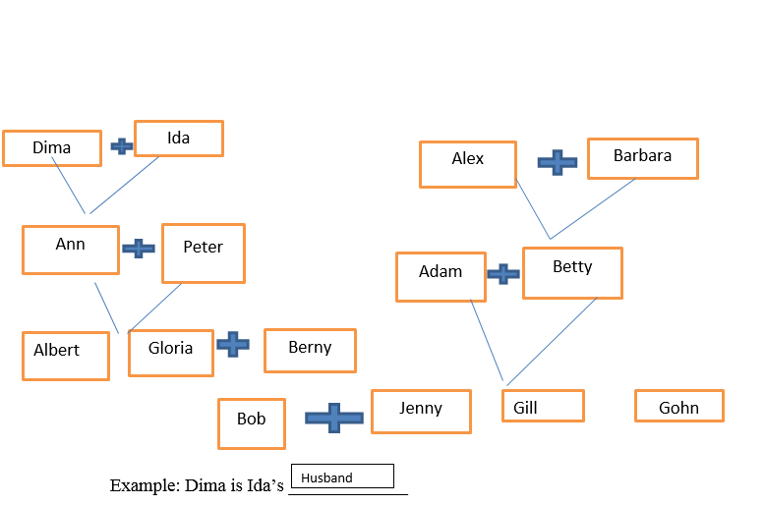
Exercise 1 Write members of the family as in the example

Slide 3
Ann is Dima’s ____________
Albert is Ida’s ___________
Albert is Gloria’s __________
Peter is Dima’s ___________
Ann is Gloria’s____________
Jenny is Bob’s ____________
Barbara is Adam ’s_________
Alex is Gill’s _____________
Gill is Gohn’s _________
Ann is Adam’s _________

Slide 4
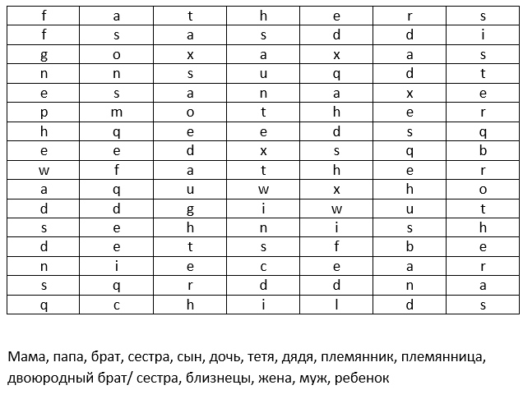
Exercise 2 Find 15 names of family members

Slide 5
Exercise 3 Put letters in the correct order
uhgeragt (daughter)
iessrt (sister)
aoergrhtnmd (grandmother)
dnaaerghtrrf (grandfather)
eeashrfttp (stepfather)
theertsorbp (stepbrother)
inwaltherom (mother in law)
alwnifathre (father in law)
onsdog (godson)
uoiscn (cousin)

Slide 6
Exercise 4 Find Russian equivalents of English expressions
8. As the old cock crows, so does the young.
1.Children are poor men's riches.
5.A good wife makes a good husband.
2. Every mother thinks her own gosling a swan.
6. You may choose your friends; your family is thrust upon you.
9. There is at least one rotten apple in every barrel.
3. There's a black sheep in every family.
7. A babe in the house is a well-spring of pleasure.
10. Blood is thicker than water.
4. Like father, like son.

Slide 7
Exercise 5 Read the text and answer the questions
We are a family of four: my father, my mother, my younger brother and I.
My name is Olga. I am seventeen. I am a school leaver. My younger brother’s name is Dima. He is ten. He is a pupil of the fifth form. Our family lives in Moscow. We have a nice three-roomed flat. We have all modern conveniences: running hot and cold water, telephone, central heating, rubbish chute. My mother is satisfied with our flat. My mother’s name is Katja. She is about 40. We all love dearly our mum and are always ready to help her about the house. My younger brother’s name is Sasha. He helps mother to set the table and wash the dishes. Dad likes to make or repair something.
My father’s name is Slava. He is an experienced engineer. He is always busy and very often he works overtime. My mother is an economist. My grandparents don't work now. They are on pension. My Granny is fond of gardening and my Grandpa likes to go fishing. Our family is friendly. like them very much.

Slide 8
Where do the family live?
How many people are there in the family?
How many rooms are there in the flat?
What is Olga’s mother name?
How old is Olga’s brother?
Who is Olga’s mother by profession?
Who is Olga’s father by profession?
What Olga’s father like?
What’s Olga’s granny fond of?
What’s Olga’s grandfather fond of?

Slide 9
Exercise 6 Read the text again and decide if the given sentences true or false
There are 4 members of the family
There are not running hot and cold water
Olga is 15 years old
Dima is in the 7th form
The family lives in Moscow
Katja is satisfied with the flat
Dima helps mother to set the table and wash the dishes
Slava often works overtime
Olga is an economist
Olga’s grandparents do not work

Slide 10
Links
https://lingvister.ru/blog/angliyskie-poslovitsy-o-semye-family-is-a-haven-in-a-heartless-world
https://ouenglish.ru/note-eng/words-family
https://docbaza.ru/topic/about/65.html

Slide 11
Results
Exercise 1-2 points for each correct answer =20 points
Exercise 2-1 point for each correct answer =10 points
Exercise 3-1 points for each correct answer =10 points
Exercise 4-2 points for each correct answer =20 points
Exercise 5-2 points for each correct answer =20 points
Exercise 6-2 points for each correct answer =20 points
Maximum 100 points

Slide 12
Answers
Ex. 1 1) daughter 2) grandson 3) brother 4) son-in-law 5) mother 6)wife 7) mother-in-law 8) grandfather 9) sister 10) cousin
Ex.2 mother, father, brother, sister, son, daughter, aunt, uncle, nephew, nice, cousin, twins, wife, husband, child
Ex.3 1) daughter, sister, grandmother, grandfather, stepfather, stepbrother, mother in law, father in law, godson, cousin
Ex.3 1) Богатому телята, а бедному ребята 2) Дите хоть и криво, а отцу-матери диво 3) В семье не без урода. 4) Каков отец, таков и сын 5) У хорошей жены и мужу нет цены 6) Родителей не выбирают 7) Дети не в тягость, а в радость 8) Яблоко от яблони недалеко падает 9) В каждой бочке ложка дегтя 10) Голос крови не заглушить.
Ex. 4 1) in Moscow 2) four 3) three 4) Katja 5) ten 6) economist 7) engineer 8) make or repair something 9) gardening 10) fishing
Ex. 5 1) true, 2) false 3) false 4) false 5) true 6) true 7) false 8) true 9) false 10) true

