Slide 1

The musical BAND

Slide 2
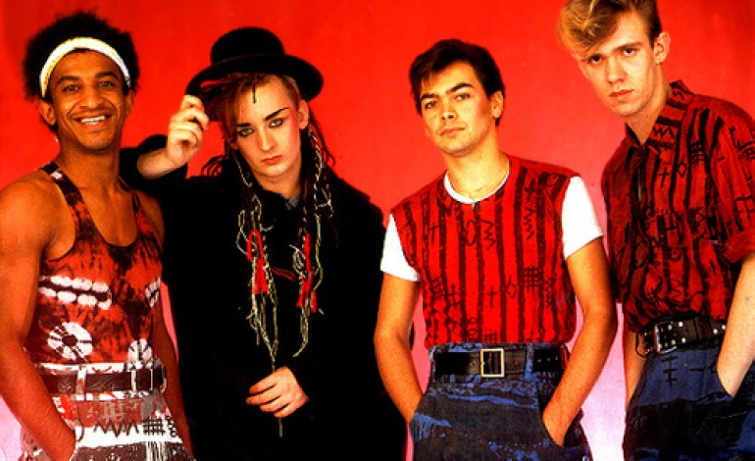
The beginning
Culture club is an English band formed in London in 1981. The band comprises Boy George, Roy Hay , Mikey Craig and Jon Moss. They are considered one of the most representative and influential groups of the 1980s

Slide 3
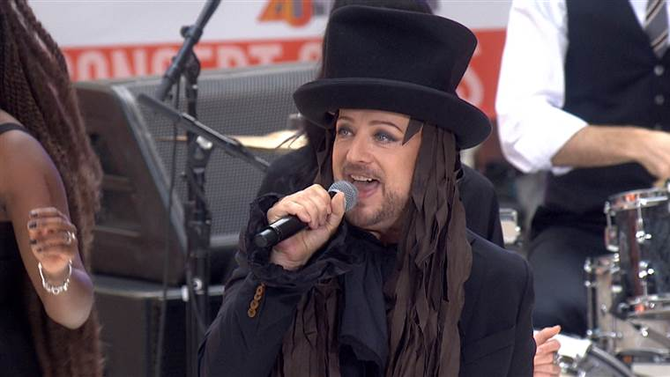
Genres and direction
New wave, soft rock, blue-eyed soul, soul, dance-rock

Slide 4
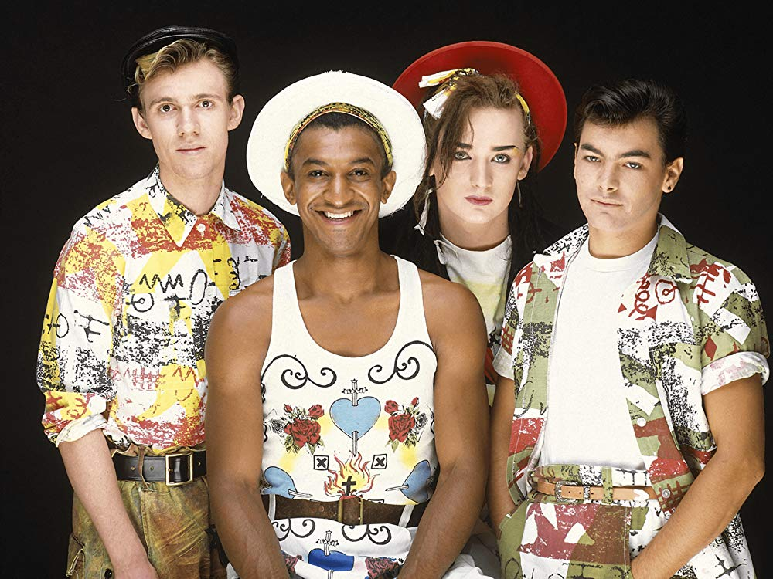
Discography
Kissing to Be Clever (1982)
Colour by Numbers (1983)
Waking Up with the House on Fire (1984)
From Luxury to Heartache (1986)
Don't Mind If I Do (1999)
Life (2018)

Slide 5
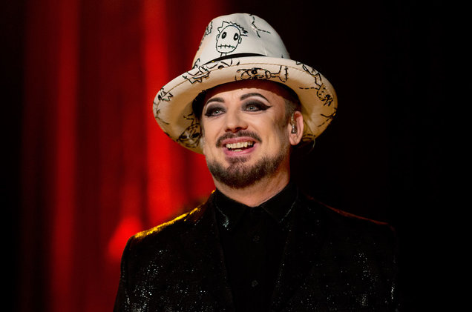
Members of the band : Boy George
Born George Alan O'Dowd; 14 June 1961
lead vocals

Slide 6

Members of the band : Roy Hay
Born Roy Ernest Hay ; 12 August 1961
guitar, keyboards, backing vocals

Slide 7
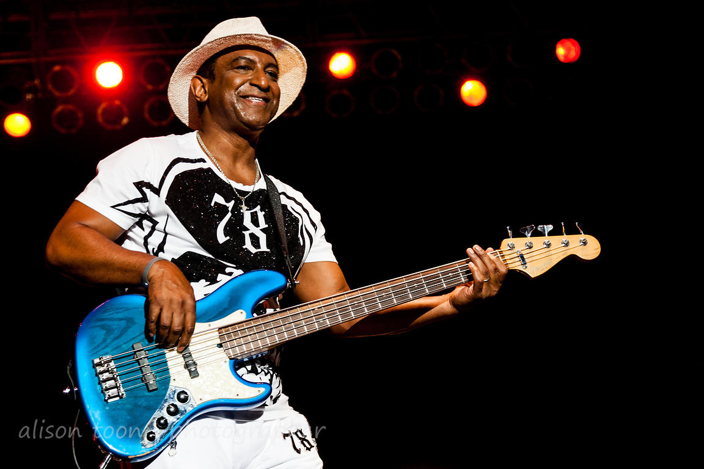
Members of the band : Mikey Craig
Born Michael Emile "Mikey" Craig ;15 February 1960
bass guitar, keyboards, backing vocals

Slide 8

Members of the band : Jon Moss
Born Jonathan Aubrey Moss ; 11 September 1957
drums, percussion, backing vocals

Slide 9
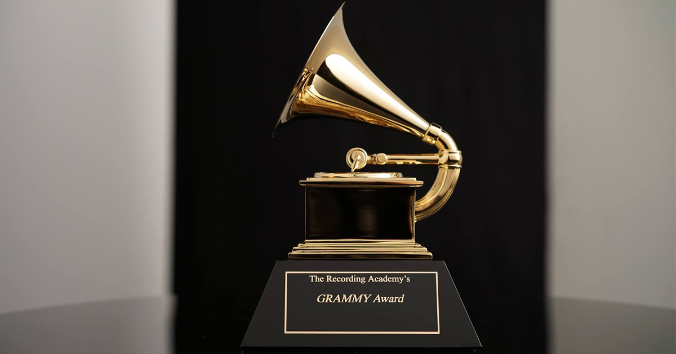
Awards and nominations
In 1984 Culture club won GRAMMY award in nomination «Best New Artist»

Slide 10
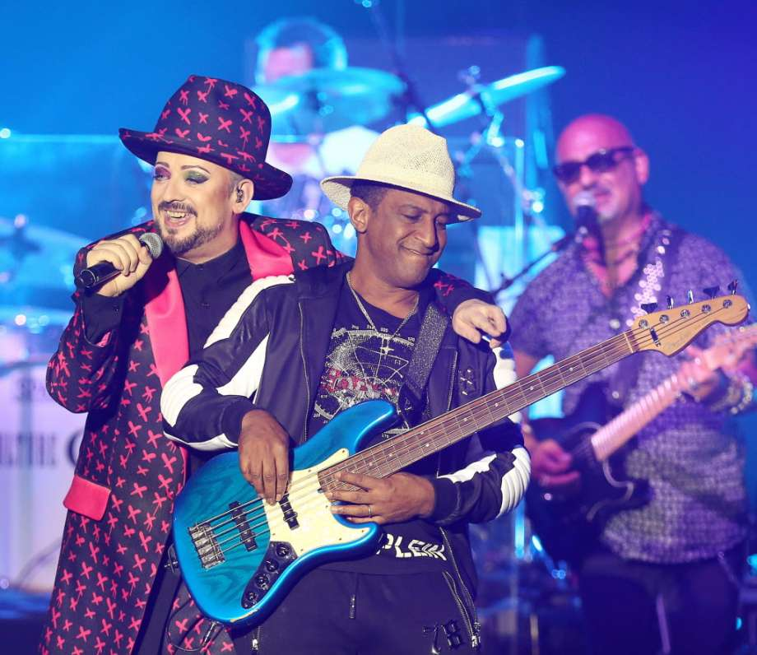
Honours
In 1999 Culture club won place in Rock n Roll hall of fame in nomination 500 Songs That Shaped Rock and Roll for their single "Time (Clock of the Heart)"

Slide 11
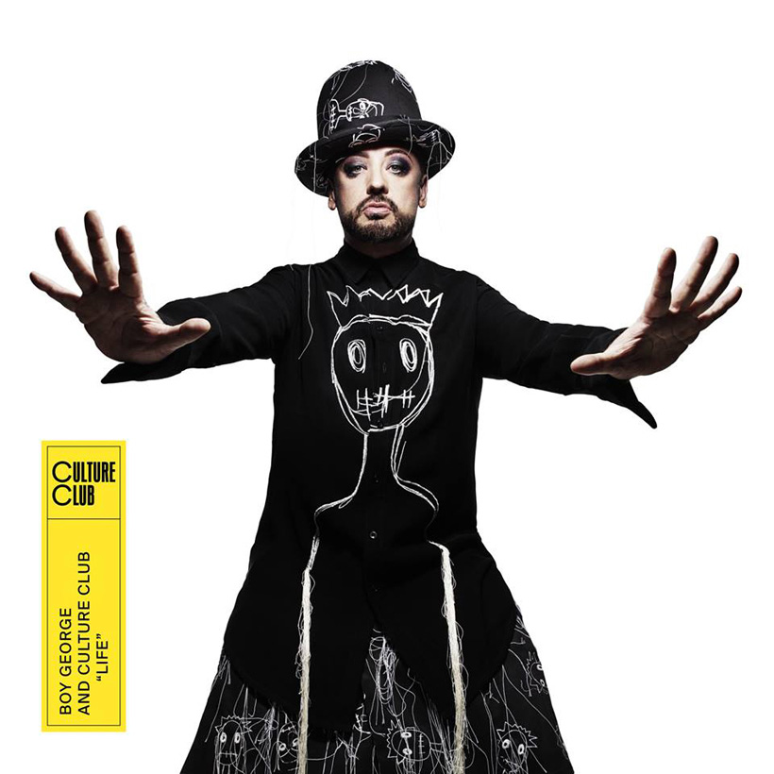
History: peak of succes
1981–1986

Slide 12

History: Decay
1986-1998

Slide 13
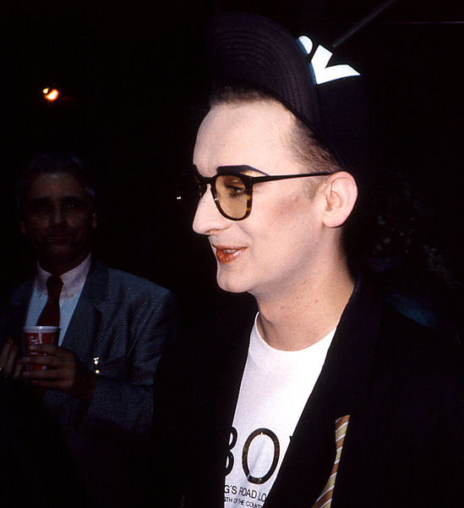
History: Reunion of 1998
1998–2002

Slide 14
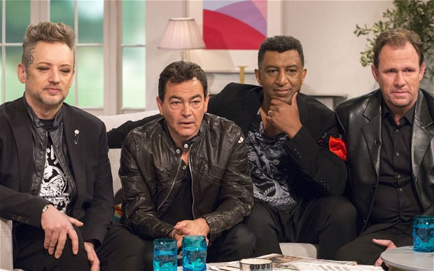
History: Reunion of 2011
2011–present

Slide 15
Thanks for your attention

