Slide 1


Slide 2
Подготовка к ВПР по английскому языку
учитель английского языка МОУ «СОШ № 2 с УИОП»
Фисенко О.С.

Slide 3
ВПР включает 6 заданий и состоит из 2 частей
Письменная
Устная

Slide 4
Письменная часть : аудирование, чтение, грамматика, лексика
Устная часть:
чтение текста вслух и говорение (монологическая речь)

Slide 5
Аудирование
Перед Вами 5 предложений A – E с пропусками и варианты слов или словосочетаний для заполнения этих пропусков, обозначенные цифрами 1 – 3. Внимательно прочитайте их. Вы услышите диалог. Для каждого предложения A – E выберите слово или словосочетание, соответствующее содержанию диалога. К каждому пропуску подходит только одно слово или словосочетание. Вы услышите запись дважды. При повторном прослушивании проверьте себя. У Вас есть 45 секунд, чтобы ознакомиться с предложениями.
А. The man wants to look at the vase _________.
1. next to the teapot 2. behind the cups 3. next to the cups
B. The teapot costs _________.
1. $10 2. $12 3. $20
C. The man wants to give the teapot to his _________.
1. grandmother 2. grandparents 3. grandfather
D. The man's meeting is at _________.
1. 3:30 pm 2. 3 pm 3. 4:30 pm
E. The weather is _________.
1. sunny 2. frosty 3. rainy
Запишите в таблицу выбранные цифры под соответствующими буквами.

Slide 6
Чтение текста вслух
Прочитайте текст вслух. У вас есть полторы минуты на подготовку и полторы минуты, чтобы прочитать текст вслух.
Physical Education is one of the subjects taught at school. Students do many different sports, exercises, and activities. There are many types of physical fitness. Physical education keeps kids and adults fit and active. It is very important for their health and well-being. Scientists have shown that brain development and physical exercise go hand in hand. Physical education can help academic success. It is important to educate people in the field of healthy and smart ways to stay active.

Slide 7
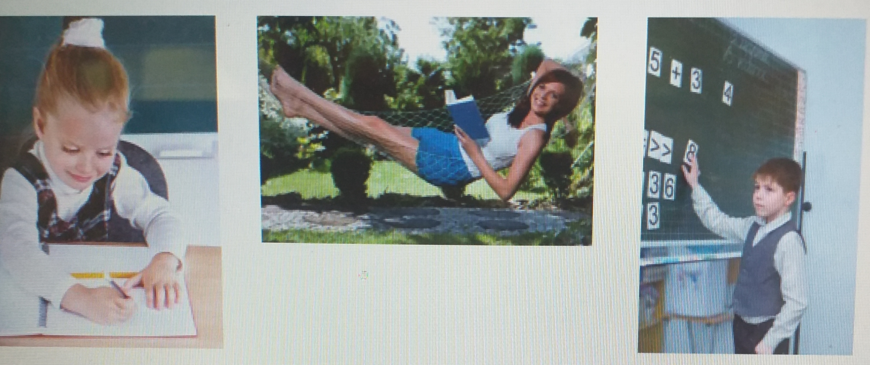
Описание фотографий
Выберите фотографию и опишите человека на ней. У вас есть полторы минуты на подготовку и не более двух минут для ответа. У вас должен получиться связный рассказ (7–8 предложений).
План ответа поможет вам:
• the place
• the action
• the person’s appearance
• whether you like the picture or not
• why
Start with: “I’d like to describe picture № ... . The picture shows …”

Slide 8
Чтение текста на соответствие
Установите соответствие между текстами A–E и их темами, выбрав тему 1–6 из списка. Используйте каждую тему только один раз. В задании одна тема лишняя.
This text deals with …
1) city attractions.
2) a London cinema.
3) a London theatre.
4) a London street.
5) nature sights.
6) a London museum.
A) The Lake District, in northwest England, is a small area, but extremely beautiful, with the varied delights of soft hills and woodland and the panoramas of the great lakes. The Lake District is more often visited, both by day tourists and holidaymakers, than any other region of outstanding natural beauty in the British Isles.
B) England's most ancient northern city lies on the River Ouse in the centre of the Vale of York between the Yorkshire Dales and the North York Moors. It was once the principal town of Yorkshire, and it remains the seat of the Archbishop of York. A child-friendly city, its Viking, Castle and Railway museums have plenty to engage young people as well as adults.

Slide 9
Грамматика
Прочитайте текст и вставьте вместо каждого пропуска нужную грамматическую форму, выбрав её из четырёх предложенных вариантов.
The Dog and the Donkey Once in a small town there lived a baker. He had two pets – a dog and a donkey. The dog kept watch over the house. The donkey carried the bread and the cakes that the baker made. One night a thief A____ into the house. The baker B____ soundly. The dog too was fast asleep, he did not bark at the thief. The donkey saw the thief and wanted to awaken C____ master, so he began to bray loudly. The thief ran away. The baker could not sleep. He came out. He could not understand why the donkey brayed so loudly and he beat the stupid but dutiful donkey very badly. But the D____ house was saved. It was the duty of the dog to keep watch and not of the donkey. However, the donkey turned out to be a E____ guard than the dog.
A 1) broken 2) was breaking 3) broke 4) was broken
B 1) sleeps 2) was sleeping 3) slept 4) has slept
C 1) him 2) her 3) he 4) his
D 1) baker 2) bakers’ 3) baker’s 4) bakers
E 1) good 2) more good 3) best 4) better

Slide 10
Лексика
Прочитайте текст и вставьте вместо каждого пропуска подходящее слово, выбрав его из списка. Два слова в списке лишние.
A Cap Seller and the Monkeys
There was a cap seller in a city. He used to go from village to village to sell his caps. His way lay A____ a forest. It was a hot summer day and he got tired. To get some rest he sat under a tree. Soon he fell B____ . Many monkeys lived on that tree. When they saw the caps, they climbed down the tree and took the caps. Then they climbed up the tree C____ . The cap seller woke up after some time. He found that his caps were missing. He looked up and saw the monkeys wearing his caps. He tried his best to get his caps D____ but he couldn’t. Suddenly an idea occurred to him. He took off his own cap and threw it on the ground. The monkeys did the same, since they are imitators. The cap seller collected all his caps and went E____ happily.
1. again
2. asleep
3. around
4. away
5. back
6. thorough
7. through

Slide 11
Сайт ВПР https://English-study-cafe.ru/.

Slide 12
Виссарион Белинский
«Человек страшится только того, чего не знает, знанием побеждается всякий страх!»

Slide 13
Thank you for your attention!
GOOD LUCK

