Slide 1

British social etiquette
E

Slide 2
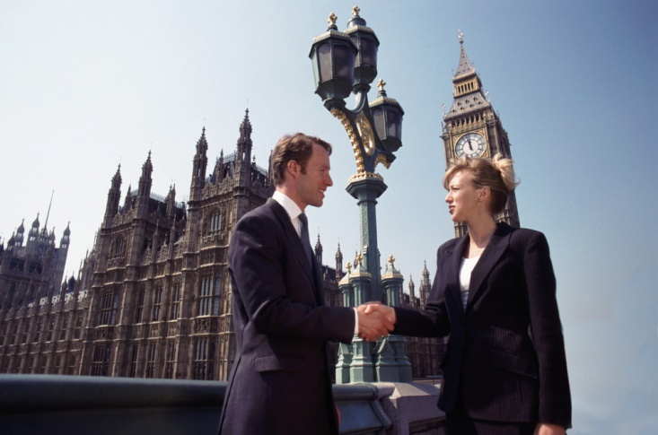
Culture and social etiquette in United Kingdom
There are no strict etiquette rules that you have to stick to when in the UK. It is advisable, however, to demonstrate decent manners and respect to the local culture and traditions.

Slide 3
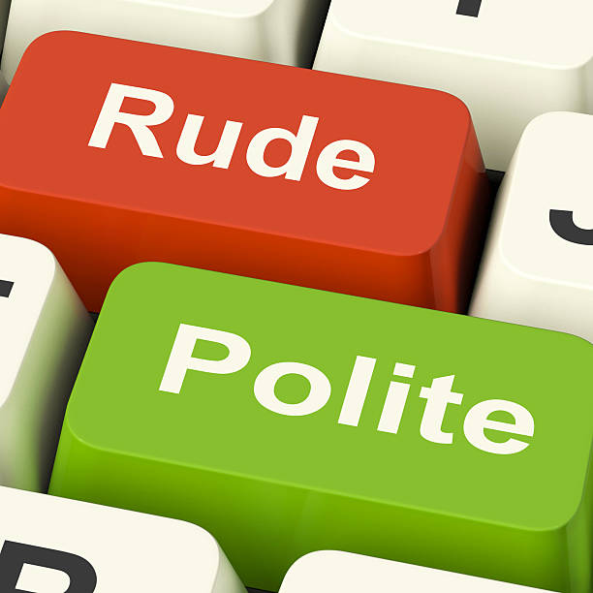
IT`S A GAME

Slide 4
Reading (Чтение) | 10 | 20 | 30 | 40
Vocabulary (Лексика) | 10 | 20 | 30 | 40
Translation (Перевод) | 10 | 20 | 30 | 40
Grammar (Грамматикa) | 10 | 20 | 30 | 40

Slide 5
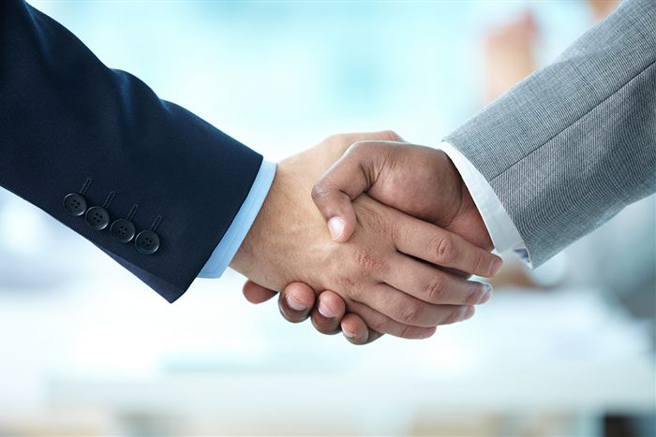
Reading words 10
Read the words correctly:
firm handshake
hug
culture etiquette
greeting behavior
politeness

Slide 6
Reading words 20
Read the sentences correctly:
If you are meeting someone for the first time, extend a hand to say hello.
When Brits ask how you are, they don`t expect a long reply about your sore throat.

Slide 7
Reading words 30
Read the proverbs correctly:
“When in Rome, do as the Romans.”
“Behavior is a mirror in which everyone displays his image.”
“Good manners will open doors that the best education cannot.”
“As a rule, there is no surer way to the dislike of men than to behave well where they behaved badly.”
“With a gentleman I am always a gentleman and a half, and with a fraud I try to be a fraud and a half.”

Slide 8

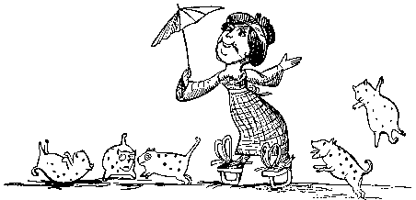
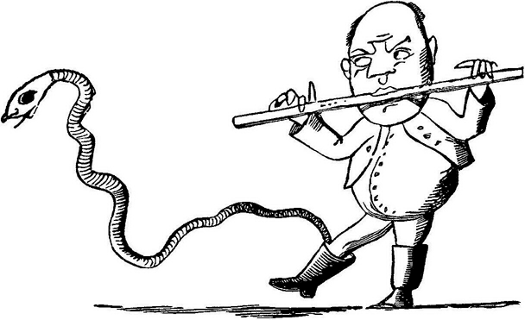
Reading words 40
Read limericks aloud with the intonation:
There was a Young Lady of Portugal,
Whose ideas were excessively nautical:
She climbed up a tree,
To examine the sea,
But declared she would never leave Portugal.
There was an Old Person of Leeds,
Whose head was infested with beads;
She sat on a stool,
And ate gooseberry fool,
Which agreed with that person of Leeds.

Slide 9
Vocabulary 10
Choose the correct word make, in, be , place, place and fill in:
…….. eye contact
…….. public
…….. aware
crowded…………
second-………….

Slide 10
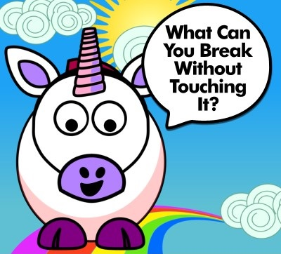
Vocabulary 20
Guess the word:
The more there is, the lees you see.
(Darkness)
Where is the ocean the deepest?
(On the bottom)
How can a man go eight days without sleep?
(He sleeps at night)
What invention allow people to walk through walls?
(Doors)
How can a man go eight days without sleep?
(He sleeps at night)

Slide 11
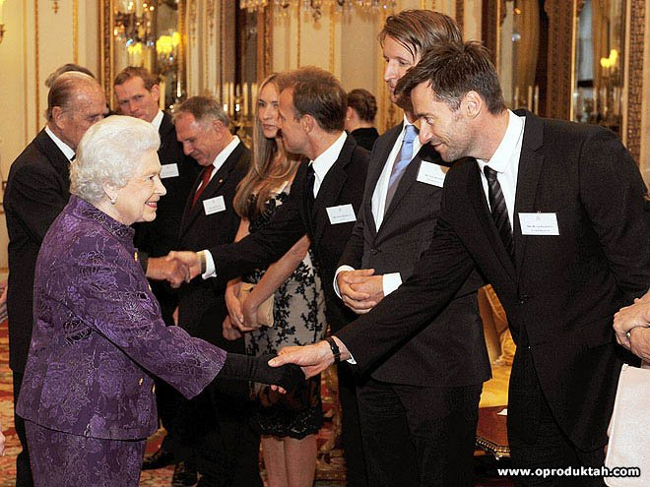
Vocabulary 30
Find not less than 10 words to describe the picture:
Extend – to reach out
Firm handshake – holding smb’s hand with a strong grip and moving it up and down
Rare – not common
Hug – putting your arms around a person and holding them tightly to show affection
Make eye contact – to look smb. straight in the eye when they look at you
Typical – usual
Greeting – way of saying hello
In public – in front of a group of people
Be aware – to make sure you know about smth.
Crowded place – area full of people
Token – sign
Elbow – the joint in the middle of the arm
Second-rate – not the best

Slide 12
Translation 10
Translate into Russian:
Worthwhile
Important rules
Insincere
Politeness
Small gift

Slide 13
Translation 20
Translate into Russian:
Do shake hands:
When you are first introduced to someone, shake their right hand with your own right hand.
Do say sorry:
If you accidentally bump into someone, say 'sorry'. They probably will too, even if it was your fault! This is a habit and can be seen as very amusing by an 'outsider'.

Slide 14
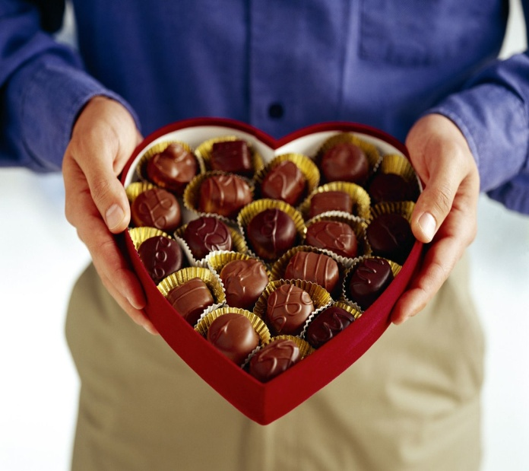
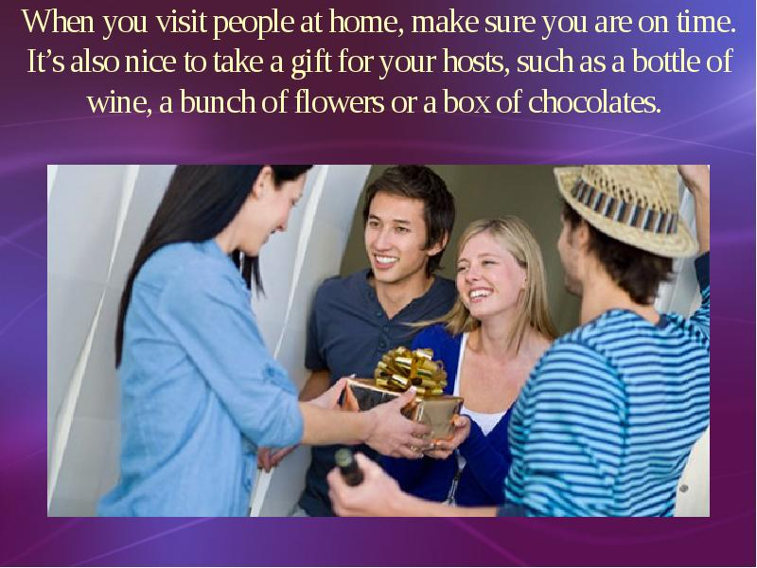
Translation 30
Translate into English:
        1.When you visit people at home, make sure you are on time. It’s also nice to take a gift or your hosts, such as a bottle of wine, a bunch of flowers or a box of chocolates.
        2.The British like their privacy, so not all topics are safe for small talk. Avoid asking people about their age, religion, politics, marital status, weight or how much they earn.
3.A British person might say ‘come and see me soon’ or ‘drop in anytime’.
However, you must always phone before you visit someone.

Slide 15
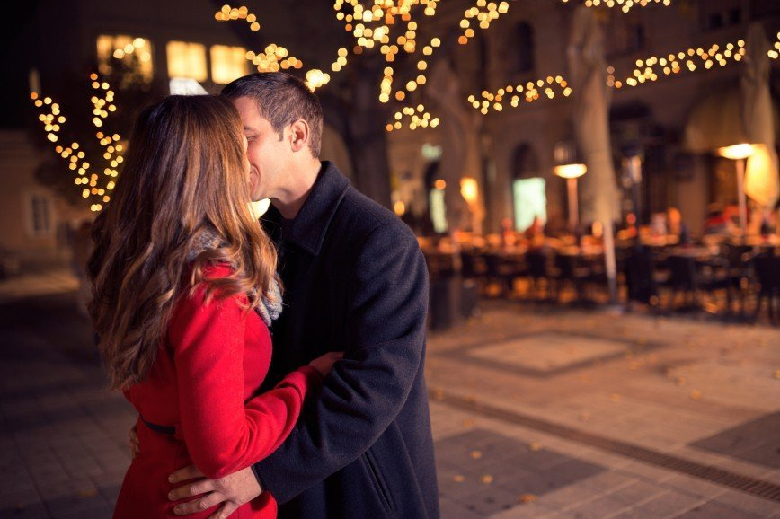
Translation 40
Translate into Russian:
The British are famous for their language, sense of humour and, of course, politeness. So, when you are in the UK, make sure you respect the social etiquette in the certain situations.
It is only when you greet close friends or relatives that you would kiss them on the cheek or give them a hug.
A British person might say ‘come and see me soon’ or ‘drop in anytime’. However, you must always phone before you visit someone.

Slide 16
Grammar 10
Give advice to sb. visiting the UK, using the phrases: extend a hand , make eye contact , give some flowers, point with, hugs.
1.You should …………….when you first meet Brit.
2. You should ……… when you talk to someone.
3. You should …………… to your host as a taken of thanks.
4. You shouldn`t ………….your index finger; use your whole hand instead.
5. ………..are unusual between friends.

Slide 17
Grammar 20
Complete sentences using the words: on, by few, at the , any .
Time and punctuality.
British people are very strict when it comes to punctuality. In Britain people make a great effort to arrive ......ime, so it is considered impolite to be late, even with ……minutes. If you are delayed, be sure to inform the person you are meeting. Here are some situations when you are obliged to be on time, as well as some situations when it is advisable:
For formal dinners, lunches, or appointments you always come …… the exact time appointed.
For public meetings, plays, concerts, movies, sporting events, classes, church services, and weddings, it's best to arrive a few minutes early.
You can arrive….. time during the hours specified for teas, receptions and cocktail parties.

Slide 18
Grammar 30
Put the words into correct order to make sentences:
1. greet cheek close or relatives you ,kiss them would on when the or give friends them a hug you them.
2. asking people their age, religion, politics about avoid people .
3. must before you phone visit you alway someone.

Slide 19
Grammar 40
Translate underlined phrases:
Body language and dress code
British people are not very keen on displaying affection in public. Hugging, kissing and touching are usually reserved for family members and very close friends. You should also avoid talking loudly in public or going to extremes with hand gestures during the course of communication. The British like a certain amount of personal space. Do not stand too close to another person or put your arm around someone's shoulder.

Slide 20
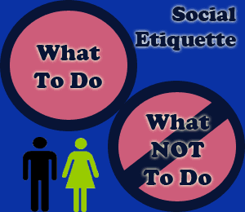
Who is the winner?

