Slide 1
Memory
this/these
Start

Slide 2
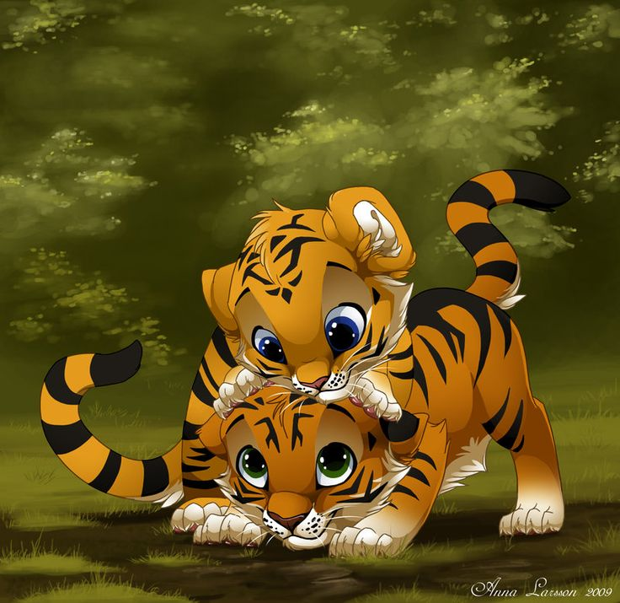
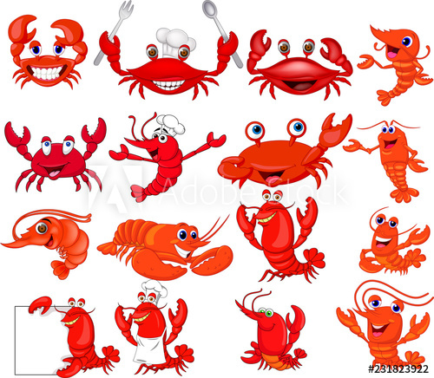
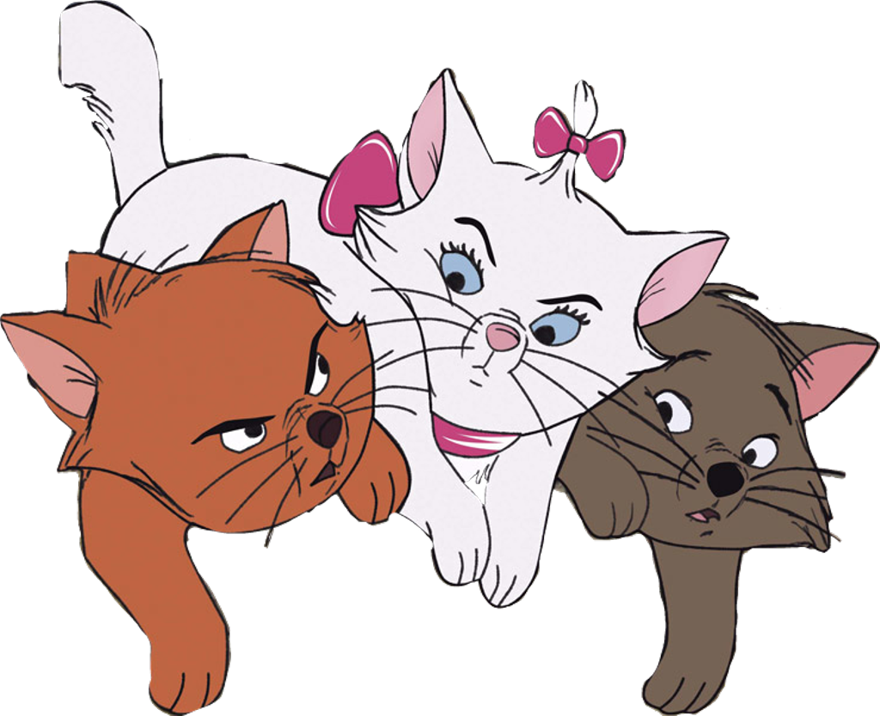
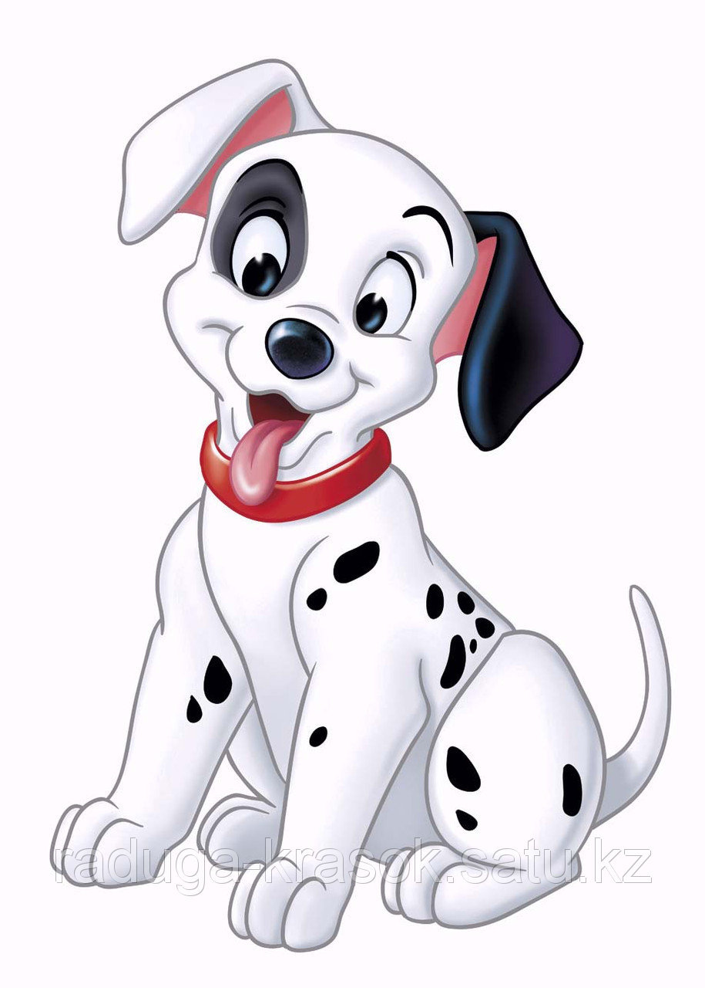
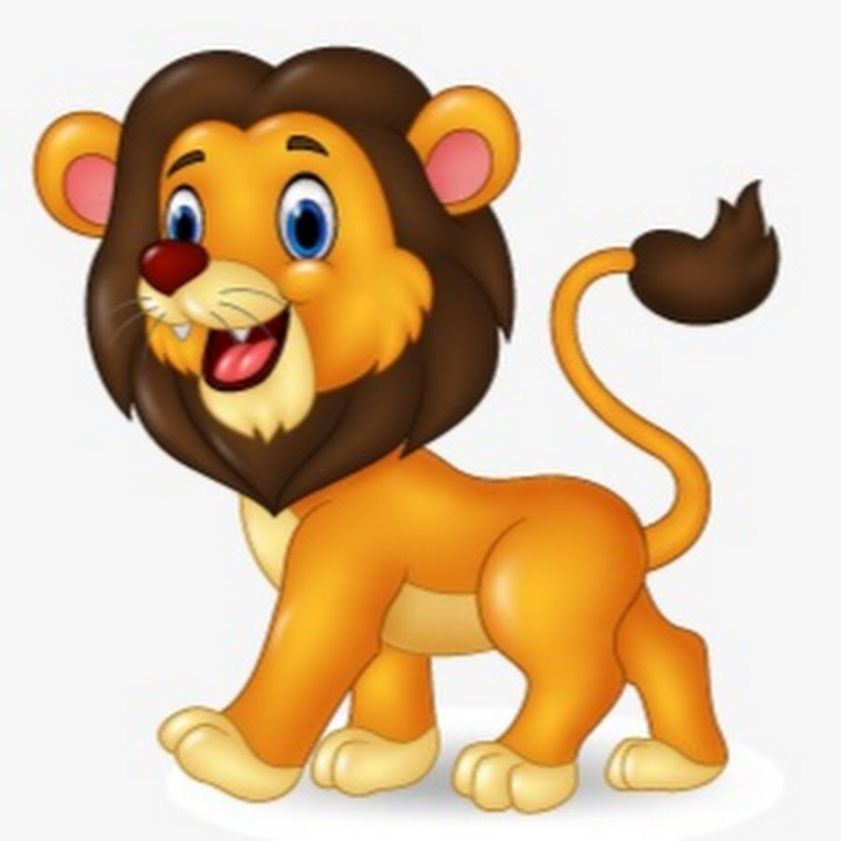



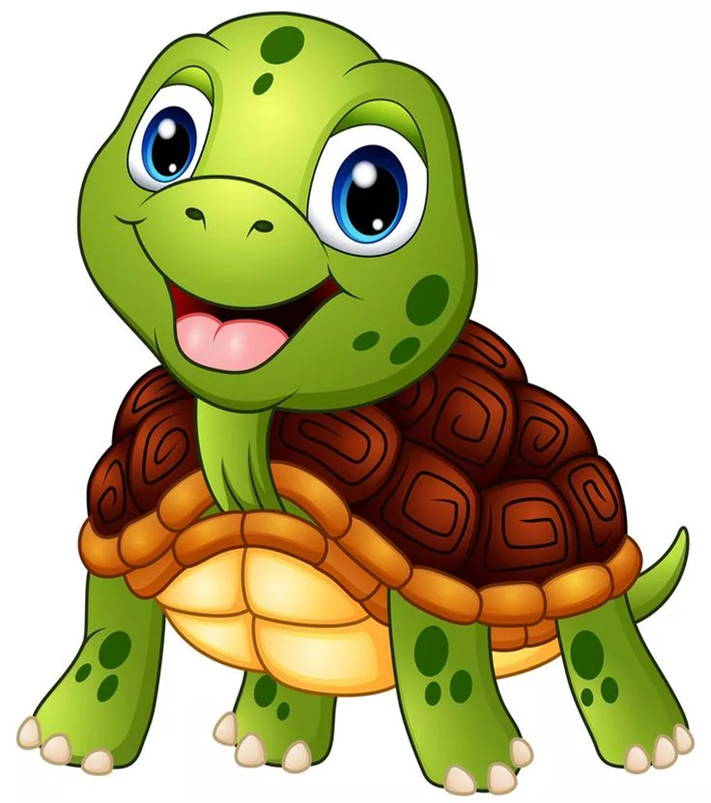
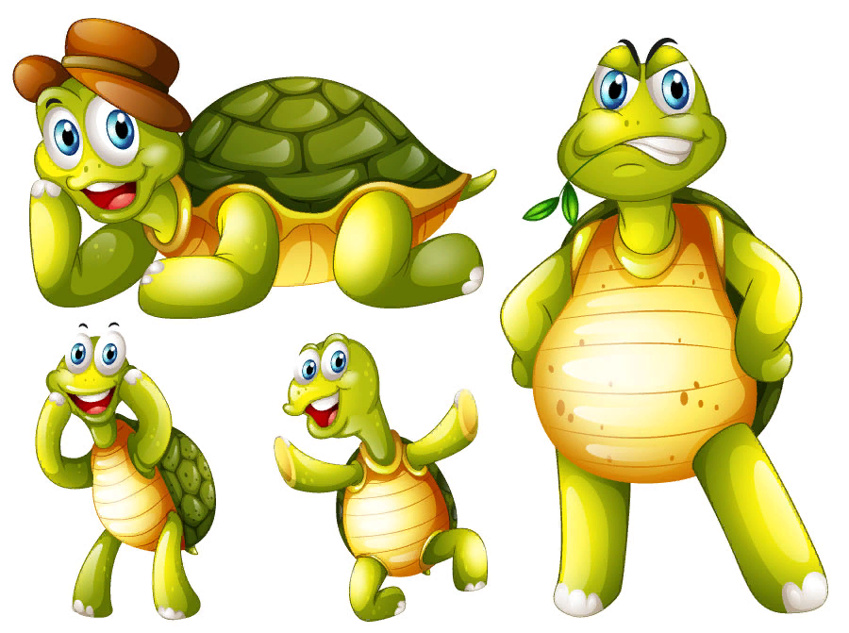
1
2
3
4
5
This is a crab.
These are turtles.
6
7
8
9
10
This is a turtle.
These are dolphins.
These are tigers.
11
12
13
14
15
These are crabs.
These are cats.
16
17
18
19
20
This is a lion.
This is a dog.
This is a dolphin.

