Slide 1


Slide 2

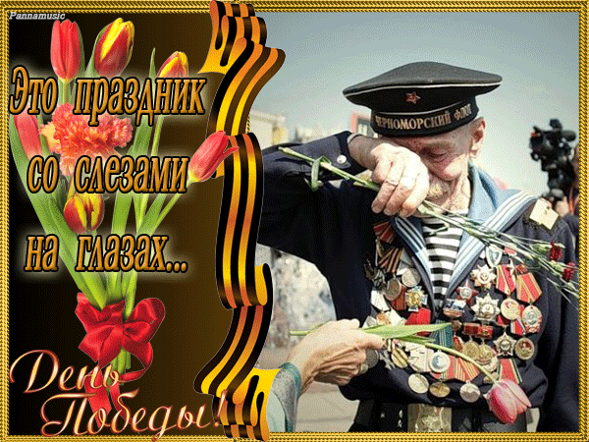
A great holiday-Victory Day!

Slide 3

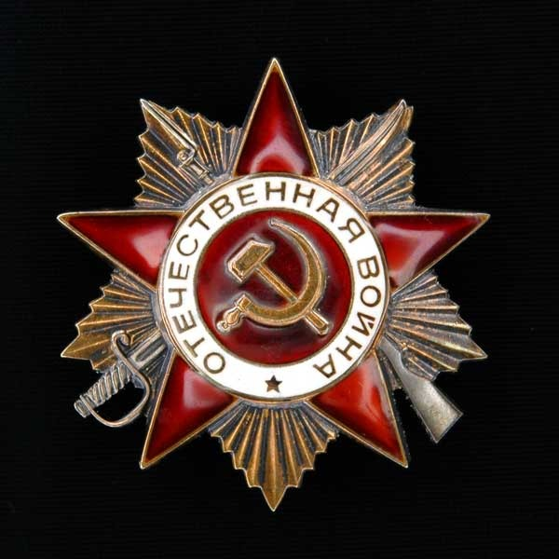









Slide 4
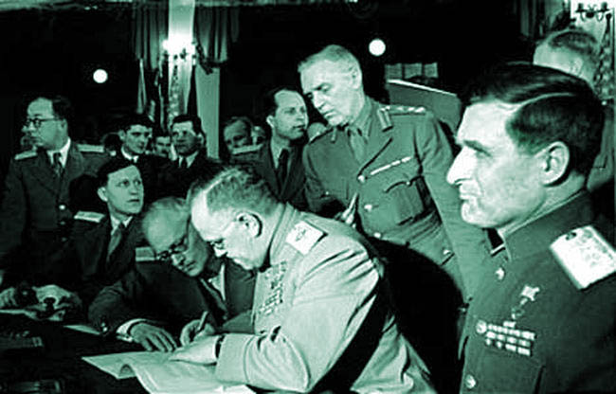

What is the date of signing the act of
Germany's unconditional surrender:
May1
May2
May 9
May7
http://www.youtube.com/watch?feature=player_embedded&v=RiRzc-QKUgU

Slide 5
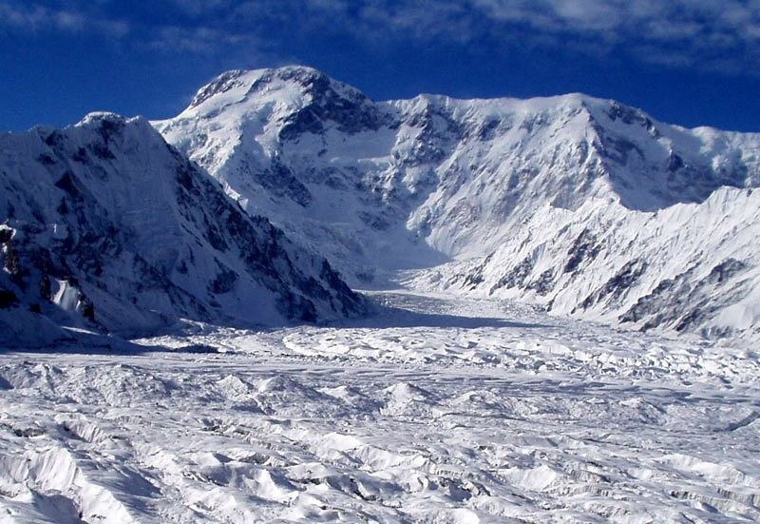
What is the highest peak of the Tien Shan named in honor of the War in 1946?
Victory Peak
http://www.youtube.com/watch?feature=player_embedded&v=48NdE5T2A34

Slide 6
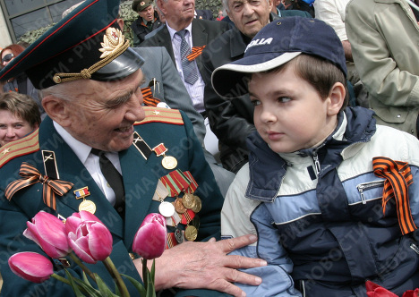
When did the action of
"St. George ribbon" start?
2000
2005
1995
2010
http://www.youtube.com/watch?feature=player_embedded&v=Bkfn-ILvXaI

Slide 7
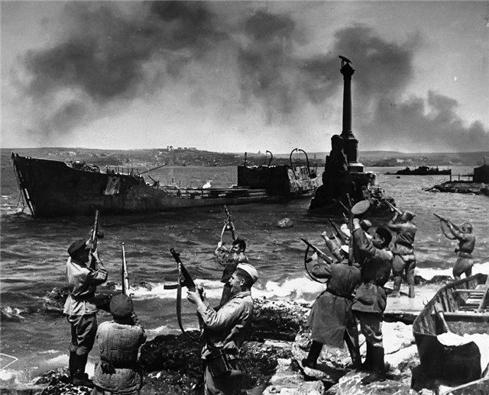
In 1941-1942 the Nazi troops spent 250 days to capture this city, and the Soviet troops liberated it within 5 days in 1944. What city is it?
Novorossiisk
Sevastopol
Moscow
http://www.youtube.com/watch?v=hhkr51FosS4

Slide 8
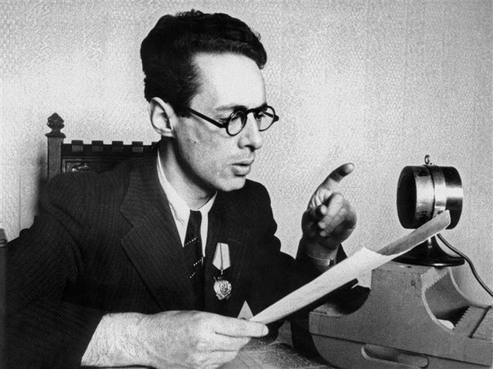
Whose voice sounded on the all-Union radio, announcing about the beginning of the World War II?
Yuri Borisovich
Levitan
h

Slide 9
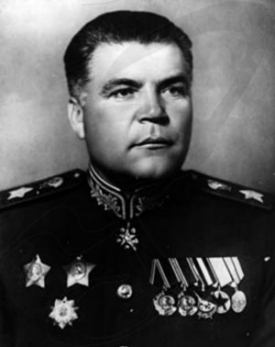
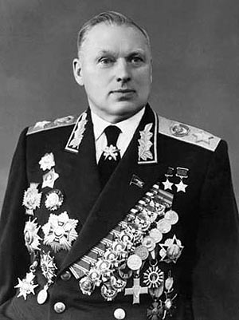
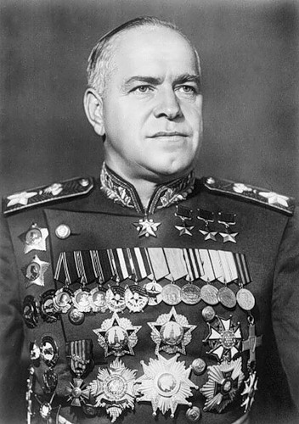
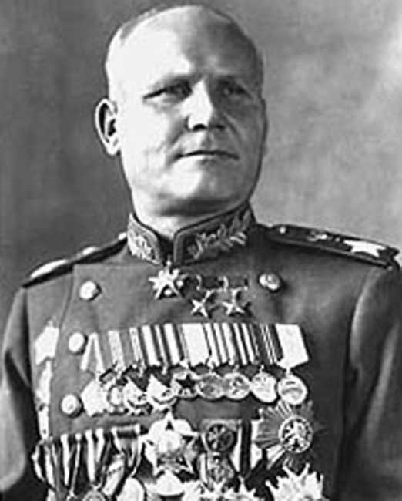
Which of the Generals was granted the honorary title of the "Marshal of the Victory" by people?
Malinovsky
Rokossovsky
Zhukov
Konev
http://www.youtube.com/watch?feature=player_embedded&v=r2wUicWobgA

Slide 10
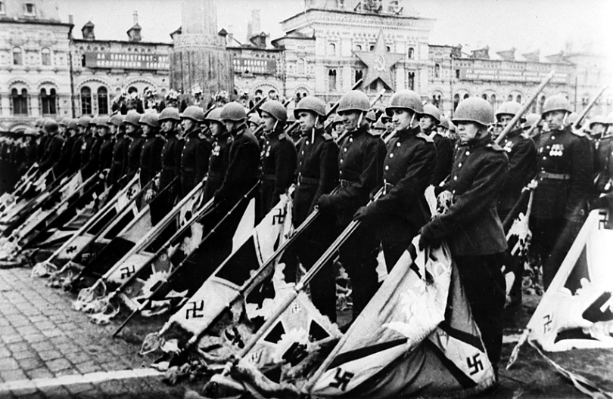
The culmination of the Victory parade on 24 June, 1945 was a March of 200 standard-bearers, who threw fascist banners on a special platform at the foot of the Mausoleum. What form element was burnt by the bearers after the parade along with the platform?
gloves
http://video.mail.ru/mail/pustinnik25/1081/2625.html?liked=1

Slide 11
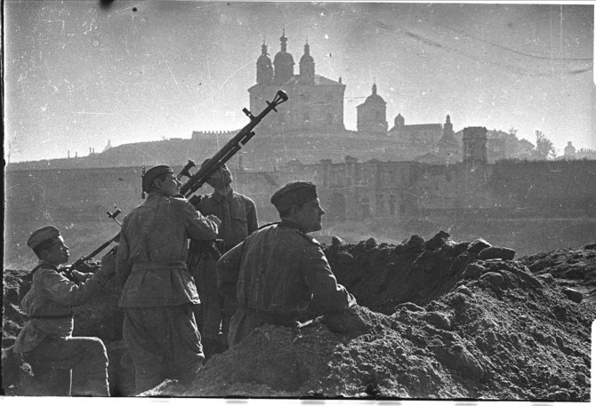
After what battle was the myth of the invincibility of Hitler's army destroyed?
After the battle under Moscow, 1941-1942
http://www.youtube.com/watch?feature=player_embedded&v=xC_dY0exgTI

Slide 12
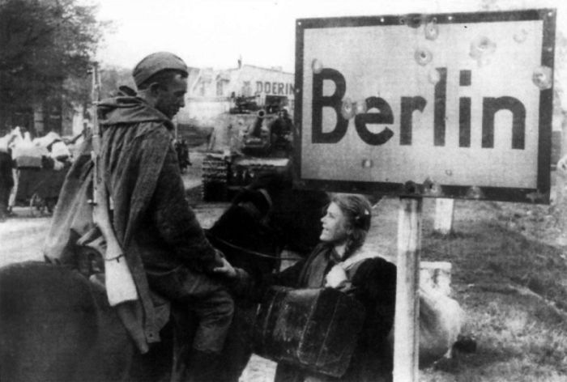
What was the name of the operation, during which the Red Army had completed the Great Patriotic War?
Berlin offensive operation
http://video.mail.ru/mail/nail_uldanov17028/9171/10586.html?liked=1

Slide 13
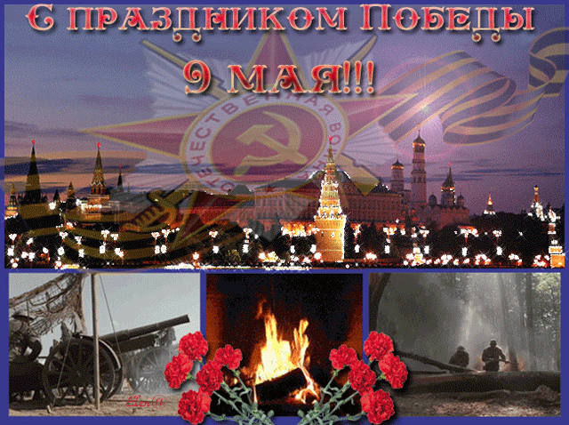
!
We do remember!

Slide 14
Internet Resources
Георгиевская ленточка. http://www.nn.ru/data/forum/images/2012-03/47361321-gergievskaj_lenta.gif
Орден Отечественной войны. http://www.gavrilsk.ru/Image/otv451309_huge.jpg
Цифры. http://www.gifpark.su/Gifs/LETTERS/8/1_md_wht.gif
Подписание акта о капитуляции. http://novved.ru/images/stories/61/akt.jpg
В атаку. http://i.smotra.ru/data/img/users_imgs/55638/sm_users_img-250360.jpg
Битва под Москвой. http://i1.2photo.ru/medium/s/0/339580.jpg
С праздником Победы. http://www.best-animation.ru/lanim/9_maya/9.gif
Этот праздник со слезами на глазах. http://s019.radikal.ru/i610/1205/3b/33f74cb6ee3a.gif
Р.Я.Малиновский. http://encycl.chita.ru/photobank/7-malinovskij_r_ya_1.jpg
К.К.Рокосовский. http://www.belta.by/newarticlesimages/s001067_924810.jpg
Г.К.Жуков. http://www.kinodom-online.ru/_ld/15/1592.jpg
И.С.Конев. http://im2-tub-ru.yandex.net/i?id=178126377-28-72&n=21
Ю.Б.Левитан. http://cs306814.userapi.com/v306814931/47ff/gm2KZeClwk4.jpg
На Берлин. http://www.krasfun.ru/images/2011/5/610f1_pobeda_16.jpg
Парад Победы. http://os1.i.ua/3/1/10226010_e7c18af3.jpg
Освобождение Севастополя. http://i021.radikal.ru/1105/01/f9452344940f.jpg
Пик Победы. http://static.7summits.ru/media/full/2/11748.jpg

Slide 15
Объявление о начале ВОВ. http://muzbaron.com/dll/%D0%BE%20%D0%BD%D0%B0%D1%87%D0%B0%D0%BB%D0%B5%20%D0%B2%D0%BE%D0%B9%D0%BD%D1%8B
Маршал Победы. http://ruskline.ru/analitika/2011/12/01/marshal_pobedy_georgij_konstantinovich_zhukov
Георгиевская ленточка. http://ru.wikipedia.org/wiki/%C3%E5%EE%F0%E3%E8%E5%E2%F1%EA%E0%FF_%EB%E5%ED%F2%EE%F7%EA%E0
Пик Победы. http://www.mountain.ru/people/VadimAlferov/2004/Pobeda/
Битва под Москвой. http://about-war.narod.ru/Moskva.htm
Акт капитуляции Германии. http://ru.wikipedia.org/wiki/%D0%90%D0%BA%D1%82_%D0%BA%D0%B0%D0%BF%D0%B8%D1%82%D1%83%D0%BB%D1%8F%D1%86%D0%B8%D0%B8_%D0%93%D0%B5%D1%80%D0%BC%D0%B0%D0%BD%D0%B8%D0%B8
Ю.Б.Левитан. http://cs306814.userapi.com/v306814931/47ff/gm2KZeClwk4.jpg
Берлинская наступательная операция. http://ru.wikipedia.org/wiki/%C1%E5%F0%EB%E8%ED%F1%EA%E0%FF_%ED%E0%F1%F2%F3%EF%E0%F2%E5%EB%FC%ED%E0%FF_%EE%EF%E5%F0%E0%F6%E8%FF
Парад Победы. http://www.world-war.ru/parad-pobedy/
Освобождение Севастополя. http://krymology.info/index.php/%D0%9E%D1%81%D0%B2%D0%BE%D0%B1%D0%BE%D0%B6%D0%B4%D0%B5%D0%BD%D0%B8%D0%B5_%D0%A1%D0%B5%D0%B2%D0%B0%D1%81%D1%82%D0%BE%D0%BF%D0%BE%D0%BB%D1%8F_%D0%B2_1944_%D0%B3%D0%BE%D0%B4%D1%83

