Slide 1
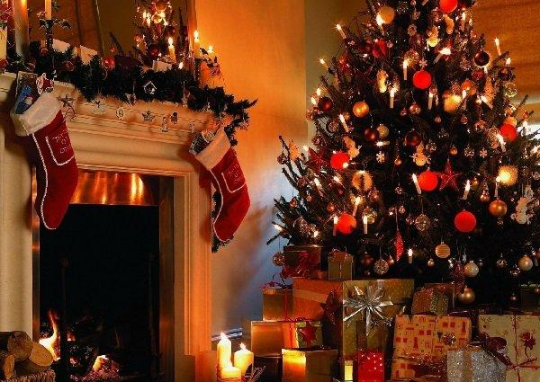
Christmas
For the majority of families in the UK and in the USA Christmas is the most important holiday of the year.

Slide 2
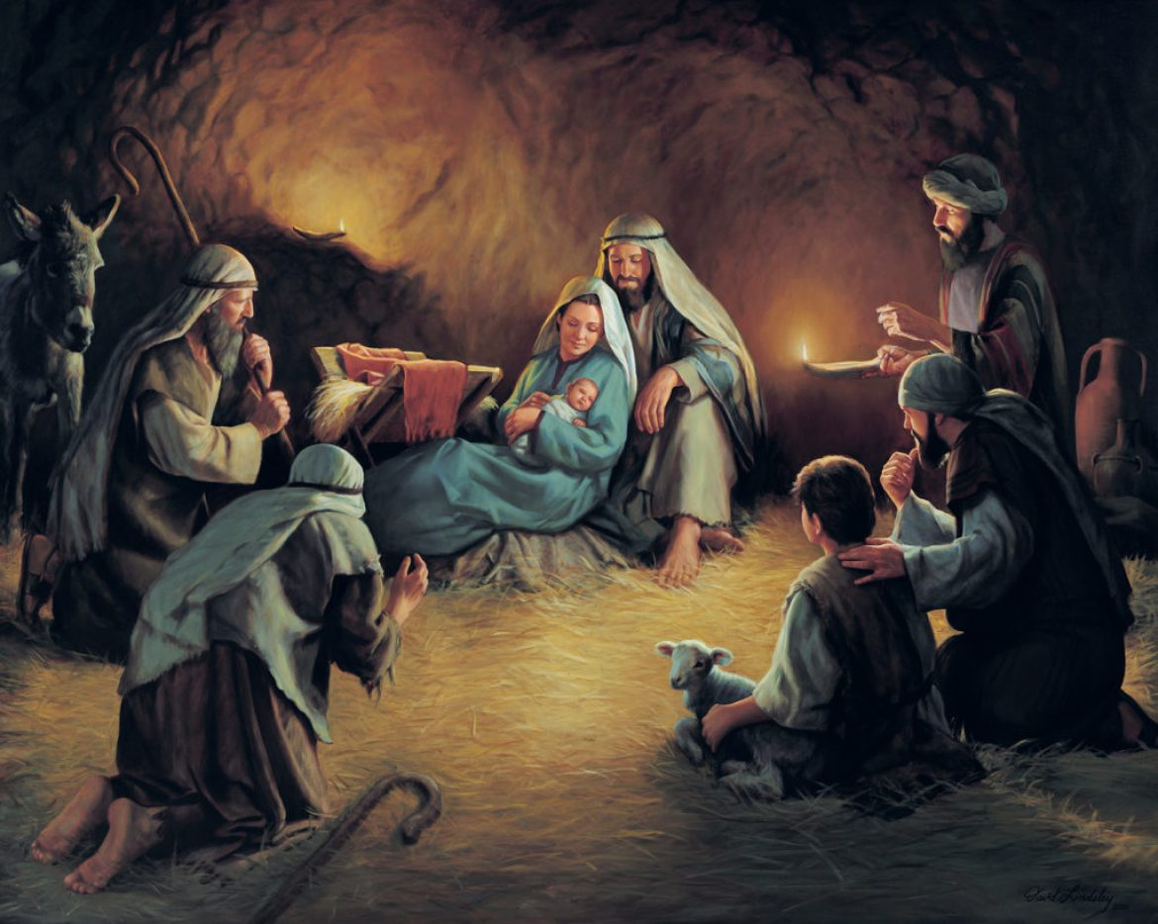
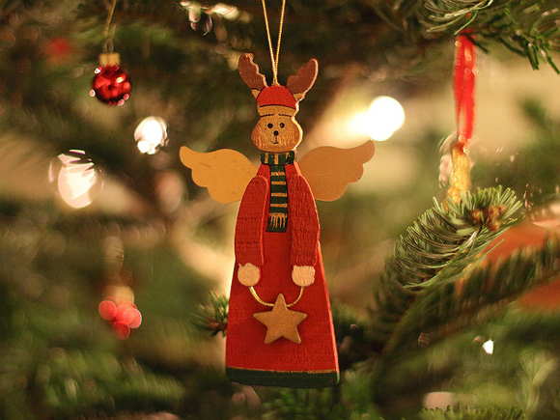
Twenty-fifth of December
The birth of Jesus Christ

Slide 3
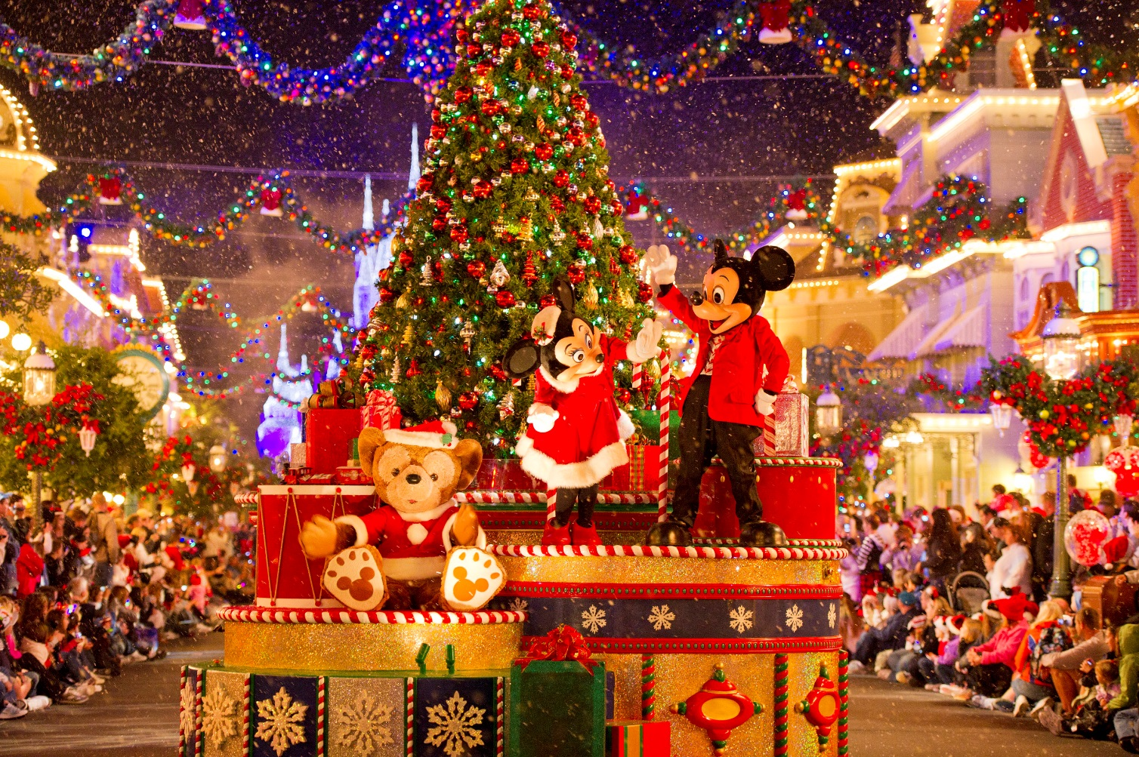
Traditional winter festivities

Slide 4

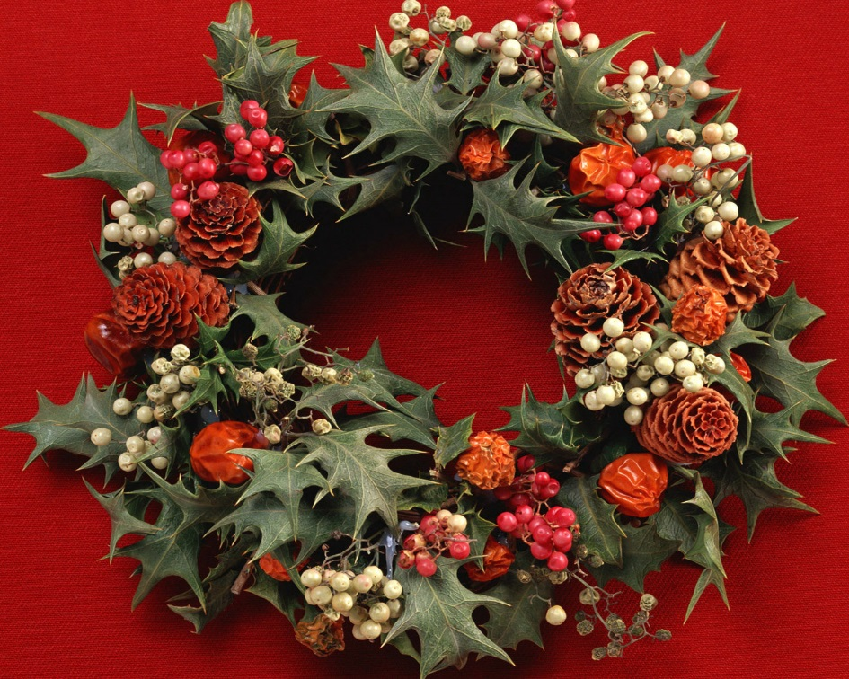
Many families decorate their houses with holly wreaths and colorful garlands .

Slide 5

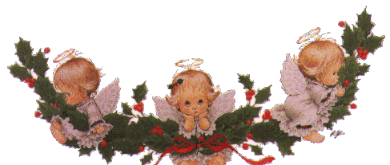

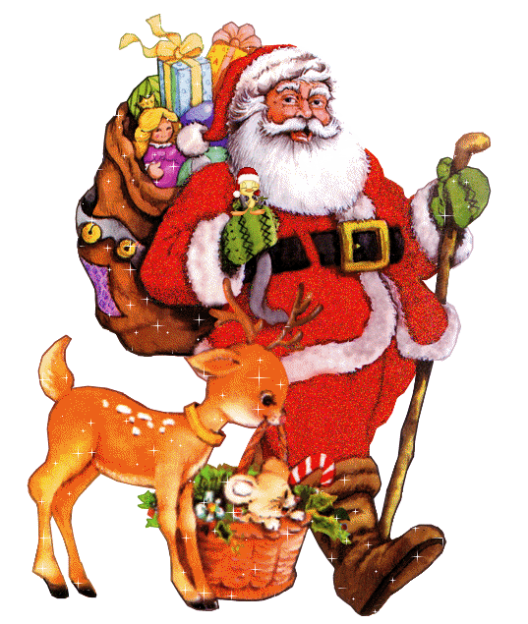

Slide 6
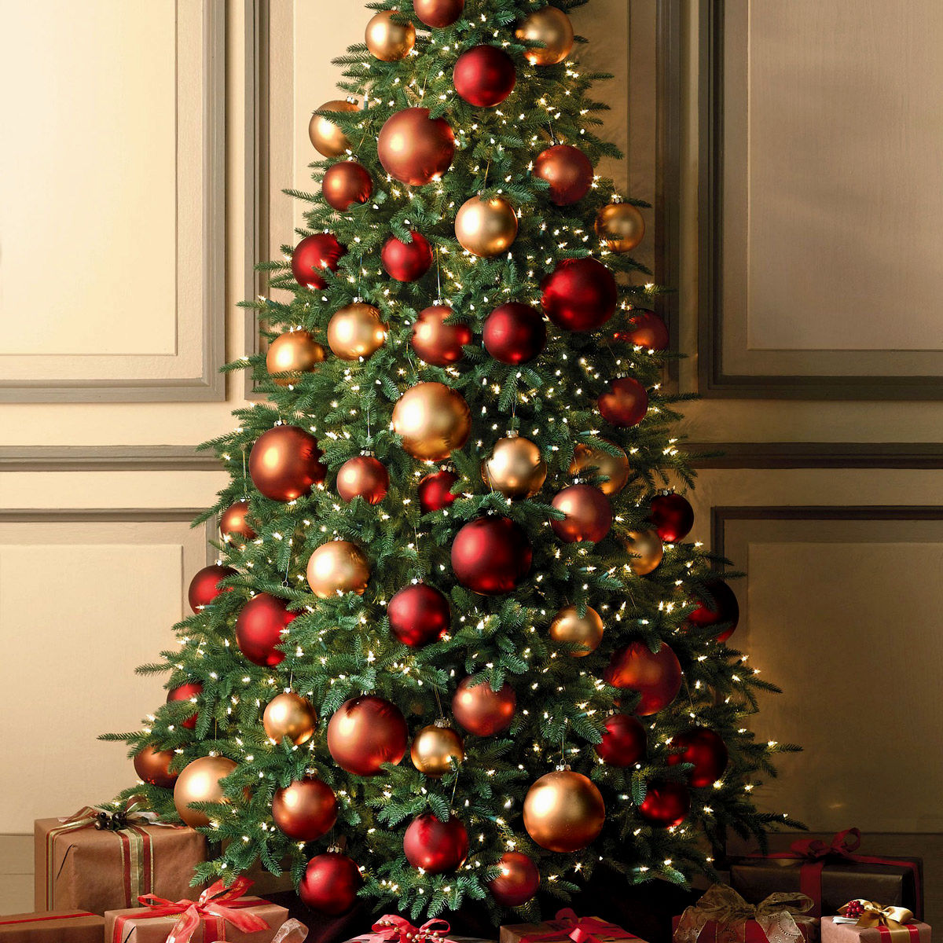
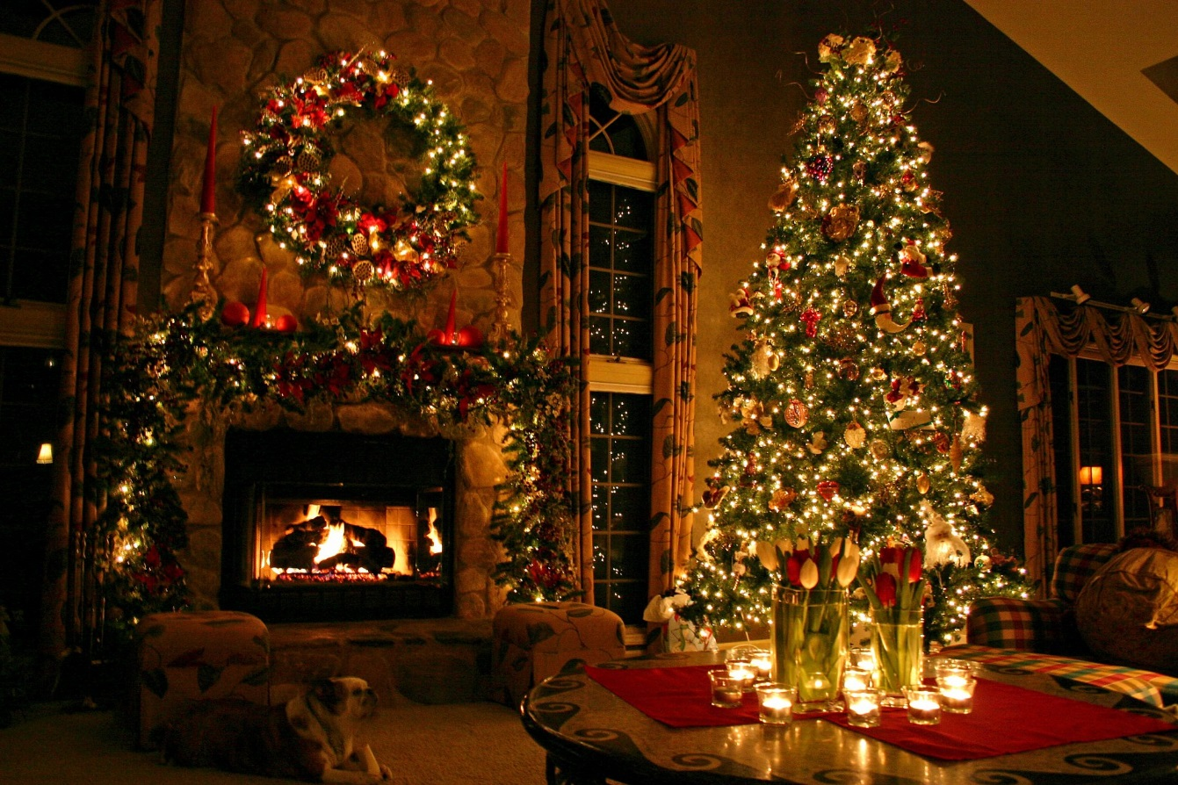
Christmas tree is one of the symbol of this holiday.

Slide 7
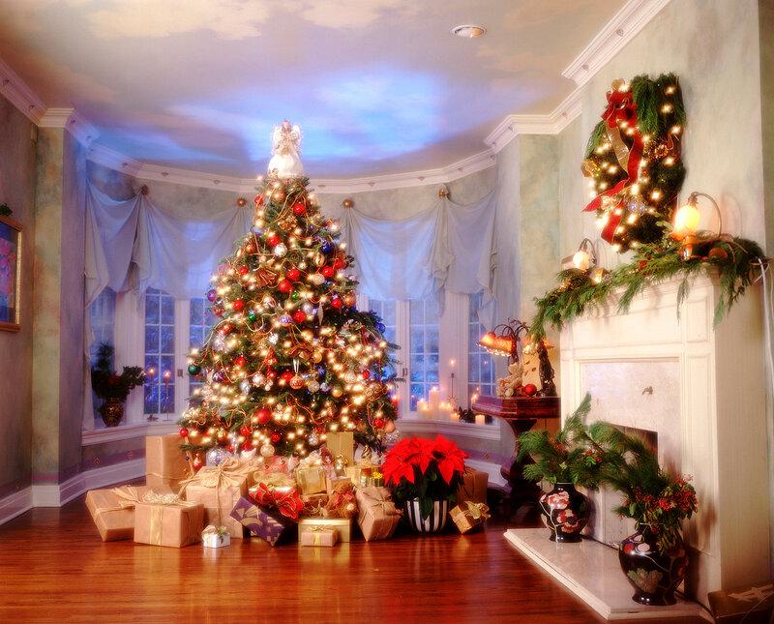
Almost every family has such a Christmas tree in their front room.

Slide 8
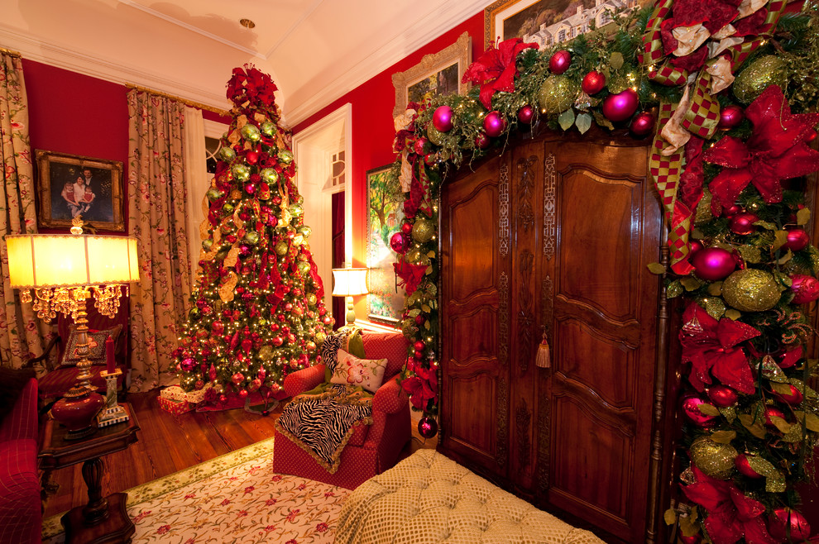

Slide 9
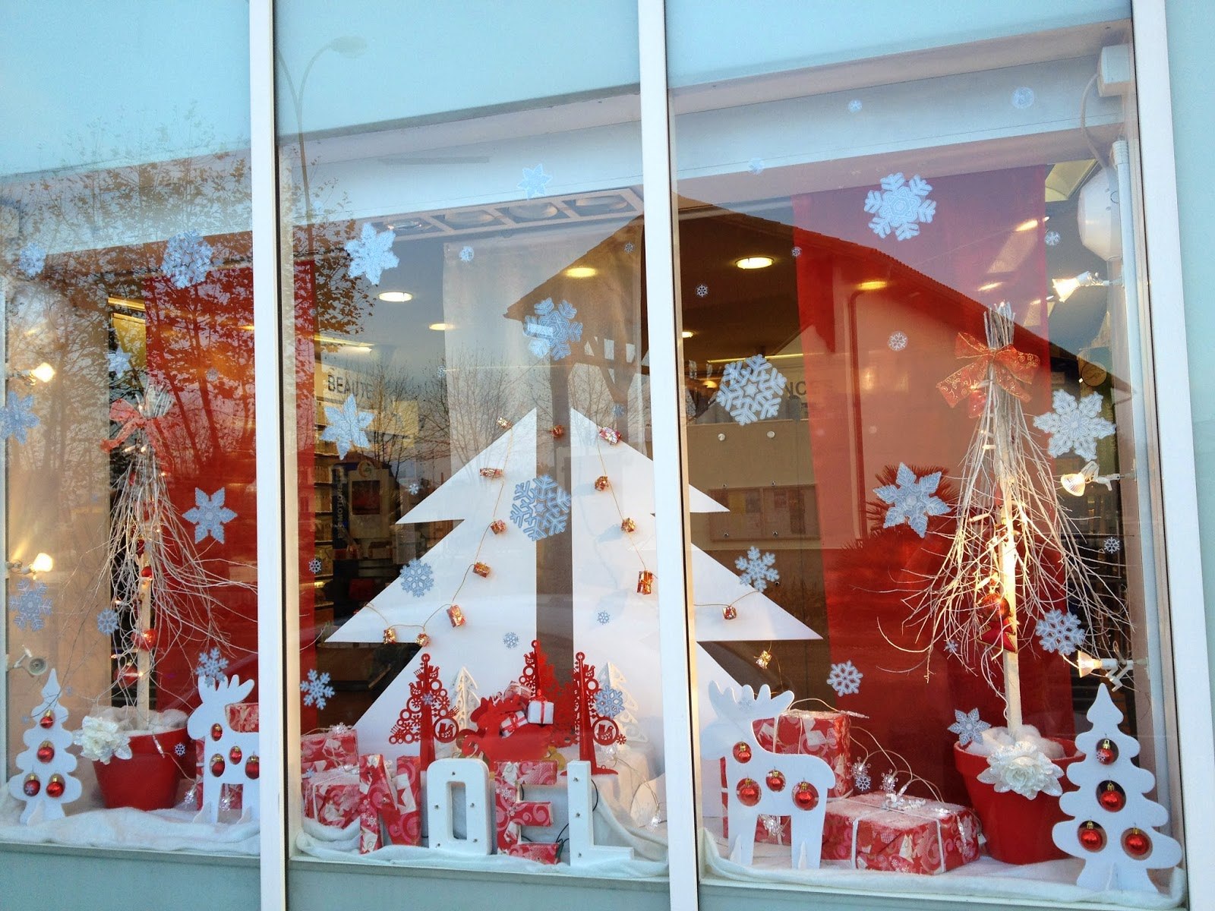
City squares, buildings and shop windows are also beautifully decorated.

Slide 10
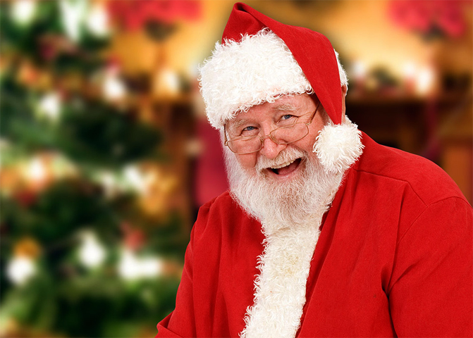
Santa Claus

Slide 11
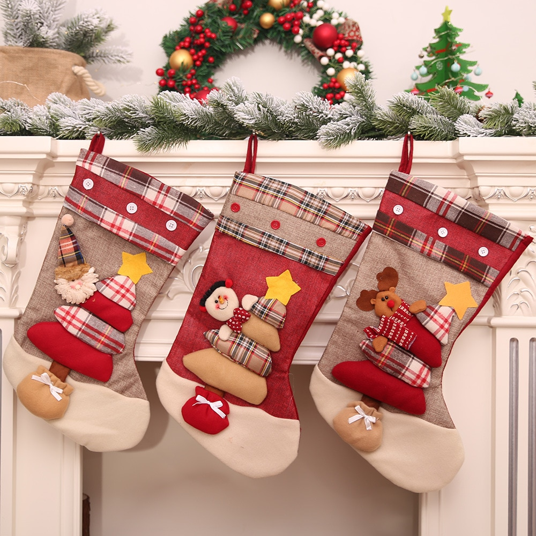
Stockings hanging above the fireplace.

Slide 12
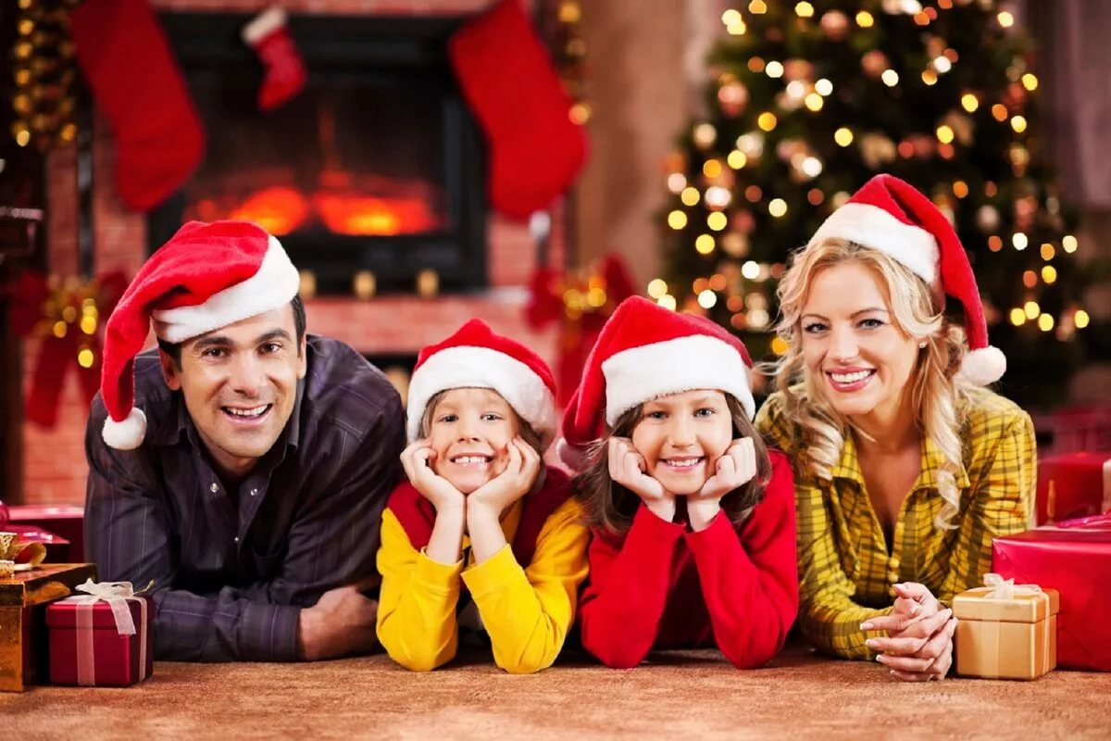
This holiday is traditionally celebrated in the bosom of the family and close friends.

Slide 13
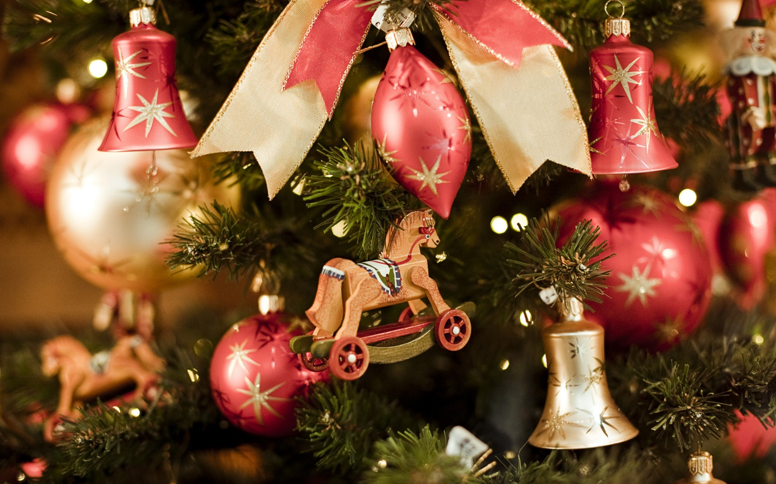
Thank you for your attention.

